Slide 1
Princess of Pikalong
Members:
Thanh Tran
Phuoc Nguyen
Hau Tran

Slide 2
BASIC IDEAS
2D, Role-Playing, Puzzle game.
Unity engine, Windows.

Slide 3
STORYLINE
In a kingdom named Pikalong, there lived a beautiful princess named Ellu who has a caring nature towards her citizens. Ellu always tried to help those in need. Among those, there was a young and brave farmer who really appreciated the princess’ kindness and mercy. One fateful day, the mighty dark lord from a faraway nation kidnapped the beautiful princess to make her his wife. She was imprisoned in his dark gloomy castle. The farmer heard the news and began his journey to save Ellu. On his adventure, he encountered a lot of obstacles and traps set up by the Dark Lord himself. Will he be able to rescue Ellu? Let’s find out!

Slide 4
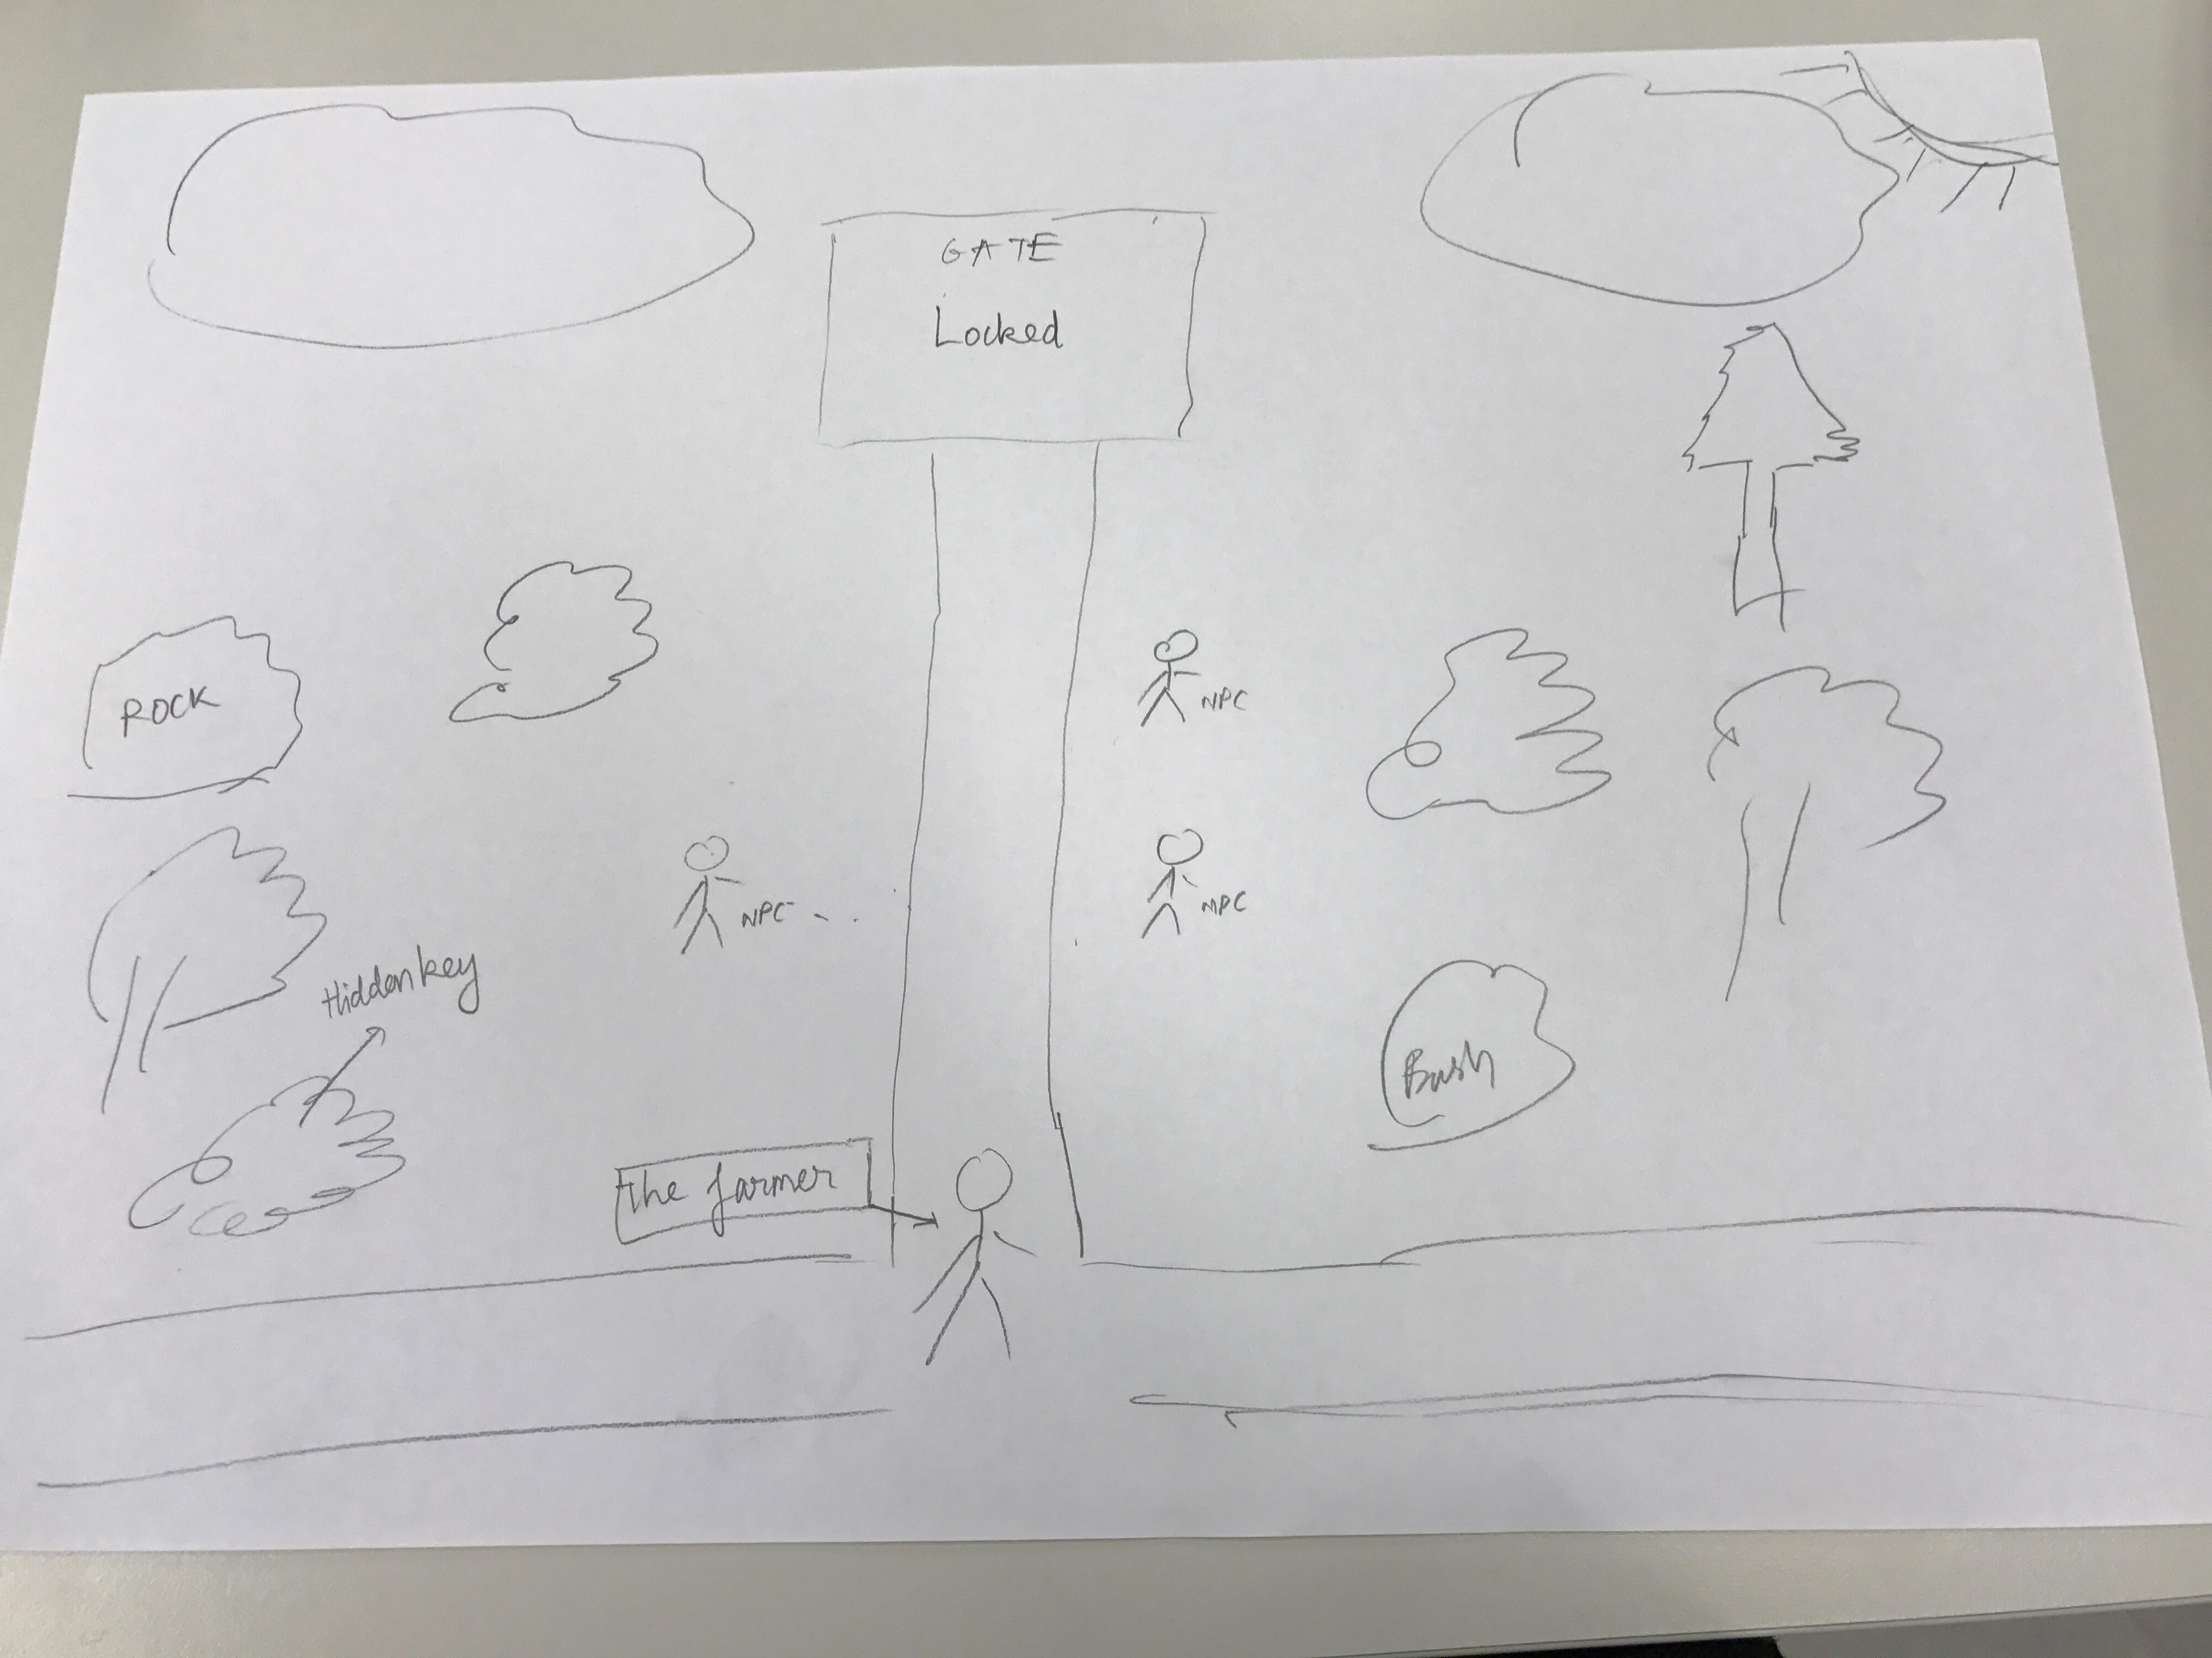
MECHANICS

