Slide 1
Keystone: Federated
Jamie Lennox
1st Aug 2014
Notes:
Good morning everybody, welcome to PyCon
My name is Jamie Lennox,
I work for Red Hat here in Brisbane.
I've been working on OpenStack for about 18 months.
I'm a member of the Keystone core team and I also do a lot of work trying to standardize all the client libraries.
Today we're going to look into development surrounding using federated identities in keystone and where we are today.

Slide 2
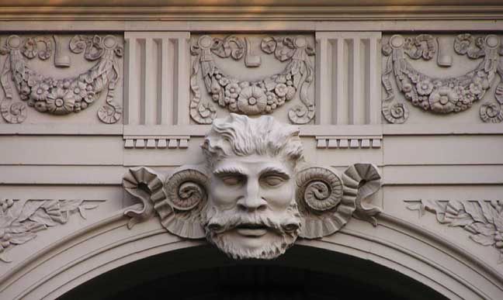
The OpenStack Identity Service
Notes:
I'm not exactly sure of the audience here, so we're going to start fairly high level and drill down so that hopefully everyone learns something
Firstly, keystone.
Keystone is the part of OpenStack that provides authentication and discovery.
It's generally your first point of contact with a cloud
You provide your credentials which for this presentation we'll assume is your username and password
You get back a token containing the roles you have and a catalog of the URLs for all the other services that you can access with your token.

Slide 3
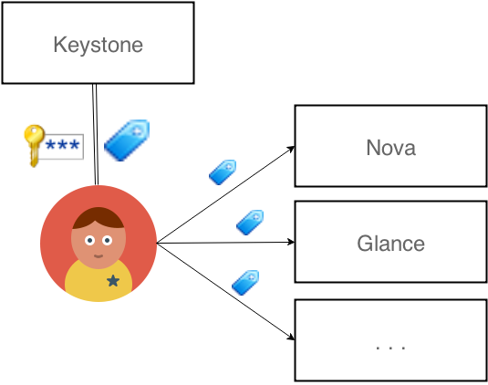
Token Flow
Notes:
So this is your standard token flow.
Our user there who i'm going to call Trevor sends off his password to keystone and receives a token.
Now when our user wants to communicate with Nova or any of the other openstack services instead of sending along there username and password again they send the token.
The tokens say 'keystone has decided i'm real, here is everything you want to know about me'.
The security advantage here is that the username and password is only used and stored once, with keystone, so there's a much lower chance for that to get intercepted.
Tokens typically expire in about an hour, passwords can live on for years so if you have to loose something the token is better.

Slide 4
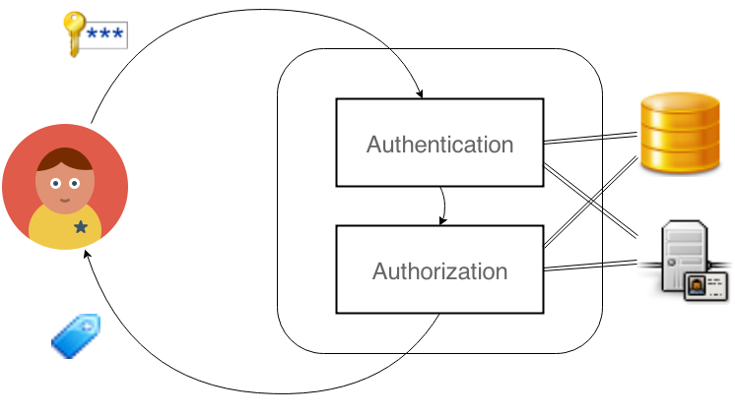
Token Issuing
Notes:
Within keystone there are two major processes, Authentication and Authorization.
The difference between these is important.
Authentication is ensuring that a person is who they claim to be.
This is the part where we use the username and password to make sure that the person is a valid user in our system.
Authorization is figuring out what that person is allowed to do. What projects they have access to, what roles they have on those projects, etc
If you go looking in keystone these components are more or less split this way and named identity and assignment.
We generally suggest people store there identity/Authentication in LDAP and store assignment /authorization in SQL.

Slide 5

Federation
Notes:
Federation in our context is the ability to use a person's identity and existing credentials across multiple services.
You've probably seen this when you go to log in to a website that offers you the choice of signing in with your existing facebook or google account.
The concept is exactly the same for keystone.
How do we let our users log in to our cloud using credentials that are maintained by a third party.
Or maybe more importantly, that sounds like a lot of work, WHY would we want to allow this?

Slide 6
Why?
Convenience
Integration
  Enterprise
  Partnerships
Migration and Interoperability
  Multiple Clouds, Single Identity
Security
  One less identity provider
Notes:
Conveniece – users have enough credentials, they don't need another
admins don't want to manage another, particularly if it's a new account just for OpenStack
Provide password reset functionality, deal with password rotation policies.
That all exists, we don't want to reinvent that particular wheel.
Better integration with existing tools.
Most enterprises already have some form of Single Sign On or centrally managed identtiy store.
We go part of the way with LDAP, but that involves dealing with schemas
Integration with partner Identity providers
Teams across companies working together need to have credentials in a common place.
Integrate multiple identity providers.
Will pathe the way for better interoperability.
If you have mutliple clouds all working from the same credentials it will be much easier to move between them
You'll quickly come across places they don't interoperate.
In the end security.
For every identity provider we have another database that can be compromised, another set of processes that can fail, another chance of ending up on the news.

Slide 7
Identity Provider (IdPs)
Notes:
In the federated world there are two types of providers.
Identity Providers (who i'll probably call IDPs) are the source of identites.
They have your password somewhere.
Service Providers are the consumers.
They provide there service and all they want to know from the idp is that the user is authenticated and allowed to do this.
This is the same diagram from before.
This original configuration of keystone makes it an identity provider,
users and credentials that are required to do authentication are stored in LDAP or SQL somewhere within keystone's access.
Keystone manages credential storage.
What we really want is for keystone to give up control of it's password database and become a service provider.

Slide 8
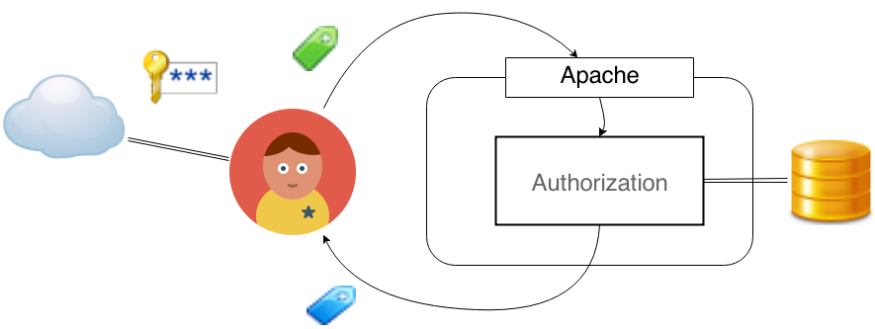
Service Provider (SPs)
Notes:
Users and authentication is handled by some existing service, be that google, facebook, or your enterprise identity manager.
Keystone provides the service of issuing tokens and handling authorization, what permissions users have and what projects and groups they are part of.
This is an obvious boost to security as you can see from the diagram your username and password is never sent to Keystone at all.
This is a fairly common setup to have apache managing the identity control.
It means that unauthenticated users never progress to the actual application.
It is a boost to performance and security as these apache modules are standardized.
For the developers in the room it also means no more dealing with eventlet.
There are a number of competing standards for this interaction
OpenID Connect, a newish one called AbFab, but the most common, particularly in the enterprise space is SAML

Slide 9
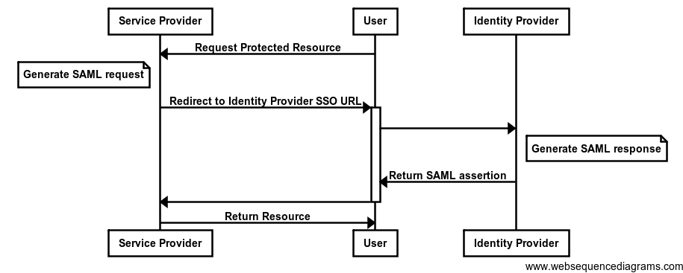
SAML
Notes:
About SAML:
It's XML based
It's an open standard that's been around for more than 10 years.
It exchanges both authentication and authorization information.
This is an important distinction from the likes of oauth, which provides delegation, but you don't know what roles the user has globally.
This workflow is particular to SAML but the competitors all work in a similar way.
<DESCRIBE IT>
The authenticated SAML response is just a bag of attributes describing the user.

Slide 10
<saml:AttributeStatement>
<saml:Attribute Name="role">
<saml:AttributeValue xmlns:xs="http://www.w3.org/2001/XMLSchema"
xmlns:xsi="http://www.w3.org/2001/XMLSchema-instance"
xsi:type="xs:string"
>user</saml:AttributeValue>
</saml:Attribute>
<saml:Attribute Name="role">
<saml:AttributeValue xmlns:xs="http://www.w3.org/2001/XMLSchema"
xmlns:xsi="http://www.w3.org/2001/XMLSchema-instance"
xsi:type="xs:string"
>staff</saml:AttributeValue>
</saml:Attribute>
</saml:AttributeStatement>
<saml:AttributeStatement>
<saml:Attribute xmlns:x500="urn:oasis:names:tc:SAML:2.0:profiles:attribute:X500"
FriendlyName="sn"
Name="urn:oid:2.5.4.4"
NameFormat="urn:oasis:names:tc:SAML:2.0:attrname-format:uri"
x500:Encoding="LDAP"
>
<saml:AttributeValue xmlns:xs="http://www.w3.org/2001/XMLSchema"
xmlns:xsi="http://www.w3.org/2001/XMLSchema-instance"
xsi:type="xs:string"
>Lennox</saml:AttributeValue>
</saml:Attribute>
</saml:AttributeStatement>
Notes:
So this is a small chunk of a SAML assertion.
The small stuff you can't read is not really important.
Other than as a reason you should never let a committee produce an XML standard.
In addition to this it contains some information like who the idp that issued this was.
Some basic restrictions
like the start time and end time,
Possibly restrictions on what services it can be used on.
Then what you can see is a list where a user has roles user and staff.
The user also has the surname lennox.
Apache receives this snippet,
parses it
verifies it's authenticity
And extracts all the useful information from it before keystone even has a chance to look at it.

Slide 11
Environment Variables
MELLON_NAME_ID=_f4daafb1565ab2d75fdeab57b4717501b0cac62859
MELLON_NAME_ID_0=_f4daafb1565ab2d75fdeab57b4717501b0cac62859
MELLON_uid=jlennox
MELLON_uid_0=jlennox
MELLON_givenName=Jamie
MELLON_givenName_0=Jamie
MELLON_sn=Lennox
MELLON_sn_0=Lennox
MELLON_cn=Jamie Lennox
MELLON_cn_0=Jamie Lennox
MELLON_mail=jlennox@redhat.com
MELLON_mail_0=jlennox@redhat.com
MELLON_eduPersonPrincipalName=jlennox@rnd.feide.no
MELLON_eduPersonPrincipalName_0=jlennox@rnd.feide.no
MELLON_urn:oid:0_9_2342_19200300_100_1_1=jlennox
MELLON_urn:oid:0_9_2342_19200300_100_1_1_0=jlennox
MELLON_urn:oid:2_5_4_42=Jamie
Notes:
In this case these are some of the environment headers that are produced.
In this case the apache module i used for SAML is called mod_mellon, which is the reason everything is prefixed with mellon.
You don't have to use it, mod_shib is probably the standard module but it is not packaged for fedora and mellon is.
It doesn't really matter so long as you can get the data through.
Again, there is a lot of information there and it doesn't really matter about most of it
but you can hopefully see in blue that sn has come through from the last snippet.
Everything else will be in those environment variables as well.
There is other useful stuff like a UID and an email address
That's very useful but now what,
what are we supposed to do with all that,
How do we map our environment variables into something that is useful for keystone?

Slide 12
Mapping
Convert IdP Assertions to OpenStack Roles
  Different roles mean different things on different IdPs
Mapping:
  The presence/value of which remote attributes,
  Lead to what user data on the local server.
Users don't exist in Keystone
  Groups can have roles
Notes:
If credentials are being submitted from the outside world the job of keystone then becomes to convert various forms of external identity into a model that makes sense for keystone and openstack.
Each IdP is different.
Each IdP uses its own roles for different reasons and they are unlikely to be the same
For example we have a federated provider for an enterprise customer and for a small business.
Trevor has the 'staff' role in the enterprise.
Susan has the 'staff' role in the small business.
Being staff in a small business probably gives you a LOT more permissions
So not only do we need to handle multiple providers we need to be able to establish mappings for every idp into our keystone roles.
But how?
The user doesn't exist in keystone, it exists in the identity manager of that enterprise, or that business.
Keystone has possibly never seen this user before.
Groups can have roles,
Typically what we are trying to do is figure out enough groups with the roles that we want, then map the remote attributes into a local user in some groups

Slide 13
Mapping Snippet
"remote": [
{
"type": "givenName"
},
{
"type": "sn",
"any_one_of": ["Lennox"]
},
{
"type": "uid"
},
{
"type": "role",
"any_one_of": ["staff"]
}
]
}
]
"rules": [
{
"local": [
{
"user": {
"name": "{0} {1}",
"id": "{2}"
}
},
{
"group": {
"id": "37ebd1d9e3..."
}
}
],
Notes:
The JSON here is all part of the one structure
A mapping is a list of rules
Each rule has a local part and a remote part.
with two parts, a LOCAL part and a REMOTE part.
For each identity provider we have a mapping from the information that comes in from the environment variables.
To some user information and some groups.
You have to match everything in remote.
Our example is kind of specific and not practical, we have four required attrbiutes, givenName, sn, uid and role.
Surname must be one of lennox
Role must be one of staff.
Anyone matching that description will be mapped to a user.
You can see from the format strings that given name and surname are combined to give name,
Id is retrieved from uid.
This user is a member of an existing group with id of 37eb.... etc
Alright, that's not so bad, how do we do all this?

Slide 14
Identity Provider CRUD
Configuring Identity Providers.
  /v3/OS-FEDERATION/identity_providers/{idp_id}
Configure a Mapping.
  /v3/OS-FEDERATION/mappings/{mapping_id}
Protocols are managed per Identity Provider
  Allows an Identity Provider to use multiple protocols
  A protocol contains a mapping.
  /v3/OS-FEDERATION/identity_providers/{idp_id}/protocols/{protocol}
Tokens are issued via the protocol
  /v3/OS-FEDERATION/identity_providers/{idp_id}/protocols/{protocol}/auth
Notes:
Step by Step,
First you'd need to create an identity provider for your host.
Then you'd need to create a mapping specific to that provider
It may be specific to the output of your apache module
Register a protocol, which says for this provider i can communicate with this information
When you authenticate you then have to go to the protocols URL and get a token.

Slide 15
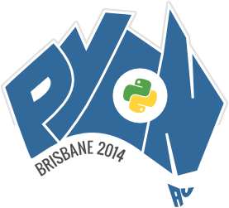
Today
It works, but...
  SAML2 ECP
  Client side is in review
Framework and the Mapper.
Notes:
You may have seen the press coverage recently from CERN and Rackspace recently about federated clouds.
ECP = Enhanced Client or Proxy
SAML at it's core is a web technology.
It expects that you hit an endpoint then get redirect and click on an authorization screen or login via a browser.
This obviously doesn't work for us.
ECP is a profile that essentially means 'without a browser',
Implementations of ECP are rare.
What's exciting is having the Framework in place and having the Mapper.
We should be able to convert from any IdP over any protocol and have it produce a useful keystone token.

Slide 16
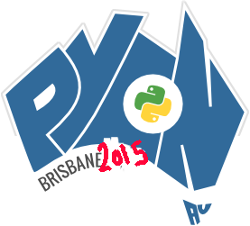
Future
Anything you can map...
  mod_auth_openid
  mod_identity_lookup
  AbFab
You could even...
  mod_auth_kerb
  mod_auth_digest
Keystone
Notes:
OpenID connect is fairly high on the list and there are blueprints dealing with it now.
mod_identity_lookup is a plugin that lets you talk to FreeIPA, and SSSD.
Among other things means we can do LDAP outside of python.
Cause that's a known pain.
AbFab is new but of particular importance to some of the european universities.
mod_auth_kerb and mod_auth_digest are not particularly useful because they don't impart any authorization information, but you could use them for simple mappings.
What's really exciting is Keystone to Keystone federation.
Means i can take the token i got from one cloud and use it as authorization for another cloud.
This is going to be the basis of things like bursting between clouds.
Take my private cloud token,
send it to the public cloud,
it maps my permissions into the public cloud and i start booting up instances there.

Slide 17






Credits
Notes:
As with most of OpenStack there have been a lot of fingers in this pie.
Of particular mention should be the team at CERN and the team at the university of kent who have done the majority of the planning and implementation work.

Slide 18
Thanks
Questions
jamielennox on freenode
jamielennox@redhat.com
@jamielennox_

Slide 19
Image Credits
Keystone: http://buffaloah.com/a/DCTNRY/k/keystone_fairfax.JPG
Federation: http://pixabay.com/en/networks-internet-facebook-social-232313/
SAML: http://www.websequencediagrams.com/?lz=cGFydGljaXBhbnQgU2VydmljZSBQcm92aWRlcgoAEQxVcwACD0lkZW50aXR5ACUKClVzZXItPgA3EDogUmVxdWVzdCBQcm90ZWN0ZWQgUmVzb3VyY2UKbm90ZSBsZWZ0IG9mAHAROiBHZW5lcmF0ZSBTQU1MIHIAQgYKAIEZEC0-K1VzAGMGZGlyZWN0IHRvAIEOEiBTU08gVVJMAIEgBwCBLxE6IACBCAZyaWdoAIEKBQAPEwCBABBzcG9uc2UKAIF7ES0-AIEMBVJldHVybgCBNwZhc3NlcnRpb24AgiAHLQCCFxEAgUUTAIFPCABCBQCCLQg&s=patent
Diagrams: https://draw.io

