Slide 1
Intro To OpenStack
Hi,
Jamie Lennox
jamielennox@redhat.com
jamielennox on freenode

Slide 2
OpenStack Services
OpenStack is not an application
A collection of semi-independent services that each provide some aspect of cloud management
Each service provides:
  a REST (HTTP) interface
  Python library
  command line application
Massively horizontally scalable

Slide 3
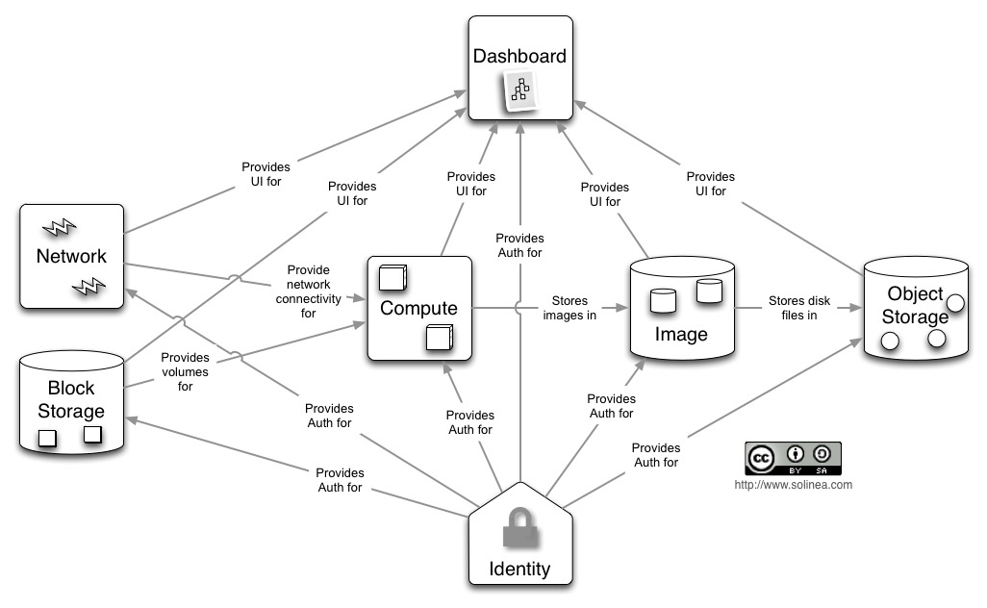
http://docs.openstack.org/training-guides/content/module001-ch004-openstack-architecture.html

Slide 4
Identity (Keystone)
Identity Management
  Users and Groups
  Roles
  Projects and Domains
LDAP, SQL, federation is coming
Authentication for all the services
Service Catalog

Slide 5
Object Store (Swift)
Containers – Logical Grouping
Objects
Data redundancy and Scalability

Slide 6
Image Service (Glance)
Images (eg fedora-18-cloud.x86_64.img)
  raw, iso, qcow2, ami, vdi, more
Storage Backends

Slide 7
Block Storage (Cinder)
Volumes
Snapshots
Again multiple backends and availability

Slide 8
Networking (Neutron)
Networks
Routers
Subnets (and private subnets)
SDN and vendor plugins

Slide 9
Compute (Nova)
Instances
Flavours
Cells and Availability Zones
Virt Drivers
  Libvirt , KVM, QEMU, Xen, vmware, Hyper-V...

Slide 10
Telemetry (Ceilometer)
Measurement collection
Monitoring of systems
Billing

Slide 11
Orchestration (Heat)
Launch composite cloud applications from templates
Auto-scale applications

Slide 12
Dashboard (Horizon)
Web UI
Allows graphical configuration and management of other services.

Slide 13
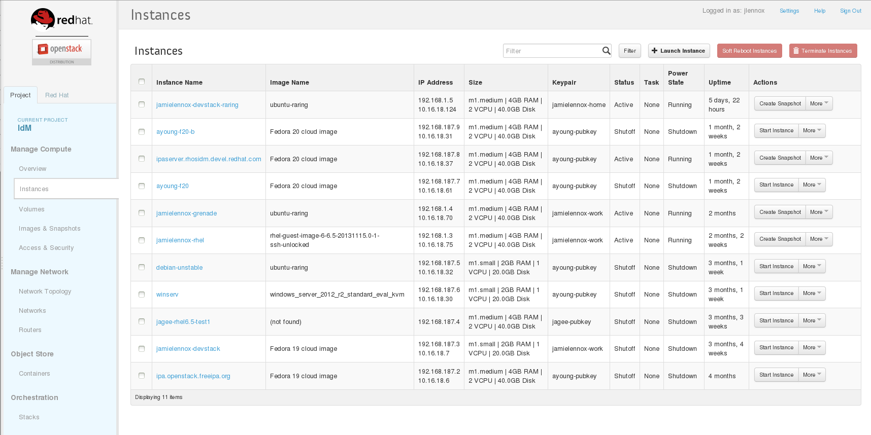
Horizon Instances

Slide 14
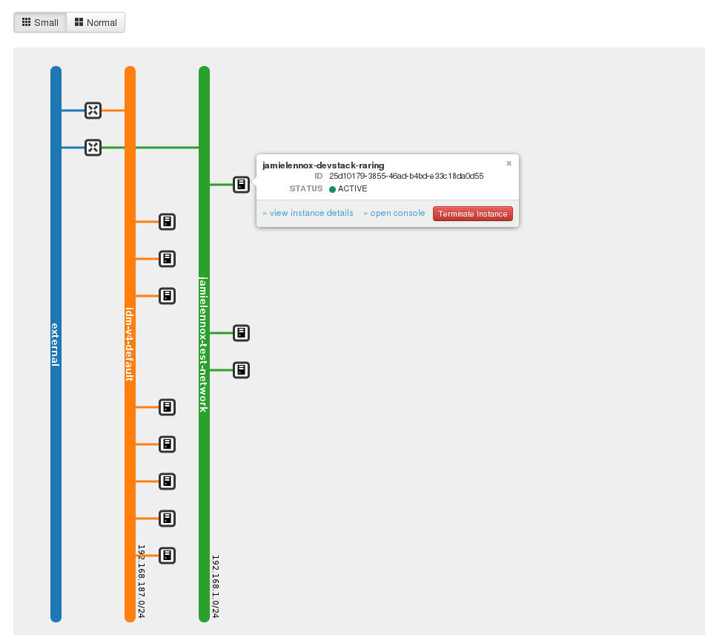
Horizon Network Management

Slide 15
Incubating
DNSaaS (Designate)
Messaging (Marconi)
DBaaS (Trove)
LBaaS (Libra)
Key storage and encryption (Barbican)
More....

Slide 16
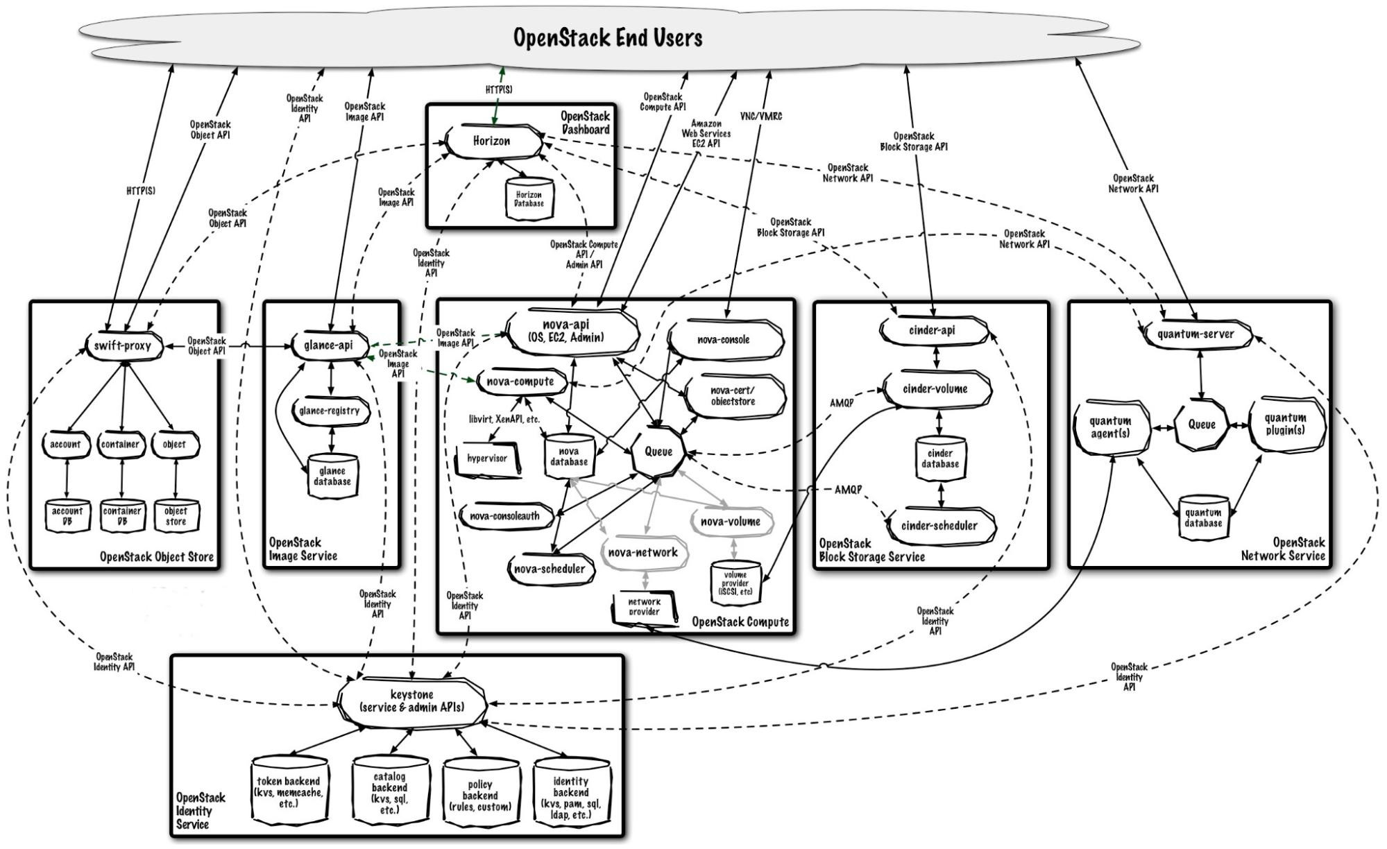
http://docs.openstack.org/training-guides/content/module001-ch004-openstack-architecture.html

Slide 17

Booting Walkthrough
Identity
Request a token from keystone for username and password.
Token contains a service catalog, user identifiers, projects and roles.

Slide 18
Booting Walkthrough
Identity
Compute
Request a new instance from Nova

Slide 19
Booting Walkthrough
Identity
Image
Compute
Get the image to create the new virtual machine from glance.

Slide 20
Booting Walkthrough
Identity
Image
Compute
Block
Talk to Cinder and attach the persistent volumes to attach.

Slide 21
Booting Walkthrough
Identity
Image
Compute
Block
Networking
Attach the virtual machine to the specified network

Slide 22
Governance
Has changed a few times in the project's history
Three main bodies:
  Foundation (Board of Directors)
  Technical Committee
  User Committee
Each Project has:
  Project Technical Lead (PTL)
  Core Team

Slide 23
Foundation
Non-profit organization
Owns trademarks
Deal with high level concepts of the project
  Community Building, brands & events, code of conduct
  Transparency Policies
  Finance management

Slide 24
Foundation Members
Board members are elected 1/3 from Platinum Sponsors, 1/3 from Gold, and 1/3 from Individual Members. Currently 24 positions.
Platinum:
  Red Hat, AT&T, HP, IBM, Canonical, Suse, Rackspace, Nebula
Gold:
  Cisco, Dell, Mirantis, vmware, Yahoo, Dreamhost, CloudScaling.... currently about 20.
200+ Sponsors

Slide 25
Technical Committee
Elected by all contributing members
Deals with the technical direction of OpenStack
Incubation and graduating services.
Release management
What are core OpenStack services and standardization

Slide 26
User Committee
This concept is fairly new
There role is to represent the users of OpenStack
User requirements
Deployment Strategies

Slide 27
Questions?
Jamie Lennox
jamielennox@redhat.com
jamielennox on freenode

