Slide 1

BASIC PRESENTATION

Slide 2

AGENDA
Introduction
Building confidence
Engaging the audience
Visual aids
Final tips & takeaways

Slide 3

THE POWER OF COMMUNICATION

Slide 4

OVERCOMING NERVOUSNESS
CONFIDENCE-BUILDING STRATEGIES

Slide 5
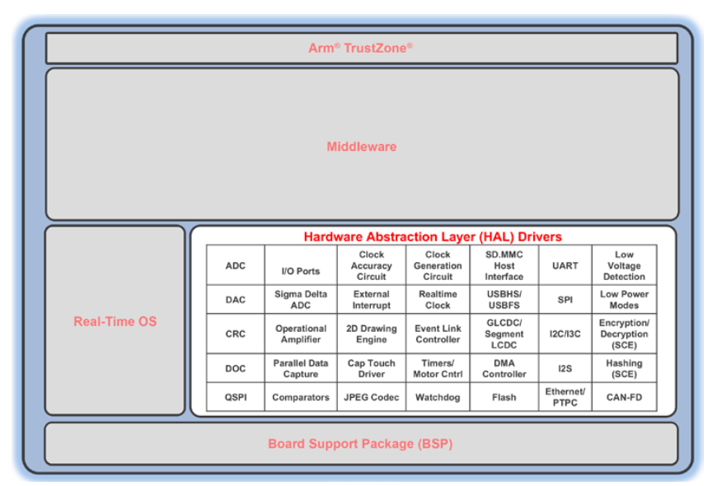
HAL (Hardware abstraction layer)
The interface to abstract the hardware is consistent throughout all modules of the HAL and can be extended.
Weave relatable stories into your presentation using narratives that make your message memorable and impactful
Encourage questions and provide thoughtful responses to enhance audience participation
Use live polls or surveys to gather audience opinions, promoting engagement and making sure the audience feel involved

Slide 6
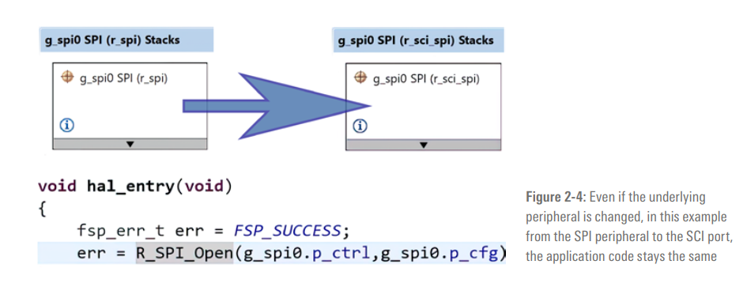
Example:
Notes:
What does it mean by the extended?
- Some of the peripherals support multiple interfaces, while some interfaces are supported by multiple peripherals - for example, the code was originally written for the dedicated hardware SPI peripheral, but later on the SPI-functionality of the SCI (Serial Communication Interface) needs to be used, it is sufficient to change the configuration information
- it is sufficient to change the configuration information.
While the API functionality can be accessed directly through the HAL interfaces, most of the functions can also be accessed through the different middleware stacks and protocols available in the FSP, which actually is the preferred method.
So how to achieve this? We will talk about it when we discuss about the FSP Architecture

Slide 7
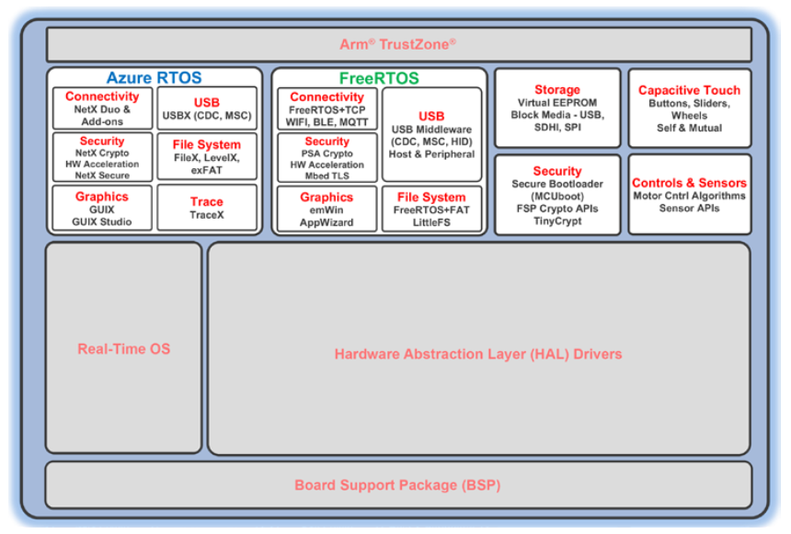
MIDDLEWARE
Its intention is to ease the use of complex peripherals like Ethernet and USB or the different security features of the RA Family of microcontrollers (MCUs).
The modules of the middleware layer provide abstractions of various system-level and technology-specific services, enabling a rich functionality with simple APIs.
Notes:
On top of the HAL layer and just below the user application sits the middleware layer, providing stacks and protocols to the application.

Slide 8
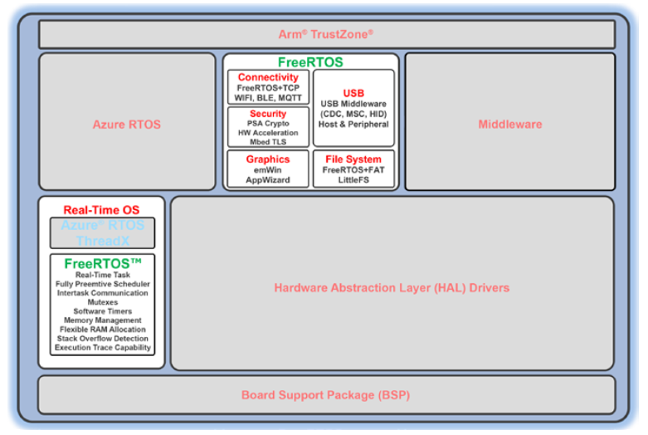
RTOS
FSP offers two quite popular Real-Time Operation Systems (RTOS): the FreeRTOS from Amazon Web Services® and the Microsoft Azure® RTOS ThreadX®.
Both provide such as real-time threads, preemptive schedulers, memory managers, or inter-thread communication via queues, semaphores, and buffers.
They also provide additional middleware libraries.
Notes:
The Flexible Software Package (FSP) comes not just with one, but with two quite popular Real-Time Operating Systems (RTOS): the FreeRTOS™ from Amazon Web Services® and the Microsoft Azure® RTOS ThreadX® Both provide not only the services
software engineers expect from operating systems, such as real-time threads, preemptive schedulers, memory managers, or inter-thread communication via queues, semaphores, and buffers

Slide 9
FSP Architecture
Application
Callback Function
BSP
Module
Interface
Module Instance
Stacks

Slide 10
FSP Architecture
Application and Callback Function
Application:
Code that is owned and maintained by the user.
Callback function:
Function that is called when an event occurs.

Slide 11
FSP Architecture
Modules

Slide 12
FSP Architecture
Interfaces
Interfaces are the way that modules provide common features.
Interfaces can be thought of as a contract between two modules
the modules agree to work together using the information that was established in the contract.
At a minimum, all FSP interfaces include three data structures: a configuration structure, an API structure, and an instance structure.

Slide 13
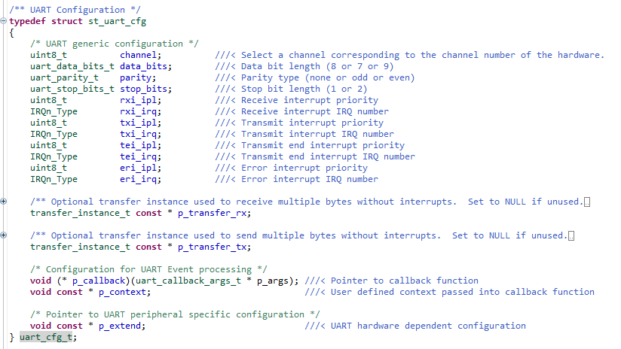
FSP Architecture
Interface Configuration Structure
The configuration structure is used for the initial configuration of a module during the <MODULE>_Open() call.
The structure consists of members such as channel number, bitrate, and operating mode.

Slide 14
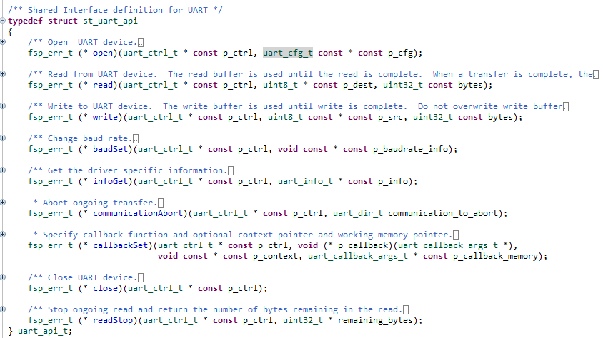
FSP Architecture
Interface API Structure
an API structure contains function pointers for all the supported interface functions.
The API structure allows for modules to easily be swapped in and out for other modules that are instances of the same interface.

Slide 15
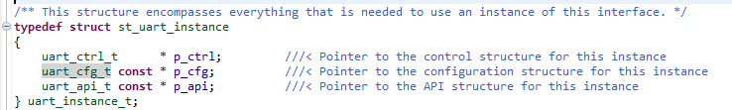
FSP Architecture
Interface Instance Structure
Every FSP interface also has an instance structure. The instance structure encapsulates everything required to use the module:
A pointer to the instance API structure
A pointer to the configuration structure
A pointer to the control structure

Slide 16
FSP Architecture
Instance
instances implement the features that are provided by the interfaces. Each instance is tied to a specific interface.
We have three types of instance:
Instance Control Structure:
FSP Extended Configuration Structure
FSP Instance API

Slide 17
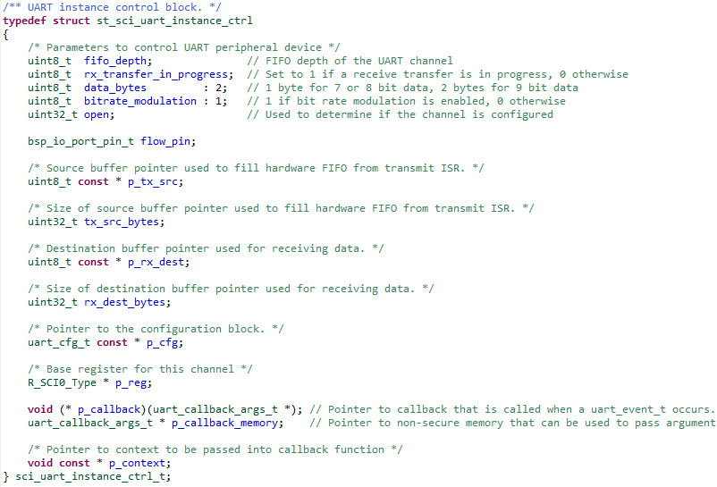
FSP Architecture
Instance Control Structure:
The control structure is used as a unique identifier for the module instance and contains memory required by the module.
The user must then send in a pointer to the control structure for all subsequent module calls.
Notes:
We can treat control structure like the pointer this of class in oop C++

Slide 18
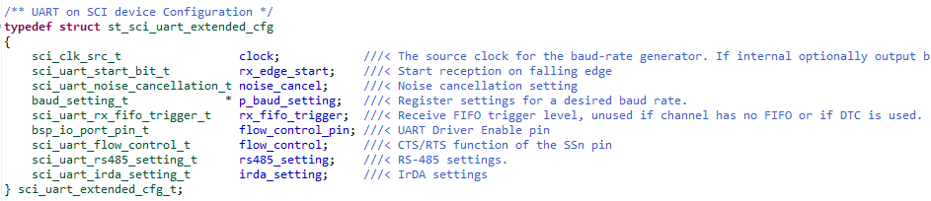
FSP Architecture
Extended Configuration Structure:
An instance offers extra features that are not common to most instances of the interface.
Notes:
We can treat control structure like the pointer this of class in oop C++

Slide 19
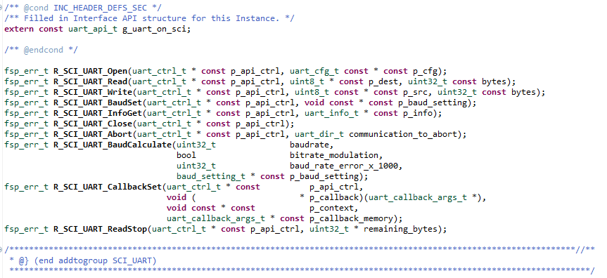
FSP Architecture
Instance API:
Notes:
We can treat control structure like the pointer this of class in oop C++

Slide 20
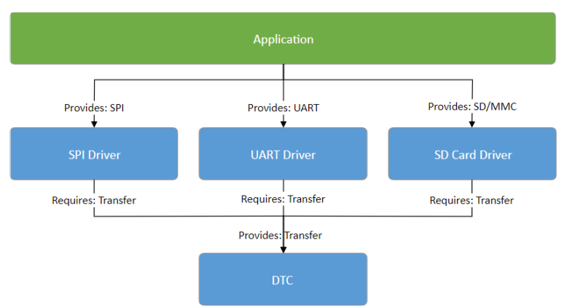
FSP Architecture
Stacks
When modules are layered atop one another, an FSP stack is formed. The stacking process is performed by matching what one module provides with what another module requires.
Notes:
We can treat control structure like the pointer this of class in oop C++

Slide 21
RA e2Studio
Stacks
When modules are layered atop one another, an FSP stack is formed. The stacking process is performed by matching what one module provides with what another module requires.
Notes:
We can treat control structure like the pointer this of class in oop C++

Slide 22
SELECTING VISUAL AIDS
ENHANCING YOUR PRESENTATION

Slide 23
EFFECTIVE DELIVERY TECHNIQUES
Effective body language enhances your message, making it more impactful and memorable.
Meaningful eye contact
Purposeful gestures
Maintain good posture
Control your expressions
This is a powerful tool in public speaking. It involves varying pitch, tone, and volume to convey emotion, emphasize points, and maintain interest.
Pitch variation
Tone inflection
Volume control

Slide 24
NAVIGATING Q&A SESSIONS
Know your material in advance
Anticipate common questions
Rehearse your responses
Maintaining composure during the Q&A session is essential for projecting confidence and authority. Consider the following tips for staying composed:
Stay calm
Actively listen
Pause and reflect
Maintain eye contact

Slide 25

SPEAKING IMPACT
Your ability to communicate effectively will leave a lasting impact on your audience
Effectively communicating involves not only delivering a message but also resonating with the experiences, values, and emotions of those listening

Slide 26
DYNAMIC DELIVERY
Learn to infuse energy into your delivery to leave a lasting impression
One of the goals of effective communication is to motivate your audience
Metric | Measurement | Target | Actual
Audience attendance | # of attendees | 150 | 120
Engagement duration | Minutes | 60 | 75
Q&A interaction | # of questions | 10 | 15
Positive feedback | Percentage (%) | 90 | 95
Rate of information retention | Percentage (%) | 80 | 85

Slide 27
FINAL TIPS & TAKEAWAYS
Consistent rehearsal
Strengthen your familiarity
Refine delivery style
Pacing, tone, and emphasis
Timing and transitions
Aim for seamless, professional delivery
Practice audience
Enlist colleagues to listen & provide feedback
Seek feedback
Reflect on performance
Explore new techniques
Set personal goals
Iterate and adapt

Slide 28
SPEAKING ENGAGEMENT METRICS
Impact factor | Measurement | Target | Achieved
Audience interaction | Percentage (%) | 85 | 88
Knowledge retention | Percentage (%) | 75 | 80
Post-presentation surveys | Average rating | 4.2 | 4.5
Referral rate | Percentage (%) | 10 | 12
Collaboration opportunities | # of opportunities | 8 | 10

Slide 29

THANK YOU
Brita Tamm
502-555-0152
brita@firstupconsultants.com
www.firstupconsultants.com

