Slide 1
Boot loader and porting Linux Kernel

Slide 2
Content
Booting sequence
Common commands

Slide 3

Overview
BIOS
(ROM CODE)
BOOT LOADER
OPERATING SYSTEM

Slide 4
What is boot loader?
When the processor is powered on, the memory does not hold an operating system, so special software is needed to bring the OS into memory from the media on which it resides. This software is normally a small piece of code called the boot loader.
On a desktop PC, the boot loader resides on the master boot record (MBR) of the hard drive and is executed after the PC's basic input output system(BIOS) performs system initialization tasks.

Slide 5
What is boot loader?
In an embedded system, the boot loader’s role is more complicated because these systems rarely have a BIOS to perform initial system configuration. Although the low-level initialization of the microprocessor, memory controllers, and other board-specific hardware varies from board to board and CPU to CPU, it must be performed before an OS can execute.
At a minimum, a boot loader for an embedded system performs these functions:
  Initializing the hardware, especially the memory controller
  Providing boot parameters for the OS
  Starting the OS

Slide 6
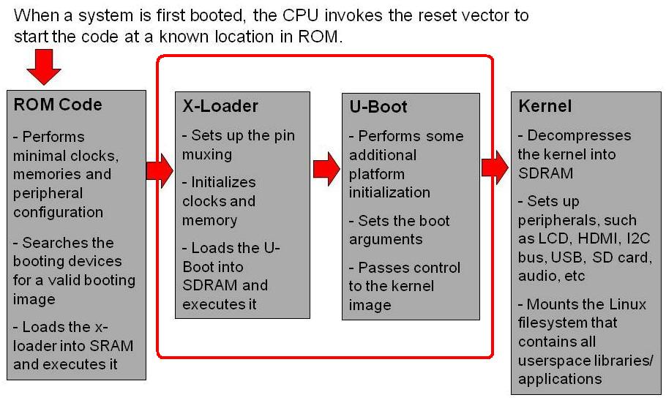
Booting sequence
Notes:
There are several stages of bootloaders that perform different levels of initialization on an OMAP platform, in order to eventually load and run the filesystem. This figure shows the booting sequence of the ROM code, x-loader, u-boot, and kernel, with each stage performing enough configuration in order to load and execute the next.

Slide 7
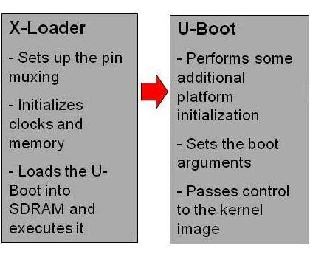
What is x-loader?
The first boot loader, x-loader, is a stripped-down version of the u-boot, designed to run in OMAP's small on-chip SRAM
It initializes the main off-chip memory of the system and other necessary device drivers, and then loads the larger boot loader for Linux, u-boot
Notes:
There are several stages of bootloaders that perform different levels of initialization on an OMAP platform, in order to eventually load and run the filesystem. This figure shows the booting sequence of the ROM code, x-loader, u-boot, and kernel, with each stage performing enough configuration in order to load and execute the next.

Slide 8
First Stage Boot
Booting device list consists of :
1) serial (UART3)
2) SD card (MMC1)
3) NAND flash.
…
How to show booting device list?
See here to decode result
>> md.b 0x480022f0

Slide 9
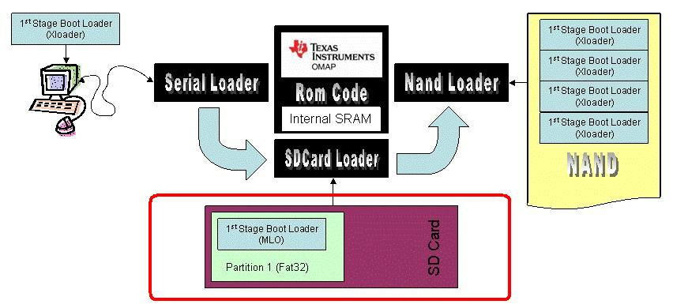
First Stage Boot
In above case, the ROM code would first look for a valid x-loader over the serial port (1), then in the SD card (2), then in the NAND flash (3). Whenever it finds a valid x-loader, it proceeds with execution of that binary.

Slide 10


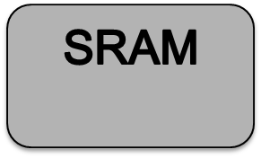

First Stage Boot – SD Card boot
The ROM looks for an SD Card on the first MMC controller. If a card is found, the ROM then looks for the first FAT32 partition. Once the partition found, the root directory is scanned for a special signed file called "MLO" . Assuming all is well with the file, it is transferred into the internal SRAM and control is passed to it. Both MMC1 and MMC2 can be used for booting.
SD Card
Partion 1 (FAT32)
ROM Code
1st stage boot loader
(x-loader MLO)
x-loader

Slide 11


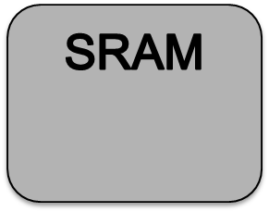



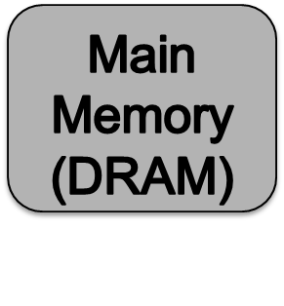
Second Stage Boot
x-loader search u-boot.bin file, transfer it into main memory and pass control to it.
SD Card
Partition 1 (FAT32)
ROM Code
1st stage boot loader
(x-loader MLO)
2nd stage boot loader
(u-boot.bin)
x-loader

Slide 12


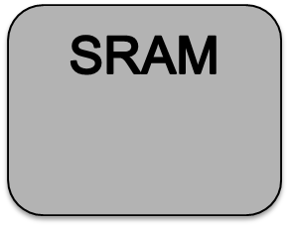



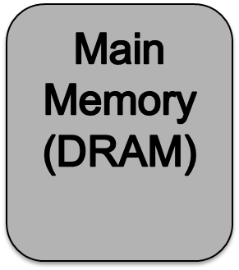

Second Stage Boot
SD Card
Partition 1 (FAT32)
ROM Code
1st stage boot loader
(x-loader MLO)
2nd stage boot loader
(u-boot.bin)
x-loader
u-boot

Slide 13
What is u-boot?
U-Boot is an open-source, cross-platform boot loader that provides out-of-box support for hundreds of embedded boards and many CPUs, including PowerPC, ARM, XScale, MIPS, Coldfire, NIOS, Microblaze, and x86.

Slide 14
u-boot sequence
Initialize
Hardware
Countdown for bootdelay second
Any key pressed
Countdown is stopped
Entering console mode
Countdown is stopped
Execute bootcmd

Slide 15
u-boot commands
Memory commands
Network commands
SPI commands
Environment variables
Booting commands

Slide 16
Memory commands
md – Display memory
mw – Write memory
mm – Modify memory (auto increment address)
nm – Modify memory (constant address)
protect – protect memory
erase – erase memory
cp – copy memory

Slide 17
md – display memory
Syntax:
md [.b, .w , .l] addr [# of objects]
Usage:
Display memory at address specified by addr argument
Sample:
u-boot # md.b 0x480022f0 1
480022f0: 0f .
u-boot # md.w 0x480022f0 1
480022f0: 030f ..

Slide 18
mw – memory write
Syntax:
mw [.b, .w, .l] addr value [count]
Usage:
The mw is a way to initialize (fill) memory with some value. When called without a count argument, the value will be written only to the specified address. When used with a count, then a whole memory areas will be initialized with this value:
Sample:
u-boot # mw 0xf9000028 1
u-boot # md 0xf9000028
f9000028: 00000000

Slide 19
protect
Syntax:
protect on/off start end
protect on/off all
…
Usage:
It is used to set certain parts of the flash memory to read-only mode or to make them writable again. Flash memorythat is "protected" (=read-only) cannot be written (with the cp command) or erased (with the erase command). Protected areas are marked as (RO) (for "read-only") in the output of the flinfo command

Slide 20
protect
Sample:
u-boot # protect off all
u-boot # erase 0xf0400000 0xf07fffff
U-boot # cp.b 0x2000000 0xf0400000 <size>

Slide 21
erase – erase flash memory
Syntax:
erase start end
erase all
Usage:
Erase flash memory
Sample:
u-boot # protect off all
u-boot # erase 0xf0400000 0xf07fffff

Slide 22
cp – copy
Syntax:
cp [.b, .w, .l] source target count
Usage:
The memory copy command copies data in memory, starting at the “source” address to the “target” address. The “count” field specifies then number of bytes, words or long words to be copied depending upon the extension field of the cp command.
Sample:
u-boot # protect off all
u-boot # erase 0xf0400000 0xf07fffff0
u-boot # tftp 0x2000000 congvt/uImage
u-boot # cp 0x2000000 0xf0400000 <size>

Slide 23
Environment variables
What is u-boot environment variables?
Print Environment variables
Setting Environment variables
Importance environment variables

Slide 24
What is u-boot environment variables?
The environment variables configure settings such as the baud rate of the serial connection, the seconds to wait before auto boot, the default boot command, and so on.
The factory default variables and their values also are stored in the U-Boot binary image itself. This allows recovering the variables and their values at any time with the envreset command.
Environment variables are stored as strings (case sensitive).

Slide 25
Print Environment variables
To show all environment variables:
To show an environment variables:
u-boot # printenv
u-boot # printenv bootargs

Slide 26
Setting environment variables
Using setenv command to setting an variable
Using saveenv command to save value of variable into flash memory
u-boot # printenv
u-boot # printenv bootargs

Slide 27
Important environment variables
bootargs | Configure boot parameters
bootcmd | Auto execute when booting in default
ipaddr | IP address of board
netmask | Configure Netmask
gatewayip | IP address of gateway
serverip | IP address of TFTP server
…

Slide 28
How to booting kernel?
Booting from SD Card
Booting from USB
Booting from Ethernet via TFTP

Slide 29






Booting from SD card
SD Card
Partition 1 (/boot)
Partition 2 (/)
x-loader
(MLO)
/bin
u-boot
(u-boot.bin)
/sbin
Boot script
(boot.scr)
/lib
Kernel image
(uImage)
…

Slide 30
Booting from SD Card
Create boot script
Setting bootcmd variable
booting

Slide 31

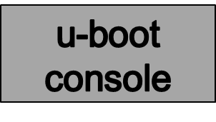

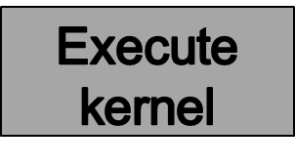
Booting from Ethernet via TFTP
TFTP Server
Loading kernel
Kernel image
(uImage)
Uncompressing
kernel

Slide 32
Booting from Ethernet via TFTP
Setting environment variables
Load image from TFTP server
Setting bootargs
Booting
>> set ipaddr 10.116.16.48
>> set serverip 10.116.16.34
>> saveenv
>> tftp 0x2000000 uImage
>> set bootargs “”
>> bootm

