Slide 1
Finite Element Method – 305333050
Instructor: Zhu Zheming （朱哲明）
Department of Engineering Mechanics, College of Architecture and Environment, Sichuan University, China
Email: zhemingzhu@hotmail.com; Phone: 186-2812-8536

Slide 2
Objective:
  The purpose of this course is to introduce the students to the fundamentals of the finite element method and its applications in Engineering with emphasis on solid structures or liquid. The students learn the necessary principle to help them create a basic finite element code (using Fortran or C programming) for the stress and deformation analysis of solid structures.
  Recommended Text:
  <有限元法基础及ANSYS应用>; <The Finite Element Method>, edited by Zienkiewicz, O.C. and Taylor, R.L.
  Grading:
  60% assignments and projects; 20% FEM code operation, 20% examination;
  Language:
  70% in English and 30% in Chinese or 100% in English
  Schedule:
  Monday from 3:50 Pm to 6:00 Pm
  Thursday from 9:50 Am to 11:30 Am
  Place : 江安文科楼 二区附楼117; 江安D -203

Slide 3
What is the finite element method
Definition: is computer-aided mathematical tool which can be used for obtaining approximate solutions to those engineering problems that can be represented by physical system subjected to external influences. Such problems are in areas like:
Solid mechanics ( elasticity; plasticity; statics; dynamics, etc.);
Heat transfer (conduction; convection; radiation);
Fluid mechanics;
Electromagnetism;
Coupled interactions of the above, e.g. fluid – solid interaction.

Slide 4
What is the finite element method
Application in solid mechanics is much more extensive, and can be classified in many different ways depending on the application, physical system shape or response, loading conditions, and so on.
Application type: structural, geotechnical and mechanical engineering; fluid mechanics.
System shape: 1-D; 2-D; 3-D;
System response: linear, nonlinear, axial displacements, in-plane biaxial displacements, out-of-plane deformation, in / out of plane action
Loading: static, dynamic

Slide 5
Generally, people’s contact with the FEM will be mostly as users of programs and less frequently as developers of new ones. As a user only, one does not have to be directly involved with the underlying mathematics. However, experience has shown that it is often difficult to be an effective user of an FE program without a good understanding of some of the basic concepts and techniques involved in the method

Slide 6
Formulation of Finite Element Method
In this part, based on the plane problem and triangular element the following content will be studied:
  Discretization of a domain (离散)
  Element displacement function, shape function and its properties
  Strain matrix, stress matrix and element stiffness matrix
  Equivalent nodal force (等效节点载荷）
  Global stiffness matrix and its properties
  Problem of displacement boundary
  Solution method and solver
  A calculation example
  High order displacement function

Slide 7
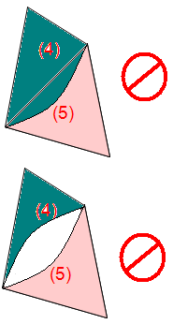
Discretization of a domain
P5
M
9
P2
3
13
6
1
(4)
10
M
(2)
4
P3
(1)
(5)
7
11
P1
2
(3)
14
(6)
(7)
12
5
8
P4
1. The continuum (or domain) is separated by imaginary lines or surfaces (3D) into a number of ‘finite elements’. The nodes are numbered.
2. The elements are assumed to be interconnected at a discrete number of nodes, not the imaginary lines

Slide 8









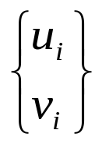
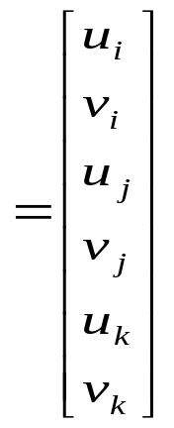
Displacement Function, Shape Function
9
M
3
13
6
P2
1
(4)
10
M
(2)
P3
4
(1)
(5)
7
11
2
(3)
(6)
14
P1
(7)
12
5
8
A typical three nodes (triangular ) element is defined by nodes i, j, k, in an anticlockwise sequence. Each node has two displacement components and can be expressed as
i = 1, 2, 3
And there are total six displacement components, so
How to get the solution of Stresses ?

Slide 9
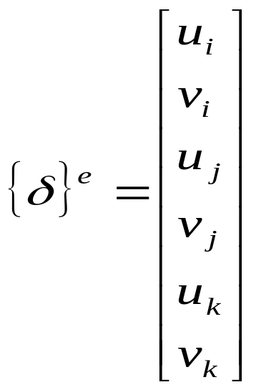
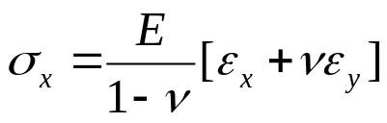
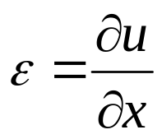
Discussion
How to solve
The Element strains and stresses
M
Suppose we know the element three node displacements
Displacements of any point inside the element
Strain
Stress

Slide 10
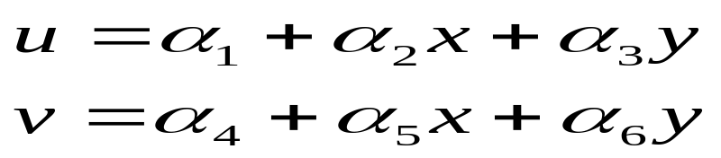
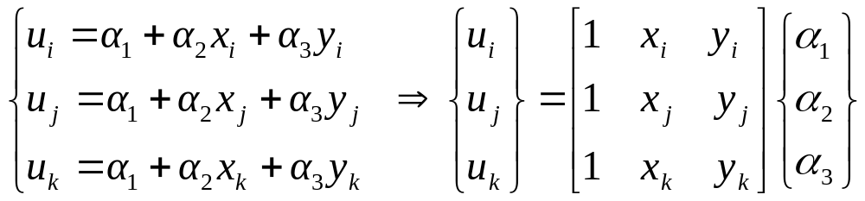
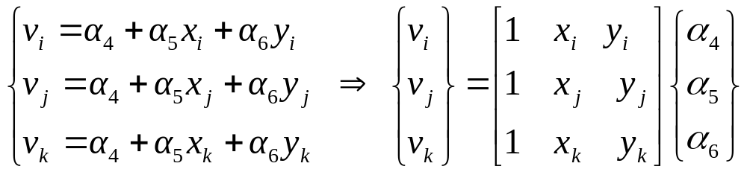
Displacement Function, Shape Function
Usually for three nodes element, the displacement function is selected as
In a three nodes element, there are six displacement components, which can be used to determine the six unknown coefficients, so
How to determine the coefficients α ?

Slide 11






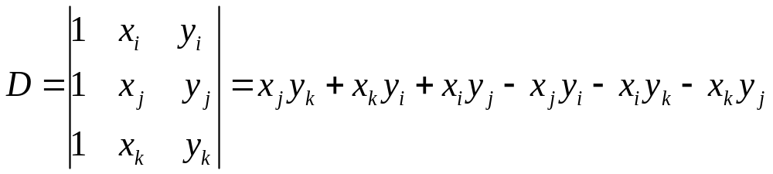
k
In order to solve the coefficients α
o
j
Illustration of the determinant
i
Where A is the triangle area

Slide 12
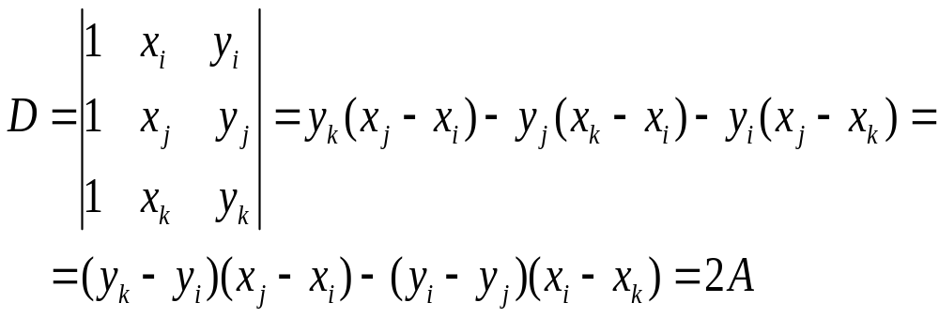
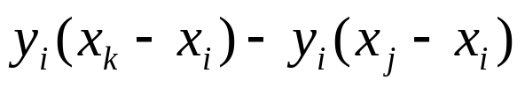
k
In order to solve the coefficients α
o
j
Illustration of the determinant
i
Where A is the triangle area

Slide 13
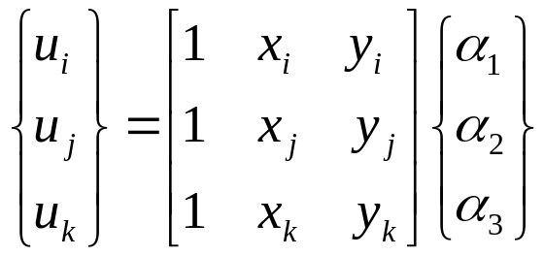
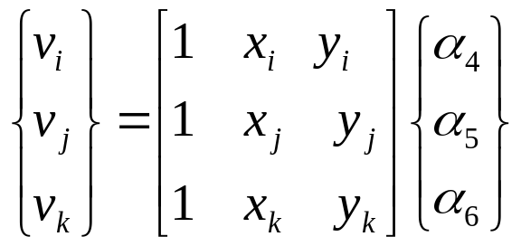
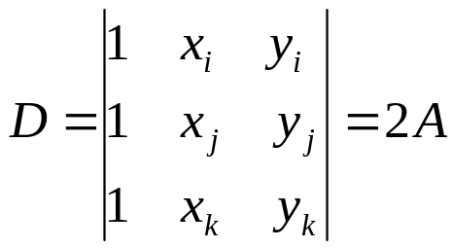
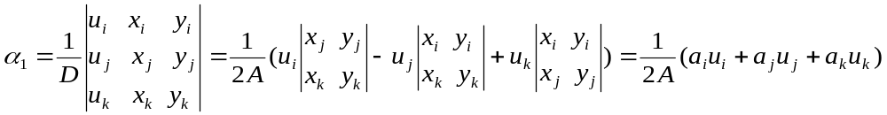
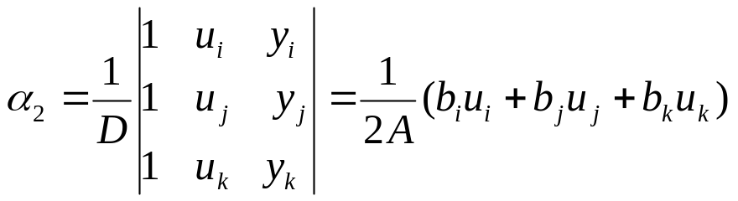
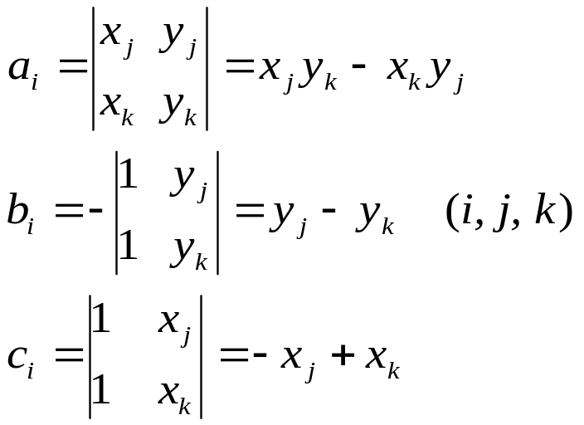
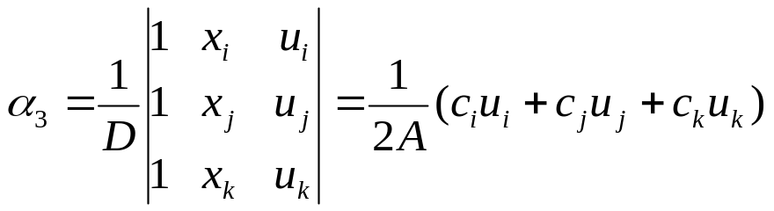
Displacement Function, Shape Function
The determinant of the above equations is
Where A is the area of the element

Slide 14
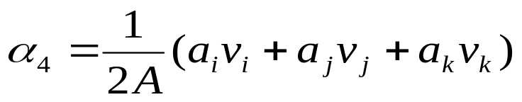
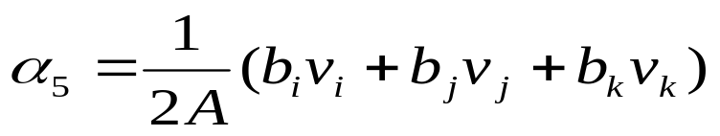
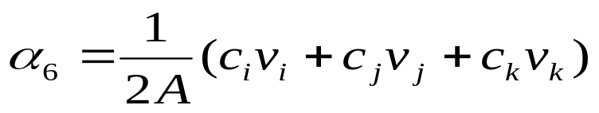
Displacement Function, Shape Function
The determinant of the above equations is
Where A is the area of the element
Similarly

Slide 15
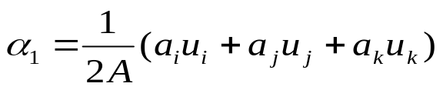
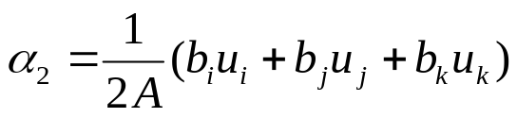
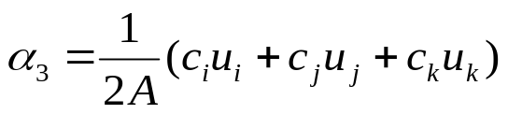
What we gonna do next ?
A set of functions is chosen to define uniquely the state of displacement within each ‘finite element’ and on its boundaries in terms of its nodal displacements.

Slide 16
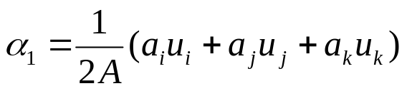
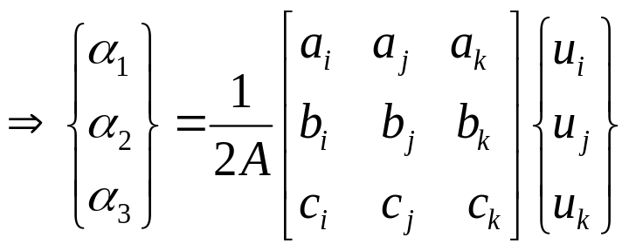
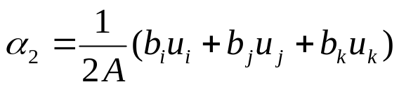

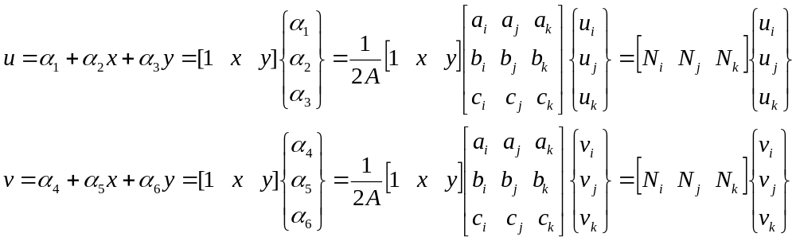
Displacement Function, Shape Function
Now the displacement can be written as

Slide 17
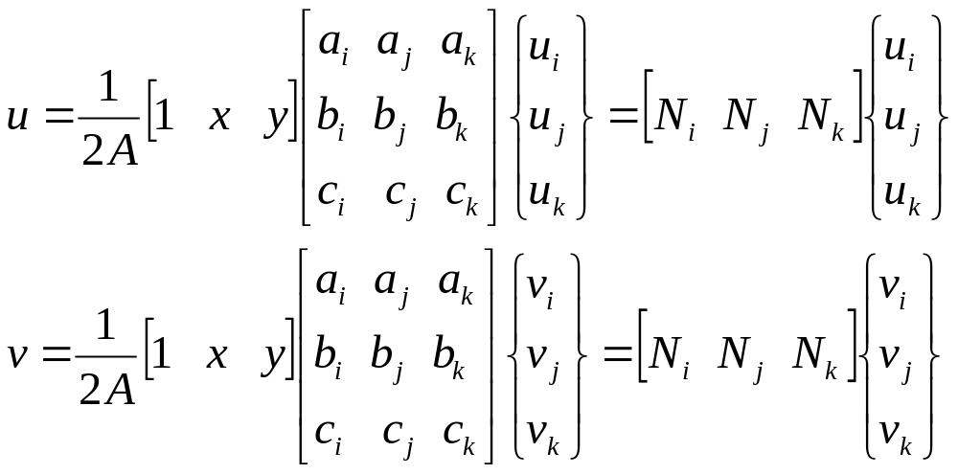
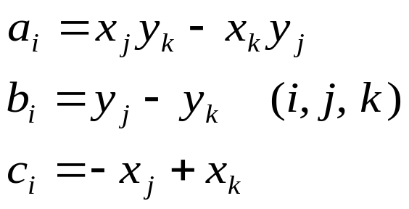
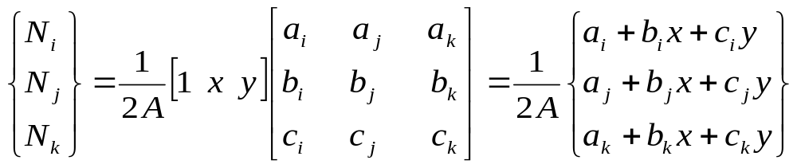
Displacement Function, Shape Function
Where the shape function is

Slide 18
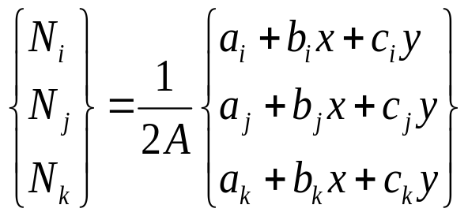
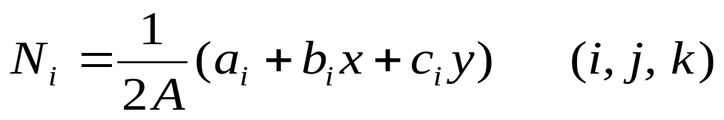
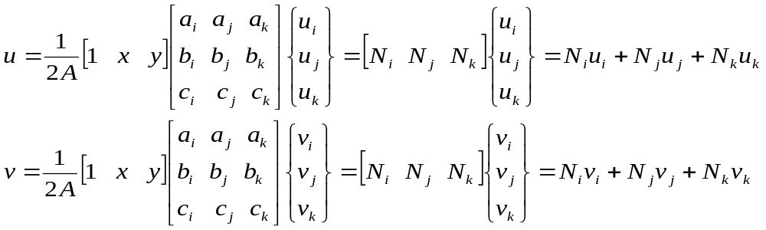
Shape Function
The shape function can be written as simple as
And the displacement

Slide 19
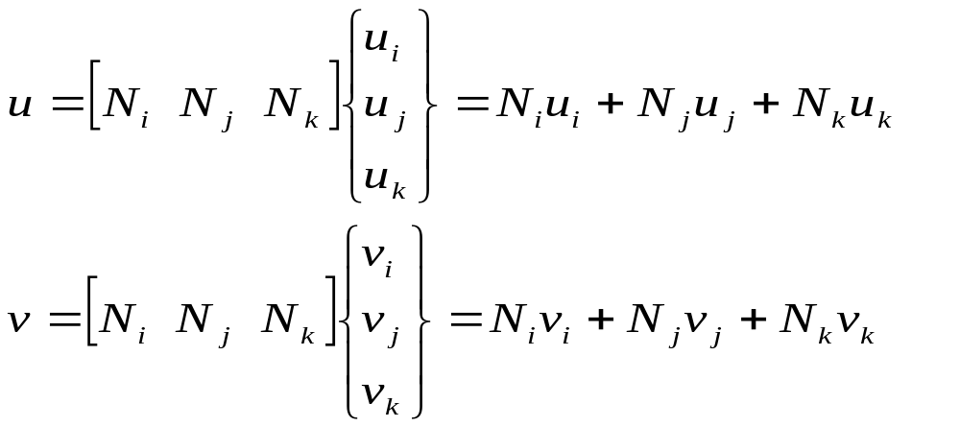
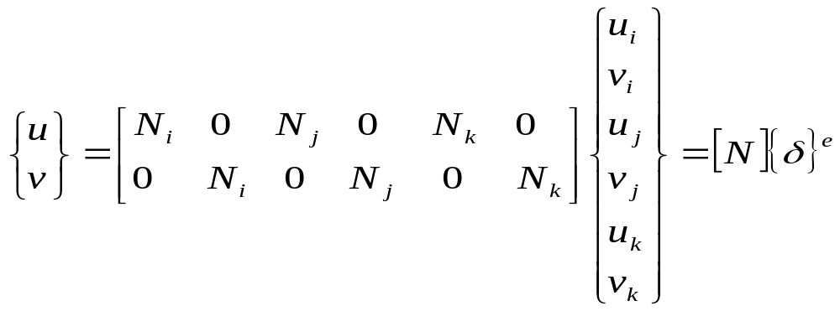

Shape Function
And the displacement
can be expressed simply as
Where is the matrix of shape function

Slide 20


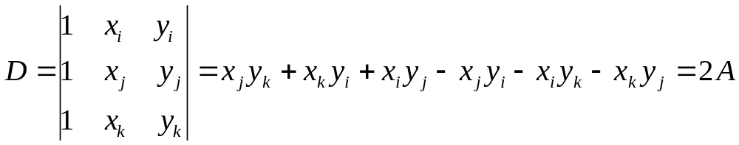

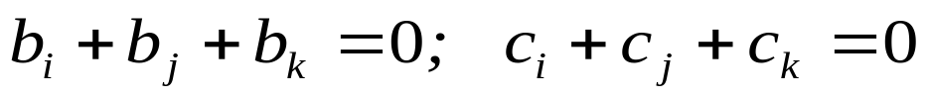
The properties of Shape Function
The shape function has the following properties
1. For any point inside an element,
k
i
j
It is easy to prove; from the shape function, we have
Where
because
and

Slide 21


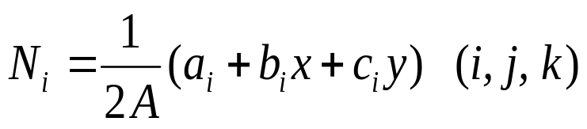


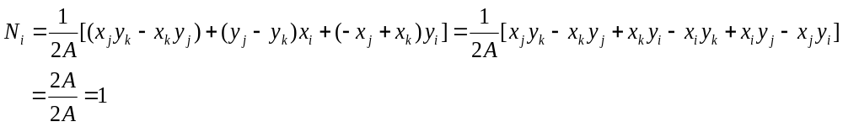
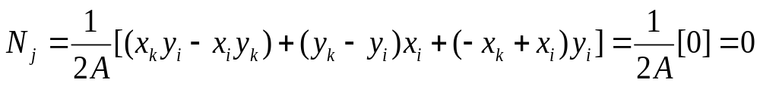
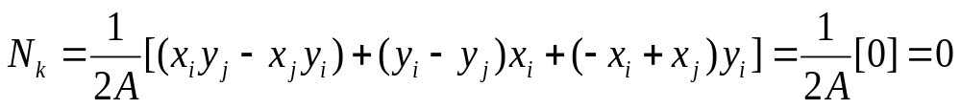
The properties of Shape Function
2. At the node i,
At the node j,
At the node k,
Because at node i
Similar conclusions can be obtained for those at nodes j and k

Slide 22
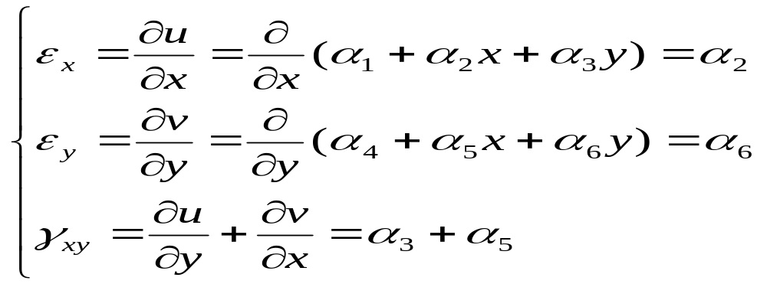

Discussion about the Displacement function
1. Displacement function must contains a constant strain because when the element size is very small, the stain inside the element approaches a constant value which will become a dominant factor. And in this study
Because
are constants, so the three strain components are also constants

Slide 23

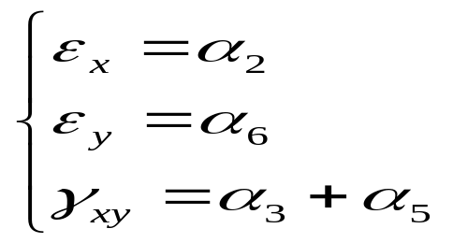

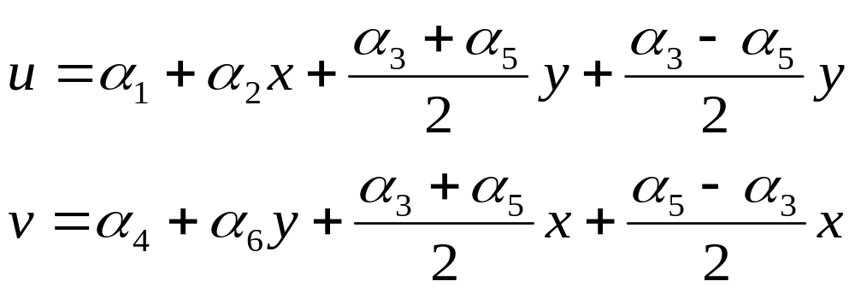
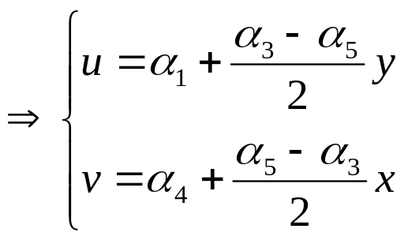
Discussion about the Displacement function
2. Displacement function must contain the rigid displacement, i.e. the displacement as the strain components equal zero,
i.e.
Then the displacement
刚体位移

Slide 24
Discussion about the Displacement function
3. For the triangular element studied here, the displacement function is linear, and the displacements inside the elements and on the boundary are determined by the nodal displacement, thus, the displacements occurring in the mutual boundary of the adjacent elements are equal, which can make the boundary continuous, so to avoid the following two cases of dislocations occurring
A
2
gap
1
B
Overlap

Slide 25
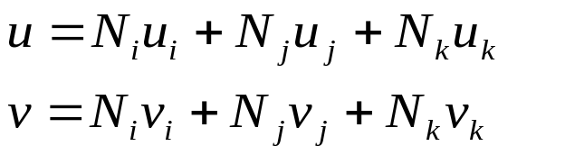
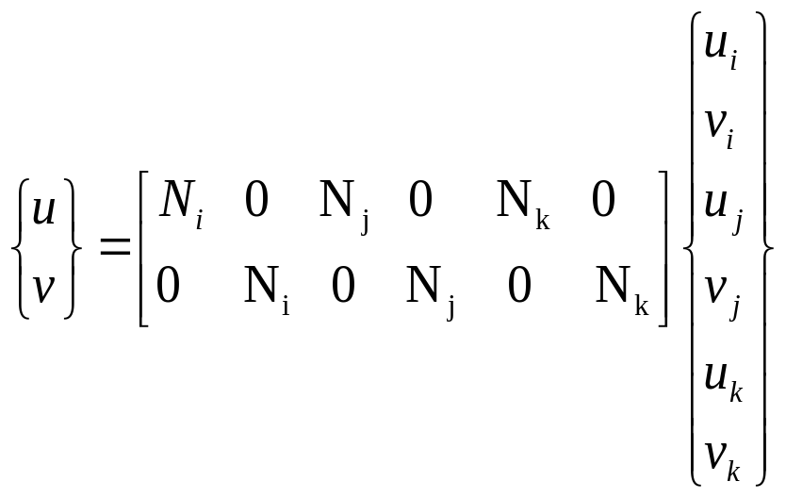
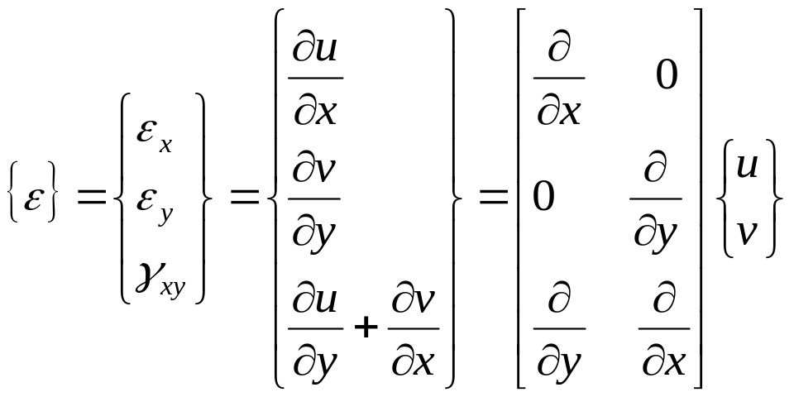

Strain Matrix
The relationship between strain and displacement can be expressed as

Slide 26




Strain Matrix
so
and
where
Discussion: the matrix B is a constant at any point within the element, so the strains calculated from this strain matrix should be constants

Slide 27





Stress Matrix
As is well known the relationship of stress versus strain for plane stress problem (for plane strain problem, only change E and ν to )
The above equation can be simply written as
where
Plane stress elasticity matrix

Slide 28






Stress Matrix
The stress matrix
and
where

Slide 29
Stress Matrix
Discussion: the stress matrix [S] is a constant at any point within the element, so the stresses calculated from this stress matrix should be constants.
Why the stress at a point within the element doesn’t relate to this point coordinates?
Right now, the strain and stress can be obtained if the nodal displacements are known

Slide 30

Discussion: if we know the three nodal displacements, we can
It can be seen that both the strain and stress are expressed in terms of nodal displacements. However, the nodal displacements are not known, so, we have to obtain the nodal displacements, how?

Slide 31












Element Stiffness Matrix
Principle of virtual displacement if a body in equilibrium under the applied loads is subjected to a kinematically admissible virtual displacement state, then the total internal virtual strain energy is equal to the total external virtual work. For an element
Where are virtual displacement and virtual strain.

Slide 32





Element Stiffness Matrix
Substituting the stress and strain matrix into the above equation, one can have
where
are constant matrix, so they can
be moved out of the integral, i.e.
Therefore
where
Element stiffness matrix

Slide 33






Element Stiffness Matrix
In the element stiffness matrix,
the integral is a constant because the matrix [B] and [D] are constants, therefore,
6X3 x 3x6 = 6x6
where

Slide 34














Slide 35


Element Stiffness Matrix
So the element equilibrium equation can be written as

Slide 36





Slide 37
Discussion: if we know the three nodal displacements, we can

Slide 38





The properties of Element stiffness matrix
The element stiffness matrix describes the anti-deformation capability of an element, as the stiffness of a spring.
Element stiffness matrix doesn’t have relation with the element position (rigid movement)
the value of (i = 1, 2, 3) must be positive

Slide 39

The properties of Element stiffness matrix
4. The element stiffness matrix is symmetric

Slide 40




A calculation example
y
y
k
15 KN
A triangular element as shown in this figure, the plate thickness t = 1; E = 2x10⁵; ν = 0.2; calculate the element stiffness matrix; the stresses.
5
20 kN
4
15 KN
j
i
3
x
According to
20 kN
We have

Slide 41


y
y
k
15 KN
5
20 kN
4
15 KN
j
i
3
x
20 kN

