Slide 1
Functions of Complex Variable
Instructor: 朱哲明 ( )
Zheming Zhu
College of Architecture and Environment, Sichuan University, China
Email: zhemingzhu@hotmail.com; Tel:13568967156

Slide 2
Conformal Mapping (保角映射)
Overview
The terminology "conformal mapping" should have a familiar sound. In
1569 the Flemish cartographer Gerardus Mercator (1512--1594) devised
a cylindrical map projection that preserves angles. The Mercator projection
is still used today for world maps. Another map projection known to the
ancient Greeks is the stereographic projection. It is also conformal
(i.e., angle preserving)
In complex analysis a function preserves angles if and only if it is analytic or
anti-analytic (i.e., the conjugate of an analytic function). A significant result,
known as Riemann mapping theorem, states that any simply connected
domain (other than the entire complex plane) can be mapped conformally
onto the unit disk.

Slide 3

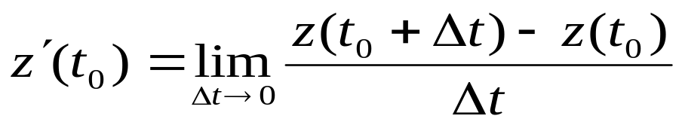
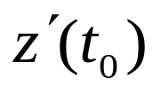
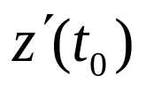
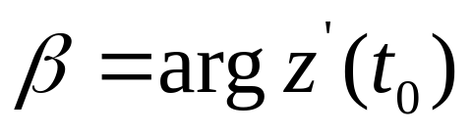
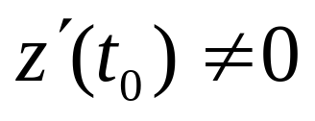
Concept of Complex Derivatives
The derivative at z₀ can be expressed as
z
C
ΔS
z₀
x
A vector is tangent to C at the point
The angle of inclination of with respect to the positive
x axis is
Where C is a curve in z-plane, z = z (t), and

Slide 4


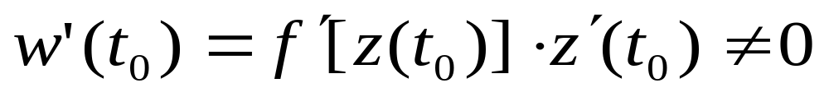
z
w
K
C
ΔS
z₀
w₀
x
u
Suppose w = f(z) is analytic at z₀ and then the image of C under the mapping w = f(z) is the curve K in the w plane. The vector tangent to K at the point w₀ = f(z₀) is given by

Slide 5
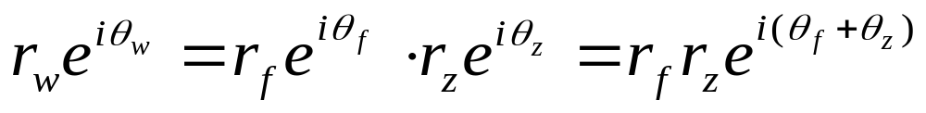
z
w
K
C
ΔS
z₀
w₀
x
u
Because

Slide 6
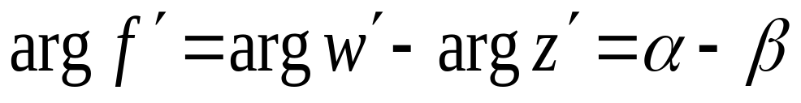
then
z
w
K
C
ΔS
z₀
w₀
x
u
Therefore, the effect of the transformation w = f (z) is to rotate the angle of inclination of the tangent vector at z₀ through the angle Arg f ’ to obtain the angle of inclination of the tangent vector at w₀ = f (z₀)

Slide 7
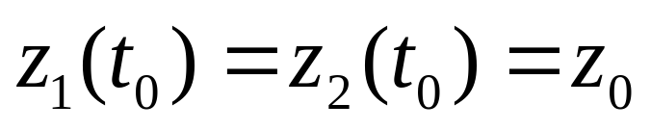


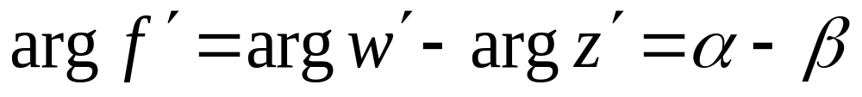

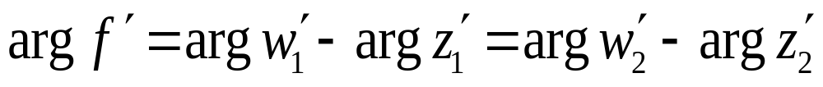
Suppose there are two curves C₁: z = z₁(t); and C₂ : z = z₂(t),
Then the images of C₁ and C₂ under the same mapping w = f(z) is the curve K1: w₁ = f [z₁(t)]; and K2: w₂ = f [z₂(t)] in the w plane.
K₁
According to
C₂
K₂
C₁

Slide 8
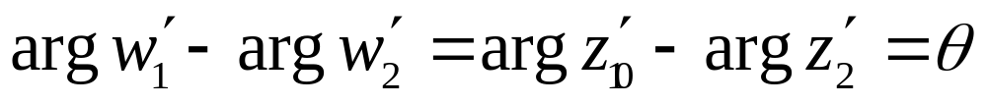
The mapping w = f(z) is said to be angle preserving, or conformal at z₀
C₂
K₁
K₂
C₁

Slide 9
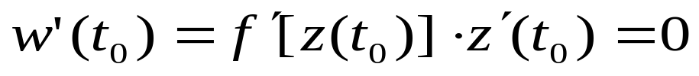
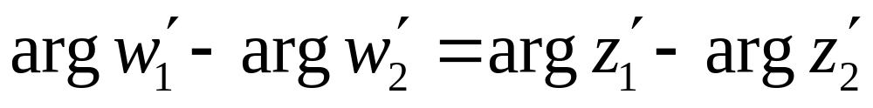
Theorem (Conformal Mapping).
Let f(z) be an analytic function in the domain D, and let z₀ be a point in D. If , then f(z) is conformal at z₀.
Let f(z) be a nonconstant analytic function. If
then from
z
C
ΔS
z₀
x
Hint: the left-hand side of the above equation is: 0 – 0 , but its right-hand side is not zero, so

Slide 10
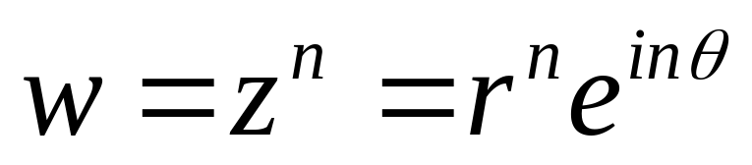
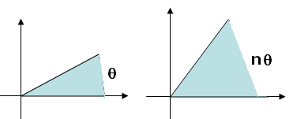
Mapping of some Elementary Functions
1.
r
n
r

Slide 11
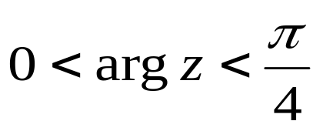
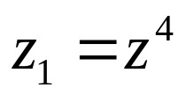
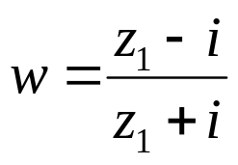
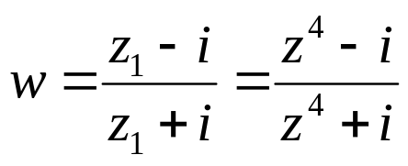
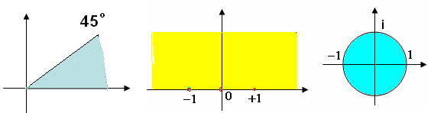
Find the transformation which maps a zone to a disk
Solution.
Can map the zone onto
and
can map the zone onto the disk
so

Slide 12
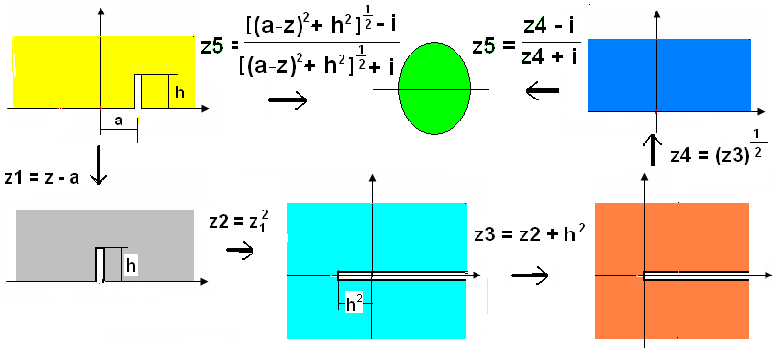
Example.
Find the transformation which maps
Solution.

Slide 13
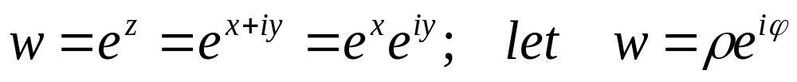
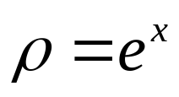

Mapping of some Elementary Functions
2.
Then
(1) If x is a constant, then ρ = constant, that is a circle;
(2) If y is a constant, then ϕ = constant, that is a radial

Slide 14
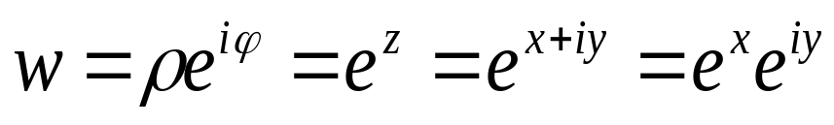
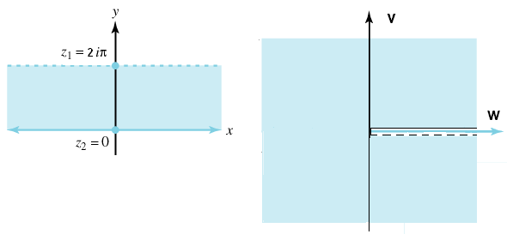
If a strip y = 0 and y = 2πi then

Slide 15
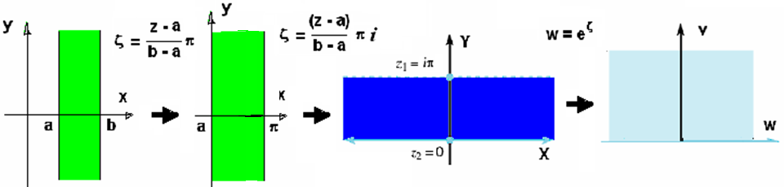
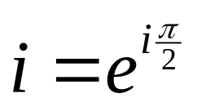
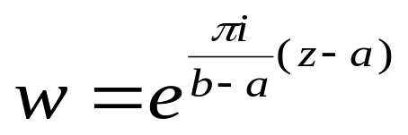
Example. A strip shown as the following figure can be mapped onto Im (z) >0
It should be noted that
So the transformation is

Slide 16


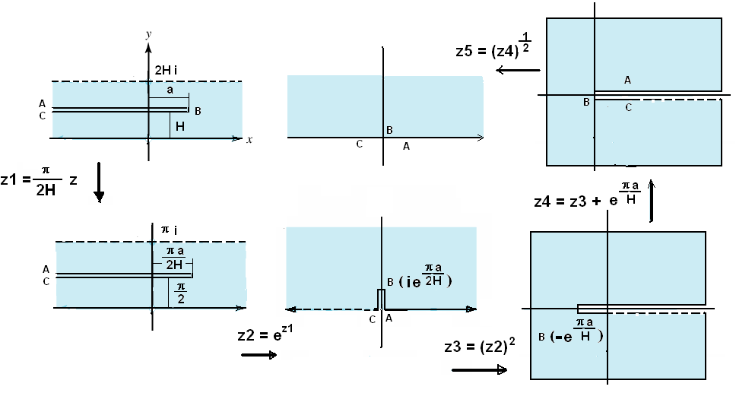
Example
A strip has a branch:

Slide 17
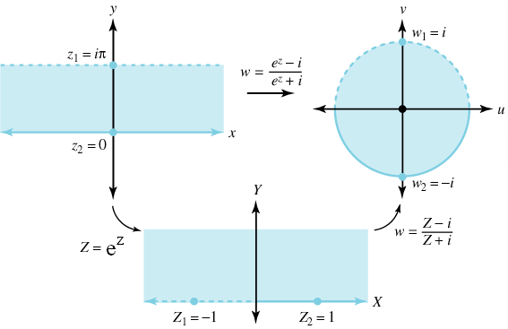
Example. Show that the transformation is a one-to-one
conformal mapping of the horizontal strip onto the disk .

