Slide 1
searching engine
presenter : shu yang

Slide 2
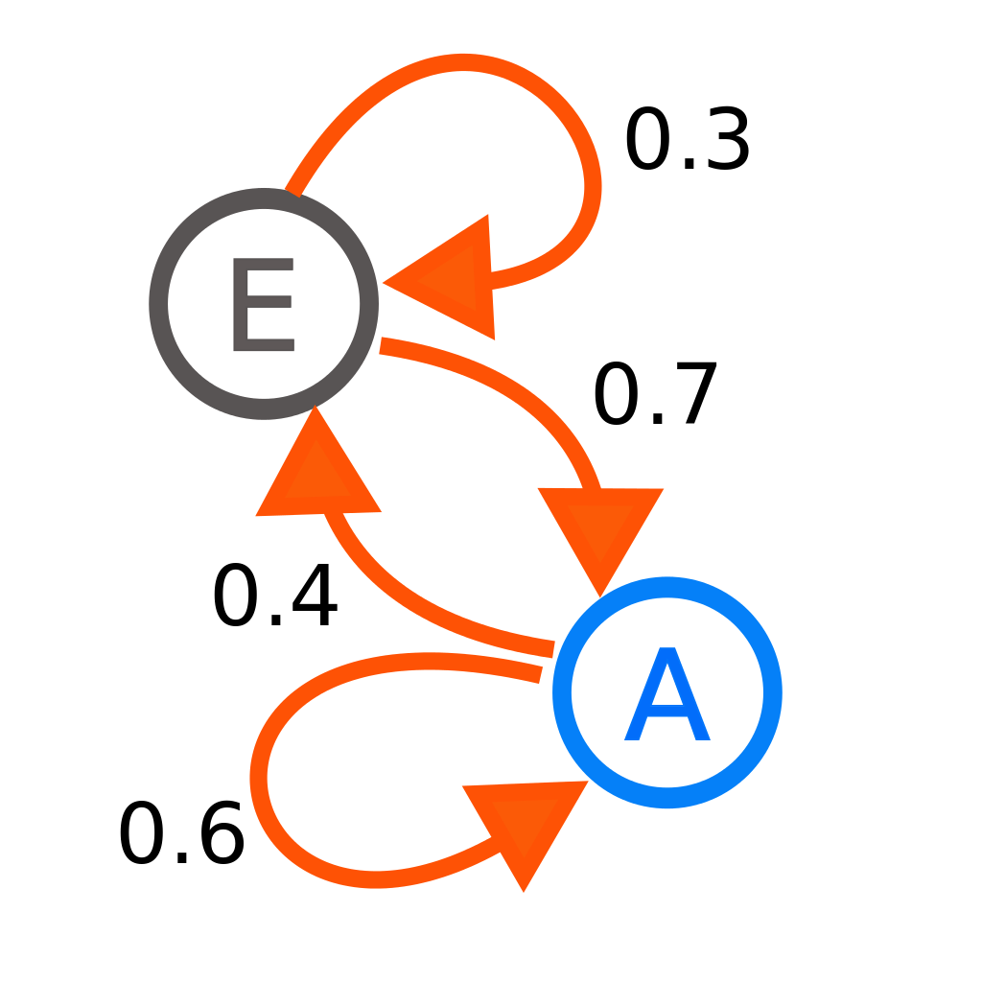
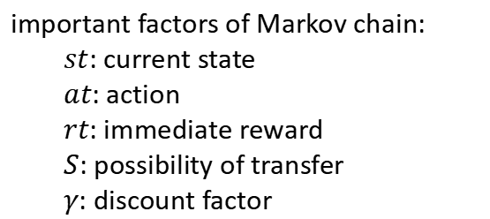
Q-learning
important factors of Markov chain:
$st$: current state
$at$: action
$rt$: immediate reward
$S$: possibility of transfer
$γ$: discount factor
target function:

Slide 3
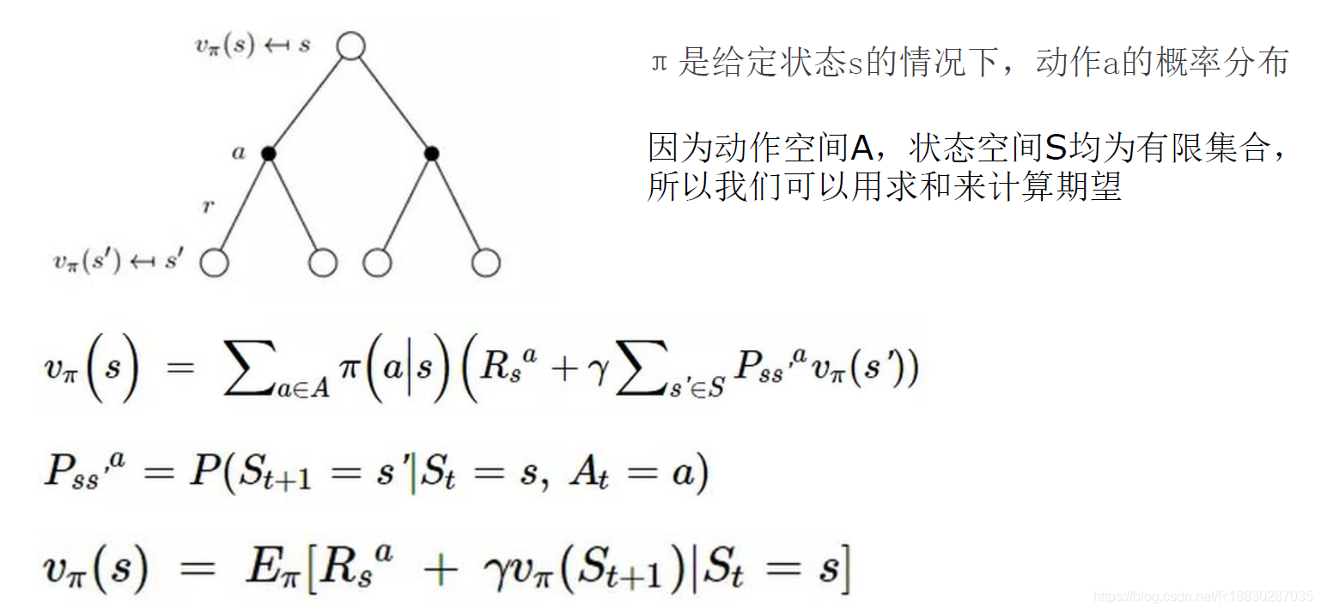
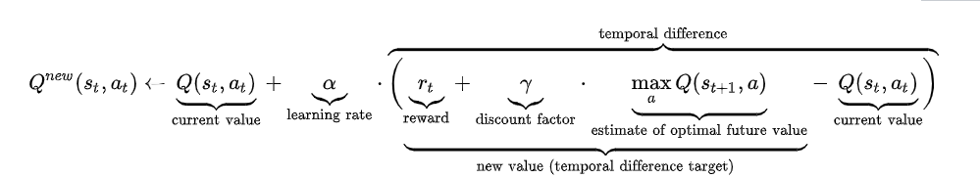
Q-learning
Bellman function:
current Q equals current reward plus next Q Bellman target function:
The Q renew function:

Slide 4
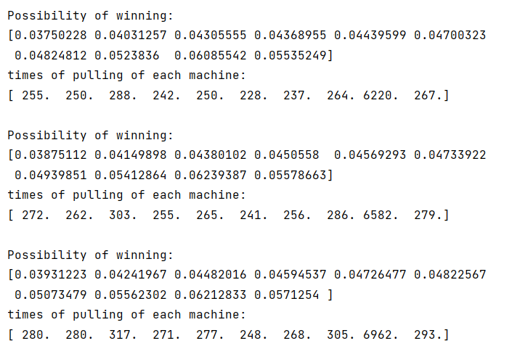
Q-learning
current problem:
pulling blackhole
cold start
limited states

Slide 5
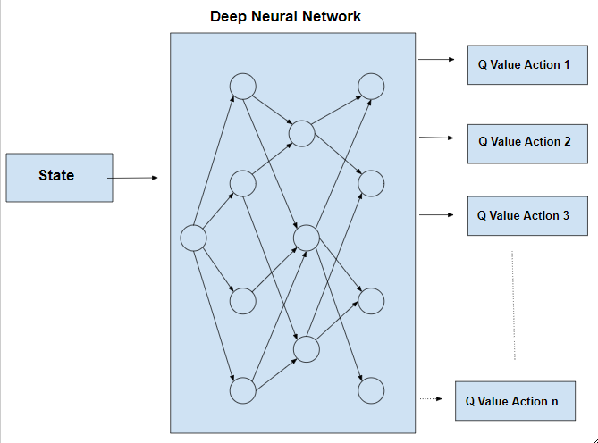
Deep Q-learning
Advantage:
adapt to infinite possible input state

Slide 6
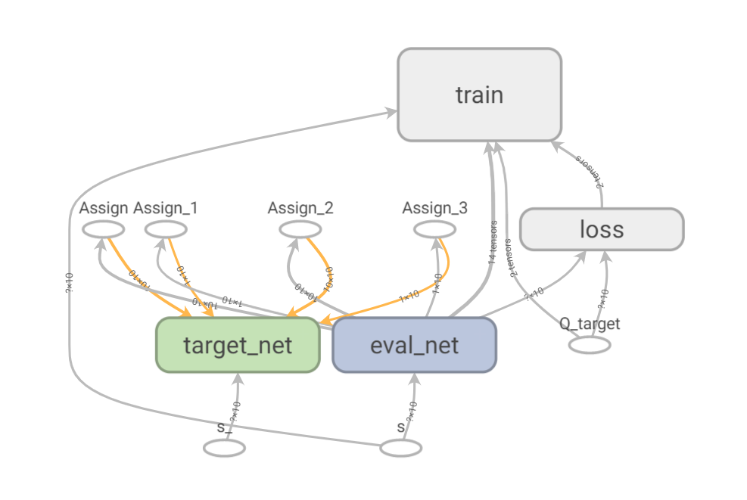
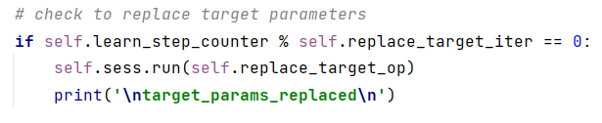
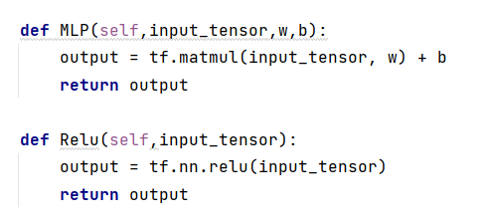
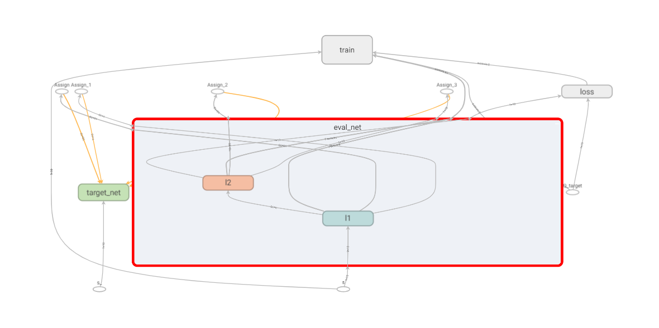
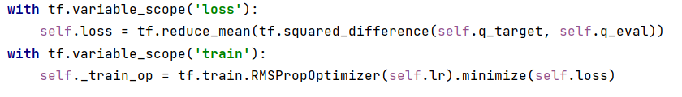
Deep Q-learning
training details:

Slide 7
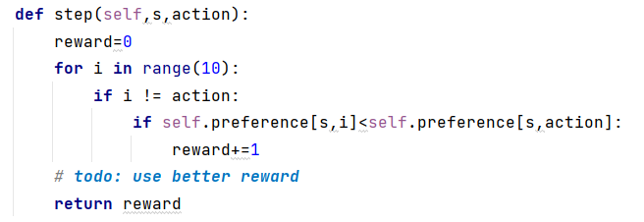
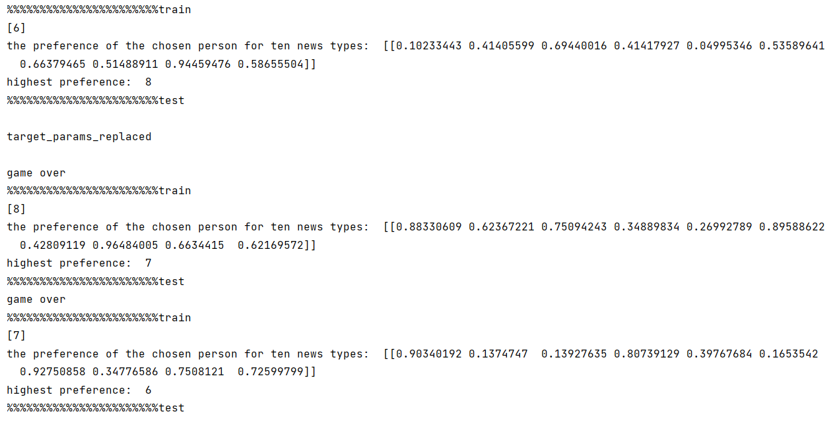
Deep Q-learning

Slide 8
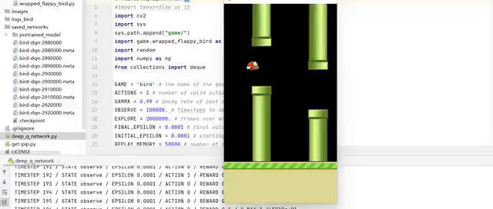
DDPG
analyze on the algorithms:
Q-learning: form a projection table, can’t handle large state space & action space
Deep Q-learning: using net to find the profection relation, good with large state space, became a blackhole facing the large action space
with actor-critic: greatly reduce calculation cost using another net to predict Q, suitable for large and dynamic action space

Slide 9
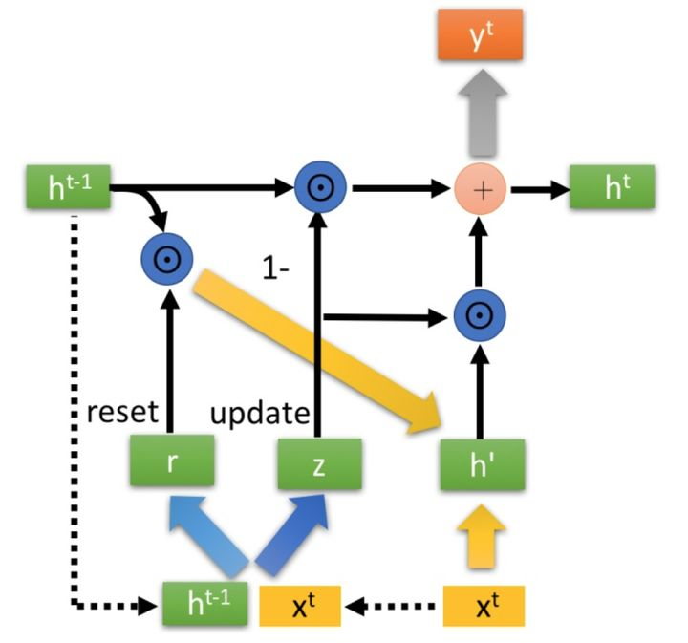
DDPG
How to update the preference?
preference may differ with time goes by
cold start

