Slide 1
searching engine
presenter:
shu yang

Slide 2
DDPG theory
Sprint 3
Q-learning: form a table, states and actions are one-to-one paired
Deep Q-learning: form a function, which is contimuous in independent variable, the state. input any state, you can have the score of the known actions
DDPG: with actor-critic structure, the output of the function is no longer the score, but a group of weight, by matrix multiplication with any action, tell the score of such action
Environment: cosine similarity

Slide 3
Embedding theory
Sprint 3
One-hot method to represent the item is low information density
Take the click action list of each customer as a sentence, each item selected as a word in the sentence, using the embedding method in NLP
Train a net, omit one item of the click history , input in the net and output should be the missing item. After training, taking one of the hidden layer output as the ID of item, take the place of one-hot.

Slide 4
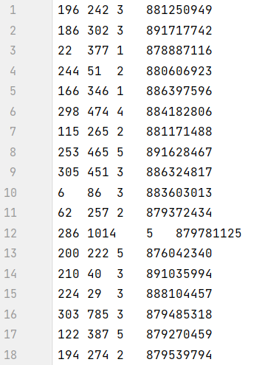
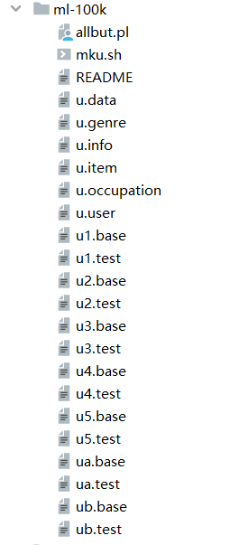
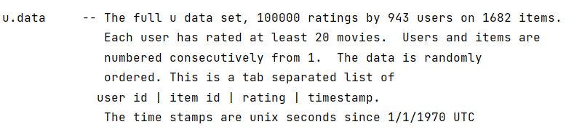
Data preprocessing
Sprint 3
IMDB movie rating dataset
raw data

Slide 5
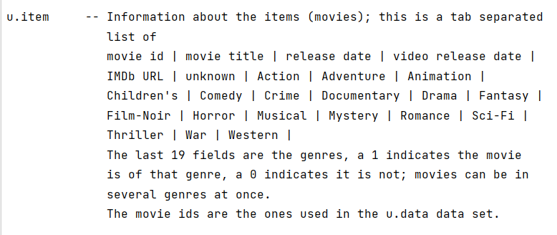
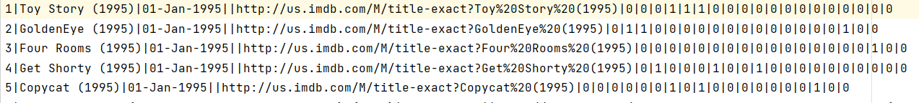
Data preprocessing
Sprint 3
IMDB movie rating dataset
raw data

Slide 6
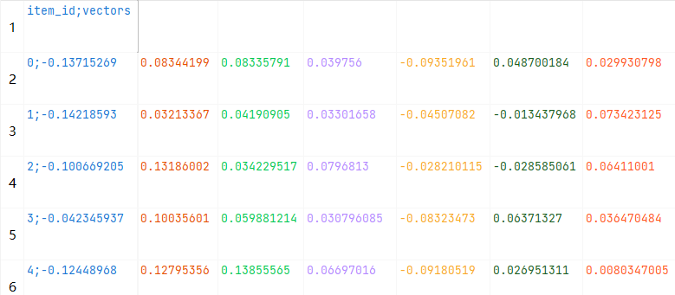
Data preprocessing
Sprint 3
IMDB movie rating dataset
embedding

Slide 7
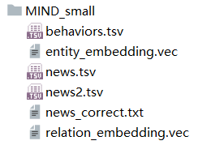
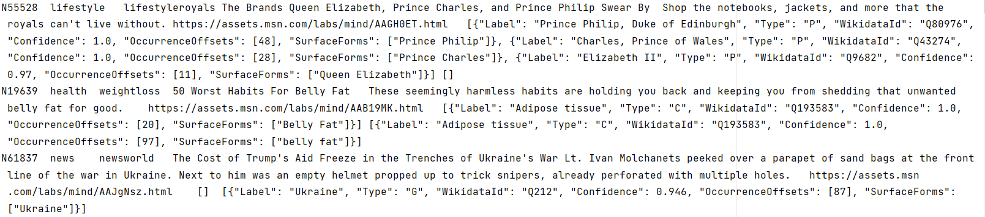
Data preprocessing
Sprint 3
Microsoft MIND news recommendation dataset
Raw data

Slide 8
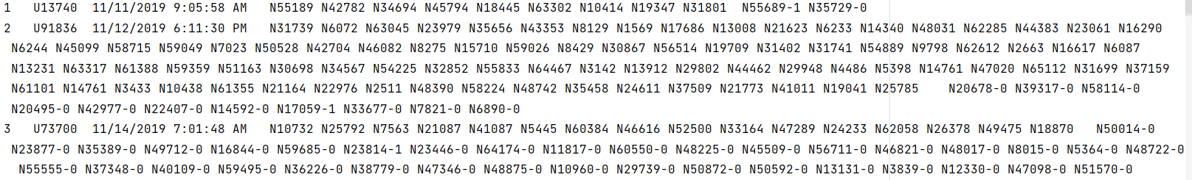
Data preprocessing
Sprint 3
Microsoft MIND news recommendation dataset
Raw data

Slide 9
Data preprocessing
Sprint 3
Microsoft MIND news recommendation dataset
Raw data

Slide 10
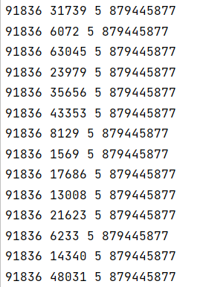
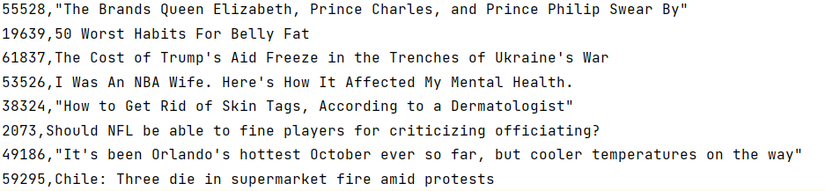
Data preprocessing
Sprint 3
Selecting history, fits the embedding net
Item ID-title pair, fits the embedding net

Slide 11
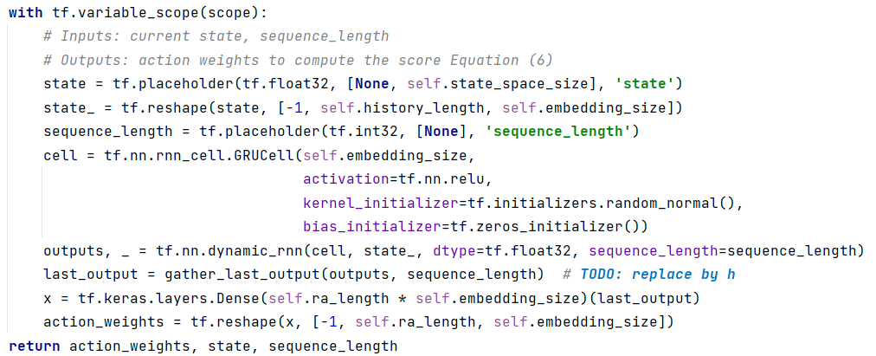
model structure
Actor net

Slide 12
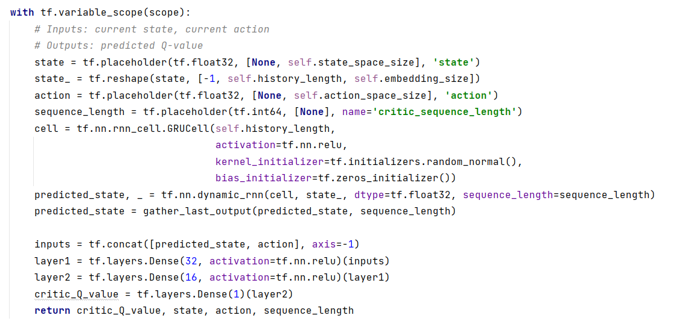
model structure
Critic net

Slide 13
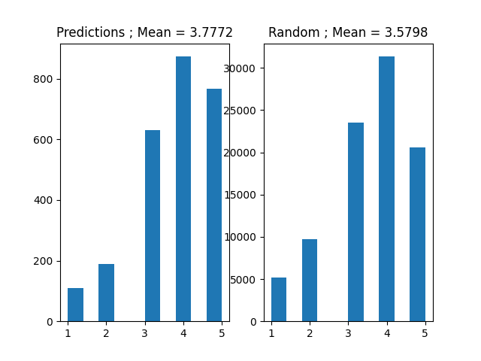
Recommendation results

