Slide 1
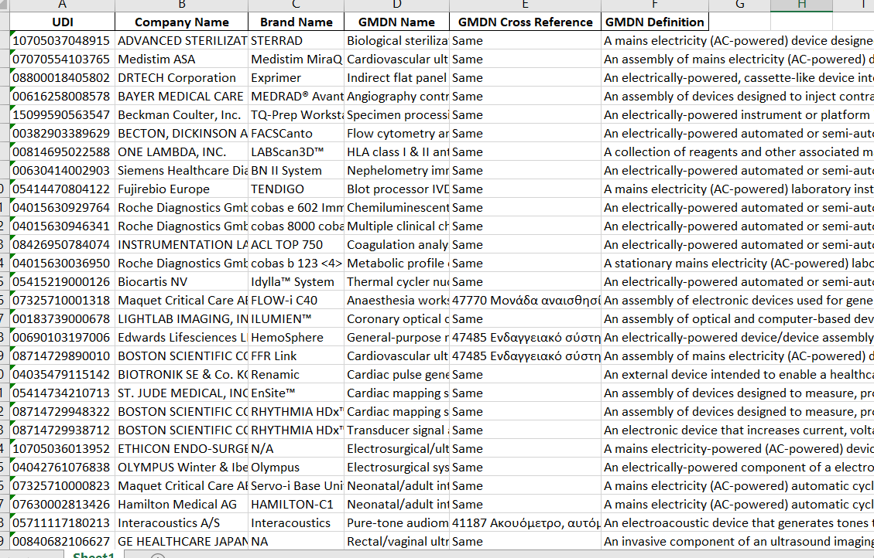
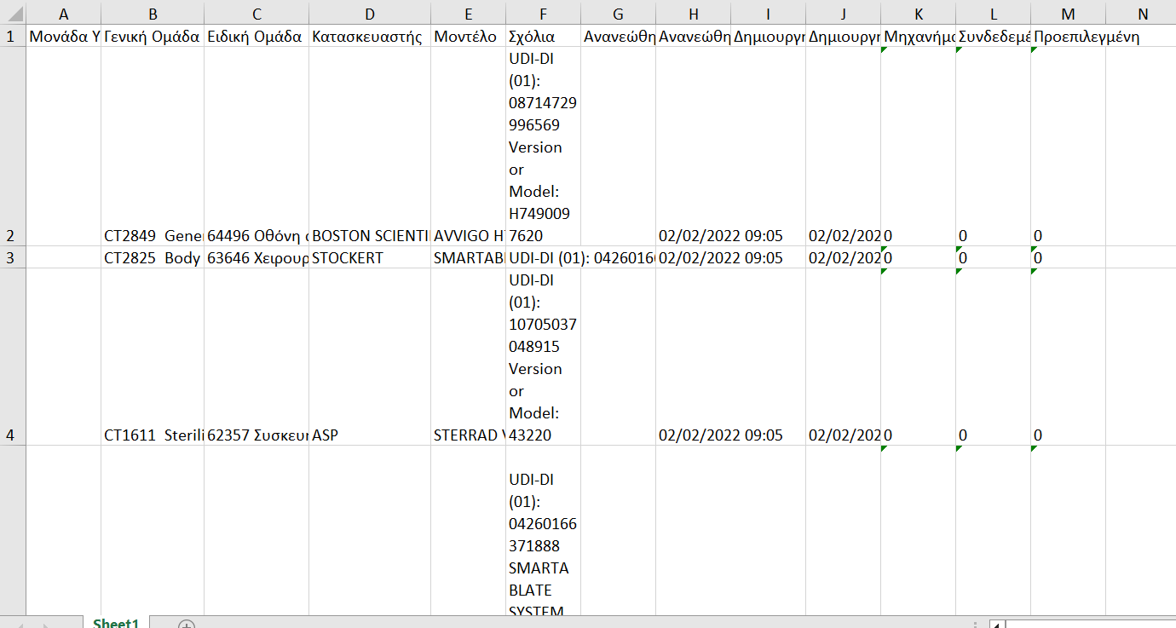
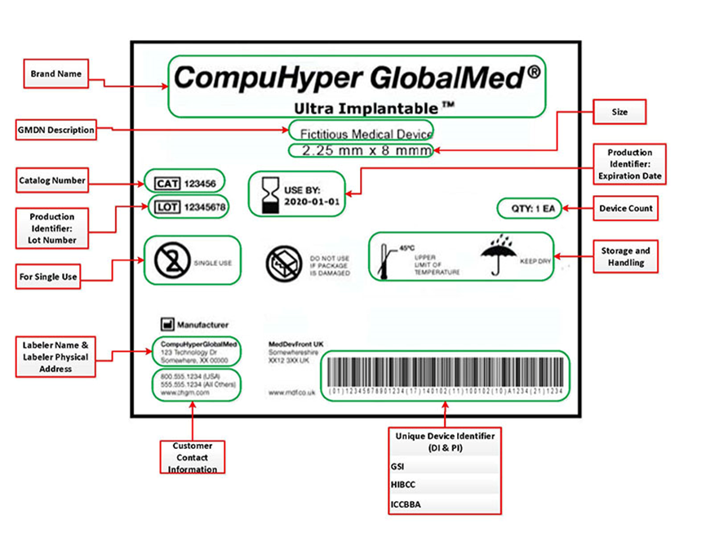
Enhancing Medical Device Data Management
Combining Web Scraping and API Integration
Liontou Agapi Konstantina
MSc in Biomedical Engineering, University of Patras
Introduction
Data Extraction Methods
Methodology
The accurate identification and management of medical devices are critical for ensuring patient safety and regulatory compliance in healthcare systems.
Unique Device Identifiers (UDIs) enable traceability and effective monitoring
Global Medical Device Nomenclature (GMDN) allows standardized categorization
Our code combines web scraping and AccessGUDID API integration
Extracts device information with web scraping and BeautifulSoup library
Seamlessly integrates with AccessGUDID API for efficient data retrieval
Cross-checking UDIs and GMDN names ensures authenticity and accuracy
Streamlines the process, empowering users with reliable device information
Delve into a cutting-edge solution that combines web scraping techniques and integration with the AccessGUDID API to retrieve, validate, and analyze device data based on UDIs and GMDN names and check them with data gained by web – Praxis.
2 effective methods for data extraction: web scraping and the utilization of APIs
offer swift and accurate data collection from multiple web pages and data repositories. These automated techniques outperform manual data retrieval in terms of accuracy and time efficiency.
User input
Data extraction
Data processing
Output generation
Web scraping + API
Python Libraries Used
requests: make HTTP requests
pandas: data manipulation
tkinter: create a GUI
re: regular expressions
time: time-related operations
BeautifulSoup: web scraping & HTML parsing
Web Scraping: technique for automated data extraction from websites.
HTML → form that can be used by computing systems
(-) : 1. changes in the structure of the web pages
2. restrictions by the creators
API – Application Programming Interface: set of rules and programming interfaces that allows different applications and services to communicate with each other
JSON and XML → common protocols for data exchange
steps
Code Functionalities:
Import data from the Excel file.
Extract the 14-digit UDI from the column ‘Σχόλια’ .
Create an empty dictionary to store the information that will be collected.
Perform a search based on the provided UDI, retrieve device information from the API and populate the data dictionary accordingly.
Perform an advanced search based on the company name and brand name (for those devices that didn’t have UDI), retrieve the necessary device information through a combination of web scraping (by reconstructing the URL) and API usage, and populate the data dictionary accordingly.
Cross-reference the GMDN definition between the initial data and the one found on the website for each device.
Present the results.
Benefits in Medical Device Data Retrieval
Secure and authorized access to device information
Extensive device database maintained by AccessGUDID
Simplified data retrieval and integration into applications
Compliance with data usage policies and standards
Benefits in Medical Device Data:
Access comprehensive device information
Timely and up-to-date data retrieval
Automation and efficiency
Scalability for handling large data volumes
Accuracy and consistency
Results
Output → an Excel file (filled with info from AccessGUDID, except GMDN Cross Reference) in the following format:
Matched UDIs: 193 / 279 (69% success rate)
Advanced search matches: 207 / 279 (74% success rate)
GMDN Cross Reference:
same → description that matches the site
other → description was obtained by examining the first page of search results on the website generated by the complex search. We identified all the GMDN names and applied a sorting algorithm to select the name that appeared most frequently
N/A: not available
Definitions
Unique Device Identifiers (UDIs): a standardized system for identifying and tracing medical devices. Each medical device is assigned a unique code that contains key information about the device.
Global Medical Device Nomenclature (GMDN): a standardized system for classifying medical devices worldwide. Provides a common language for device identification and categorization.
UDI + GMDN → complementary systems
Methodology
Given Data: Excel File with data from web-Praxis
in total: 279 registrations (→ 279 different excel medical devices) with the following form:
Conclusion
Combination of web scraping and API integration to streamline device data management.
UDIs and GMDN → ensure standardized identification, enhanced device verification, and improved decision-making.
Future enhancements: data quality measures, system integration, and collaborations with regulatory bodies and manufacturers. Together, we can advance medical device data management and drive advancements in healthcare technology.

