Slide 1

$UCCESS IN THE MOVIE INDUSTRY
Genre VS ROI Analysis for Film Studios
2020
Notes:
ONLINE-DS-PT-052620
MOD1-PROJECT
CONNOR PATE, NICK CATALANO, JESSICA YOON

Slide 2

Plan of Action
Gather Data
Find Trends
Goal: Maximize Investment
Notes:
Gathered Data from IMDB, The Box Office Mojo, The Numbers, etc. via Importing, Web-Scraping, and API
Cleaned Data to Observe and Analyze Trends
Conclusions = Where you should invest your time and money for large ROI

Slide 3


Return oN Investments
$
$
Invested
REVENUE
Notes:
Observing Data Trends with Return on Investment (ROI): *Quantitative Measure of Profitability
(ROI = Cost of Investment/Final Value of Investment − Initial Value of Investment​×100%)
*2020: Can we argue that profitability is more important than actual dollar amounts because of the pandemic?
Without the box office, studios would have to find other ways to make money, mainly digital releases so that would mean the profit ratio is more important?
Also, we avoid looking at directors/actors because of the social movement: politically motivated bias so it makes more sense to focus on just quantitative factors like roi, genre, and maybe release date.. Well not really release date because its not relevant?

Slide 4
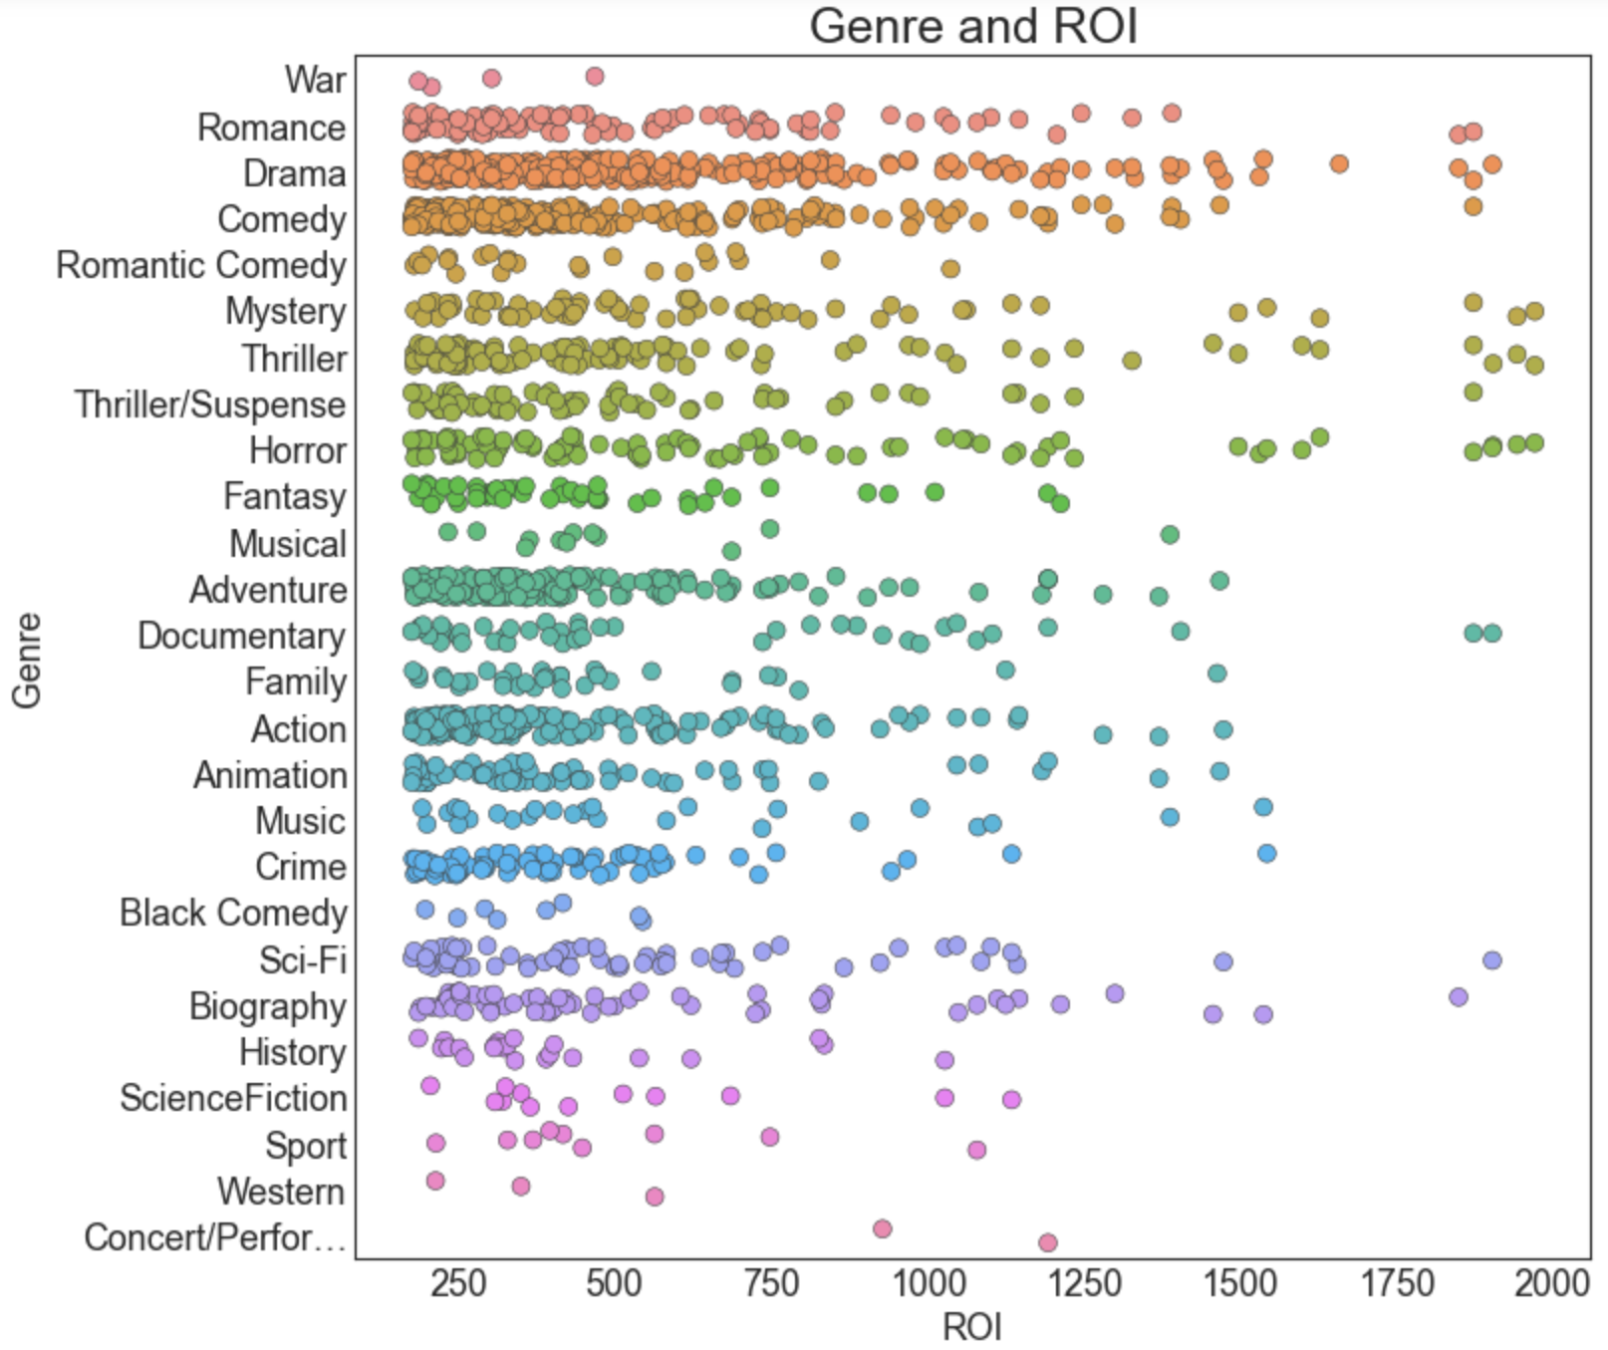
Overview of ROI per Genre
Notes:
Fully aware an initial foray into a new field for a specialized company requires tight margins and an understanding of risks, our analysis of the pre-COVID19 film market anchors itself on dollar use and high returns.
As such, before Microsoft allocates any of its resources into funding of a new studio, it’s best to understand the current state of the market and genre trends.
While there is further research to be done on the proliferation and profitability of Action/Adventure tentpole films (e.g., comic book movies, franchises, etc.), our analysis based strictly on ROI per genre suggests smaller, more inclusive films will net a higher return.

Slide 5
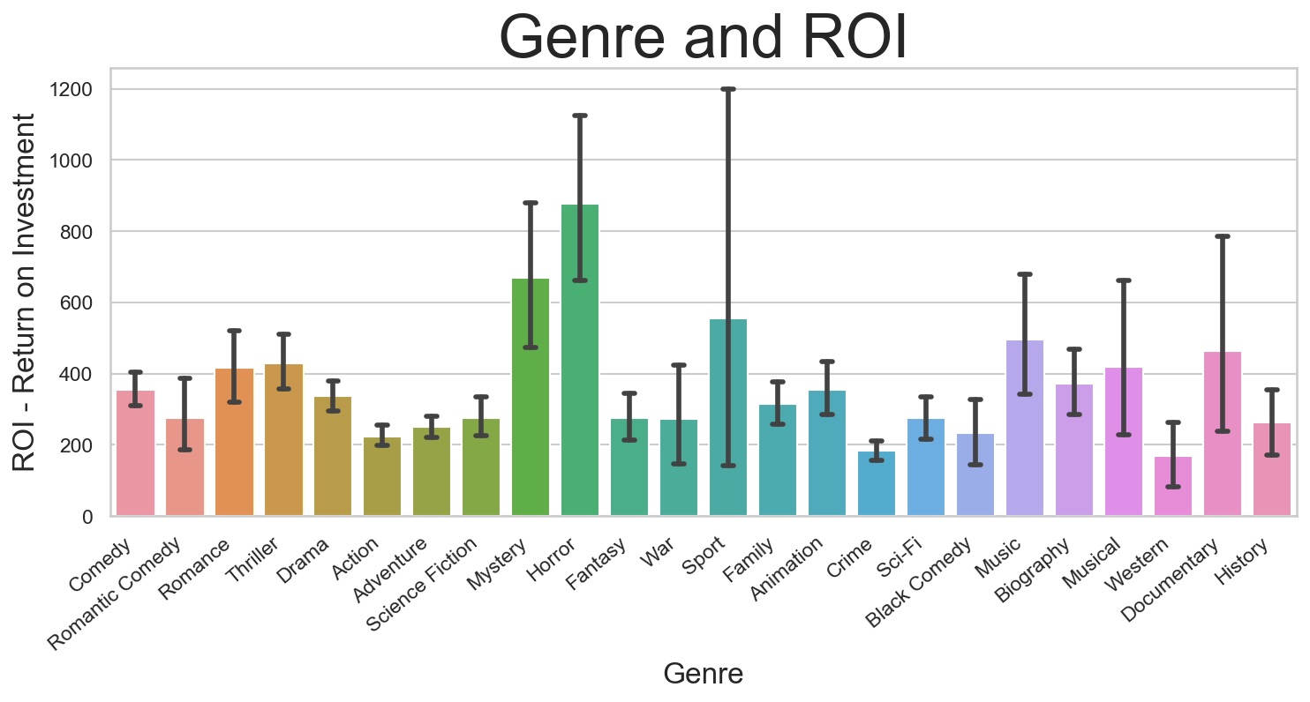
Further Breakdown of ROI/GEnre
Notes:
As the last slide illustrated, smaller budgeted and more inclusive (per subject matter) films resulted in a higher ROI.
While the aforementioned tentpole films often have a 200% or more ROI, other genre films double or triple those amounts.
Based on the prior two visualizations, we decided to take a closer look at four genres: Horror, Mystery, Romance, Drama, and Thriller.

Slide 6
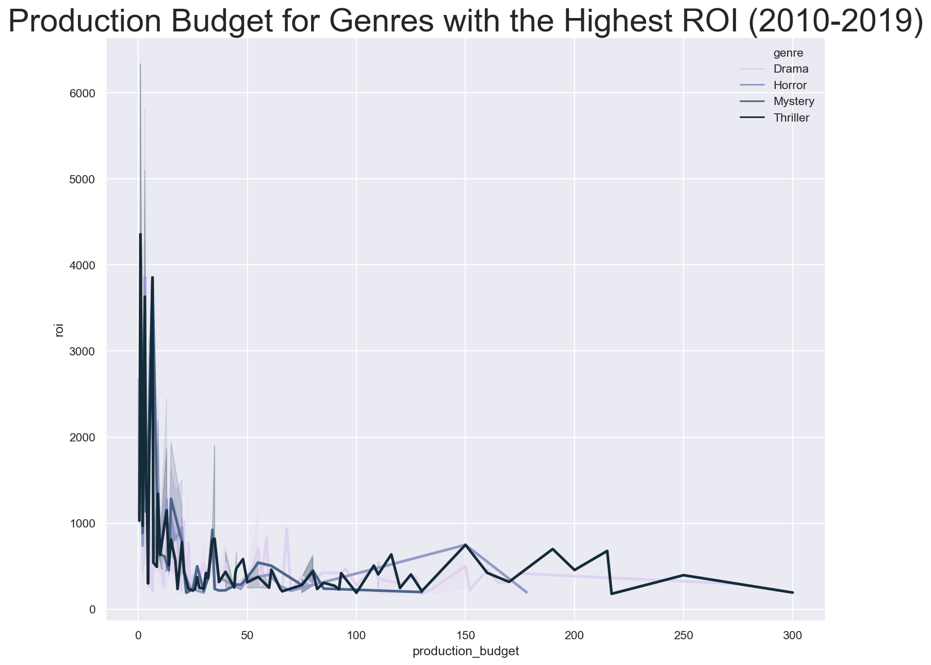
Budget Breakdown
Focused Observation on Drama, Horror, Mystery, and Thriller Genres
Smaller budgets make for a higher ROI
Notes:
Further confirming our initial suspicions, our genres chosen for analysis show a low financial investment with a high return rate.
Great smooth transition into the industry

Slide 7
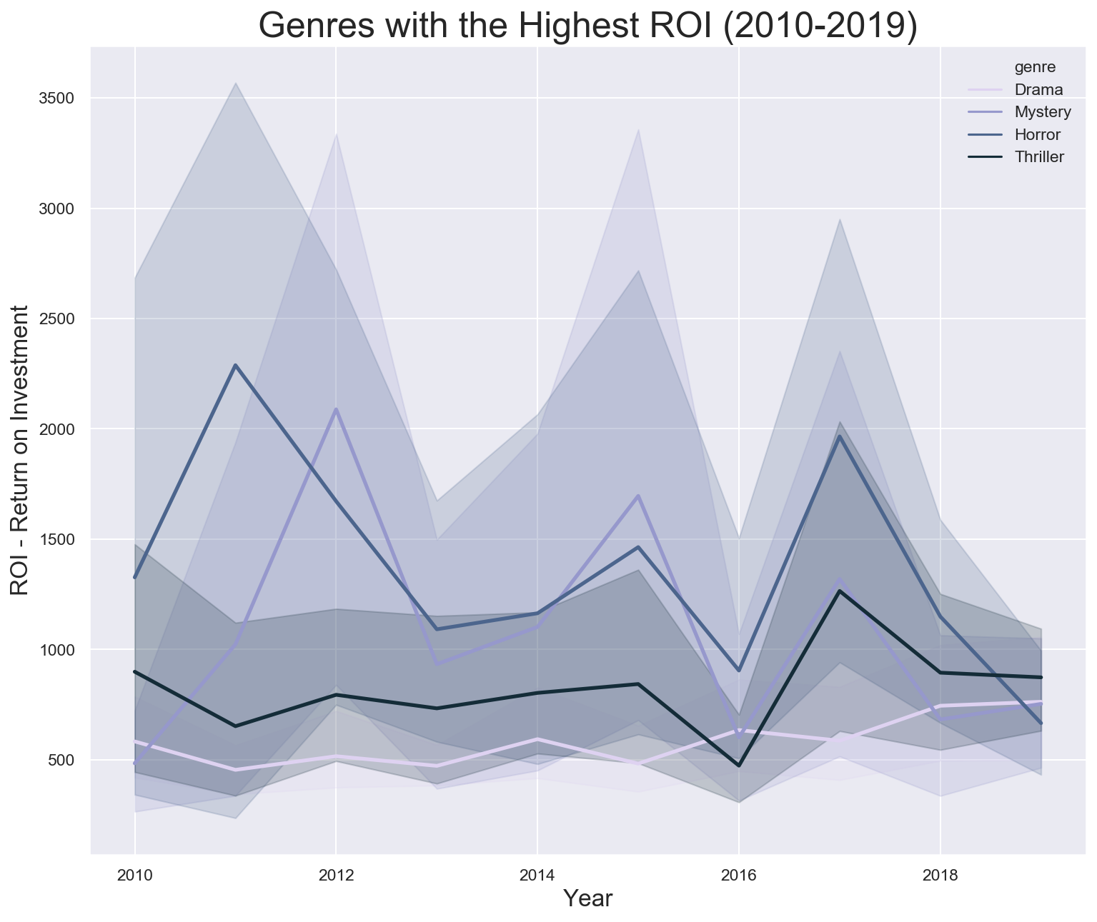
Yearly trends
Selected genres (Drama, Horror, Mystery, and Thriller) show consistently high ROI over time
Notes:
Deconstructing the data over a ten year period, we can see our selected genres do well over an extended period of time, eliminating the need to search for outliers misconstruing our data.

Slide 8
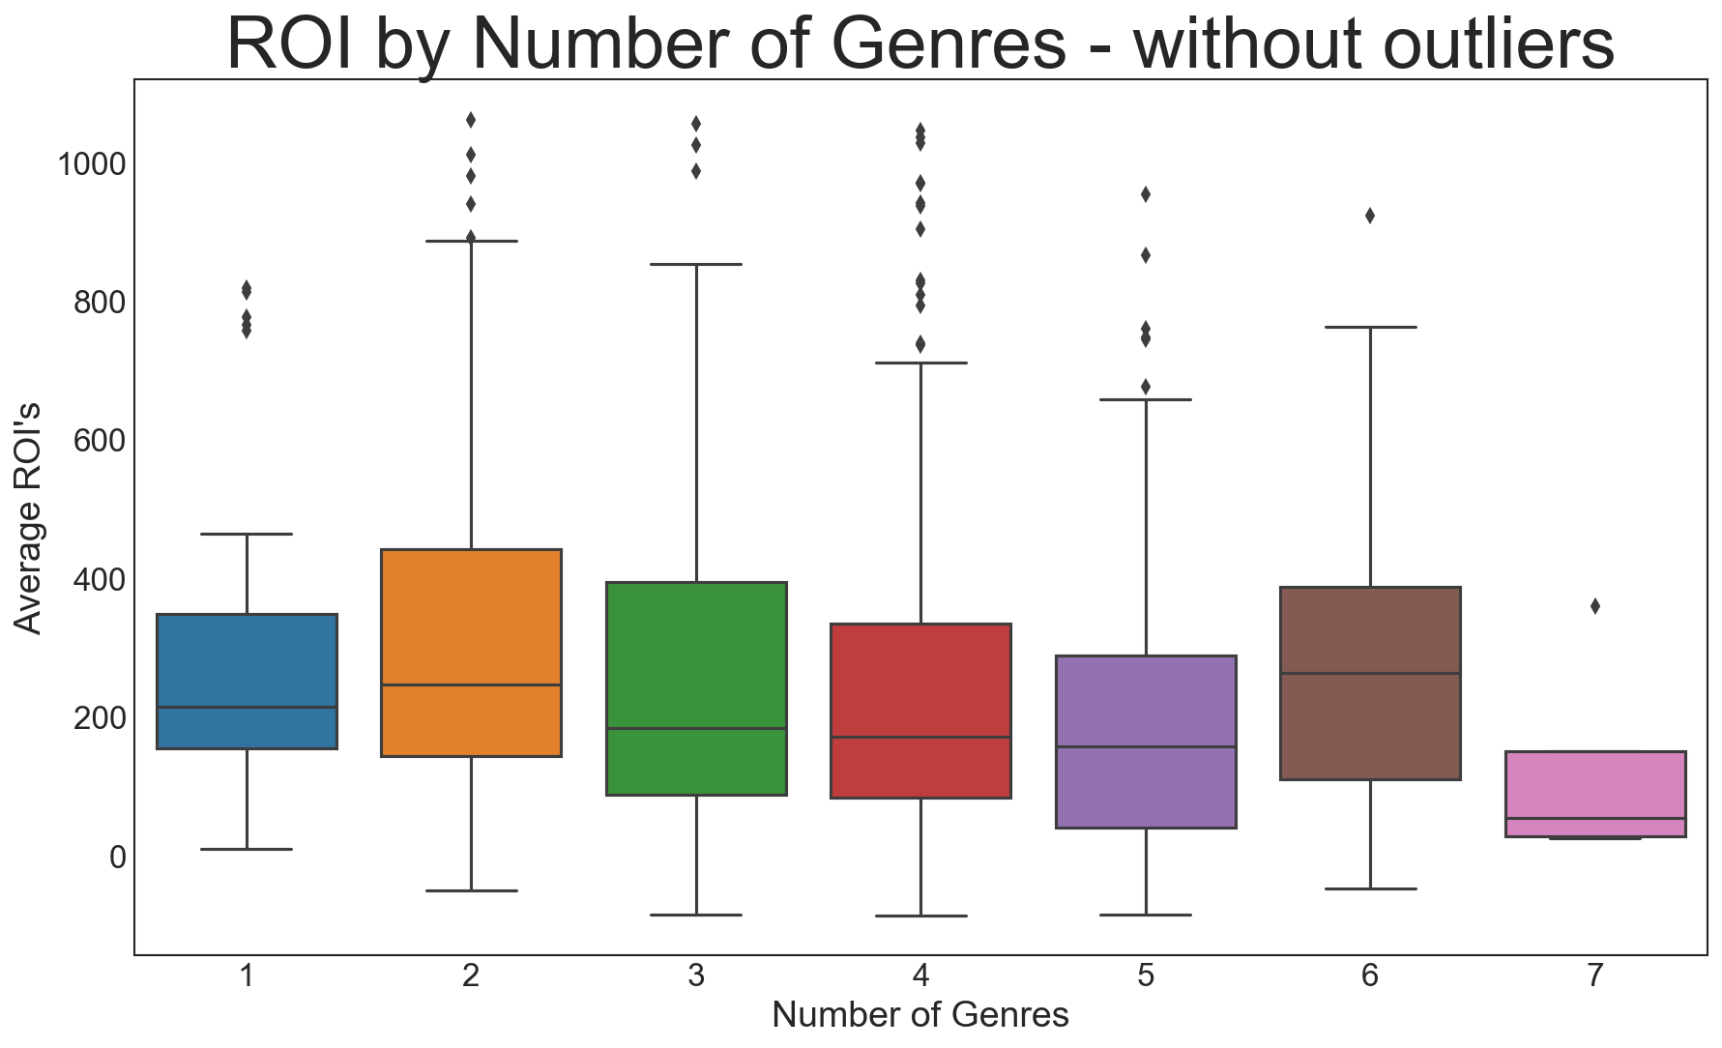
Number of Genres VS ROI
Notes:
Medians favor fewer genres for higher ROI

Slide 9
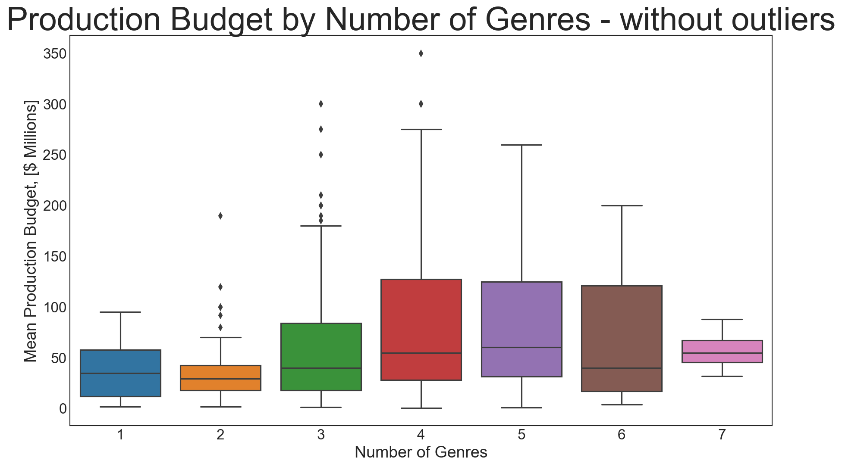
Number of Genres VS Budget
Notes:
Higher investment does not always guarantee a bigger profit

Slide 10
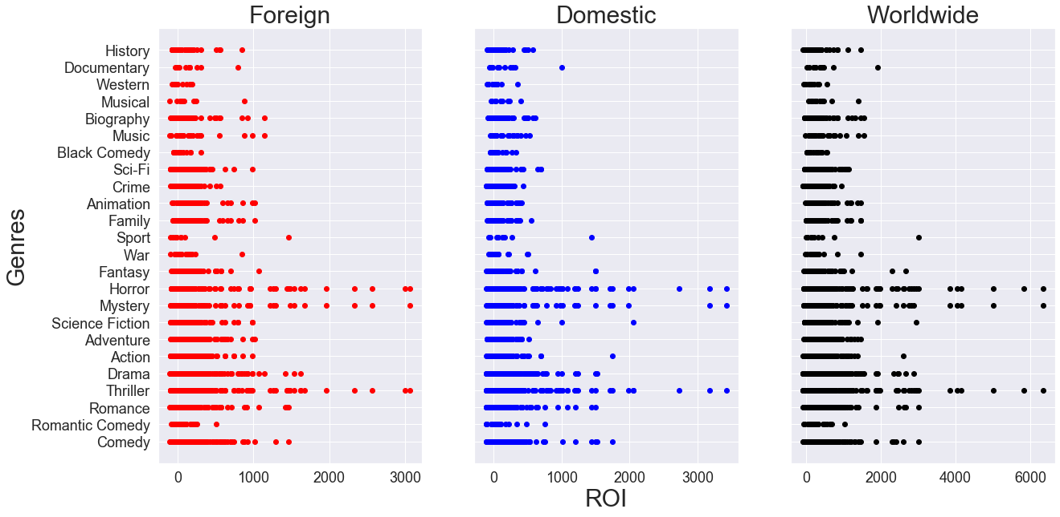
Foreign VS Domestic Audiences
Notes:
Outliers are: Unfriended, paranormal activity get out, Chernobyl diaries, paranormal activity

Slide 11
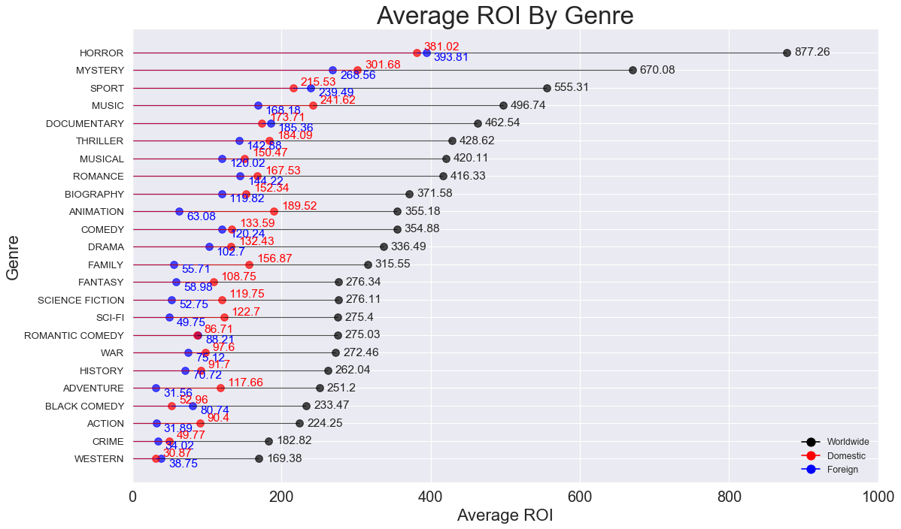
Average ROI Trends

Slide 12
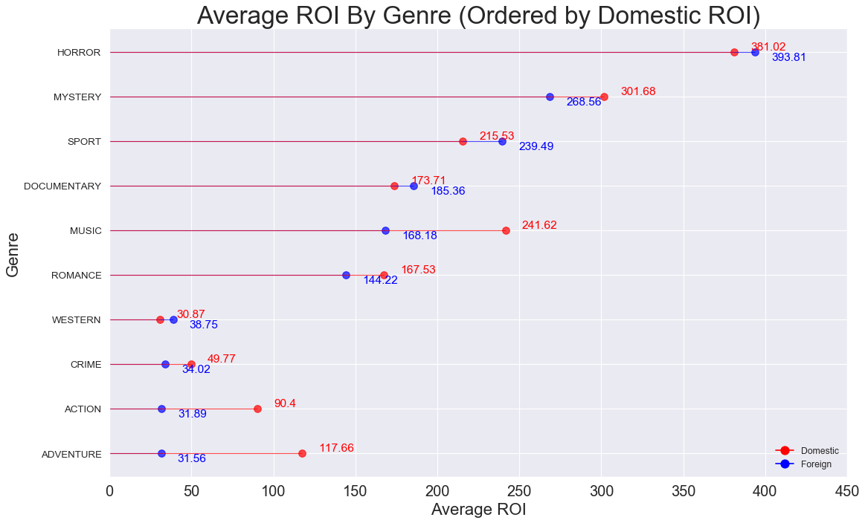

Slide 13
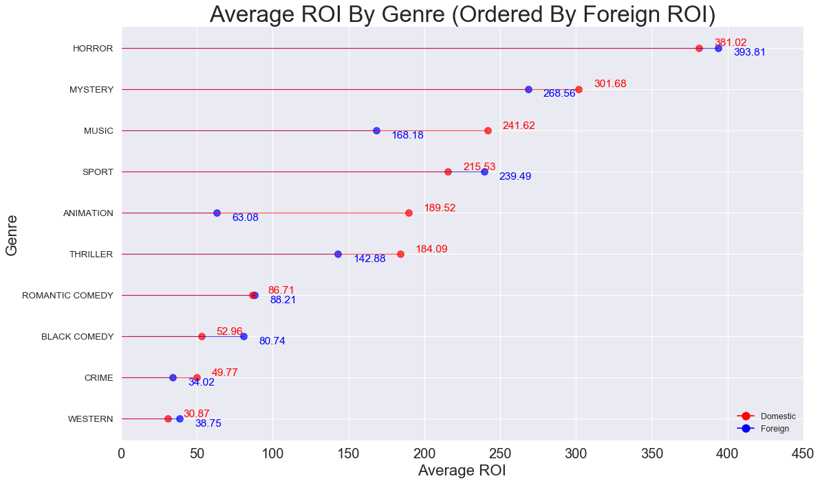

Slide 14



Components of profitable movies
Invest in low budget but consistently high ROI genres: Drama, Horror, Mystery, Thriller
Keep the genre count low.
Follow trends based upon target audience.

Slide 15
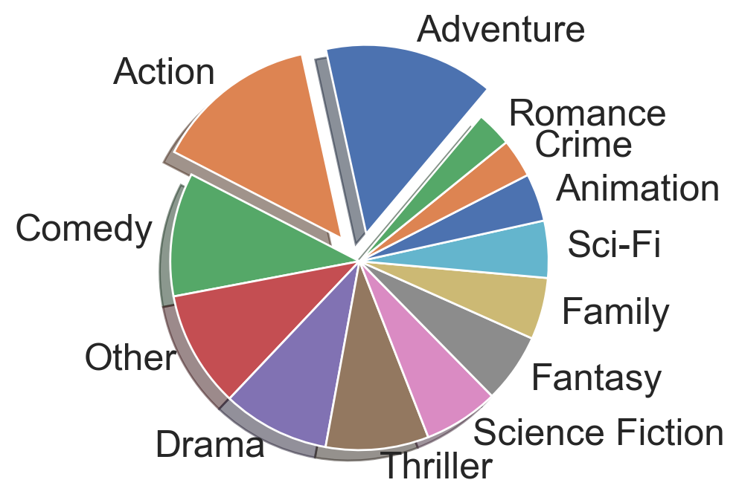
Further Exploration
Largest amounts of money made in the Action, Adventure, and Comedy Genres
The chart above displays what portion of the total box-office sales that each genre made from 2010-2019.

Slide 16

Thank you for your time.
We anticipate seeing your future productions.

Slide 17
Picture Sources
Tristan Pope: “OLM_2012_Film_Fest_Laurel”
Creative Commons: https://www.pngfind.com/mpng/ihxbmo_clapperboard-clipart-clipart-collection-film-slate-clapper-board/
Creative Commons: https://www.pngfind.com/mpng/xbxwoJ_filmstrip-clipart-vintage-movie-reel-film-paper-clipart/
Creative Commons: http://clipart-library.com/clipart/408744.htm
The Wrap: “Hollywood Juneteenth”

