Slide 1

$UCCESS IN THE MOVIE INDUSTRY
Genre VS ROI Analysis for Film Studios
2020
Notes:
ONLINE-DS-PT-052620
MOD1-PROJECT
CONNOR PATE, NICK CATALANO, JESSICA YOON

Slide 2

Plan of Action
Gather Data
Find Trends
Goal: Big Profit Margin
Notes:
Gathered Data from IMDB, The Box Office Mojo, The Numbers, etc. via Importing, Web-Scraping, and API
Cleaned Data to Observe and Analyze Trends (unbiased)*
Conclusions = Where you should invest your time and money for maximum profit margin

Slide 3


Return oN Investments
$
$
Invested
REVENUE
Notes:
Observing Data Trends with Return on Investment (ROI): *Quantitative Measure of Profitability
(ROI = Cost of Investment/Final Value of Investment − Initial Value of Investment​×100%)
*Can we argue that profitability margins are more important that actual budgets because of the pandemic?
Without the box office, studios would have to find other ways to make money, mainly digital releases so that would mean the profit margins are more important?
Also, we avoid looking at directors/actors because of the social movement: politically motivated bias so it makes more sense to focus on just quantitative factors like roi, genre, and maybe release date?/

Slide 4
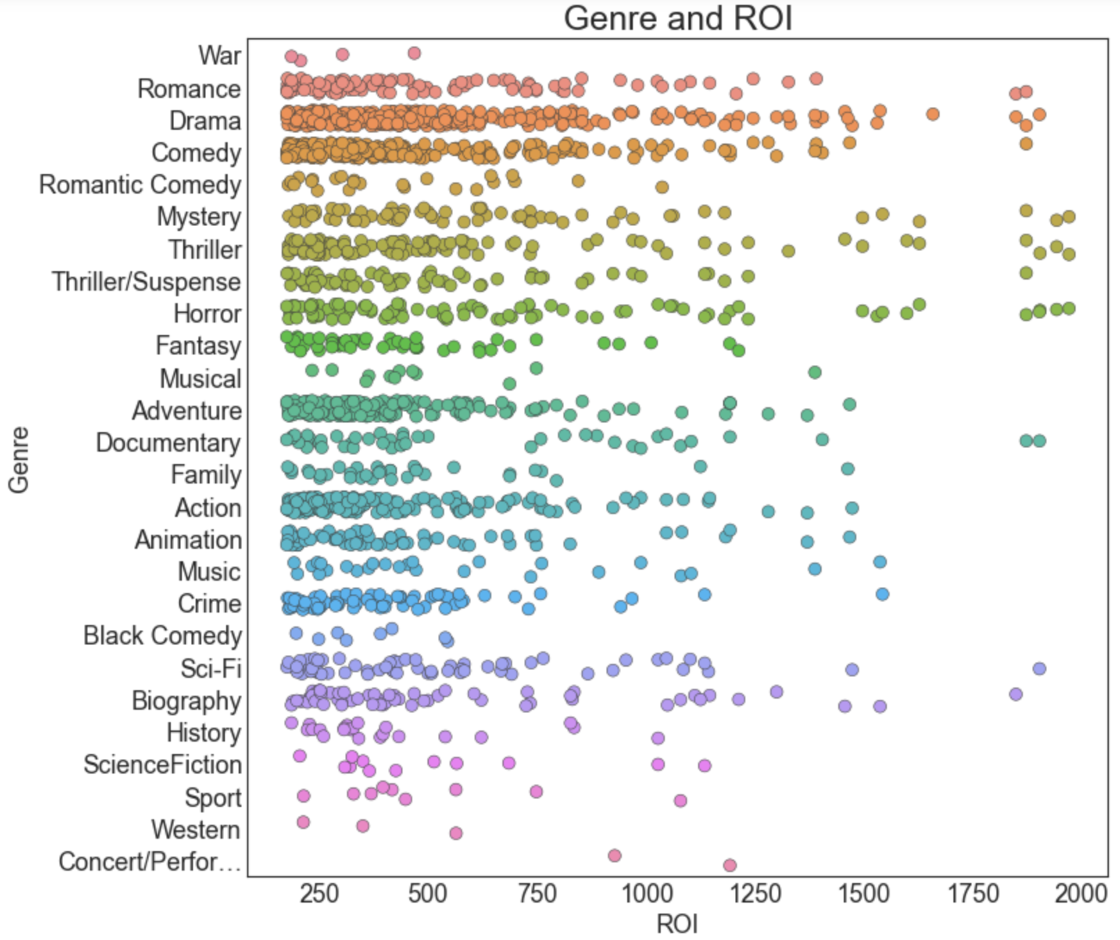
Overview of ROI per GEnre
Notes:
Fully aware an initial foray into a new field for a specialized company requires tight margins and an understanding of risks, our analysis of the pre-COVID19 film market anchors itself on dollar use and high returns.
As such, before Microsoft allocates any of its resources into funding of a new studio, it’s best to understand the current state of the market and genre trends.
While there is further research to be done on the proliferation and profitability of Action/Adventure tentpole films (e.g., comic book movies, franchises, etc.), our analysis based strictly on ROI per genre suggests smaller, more inclusive films will net a higher return.

Slide 5
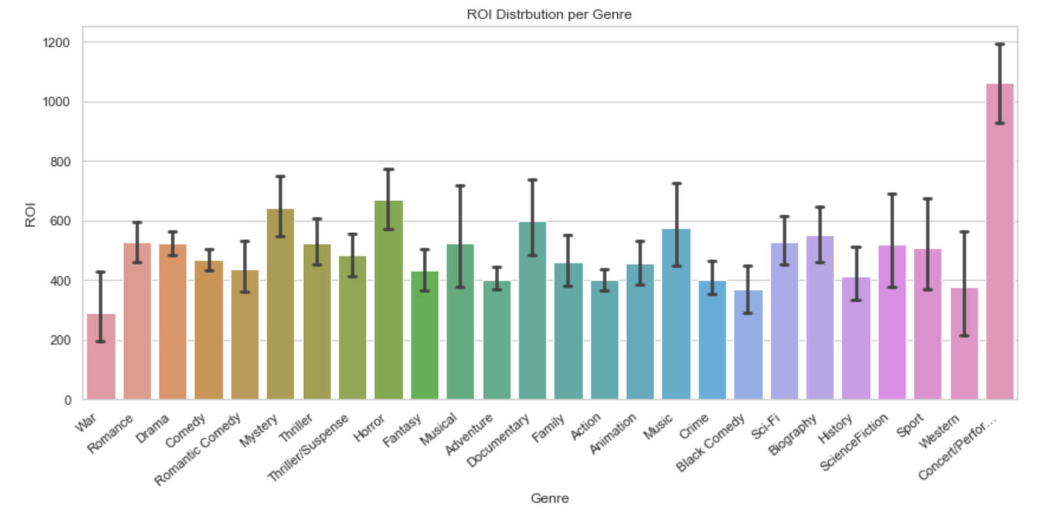
Further Breakdown of ROI GENRE
Notes:
As the last slide illustrated, smaller budgeted and more inclusive (per subject matter) films resulted in a higher ROI.
While the aforementioned tentpole films often have a 200% or more ROI, other genre films double or triple those amounts.
Based on the prior two visualizations, we decided to take a closer look at four genres: Horror, Mystery, Romance, Drama, and Romance.

Slide 6
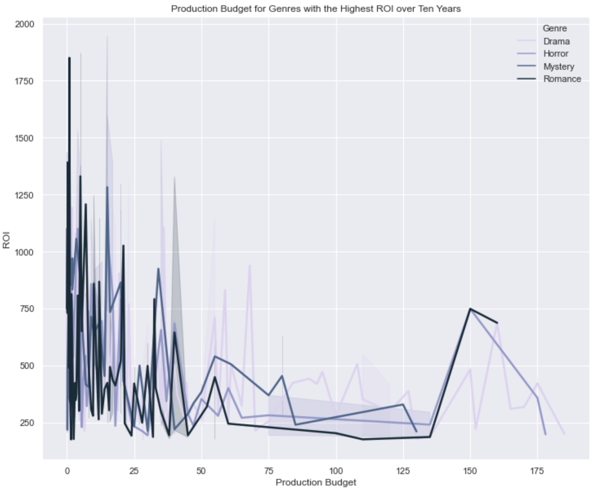
Budget Breakdown and Yearly Trends
Notes:
Further confirming our initial suspicions, our genres chosen for analysis show a low financial investment with a high return rate.

Slide 7
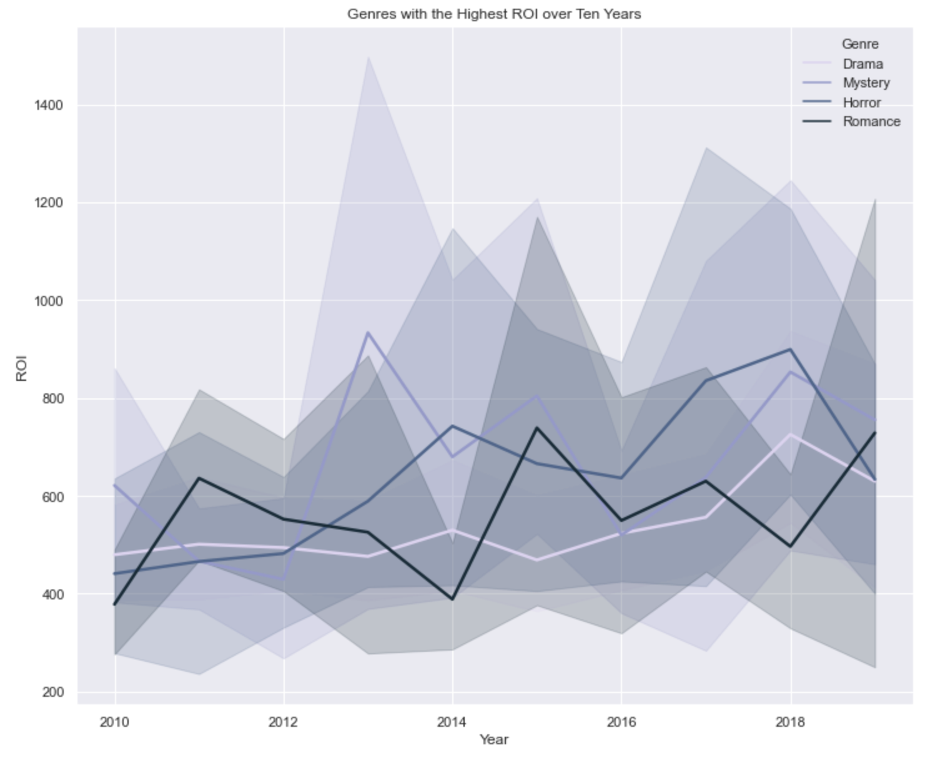
Budget Breakdown and Yearly Trends
Notes:
Deconstructing the data over a ten year period, we can see our selected genres do well over an extended period of time, eliminating the need to search for outliers misconstruing our data.

Slide 8
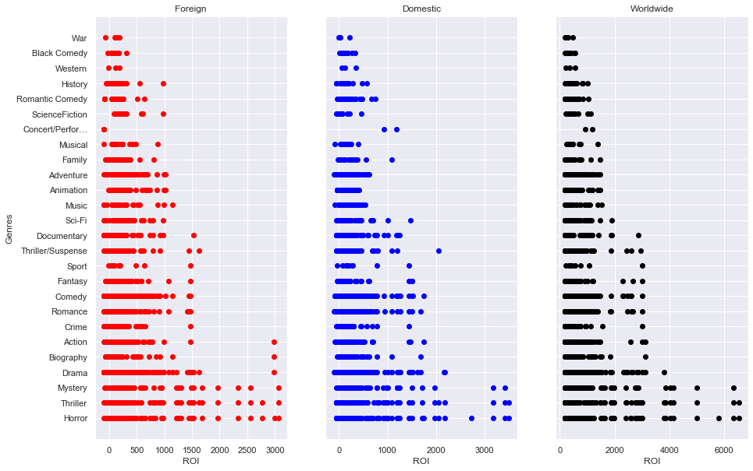
ROI by Genre (2010-2019)

Slide 9
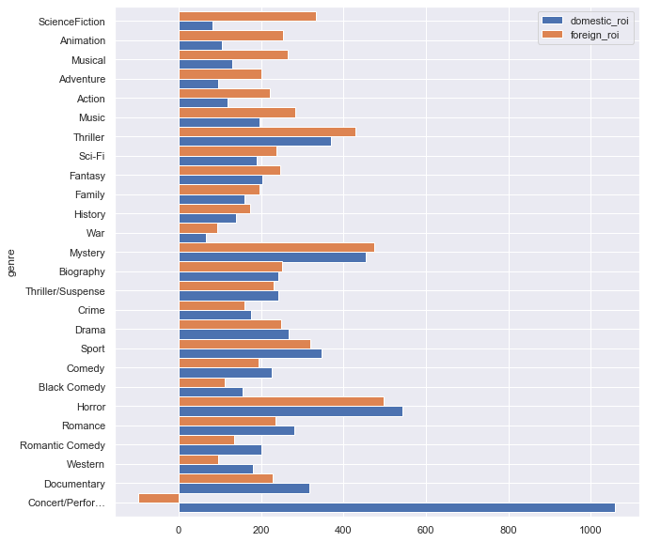
Difference by Genre (2010-2019)

Slide 10
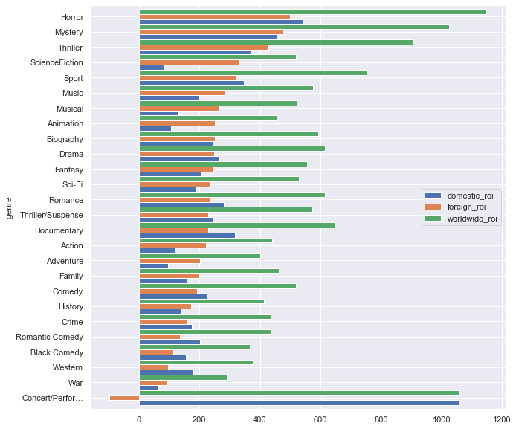
Average ROI by Genre (2010-2019)
Notes:
When targeting foreign audiences, Horror/Mystery/Thriller genres give the highest return of investment.
Science Fiction, Animation, Musical, Adventure, Action genres have a higher average foreign ROI compared to domestic values.
Data excludes 2 films (ROI above 6000):
The Gallows (Horror)
The Devil Inside (Horror)

Slide 11
Genre Counts and ROI

Slide 12
Components of a high profit movie
ROI over time: drama, horror, mystery romance (lowest budget, highest ROI over ten years)
Foreign Audience: Horror, Animation/Domestic Audience: aslkdjf, asdfjldsf,sdf
Minimize the amount of genres, Action/Adventure but also trying to target specific genres: action adventure based on actual profit
Notes:
Popcorn image

Slide 13
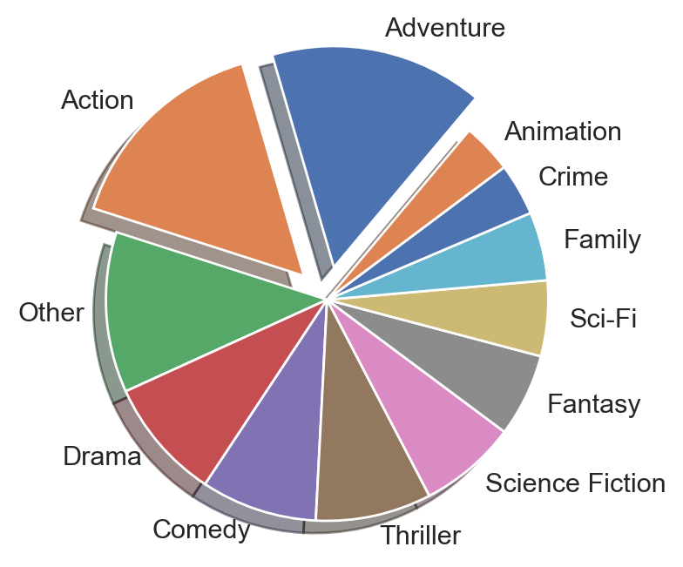
Further Exploration

Slide 14

Thank you for your time.
We anticipate seeing your future productions.

Slide 15
Picture Sources
Tristan Pope: “OLM_2012_Film_Fest_Laurel”
Creative Commons: https://www.pngfind.com/mpng/ihxbmo_clapperboard-clipart-clipart-collection-film-slate-clapper-board/
Creative Commons: https://www.pngfind.com/mpng/xbxwoJ_filmstrip-clipart-vintage-movie-reel-film-paper-clipart/
Creative Commons: http://clipart-library.com/clipart/408744.htm
The Wrap: “Hollywood Juneteenth”

