Slide 1
Models of evolution
Conor Meehan (he/they)
conor.meehan@ntu.ac.uk
@con_meehan

Slide 2
Learning outcomes
Calculate corrected distances using different models of evolution
Explain a rate matrix
Describe how site heterogeneity is modelled
Define ascertainment bias and its effect on phylogenetics

Slide 3
How to read a WGS phylogenetics methods section
Four decades of transmission of a multidrug-resistant Mycobacterium tuberculosis outbreak strain Eldholm et al. Nature Communications (2015)
In BEAST, rates were modelled using the GTR substitution model of evolution and variation among sites was simulated using a discrete gamma distribution with four rate categories. We further assumed a lognormal relaxed clock to allow variation in rates among branches in the tree. The tree was calibrated using tip dates only with sample time span ranging from October 1996 to December 2009.
For each analysis we ran four independent chains in which samples were drawn every 5,000 MCMC steps from a total of 50,000,000 steps, after a discarded burn-in of 5,000,000 steps.

Slide 4
Models of evolution
To account for multiple mutations and weight subsitutions based on different factors we need a model of evolution
These factors include
Chemical properties
E.g. Transition vs transversion
The relative frequencies of each base over time
E.g. GC content
Equilibruim frequencies (𝛑)
Position in the sequence
E.g. Hypervariable vs core
Rate heterogeneity/site-specific variation (γ)
For distance approaches (e.g. UPGMA), we need to correct the distance based on these factors

Slide 5
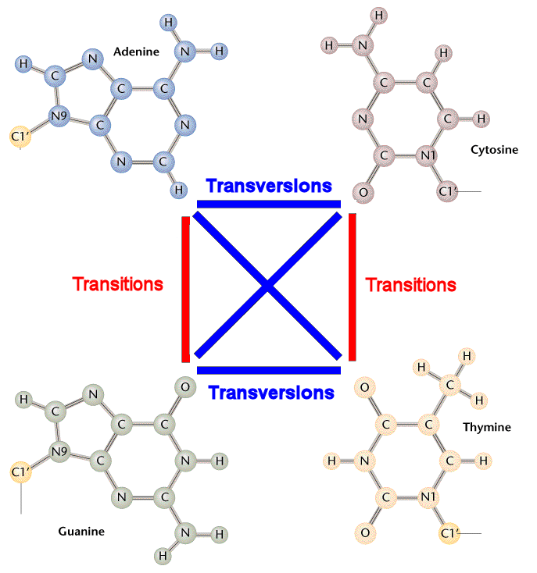
Transition vs transversion
https://www.mun.ca/biology/scarr/Transitions_vs_Transversions.html

Slide 6
Applying weights to rates
T->C is a transition so a different weight than the T->A/G transversion
Frequency:
A 2/18 11%
C 7/18 39%
G 1/18 6%
T 8/18 44%
More likely to change towards a C or a T
Column 3 is quite variable but site 1 is quite invariant
S1: CTT
S2: CTC
S3: CTC
S4: TTA
S5: CTA
S6: CTG

Slide 7
Distance matrices and models of evolution
For distance methods we can directly modify the distance between two sequences
Transitions/transversions
Base frequency
Cannot incorporate position hetrogeneity in the sequence
Can only handle simple models
Complex models need rate matrices (covered later) and parameteric methods (ML/Bayesian)

Slide 8
Simplest model
The Jukes Cantor model states:
all nucleotide changes have equal probabilities
(A->C/G/T = 0.25)
All base frequencies are the same
π_{a}= π_{c} =π_{g} =π_{t}
d_{jc}=-³/₄ln(1-⁴/₃D)
d_{jc} is the corrected distance
D is the original (uncorrected) distance
Works when distances are <0.75

Slide 9
Simplest model
Correcting distances between S2 and S3
d_{jc}=-³/₄ln(1-⁴/₃D)
D = 2/5= 0.4
d_{jc}=-³/₄ln(1-⁴/₃*0.4)
d_{jc}= 0.4714564946
S1: TTCAG
S2: TTCGG
S3: TTTTG
S4: TTATG
S5: AACTG

Slide 10
Accounting for transitions/transversions
The Kimura 2 parameter (K2P or K80) model states:
Transitions and transversions have different rates
P = transition proportion (sites with transitions / length of alignment)
Q = transversion proprotion (sites with transversions / length of alignment)
All base frequencies are the same
π_{a}= π_{c} =π_{g} =π_{t}
d_{k2p}= -¹/₂ln[1-2P-Q] - ¹/₄ln[1-2Q]
d_{k2p} is the corrected distance

Slide 11
K2P model
Correcting distances between S2 and S3
d_{k2p}= -¹/₂ln[1-2P-Q] - ¹/₄ln[1-2Q]
P= 1/5 (C/T)
Q= 1/5 (G/T)
d_{k2p}= -¹/₂ln[1-2*0.2-0.2] - ¹/₄ln[1-2*0.2]
d_{k2p}= 0.58585177187
S1: TTCAG
S2: TTCGG
S3: TTTTG
S4: TTATG
S5: AACTG

Slide 12
Accounting for base frequences
The F81 model states:
all nucleotide changes have equal probabilities
(A->C/G/T = 0.25)
Base frequencies (π) are different
Derived from the empirical data (alignment)
d_{f81}=-Bln(1-(D/B))
d_{f81} is the corrected distance
B = 1- (π_{a}² + π_{c}² + π_{g}² + π_{t}²)
D is the original (uncorrected) distance

Slide 13
F81 model
Correcting distances between S2 and S3
Frequencies:
π_{a}=0; π_{c}=0.1; π_{g}=0.3; π_{t}=0.6
B= 1- (0² + 0.1² + 0.3² + 0.6²)
B= 0.54
d_{f81}= -Bln(1-(D/B))
d_{f81}= -0.54*ln(1-(0.4/0.54))
d_{f81}= 0.72896042715
S1: TTCAG
S2: TTCGG
S3: TTTTG
S4: TTATG
S5: AACTG

Slide 14
Tasks 1
If a uncorrected distance between two sequences is 0.3, what is the d_{jc}?

Slide 15
Break

Slide 16
Substitution matrices (models of evolution)
Parametric approaches (e.g. ML) calculate column by column, not sequence pairs
Cannot correct distance
A substitution model represents the rate that one nucleotide transitions to another
Rate matrix (Q)
This can incorporate the factors we have seen before
Chemical properties
E.g. Transition vs transversion
The relative frequencies of each base over time
Equilibruim frequencies (π)
Positional variability
Rate heterogeneity/site-specific variation (γ)

Slide 17
Models of evolution
Jukes-Cantor (often called JC69)
Rates are the same
Frequencies are the same
K80 (also called Kimura 2 parameter (K2P))
Transitions (A-G or C-T) different rate to transversions
Frequencies are the same
F81
Rates are the same
Frequencies can vary from 0.25 (as they are in JC69)
HKY85
Combination of the above
GTR
All rates and frequencies free to vary (the general Q matrix a few slides back)
Most general model (GTR: generalised time-reversible)
All above models are submodels of the GTR

Slide 18
GTR Q (rate) matrix
 | A | C | G | T
A | -μ(aπ_{C}+bπ_{G}+cπ_{T}) | μaπ_{C} | μbπ_{G} | μcπ_{T}
C | μgπ_{A} | -μ(gπ_{A}+dπ_{G}+eπ_{T}) | μdπ_{G} | μeπ_{T}
G | μhπ_{A} | μjπ_{C} | -μ(hπ_{A}+jπ_{C}+fπ_{T}) | μfπ_{T}
T | μiπ_{A} | μkπ_{C} | μlπ_{G} | -μ(iπ_{A}+kπ_{C}+lπ_{G})
μ= mean instantaneous substitution rate
If measuring as substitutions μ=1
If measuring as time, this is the mutation rate
a,b,c,...l = rate parameter for each possible transformation of one base to another
π_{A}= frequency of bases A, C, G, T
Transitions are in bold

Slide 19
Jukes Cantor Q (rate) matrix
 | A | C | G | T
A | -μ(3/4) | μ/4 | μ/4 | μ/4
C | μ/4 | -μ(3/4) | μ/4 | μ/4
G | μ/4 | μ/4 | -μ(3/4) | μ/4
T | μ/4 | μ/4 | μ/4 | -μ(3/4)
a=b=c..=1
π_{A}= π_{C}= π_{G}= π_{T}=1/4

Slide 20
Creating a HKY85-based Q matrix
 | A | C | G | T
A | -μ(βπ_{C}+απ_{G}+βπ_{T}) | μβπ_{C} | μαπ_{G} | μβπ_{T}
C | μβπ_{A} | -μ(βπ_{A}+βπ_{G}+απ_{T}) | μβπ_{G} | μαπ_{T}
G | μαπ_{A} | μβπ_{C} | -μ(απ_{A}+βπ_{C}+βπ_{T}) | μβπ_{T}
T | μβπ_{A} | μαπ_{C} | μβπ_{G} | -μ(βπ_{A}+απ_{C}+βπ_{G})
π_{A}≠π_{C}≠π_{G}≠π_{T}
Transitions: α
(b, e, h, k in GTR)
Transversions: β
(a, c, f, g, d, i, j, l in GTR)

Slide 21
Creating a HKY85-based Q matrix
 | A | C | G | T
A | -μ(βπ_{C}+απ_{G}+βπ_{T}) | μβπ_{C} | μαπ_{G} | μβπ_{T}
C | μβπ_{A} | -μ(βπ_{A}+βπ_{G}+απ_{T}) | μβπ_{G} | μαπ_{T}
G | μαπ_{A} | μβπ_{C} | -μ(απ_{A}+βπ_{C}+βπ_{T}) | μβπ_{T}
T | μβπ_{A} | μαπ_{C} | μβπ_{G} | -μ(βπ_{A}+απ_{C}+βπ_{G})
μ=1
π_{A}=0.2
π_{C}=0.3
π_{G}=0.4
π_{T}=0.1
Transitions (α): 5
Transversions (β): 1

Slide 22
Creating a HKY85-based Q matrix
 | A | C | G | T
A | -1((1*0.3)+(5*0.4)+(1*0.1)) | 1*1*0.3 | 1*5*0.4 | 1*1*0.1
C | 1*1*0.2 | -1((1*0.2)+(1*0.4)+(5*0.1)) | 1*1*0.4 | 1*5*0.1
G | 1*5*0.2 | 1*1*0.3 | -1((5*0.2)+(1*0.3)+(1*0.1)) | 1*1*0.1
T | 1*1*0.2 | 1*5*0.3 | 1*1*0.4 | -1((1*0.2)+(5*0.3)+(1*0.4))
μ=1
π_{A}=0.2
π_{C}=0.3
π_{G}=0.4
π_{T}=0.1
Transitions (α): 5
(b, e, h, k)
Transversions (β): 1
(a, c, f, g, d, i, j, l)

Slide 23
Creating a HKY85-based Q matrix
 | A | C | G | T
A | -2.4 | 0.3 | 2 | 0.1
C | 0.2 | -1.1 | 0.4 | 0.5
G | 1 | 0.3 | -1.4 | 0.1
T | 0.2 | 1.5 | 0.4 | -2.1
μ=1
π_{A}=0.2
π_{C}=0.3
π_{G}=0.4
π_{T}=0.1
Transitions (α): 5
(b, e, h, k)
Transversions (β): 1
(a, c, f, g, d, i, j, l)
REMEMBER: rate matrix so more likely is higher rate

Slide 24
Rate matrix to transition probability matrix
The rate matrix (Q) tells us what rate one nucleotide changes to another
We often want to know the probability that nucleotide x changes to nucleotide y after a certain evolutionary amount of time
To get this, we do a matrix exponential of the Q matrix
P(v)=e^{Qv}
v is the time (branch length)
Staying the same (A->A) is a ‘transition’ over time
Shorter timeframes increase probability of staying the same
Longer timeframes mean transitions are based on frequencies

Slide 25
Rate matrix to transition probability matrix
Mx calculator: https://comnuan.com/cmnn01015/cmnn01015.php

Slide 26
Site heterogeneity
The rate of variation between nucleotides may differ between positions in alignment
Thus, we may wish to give more/less weight to differences in an area of high/low variation
Hypervariable vs structural regions
In models of evolution, this is often represented as a gamma (γ) parameter

Slide 27
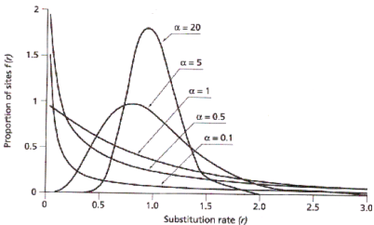
Site heterogeneity
Positions are drawn from a gamma distribution
Controlled by an 𝛂 parameter
𝛂<1 Most positions evolve slowly, some evolve rapidly
𝛂>1 Decreases variation, tends towards equal rates
For computational purposes, usually split into 4 sections
Weights assigned based on which category the position falls into
May have a separate category for Invariant sites (I)
Added to other models
E.g.
GTR+γ+I (or GTR+G+I)
http://www.ccg.unam.mx/~vinuesa/Model_fitting_in_phylogenetics.html

Slide 28
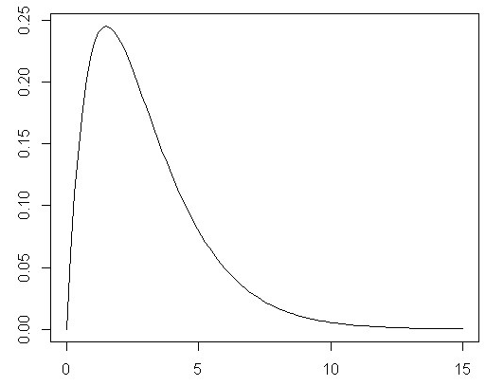
Heterogeneity example (4 categories)
 | A | C | G | T
A | -μ(aπ_{C}+bπ_{G}+cπ_{T}) 𝛾 | μaπ_{C}𝛾 | μbπ_{G}𝛾 | μcπ_{T}𝛾
C | μgπ_{A}𝛾 | -μ(gπ_{A}+dπ_{G}+eπ_{T}) 𝛾 | μdπ_{G}𝛾 | μeπ_{T}𝛾
G | μhπ_{A}𝛾 | μjπ_{C}𝛾 | -μ(hπ_{A}+jπ_{C}+fπ_{T}) 𝛾 | μfπ_{T}𝛾
T | μiπ_{A}𝛾 | μkπ_{C}𝛾 | μlπ_{G}𝛾 | -μ(iπ_{A}+kπ_{C}+lπ_{G}) 𝛾
γ₁
γ₂
γ₃
γ₄
4 Q matrices
γ₁-γ₄

Slide 29
Ascertainment bias
SNP data creates an ascertainment bias problem
Only selected the variable sites
Invariant sites affect branch lengths
Nucleotide frequencies
Change at every position vs change at a few
Small branch lengths may change topologies
Can correct for this with ascertainment bias correction
Tell method number of invariant sites
Total count
Per nucleotide

Slide 30
Makes more sense now? (blue bits in phylodynamics lecture
Four decades of transmission of a multidrug-resistant Mycobacterium tuberculosis outbreak strain Eldholm et al. Nature Communications (2015)
In BEAST, rates were modelled using the GTR substitution model of evolution and variation among sites was simulated using a discrete gamma distribution with four rate categories. We further assumed a lognormal relaxed clock to allow variation in rates among branches in the tree. The tree was calibrated using tip dates only with sample time span ranging from October 1996 to December 2009.
For each analysis we ran four independent chains in which samples were drawn every 5,000 MCMC steps from a total of 50,000,000 steps, after a discarded burn-in of 5,000,000 steps.

Slide 31
Tasks 2
How do we convert a rate (Q) matrix into a transition (P) matrix?
Why?
What kind of data requires ascertainment bias correction?
Why?

Slide 32
Learning outcomes
Calculate corrected distances using different models of evolution
Explain a rate matrix
Describe how site heterogeneity is modelled
Define ascertainment bias and its effect on phylogenetics

