Slide 1
Biological databases and BLAST
Conor Meehan (he/they)
conor.meehan@ntu.ac.uk
@con_meehan

Slide 2
Learning outcomes
Identify online database types and retrieve data
Describe types of homologs and gene evolution
Recognise the types of BLAST and their uses

Slide 3
Biological data
Many biological studies involve the generation and storage of large datasets
Datasets break down into two main types:
DNA
Gene Sequences
Genomes
Gene expression
Genome variation (polymorphisms)
Protein
Protein sequences
Protein structures
Motif/functional data
Where and how do we store and retrieve such data?

Slide 4
Biological data
Primary
Contains information on DNA/protein sequences or structures only
E.g. Genbank, UniProt, and Protein Databank (PDB)
Secondary
Contains information on derived features, or classification of features
Examples of such information are secondary structures and conserved motifs
E.g. Prosite, COGs, GO and SCOP/CATH
Composite
Contain multiple databases to reduce on searching time
Often also contain analysis tools
E.g. NCBI, ExPaSy

Slide 5
Nucleotide primary databases
Genbank, EMBL, DDBJ
All share data and have highly similar formats
Genbank is accessed through the NCBI portal
http://www.ncbi.nlm.nih.gov/genbank/
Here we will look through a GenBank entry and the individual parts for the rpoB gene in Mycobacterium tuberculosis
http://www.ncbi.nlm.nih.gov/nuccore/KP744370.1

Slide 6
Genbank entry

Slide 7
Genbank entry

Slide 8
Genbank sequence entry
Click the ‘fasta’ button at the top to get the fasta format of the sequence
Fasta format has a header starting with a > and on the next line (or multiple lines) the sequence
Is used for both DNA and protein sequences
Can click the ‘send to’ button to save the fasta format to file

Slide 9
Protein primary databases
Several databases exist for storing amino acid sequences
UniProt is one resource
www.uniprot.org
Contains protein sequences for a wide variety of organisms
Links data to other databases
Here we will look through a UniProt entry for OTX2 in Mus musculus
https://www.uniprot.org/uniprot/P80206

Slide 10
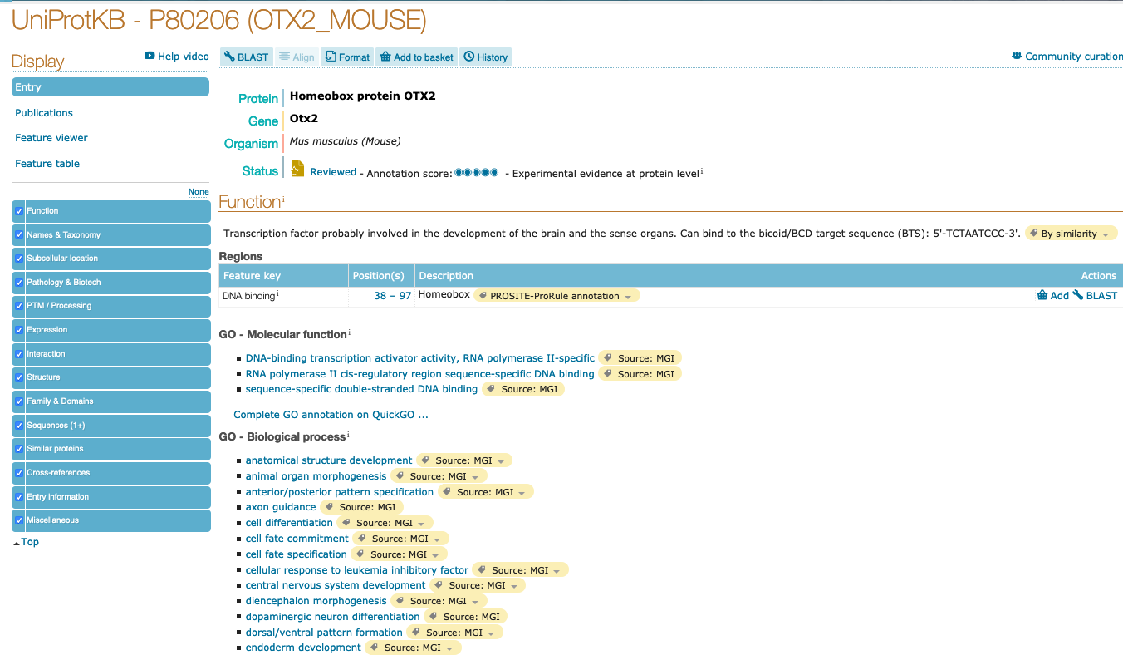
UniProt entry

Slide 11
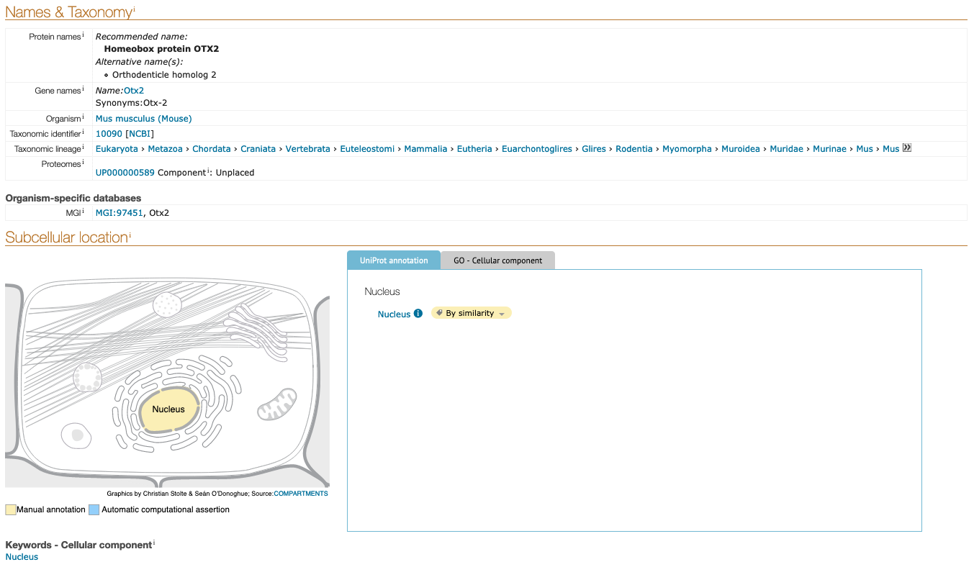
UniProt entry

Slide 12
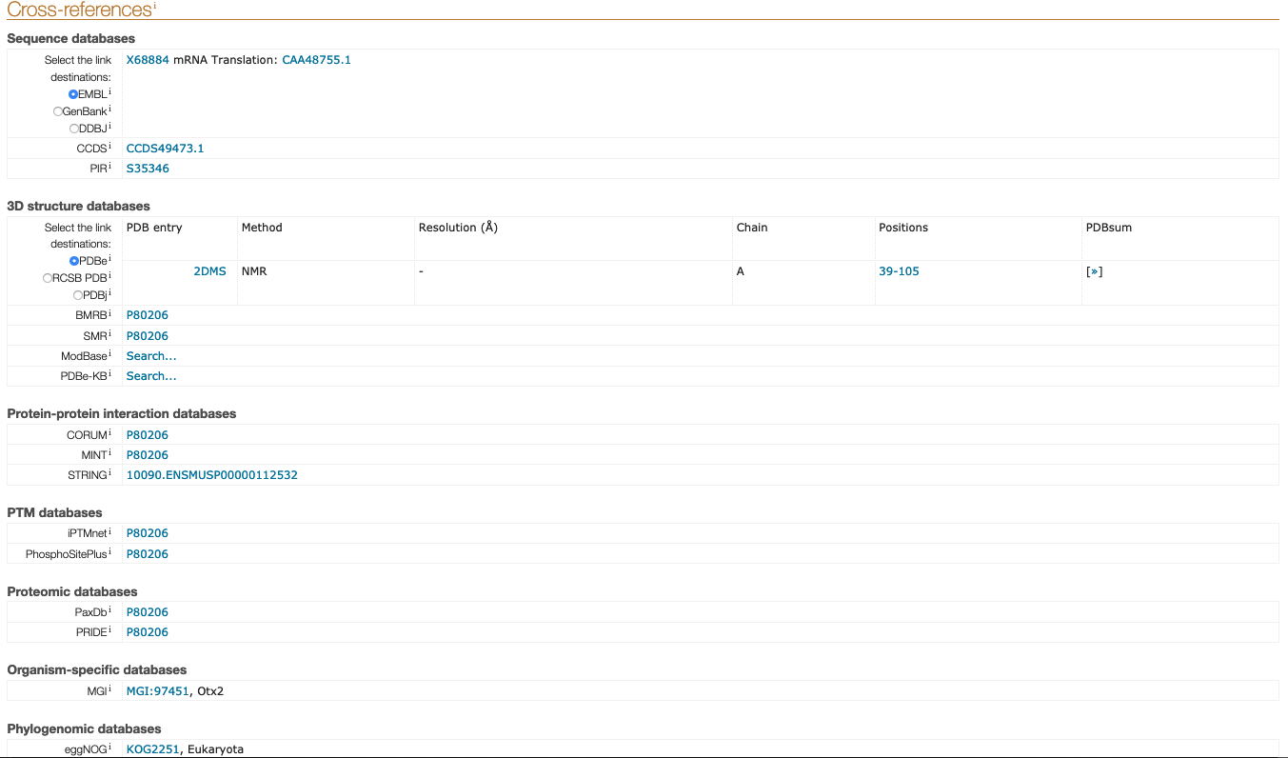
UniProt entry

Slide 13
Protein structure database
Protein Data Bank (PDB)
www.rcsb.org/
Contains solved structures from NMR, X-ray crystallography etc.
Web pages are interactive with viewer
Allows for downloading of PDB files that contain structure information
Uniform file format of x, y, z co-ordinates of each atom in structure
Also contains information on species, resolution etc

Slide 14
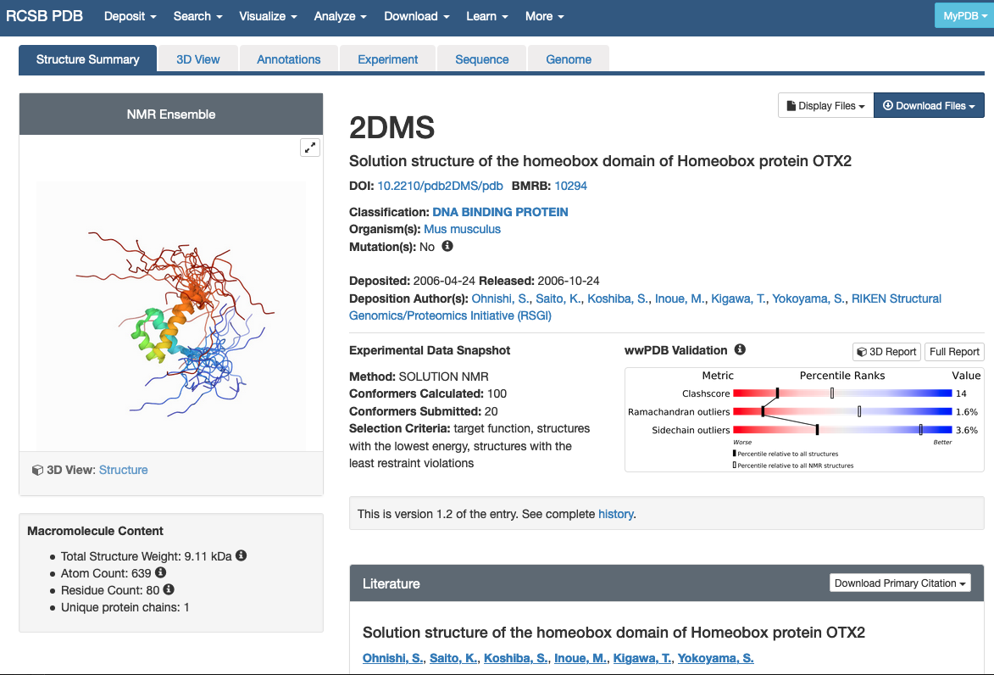
Protein structure database

Slide 15
Secondary databases
Databases containing information on classifications, motifs etc
May be group specific
GOBASE (organelles)
WormBase (nematodes)
Main protein secondary database is PROSITE
Contains biologically important amino acid motifs/patterns/sites
Such patterns may be DNA binding sites, substrate recognition motifs etc.
Can search against this database to estimate the function of an unknown protein sequence or search a motif against the database to get proteins that contain that signature.

Slide 16
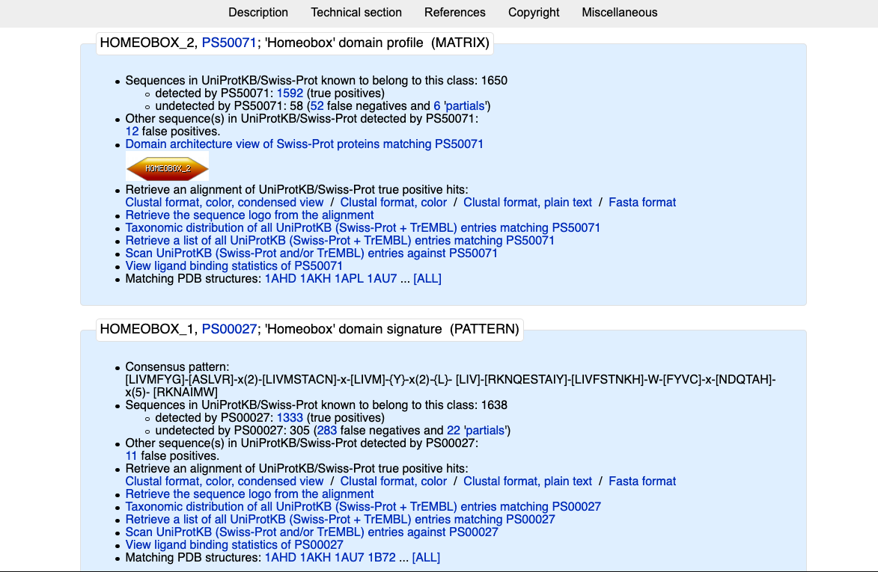
Prosite

Slide 17
Prosite
Motif entries detail the schematic representation of a signature/motif. E.g. for a homeobox:
xxxHHHHHHHHtttHHHHHHHHxxx
(H= helix;t=turn)
Also shows the consensus pattern for a motif
E.g. Start of homeobox:
[LIVMFYG]-[ASLVR]-x(2)-[LIVMSTACN]-x-[LIVM]-{Y}
[]: different amino acids possible at one position
X(2): any amino acid followed by any amino acid
{Y} : Any residue except tyrosine
Letter by itself denotes only that amino acid at that position
- : separates positions

Slide 18
Motif task
Also available on github with sample answer
Write this motif:
1: Any residue except Glycine (G)
2: A cytosine (C)
3: Any of the following residues: A, L, W, S
4-5: Two positions of any residue
6: A proline (P)
Guide:
[]: different amino acids possible at one position
X(2): any amino acid followed by any amino acid
{Y} : Any residue except tyrosine
Letter by itself denotes only that amino acid at that position
- : separates positions

Slide 19
Functional categorisation
Protein functions can be classified in many ways
Many systems exist for this:
Cluster of Orthologous Groups (COGs)
Gene Ontology (GOs)
Kyoto Encyclopaedia of Genes and Genomes (KEGG)
Protein families (Pfam)
Many primary databases have links to these databases for all their annotated proteins

Slide 20
COGs
COGs are based around the idea that proteins with similar sequences have similar functions
https://www.ncbi.nlm.nih.gov/research/cog
A system was created to place general functions on these sets of orthologs for easy comparison
Has 4 main categories broken down into sub-categories

Slide 21
COGs
INFORMATION STORAGE AND PROCESSING
[J] Translation, ribosomal structure and biogenesis
[A] RNA processing and modification
[K] Transcription
[L] Replication, recombination and repair
[B] Chromatin structure and dynamics
CELLULAR PROCESSES AND SIGNALING
[D] Cell cycle control, cell division, chromosome partitioning
[Y] Nuclear structure
[V] Defense mechanisms
[T] Signal transduction mechanisms
[M] Cell wall/membrane/envelope biogenesis
[N] Cell motility
[Z] Cytoskeleton
[W] Extracellular structures
[U] Intracellular trafficking, secretion, and vesicular transport
[O] Posttranslational modification, protein turnover, chaperones
[X] mobilome: prophages, transposons
METABOLISM
[C] Energy production and conversion
[G] Carbohydrate transport and metabolism
[E] Amino acid transport and metabolism
[F] Nucleotide transport and metabolism
[H] Coenzyme transport and metabolism
[I] Lipid transport and metabolism
[P] Inorganic ion transport and metabolism
[Q] Secondary metabolites biosynthesis, transport and catabolism
POORLY CHARACTERIZED
[R] General function prediction only
[S] Function unknown

Slide 22
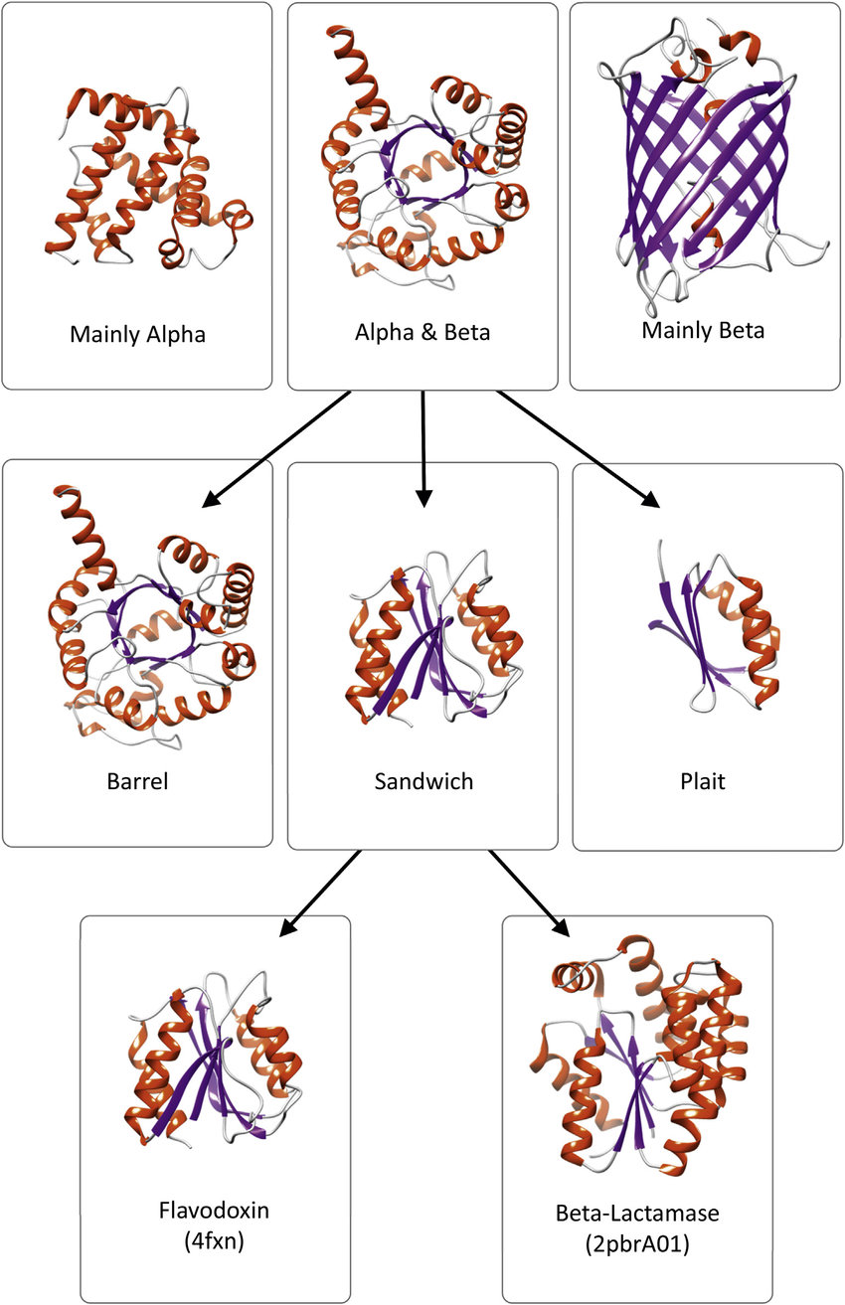
Protein structure secondary databases
Protein structure is made up of multiple layers of folding
Primary (sequence)
Secondary (alpha helix/beta sheet etc)
Super-secondary (beta hairpins etc)
Tertiary (alpha+beta, all alpha etc)
Quaternary (multi-domain/multi-chain)
Databases (SCOP and CATH) classify proteins based on their hierarchy of folds
Each has unique and overlapping terms for classification

Slide 23
Composite database
As primary and secondary databases grow, there is a need to link all available information together
Combine multiple types of databases into one place
NCBI contains multiple databases, PubMed and BLAST
ExPASy contains protein databases and analysis tools
Blurred line between database types
NCBI contains GenBank
ExPASy contains UniProt and Prosite
Go! Explore!

Slide 24
Metadata databases
Biological databases are often thought of to be data collected from organisms
Many researchers also want information on the habitats that their organism resides in, or overall distribution of an organism
Several databases exist that contain resources for exploring biodiversity, climate information etc.
Two examples:
GBIF.org
Contains information on biodiversity across the globe
Can search by species(e.g. Mus muculus), taxonomic name (e.g. Mammalia) or country
Integrated in many biogeography tools such as GenGIS
WorldClim.org
Details climate layers (temperature, rainfall etc.) from across the globe
Uses models to predict such climate features in the future and past (previous to their collected datasets)
Also intergrated into many geospatial tools

Slide 25
Biological databases
These are only a few examples of available biological databases
Many specific groups or organisms have dedicated databases
Keep note of the database version or access date that you used the database
Try to find out how often the database is updated before you use it
E.g. COGs is widely used but hasn’t been updated in 11 years
Good rule of thumb: Start with NCBI (e.g. BLAST) or ExPASy (e.g. InterProScan) and follow links to other databases from there

Slide 26
Break

Slide 27
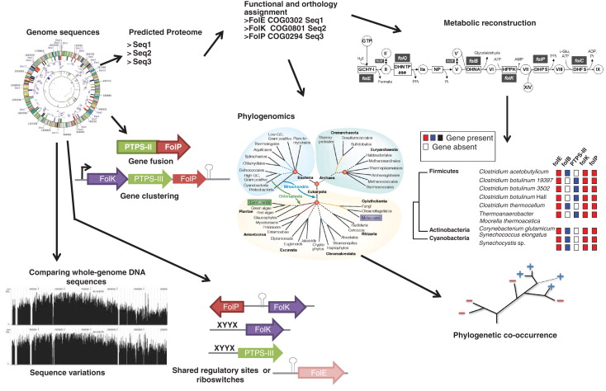
Comparative genomics
Delsuc et al Nat Rev Gen 2005

Slide 28
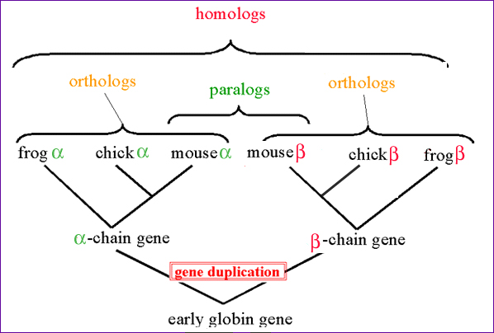
Homologs
Two genes are said to be homologs if they share an ancestor
3 types:
Ortholog
Paralog
Xenolog
http://www.discoveryandinnovation.com/bioinformatics/glossary_detail/homolog.html

Slide 29
Sequence homology
Can search for homologs by comparing gene/protein sequences
Can look for primers
Try to estimate function (not always accurate, better ways to do this)
Identify species sequence may have come from
If the DNA/AA sequence of 2 genes/proteins is very similar, we would say they are homologs
The primary tool for homology searching is BLAST
Basic Local Alignment Search Tool

Slide 30
BLAST
Basic Local Alignment Search Tool
Allows for a search of a database to find homologous sequences
Web tool searches NCBI database
Default is NR (non-redundant)
Can search subsections
Reference sets
Specific genomes
Exclude specific sections
Command line tool: BLAST+
Download premade NCBI databases
Create own databases
Can do this in Galaxy

Slide 31
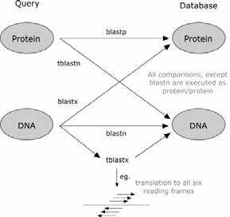
Types of BLAST
Program | Query | Database
BLASTn | Nucleotide | Nucleotide
BLASTp | Protein | Protein
BLASTx | Translated Nucleotide | Protein
tBLASTn | Protein | Translated Nucleotide
tBLASTx | Translated Nucleotide | Translated Nucleotide

Slide 32
Homology terminology quiz
Paralogs are defined as:
Homologs , usually with different functions, that arose from a gene duplication event
Homologs , usually with the same function, that arose from a speciation event
Homologs , usually with the same function, that arose from a horizontal gene transfer event

Slide 33
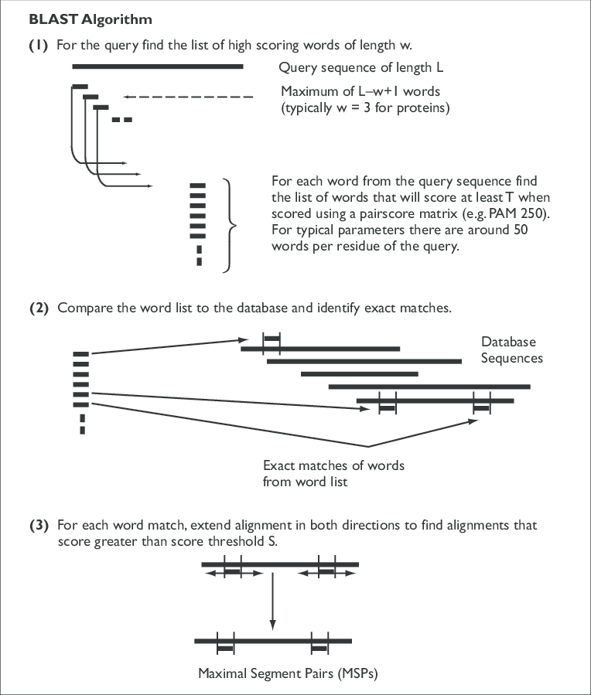
BLAST algorithm
Sansom Brief in Bioinf 2000

Slide 34
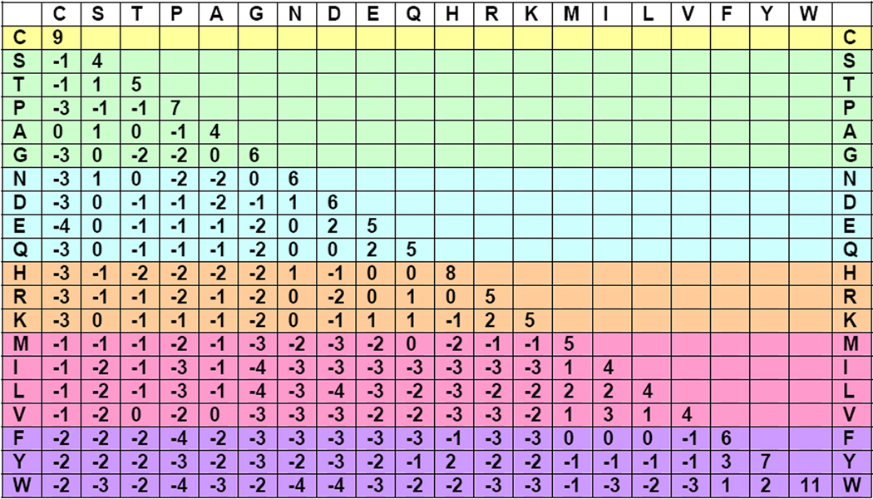
BLOSUM62
PQG -> PAG: 7+ (-1)+6= 12
PQG -> QAG: -1+(-1)+6= 4

Slide 35
BLAST algorithm
Sansom Brief in Bioinf 2000

Slide 36
BLAST algorithm
Sansom Brief in Bioinf 2000

Slide 37


Defining significance
Evaluate the significance of each HSP
Generate a cut-off S from random sequences
λ and K depend on the substitution matrix, sequence composition etc.
Often K = 0.009, λ = 0.229
m` and n` are the query and sequence lengths
x=10 is often used as the expected cut-off from random
Calculate the raw bit score
This is independent of substitution matrix, K, λ etc.
i.e. bit-score is a standard unit of score

Slide 38
Defining significance
Calculate the e-value
Significance score that is dependent on database size
Larger DBs = higher chance of false positive
E = (m x d)/2^{S’}
m is the query length
d is the database size
S’ is the bit score
The lower the E-value the closer the match
E=0 is an exact match
Closely related organisms
Maybe E⁻³⁰
Distantly related organisms
Maybe E⁻³

Slide 39
BLAST output

Slide 40
What do we need to know to use BLAST?
Type of sequence
DNA/protein
Type of database
DNA/protein
Example:
Searching for functional orthologs between closely related species/strains?
Searching for pseudogenes?
E-value/similarity cut-off
Smaller the better
Can do it online for small sets of queries
https://blast.ncbi.nlm.nih.gov/Blast.cgi
Can do through UNIX/DOS/Galaxy on computer for large sets or custom databases

Slide 41
BLAST types and cut-offs quiz
BLASTx is used for:
A protein sequence against a protein database
A nucleotide sequence against a nucleotide database
A protein sequence against a nucleotide database
A nucleotide sequence against a protein database
Which of these is the most stringent e-value cut-off?
0.0
1e-30
1e-3

Slide 42
Learning outcomes
Identify online database types and retrieve data
Describe types of homologs and gene evolution
Recognise the types of BLAST and their uses

