Slide 1
Plasmodium genomics
Conor Meehan (he/they)
conor.meehan@ntu.ac.uk
@con_meehan
Much material contributed by Dr. Eline Kattenberg, Institute of Tropical Medicine, Belgium

Slide 2
Learning outcomes
Classify Plasmodium species, specifically those that infect humans
Describe the genetic structure of Plasmodium across the three structures
Compare amplicon and genome sequencing approaches
Describe linkage disequilibrium and its uses in Plasmodium epidemiology
Recognise the key genes involved in Plasmodium drug resistance
State the primary data types and computational approaches for determining Plasmodium population structure

Slide 3
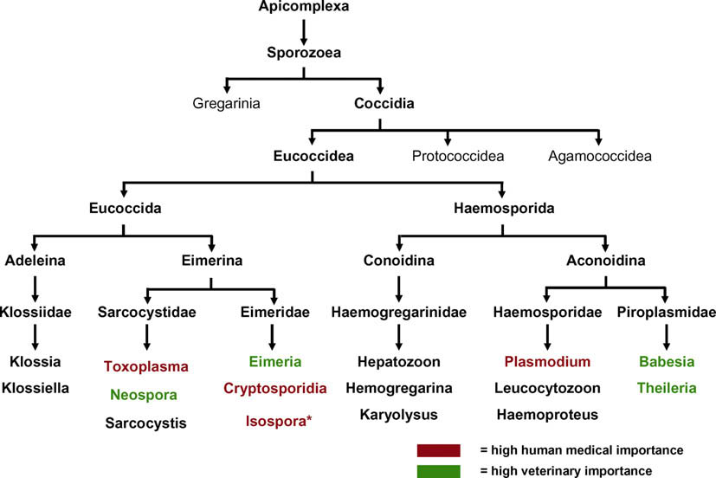
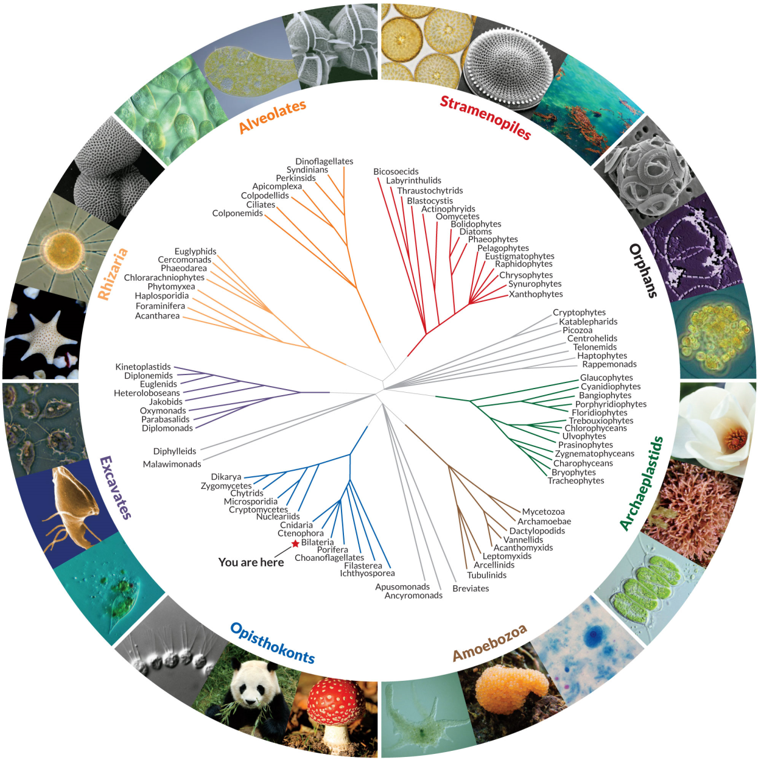
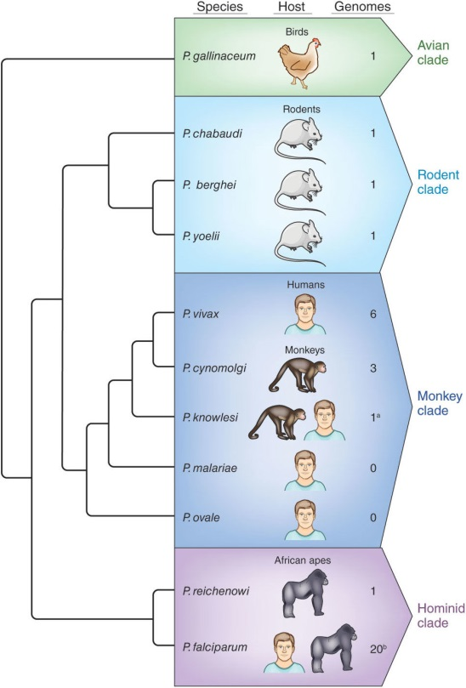
Plasmodium species
Plasmodium species
Taken from
Beck et. al 2009
Eukaryotes
Subgenus: Plasmodium
Subgenus: Laverania
Taken from
Hall et al. 2012
Taken from Science News

Slide 4
Human Plasmodium species
There are >100 species of Plasmodium, which can infect many animal species such as reptiles, birds, and various mammals.
4 species naturally infect humans:
P. falciparum
P. vivax
P. ovale
P. malariae
1 species naturally infects macaques, but can cause zoonotic malaria in humans:
P. knowlesi

Slide 5
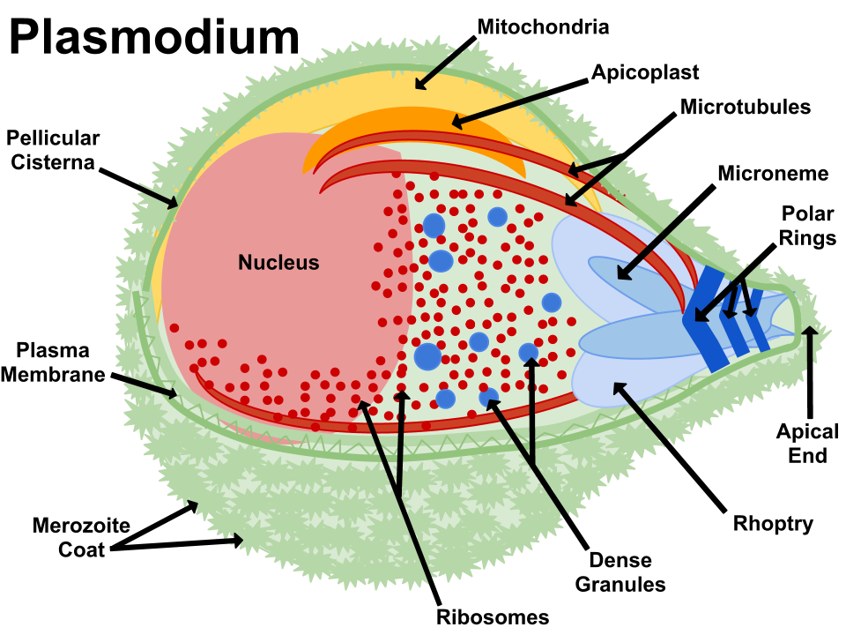
Plasmodium cell structure
DNA containing
By Jfbranch14 - Own work, CC BY-SA 3.0, https://commons.wikimedia.org/w/index.php?curid=19558260

Slide 6
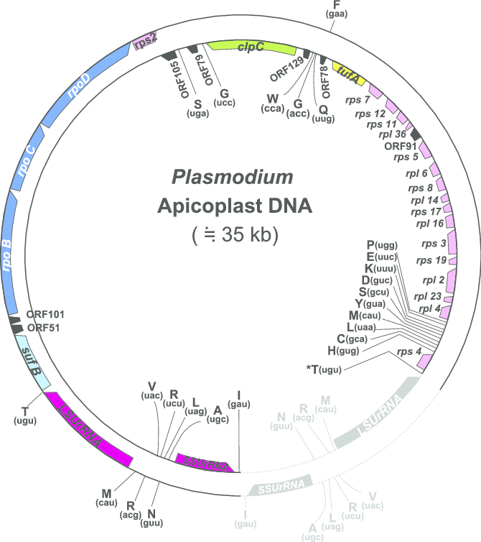
Apicoplast
Non-photosynthetic plastid found in most Apicomplexa
Contains 35 kb long circular DNA strand that codes for approximately 30 proteins, tRNAs and some RNAs.
DNA is of red algal and bacterial origin
Encoded metabolic pathways are similar to those found in bacteria and distinct from the pathways found in the mammalian host.
Potential drug targets
Arisue et al MBE 2012

Slide 7
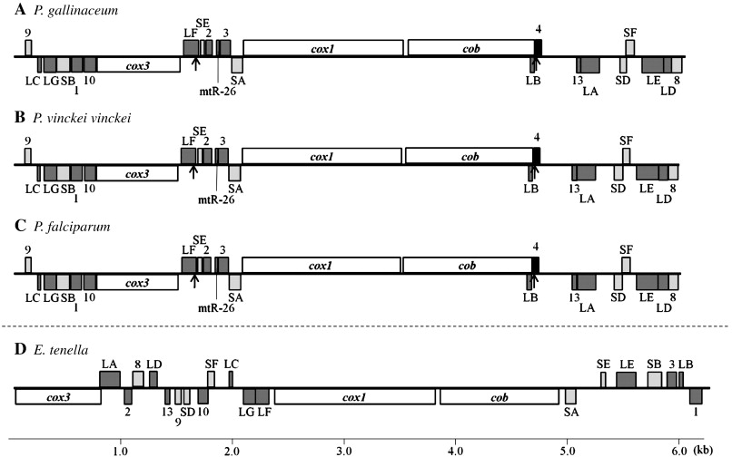
Mitochondrial genome
Tandemly repeated, linear element of 6 kb.
Encodes
Three protein genes
cox1, cox3 and cob
large- and small-subunit ribosomal RNA (rRNA) genes
highly fragmented with 19 identified rRNA pieces.
Hikosaka et al Parasitology International 2011

Slide 8
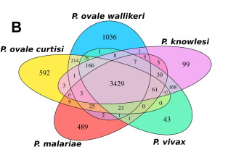
Nuclear genome
Species and Strains | Genome Size(Mb) | # Chromosomes | # encoded genes | AT%
P. falciparum 3D7 | 23.3 | 14 | 5403 | 80.6
P. knowlesi H | 23.5 | 14 | 5188 | 62.5
P. vivax SaI-1 | 26.8 | 14 | 5433 | 57.7
P. malariae | 31.9 | 14 | 6462 | 75.3
P. ovale wallikeri | 35.3 | 14 | 8582 | 71.1
P. ovale curtisi | 38.0 | 14 | 8825 | 72.2
Nuclear genomes of Plasmodium genus members (incl. non-human)
17 Mb to 40 Mb
On average ~ 5500 genes
14 chromosomes.
P. falciparum genome is very AT rich, complicating molecular analysis.
~77% orthologous genes between human infecting species
A or T homopolymers are difficult to sequence
Ansari et al IJP 2016

Slide 9
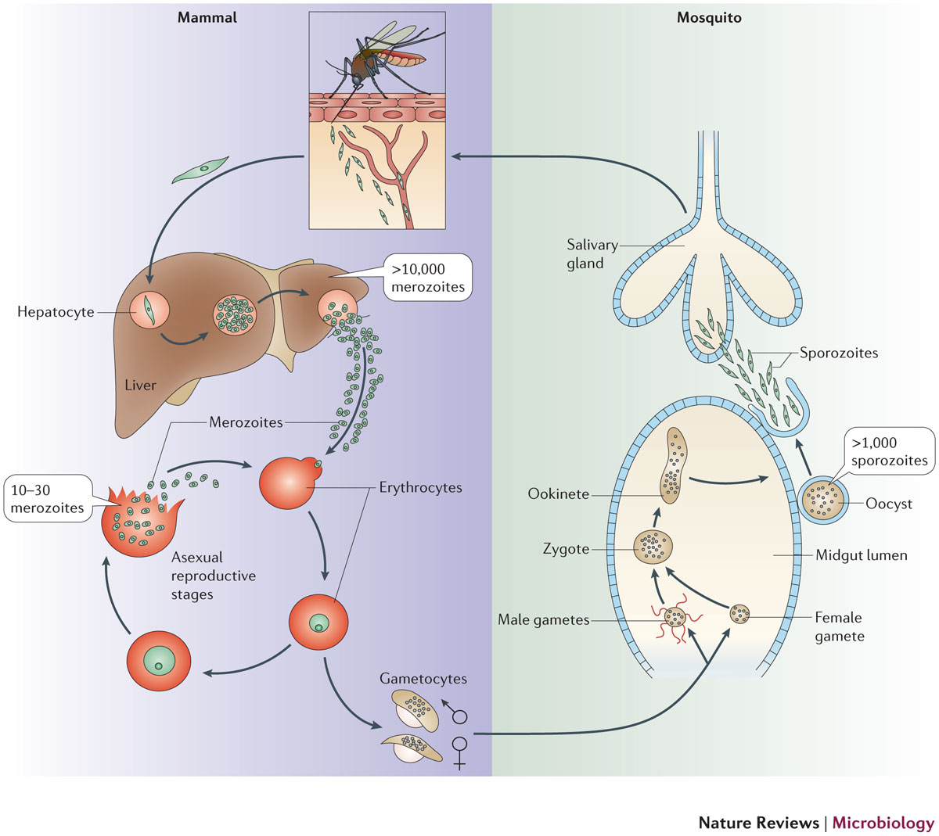
Ploidy
x = nr. of parasite cells/genomes per host cell
Mostly haploid
has a single set of chromosomes
Diploid in the zygote,
sexual recombination
Parasite cell to host cell ratio changes constantly
i.e. Genome copy numbers change
x=~10,000
x=1
x=1*
x=~1000
x=10-30
Zygote =diploid! (1 parasite cell, 2 sets of chromosomes)
x=1
x=8
x=1
x=1
* note: multiple P. falciparum merozoiets can infect a single red blood cell, but typically not with the other species.
Menard et al Nat Rev Micro 2013

Slide 10
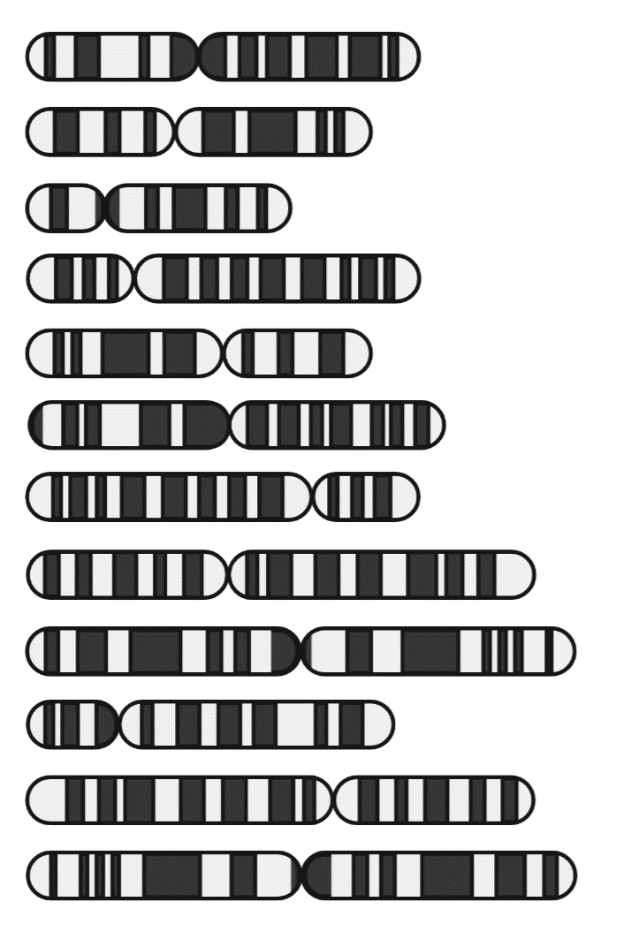
Sequencing Plasmodium genomes
Targeted approach (e.g., PCR)
sWGA with WGS
Targeted (amplicon) sequencing
Few targets
Cost effective
May miss diversity
Reduced if panels local constructed correctly
Works from dried blood spots (DBS)
Selective whole genome amplification
Many targets
Captures most diversity
Very expensive and difficult (currently)
DBS extraction improving
Both useful for population structure and drug resistance
Need to know informative targets

Slide 11
Linkage disequilibrium
Non-random association of alleles at different loci in a population
Influenced by many factors, e.g.
selection,
the rate of recombination,
genetic drift,
population structure
etc.
As a result, the pattern of LD is a powerful signal of the population genetic processes that are structuring it.

Slide 12
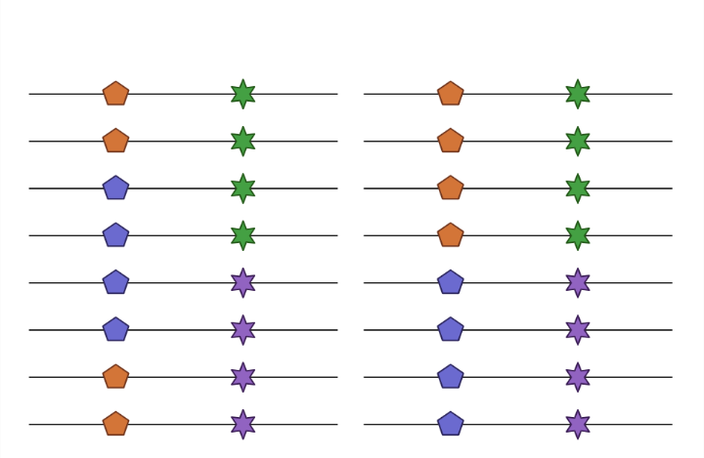
Non-random association of alleles
Random association of alleles
Non-random association of alleles
Linkage Equilibrium
Linkage Disequilibrium

Slide 13
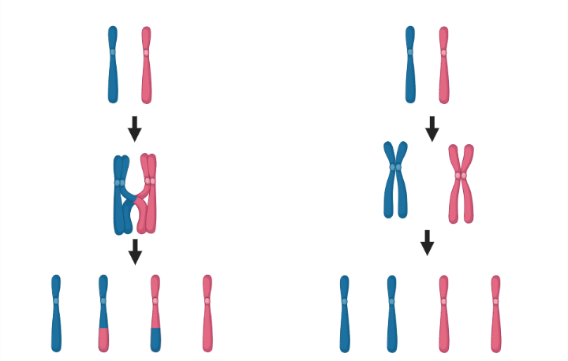
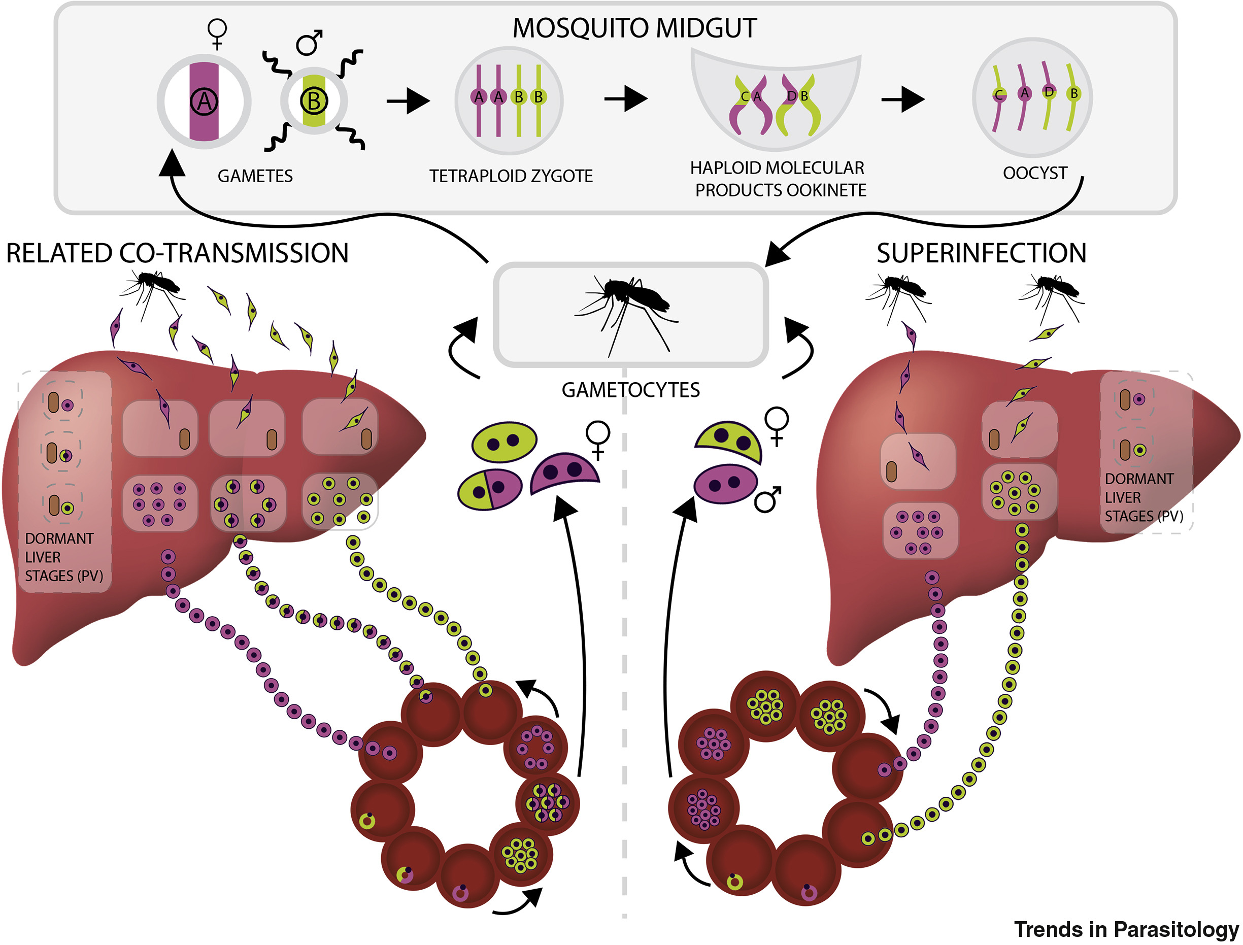
Meiosis breaks down LD
Recombination mixes alleles
Creates random associations
Co-transmission and superinfections increase recombination
Lower LD
Siegel & Rayner 2020, Trends in Parasitology

Slide 14
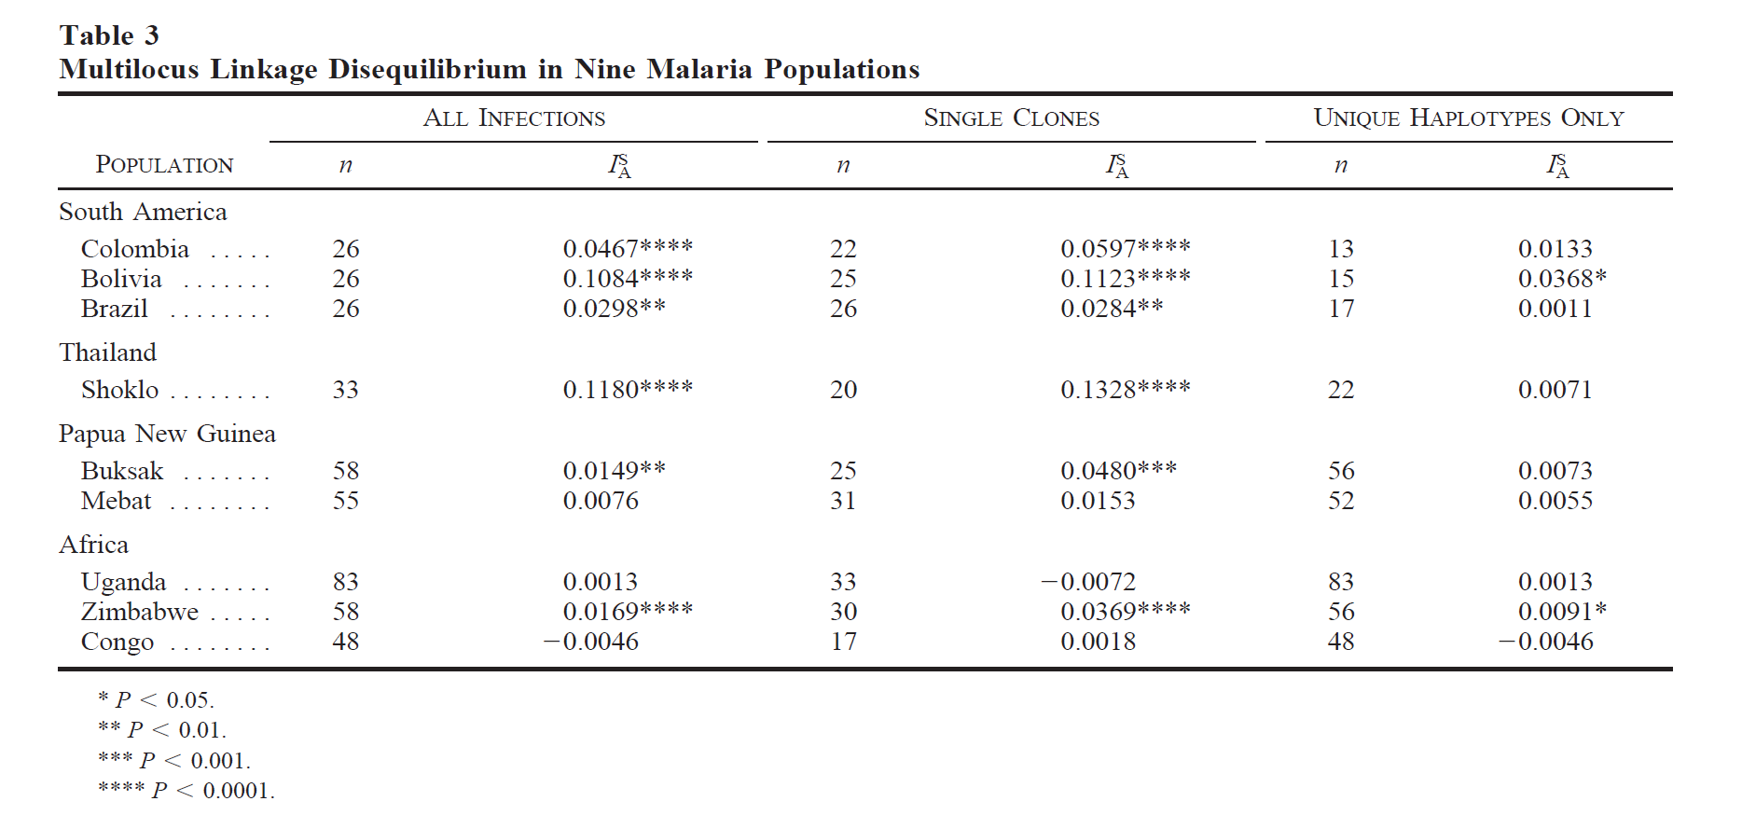
LD as a marker of transmission rates
High LD usually signifies low transmission
Not much population mixing
Low recombination
Not perfect for this
Drug resistance increases LD
Selective sweeps
Inbreeding increases LD
High transmission but similar parasites
Anderson et al. 2000 Mol. Biol. Evol

Slide 15
Plasmodium drug resistance
Drug | P. falciparum resistance marker (gene, protein (PlasmoDB gene identifier)) | Protein function | Geography and resistance reports
Artemisinin derivatives | k13, Kelch protein K13 (PF3D7_1343700) | Scaffold protein that may be involved in maintaining phosphatidylinositol-3-phosphate levels²⁵³ | Greater Mekong subregion (Southeast Asia)^{45,270–273}
Lumefantrine | mdr1, multidrug resistance protein 1 (PF3D7_0523000) | ATP-dependent drug efflux pump from the ABC transporter B family^{267,274,275} | Reports of polymorphisms in Uganda and Tanzania, but no robust evidence of resistance^{276–278}
Amodiaquine | crt, chloroquine-resistance transporter (Pf3D7_0709000); and mdr1 (PF3D7_0523000) | Drug metabolite transporter superfamily of electrochemical potential-driven transporters²⁷⁹ | Africa and Asia^{277,280}
Mefloquine | mdr1 (PF3D7_0523000) | Drug metabolite transporter superfamily of electrochemical potential-driven transporters²⁷⁹ | Greater Mekong subregion^{281–283}
Piperaquine | plasmepsin 2 (PF3D7_1408000); plasmepsin 3 (also known as HAP; PF3D7_1408100); and exo, putative exonuclease gene (PF3D7_1362500) | Food vacuole histo-aspartic proteases²⁸⁴ and putative exonuclease gene^{168,273} | Greater Mekong subregion^{168,273,285}
Pyronaridine | None reported | Not available | No robust reports
Primarily point mutations
A growing list as more discovered
WHO reports
Prevalence differs between countries
K13 mutations very common in Rwanda
Phillips et al. Nat Rev Disease Primers 2017

Slide 16
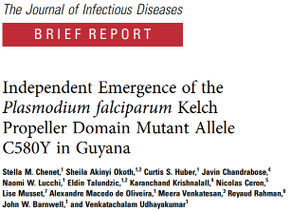
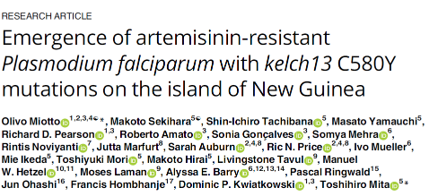
Emergence vs spread of drug resistance
Prevalence differs between countries
K13 mutations very common in Rwanda
Can serve as epidemiological markers

Slide 17
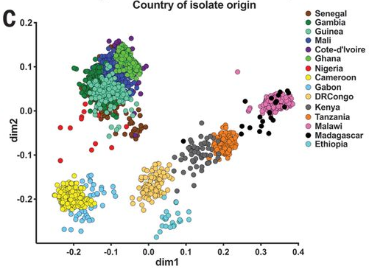
Markers of population structure
Microsatellites (MS) used in the past for population structure
Medium resolution
SNP barcoding better for determining populations
Need more SNPs than MS for resolution
29k used in recent African study
Country-specific signatures clear
Not so clear within country
Need locally validated barcodes
Biallelic
Minor allele frequency >10%
Low LD
Amambua-Ngwa et al Science 2019

Slide 18
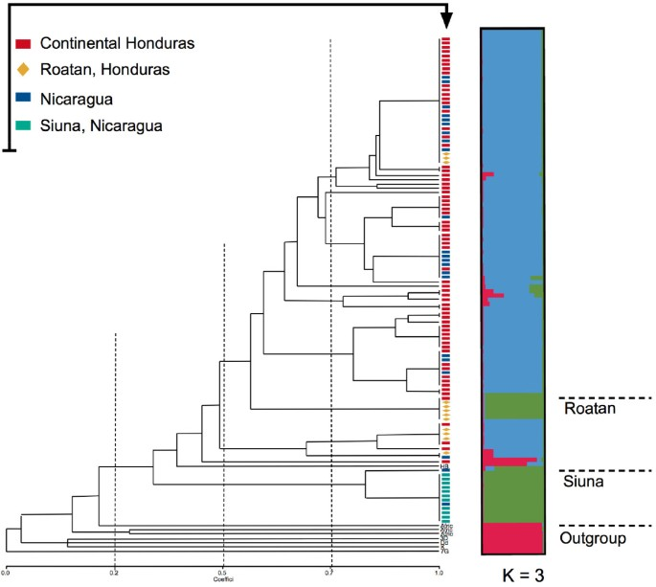
Determining population structure
STRUCTURE
Bayesian programme for determining population structures
fastSTRUCTURE can be used on large SNP datasets
Useable on MS, SNPs and other typing markers
Infers populations based on allele frequencies
Can assess presence of individuals in given structured populations
Combine with phylogenetics to look for population spread
F_{st}
How different populations are base don genetic determinants
Can also be a measure of how much a SNP/MS segregates a population
F_{st}=1 means complete segregation
Larranaga et al Malaria 2013

Slide 19
Bioinformatics for Plasmodium
Still in its infancy
Assembling microbial eukaryotic genomes is more difficult than bacteria and viruses
Larger
More complex (multiple chromosomes, diploid stages)
More features (introns etc)
Host contamination more difficult to spot
Many orthologs between microbial eukaryotes and hosts
Easy to use pipelines don’t exist
Slowly being built
Mainly UNIX/R-based with multiple steps
Markers of resistance and transmission not fully known
SNP panels
WGS approaches
Methylation contributions
PlasmodDB is a good resource to use
https://plasmodb.org/plasmo/app

Slide 20
Learning outcomes
Classify Plasmodium species, specifically those that infect humans
Describe the genetic structure of Plasmodium across the three structures
Compare amplicon and genome sequencing approaches
Describe linkage disequilibrium and its uses in Plasmodium epidemiology
Recognise the key genes involved in Plasmodium drug resistance
State the primary data types and computational approaches for determining Plasmodium population structure

