Slide 1
Data handling and presentation
Conor Meehan (he/they)
conor.meehan@ntu.ac.uk
@con_meehan

Slide 2
Learning outcomes
Identify the steps in the research cycle
Describe selection bias
Explain a data management plan and storage approach
Differentiate data cleaning and tidying
Use the Abela chart to select an appropriate graph
Recognise the different parts of a figure and legend

Slide 3
What is data?
The information we gather from published sources
Publications, reports, presentations
The forms we will in and processes we follow
COSHH, ethics
The input to experiments
Predictor/Independent Variables
The output of experiments
Outcome/Dependent variables
The presentations, reports, posters, papers that we create
Graphs, text

Slide 4
Data and the research cycle
Capture
Maintain
Process
Analyse
Communicate

Slide 5
Data Capture

Slide 6
Data capture steps
Select a research approach
Quantitative vs qualitative
Select an experimental set up
Experimental vs correlation
Decide on variables
Choose sample types and number
All covered in the statistics lecture

Slide 7
Collecting samples
The samples you use must allow you to test your hypothesis
They must be:
Appropriate
Related to the hypothesis and measurable
Representative
Randomly chosen or specific characteristics?
Sufficient sample size
More variable populations need larger sample sizes
May need ethical approval

Slide 8
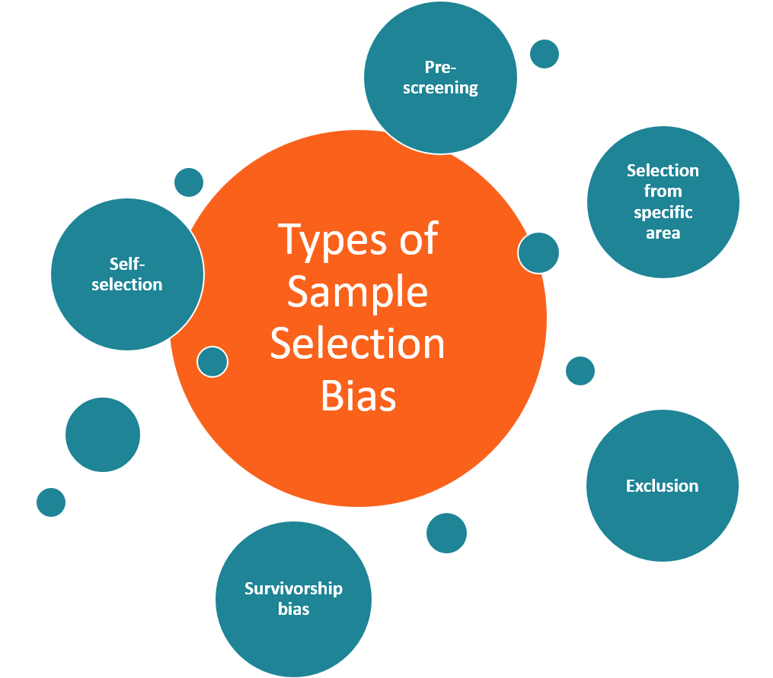
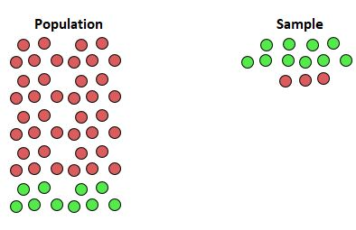
Sampling bias
https://www.statology.org/undercoverage-bias/

Slide 9
Data Maintenance

Slide 10
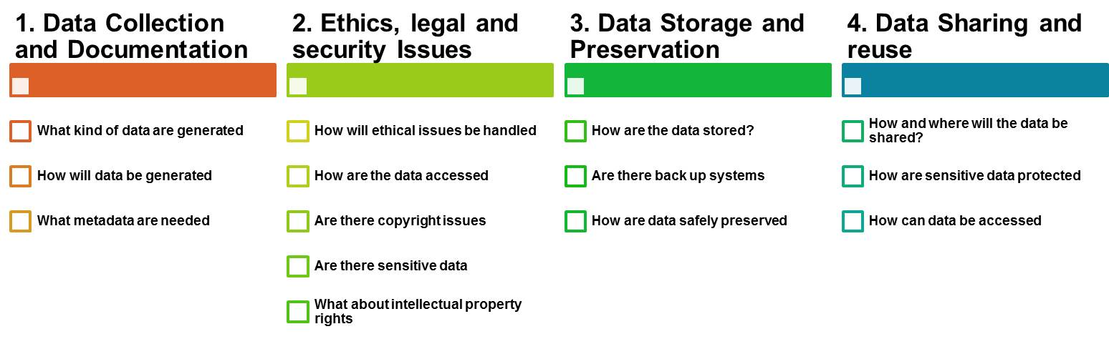
Data management plan
https://www.uzh.ch/blog/hbz/2018/11/15/data-management-plan-in-a-nutshell/?lang=en

Slide 11
Data storage
Hart et al Plos Computational Biology 2016
Ethical and GDPR considerations
Limitations on length and type
Confidentiality
Backups
External
Cloud
Sample storage
Freezer
Dried
Collections
Moving towards open data storage

Slide 12
Data Processing

Slide 13
Standard operating procedures
Step by step guide on routine tasks
Repeatability
Traceability
How is data passed through the experiment/clinical pipeline?
Where to find SOPs?
Supervisors
Previous lab personal
Protocols.io

Slide 14
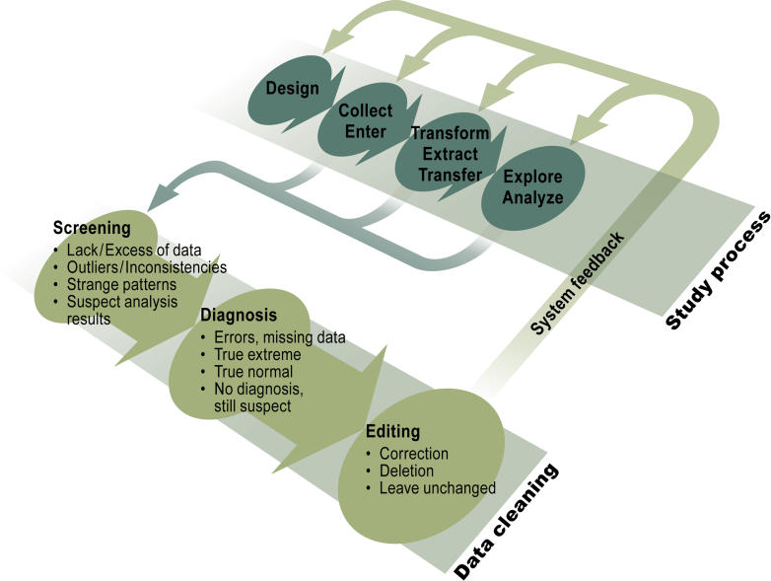
Data cleaning
Errors will occur
Sample switch
Wrong/missing reading
Impossible results
Data cleaning is the removal of faulty data
E.g. outliers due to bad technique
It is not manipulation of data to remove unwanted results
Van den Broeck et al Plos Med 2005

Slide 15
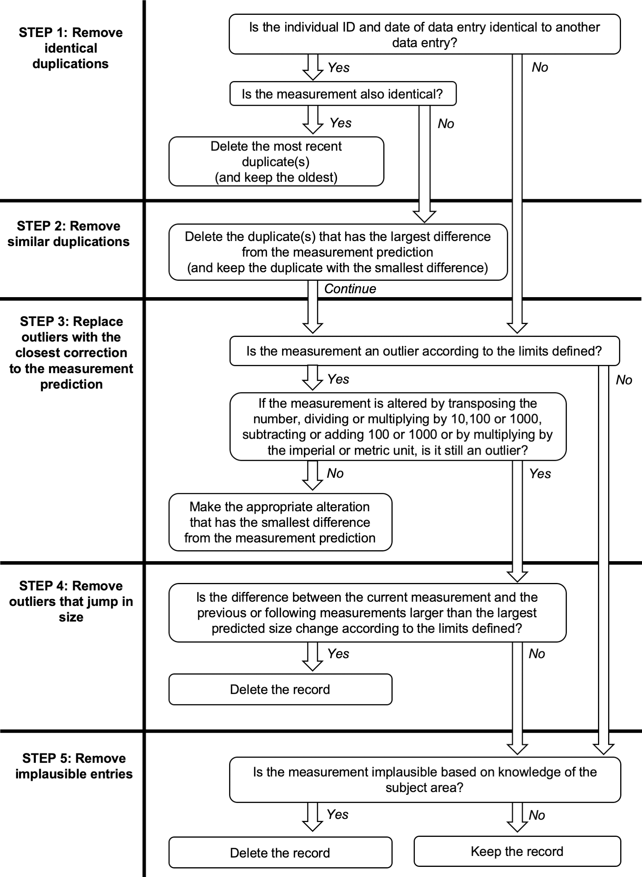
Data cleaning example
Wooley et al Plos1 2020

Slide 16
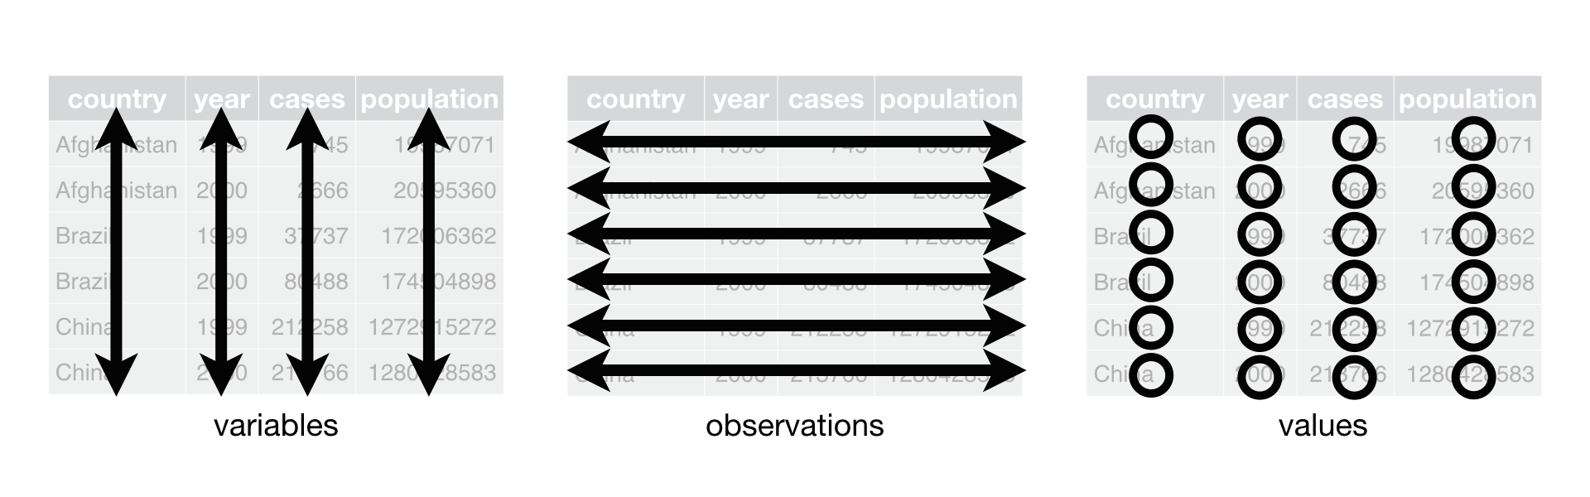
Data tidying
Organising data into structured formats
Spreadsheets
Careful on formatting in excel
3 basic principles:
https://cfss.uchicago.edu/notes/tidy-data/

Slide 17
Data Analysis Controls/Replicates/Outliers Covered in statistics lecture

Slide 18
Data Communication

Slide 19
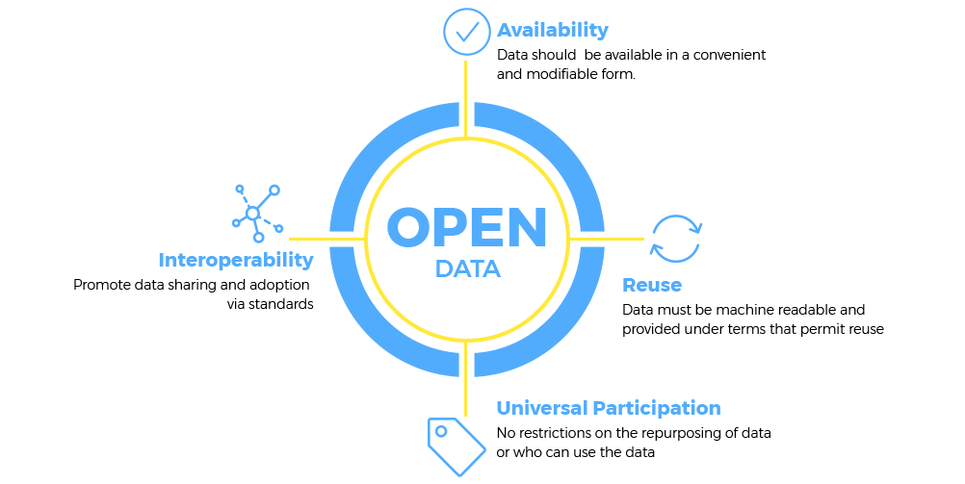
Open and FAIR data
https://opendata.info/

Slide 20
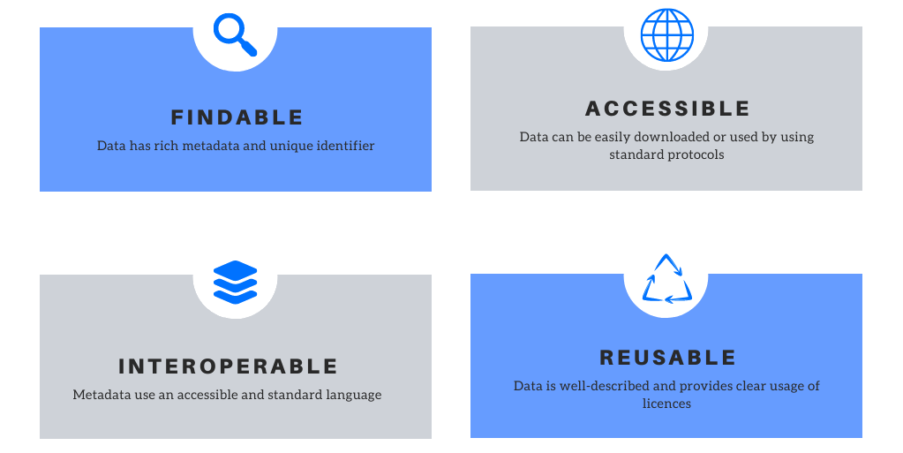
Open and FAIR data
https://blog.orvium.io/fair-principles-in-scientific-data/

Slide 21
Communicating data
Initial data exploration often includes creating graphs/tables
How to choose what graph is best for your data?
Is a table better?
Need to know:
Number of variables
What you want to show
Always refer to the figure/table in the text
“As seen in figure 1…”
“No difference in biofilm formation was observed (Table 1).”

Slide 22
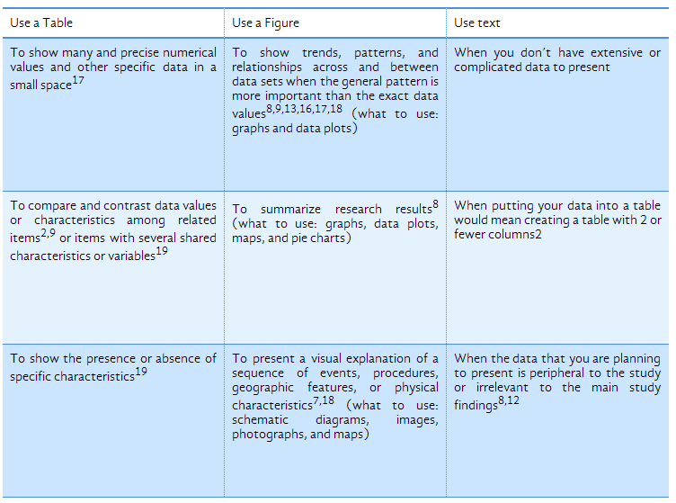
Figure or table or text?
https://www.editage.com/insights/tips-on-effective-use-of-tables-and-figures-in-research-papers

Slide 23
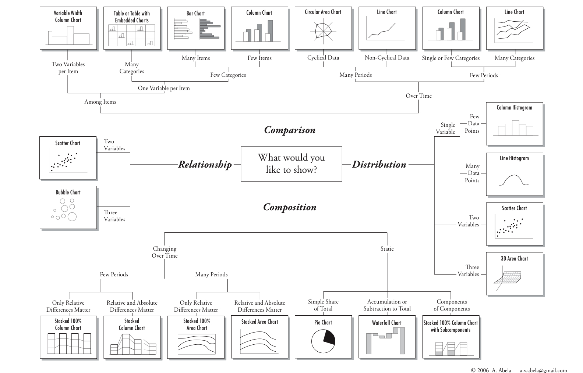
Abela chart: selecting a chart

Slide 24
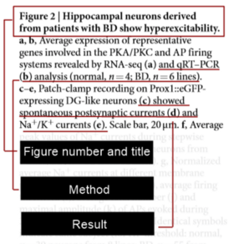
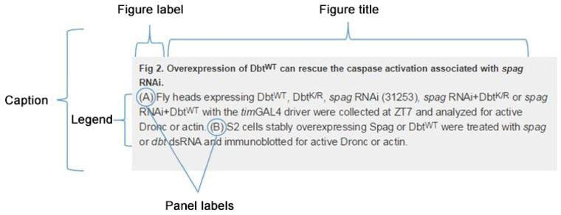
Figure legend format
READ THIS
https://blog.bioturing.com/2018/05/10/how-to-craft-a-figure-legend-for-scientific-papers/
https://journals.plos.org/plosone/s/figures

Slide 25
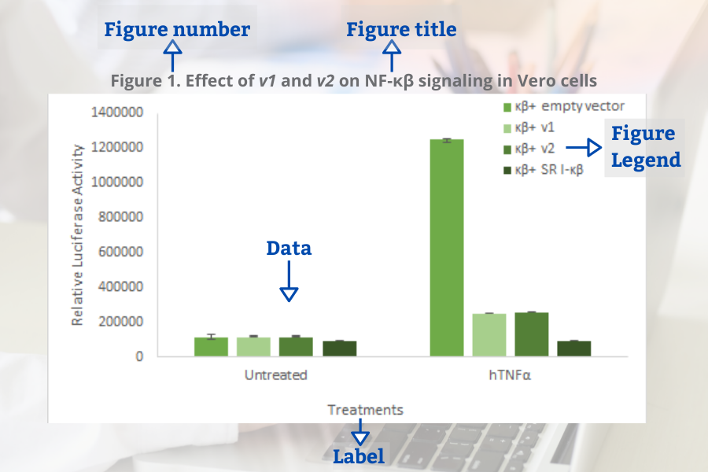
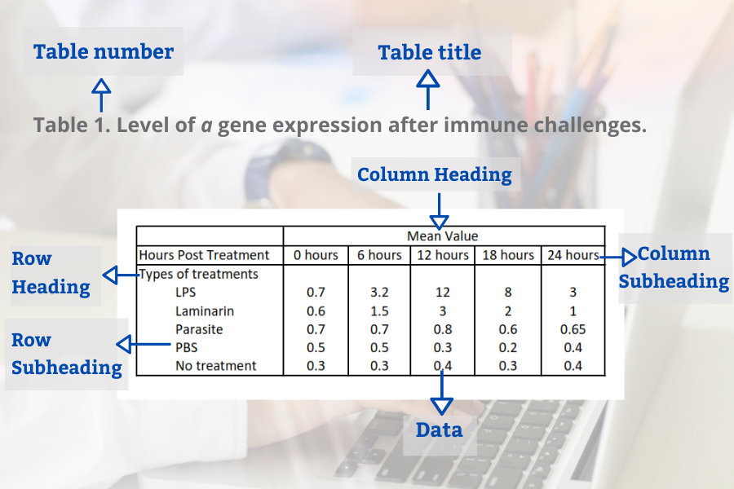
Sections of a figure/table
Figure captions/legends above the figure, table captions/legends below the figure
https://www.goldbio.com/articles/article/Guide-to-results-and-discussion-section

Slide 26
Colour schemes in figures
Choose colours that are easy to distinguish from each other
Colours should be colourblind friendly
https://medialab.github.io/iwanthue/
https://colorbrewer2.org/

Slide 27
Learning outcomes
Identify the steps in the research cycle
Describe selection bias
Explain a data management plan and storage approach
Differentiate data cleaning and tidying
Use the Abela chart to select an appropriate graph
Recognise the different parts of a figure and legend

