Slide 1
Genome assembly and annotation
Conor Meehan (he/they)
conor.meehan@ntu.ac.uk
@con_meehan

Slide 2
Learning outcomes
Describe the primary steps in de novo assembly
Implement basic assembly quality control and metrics
List the primary outputs of genome annotation
Describe the primary steps in reference mapping
Compare the pros and cons of assembly and mapping approaches

Slide 3
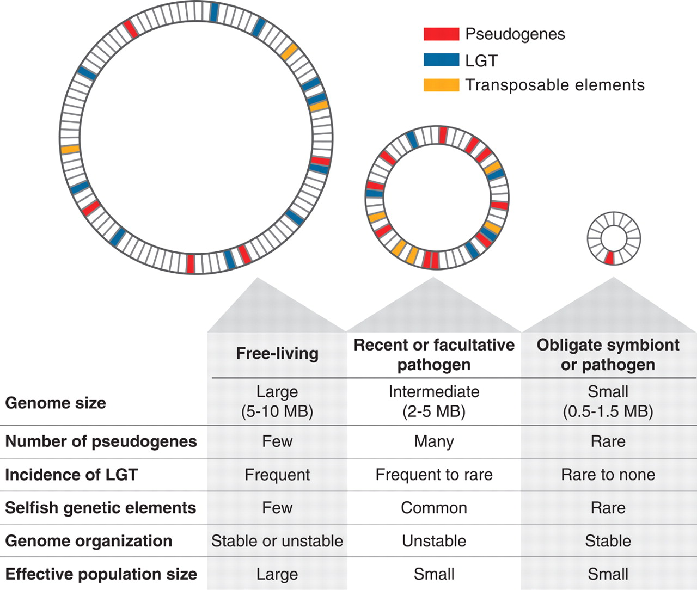
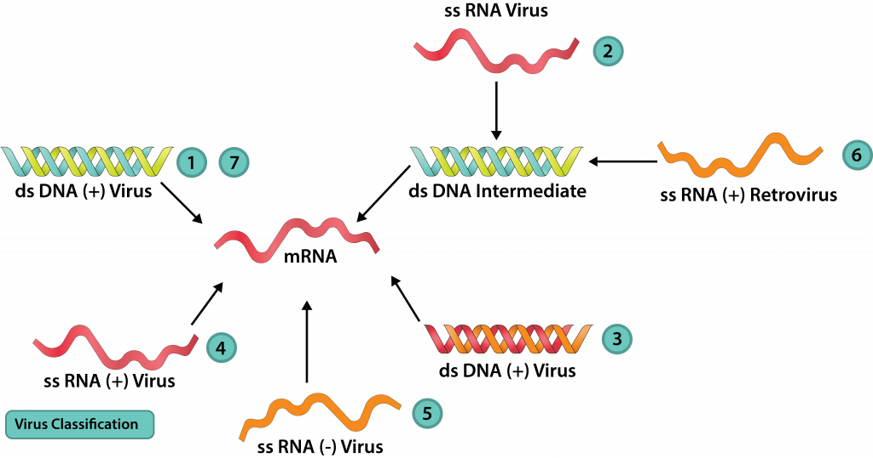
Bacterial and viral genomes
Ochman and Davalos Science 2006
https://bio.libretexts.org/Bookshelves/Microbiology/Book%3A_Microbiology_(Bruslind)/22%3A_The_Viruses

Slide 4
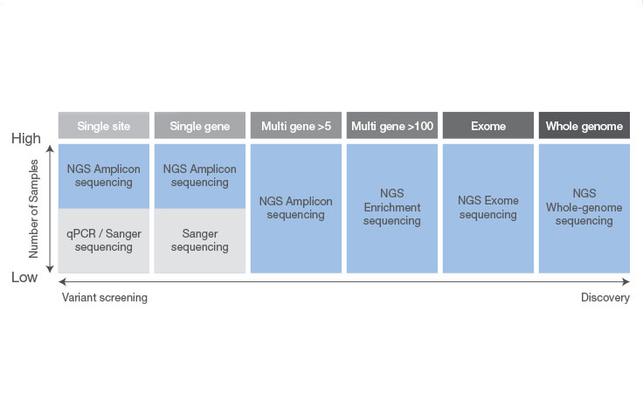
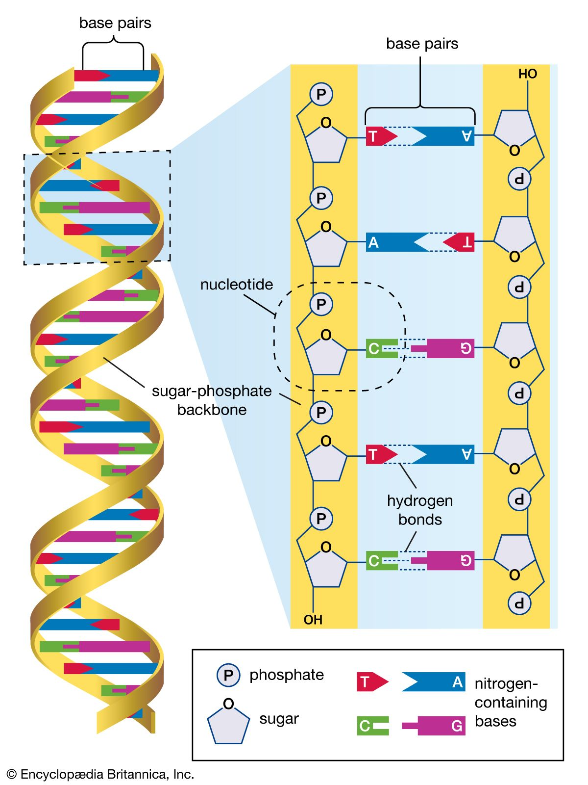
DNA sequencing

Slide 5
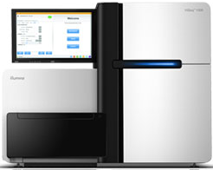
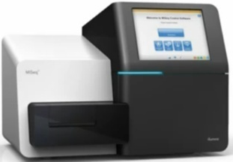
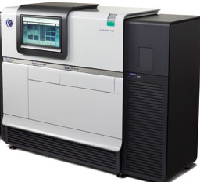
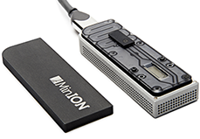
DNA sequencing terminology
Whole genome sequencing (WGS): Determine the near complete genomic sequence of an organism
Targeted sequencing: Determine the sequence of a particular portion of a genome (e.g. a set of genes)
Next generation sequencing (NGS): Massively parallel sequencing of relatively short fragments (~50 to 400 bp) - Illumina, Ion Torrent, Roche 454, Solid
Third generation sequencing (Third-gen): Real-time single molecule sequencing, usually long read lengths (> 20,000 bp) - Pacific Biosciences, Oxford Nanopore

Slide 6
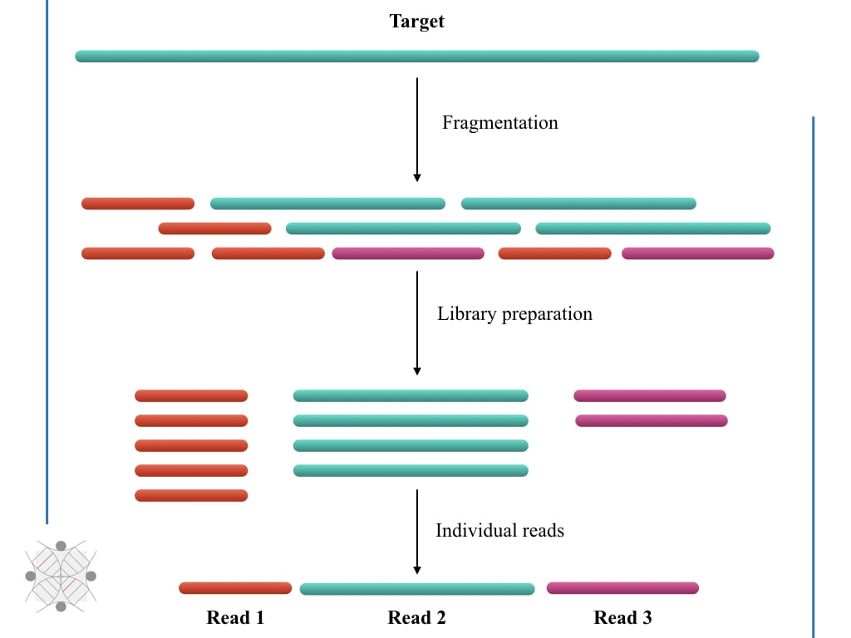
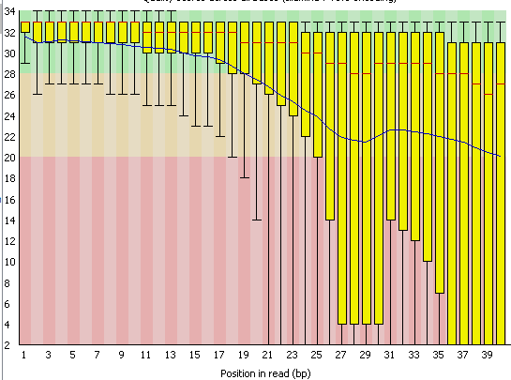
Quality control of reads
Sequencing platforms produce reads
Shredded sections of DNA
Usually stored in FastQ files
Need to remove bad quality reads and bases
FastQC to visualize raw read sets
Trimmomatic to perform QC
Trim ends of bad quality bases
Remove reads with low quality
Usually a cut-off of 20 for both
FastQC to visualize trimmed read sets

Slide 7
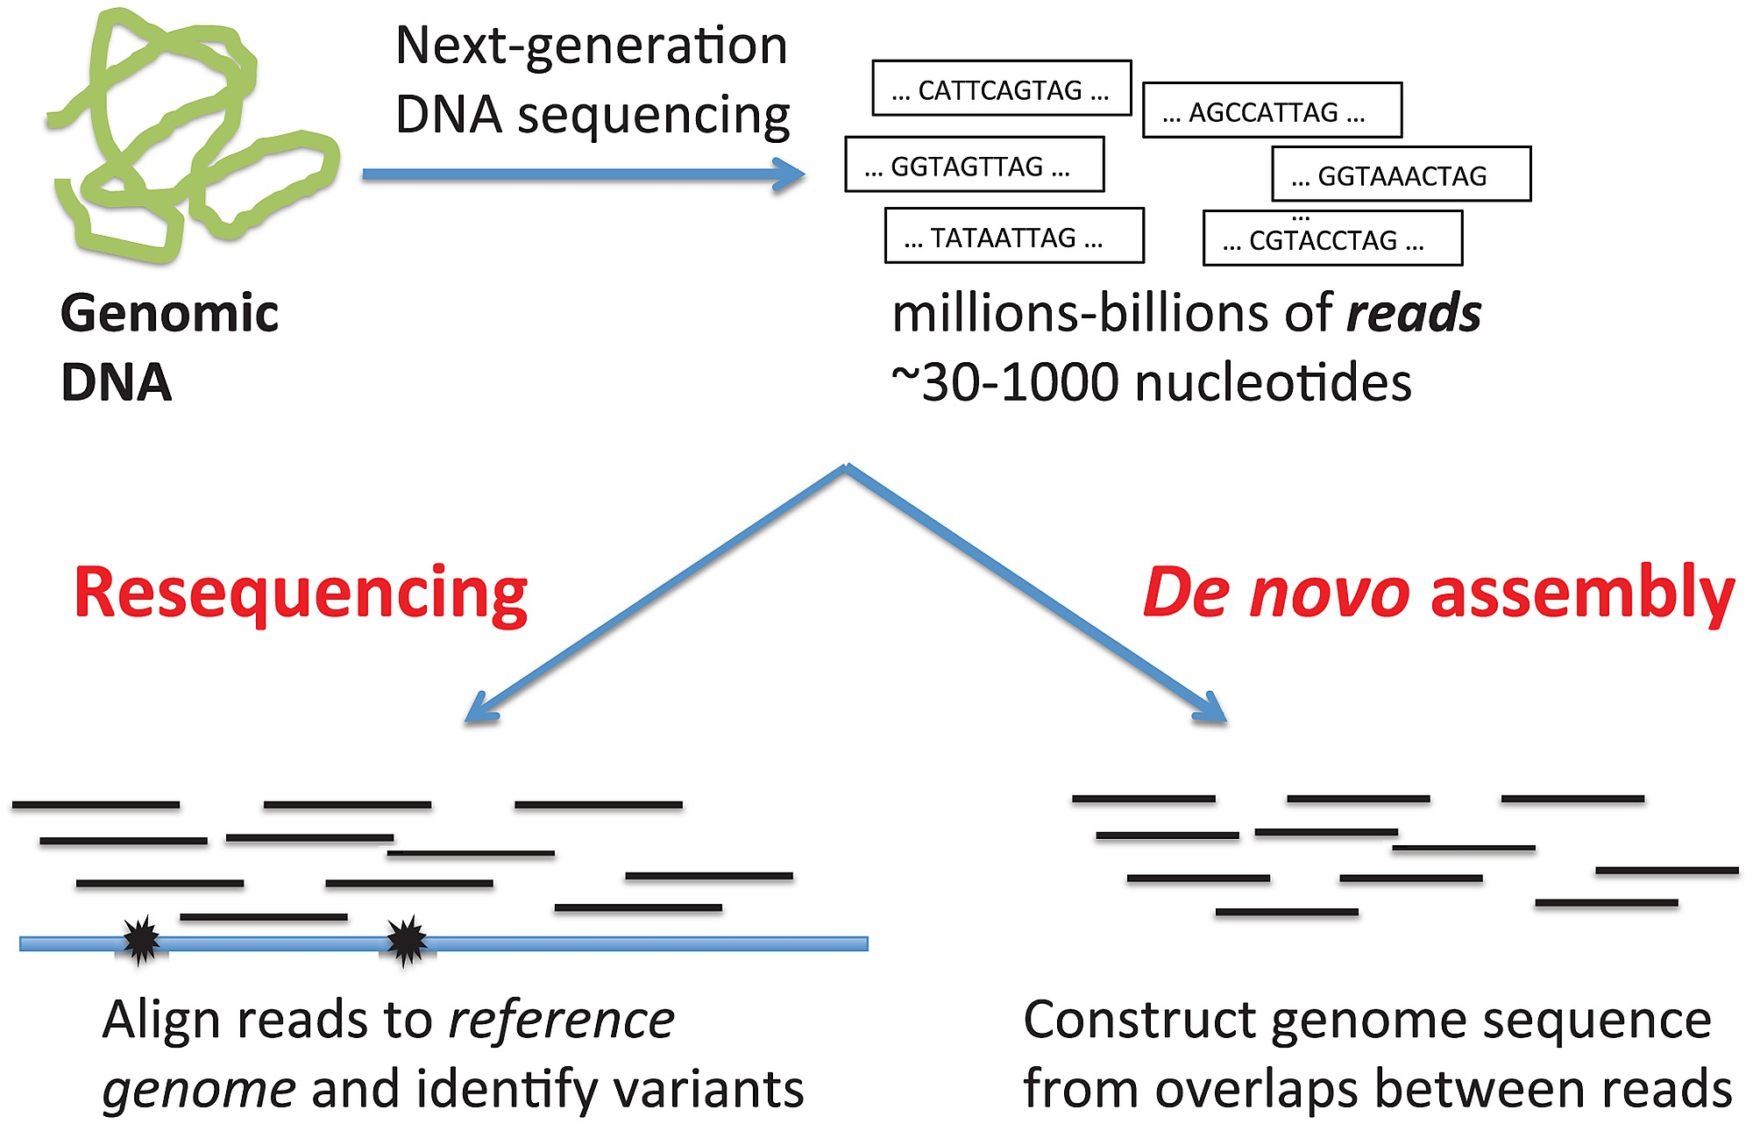
Genome assembly
Reference-based (resequencing)
Compare reads to known reference genome
Look for Single Nucleotide Variants (SNVs)
Technically not assembly but mapping
De novo
Assemble reads by comparing to each other
No comparisons to a completed genome
https://doi.org/10.1371/journal.pcbi.1002821.g002

Slide 8
NGS coverage/depth
The number of reads that cover a certain section of DNA in the gene/genome
Referred to as the coverage of a position
In below example the G has 10x coverage (10 reads cover this nucleotide position)
Genome coverage is the average of all individual nucleotide coverages

Slide 9
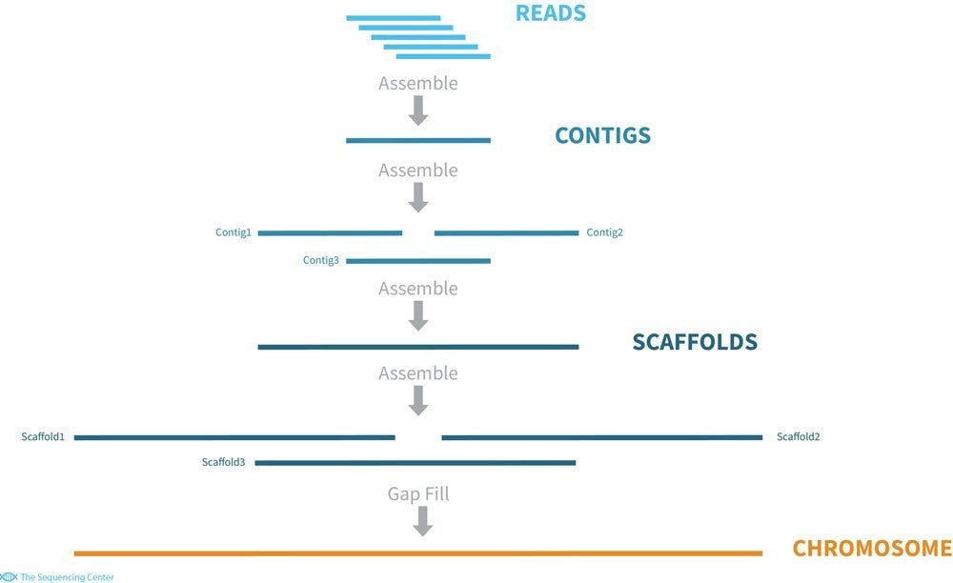
De novo assembly
Used for species/populations without a sequenced reference genome
Also useful in species with a lot of genome content differences (e.g. high levels of HGT)
Compare reads to each other
Find overlaps
Stick together into longer contigs
Order contigs together in scaffolds

Slide 10
De Bruijn graph assembly
Derived from https://www.youtube.com/watch?v=OY9Q_rUCGDw
AACCGGTTA
GGTTATAC

Slide 11
De Bruijn graph assembly
Cut the reads into shorter k-mers (k=4 in this example)
AACCGGTTA
AACC
ACCG
CCGG
CGGT
GGTT
GTTA
GGTTATAC
GGTT
GTTA
TTAT
TATA
ATAC

Slide 12
De Bruijn graph assembly
Find the k-mers that overlap
AACCGGTTA
AACC
ACCG
CCGG
CGGT
GGTT
GTTA
GGTTATAC
GGTT
GTTA
TTAT
TATA
ATAC

Slide 13
De Bruijn graph assembly
Walk along the start of each k-mer to get the base
Don’t count the overlaps twice
Keep all of the final k-mer
AACCGGTTA
AACC
ACCG
CCGG
CGGT
GGTT
GTTA
GGTTATAC
GGTT
GTTA
TTAT
TATA
ATAC

Slide 14
De Bruijn graph assembly
Final sequence: AACCGGTTATAC
AACCGGTTA
AACC
ACCG
CCGG
CGGT
GGTT
GTTA
GGTTATAC
GGTT
GTTA
TTAT
TATA
ATAC

Slide 15
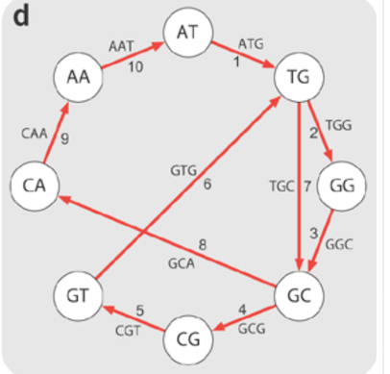
De Bruijn graph assembly paths
Genome assemblers use k-mers of 32-127nt long
Specific ‘walking’ algorithms find the unique k-mer paths through the reads
Passes each edge only once
Repeated DNA creates non-unique paths

Slide 16
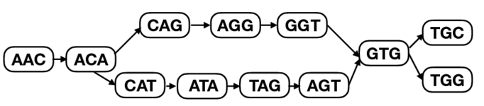
Repeat DNA creates contigs
Repeat DNA makes alternative walking orders
Top or bottom path comes first in genome?
Split these k-mer bubbles into two unique sequences
CAG
CATA
Each unique side of the bubble is a contig
Repeated elements often a single contig
No idea how often repeated
Long read sequencing overcomes the repeat problem (longer k-mers possible)

Slide 17
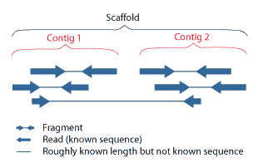
Scaffolding
Use the pairs of reads to match contigs together
One read of each pair may be in different contigs
Only works with paired end sequencing
Sections between contigs usually filled with Ns (ambiguous base calls)
https://mycocosm.jgi.doe.gov/help/scaffolds.jsf

Slide 18
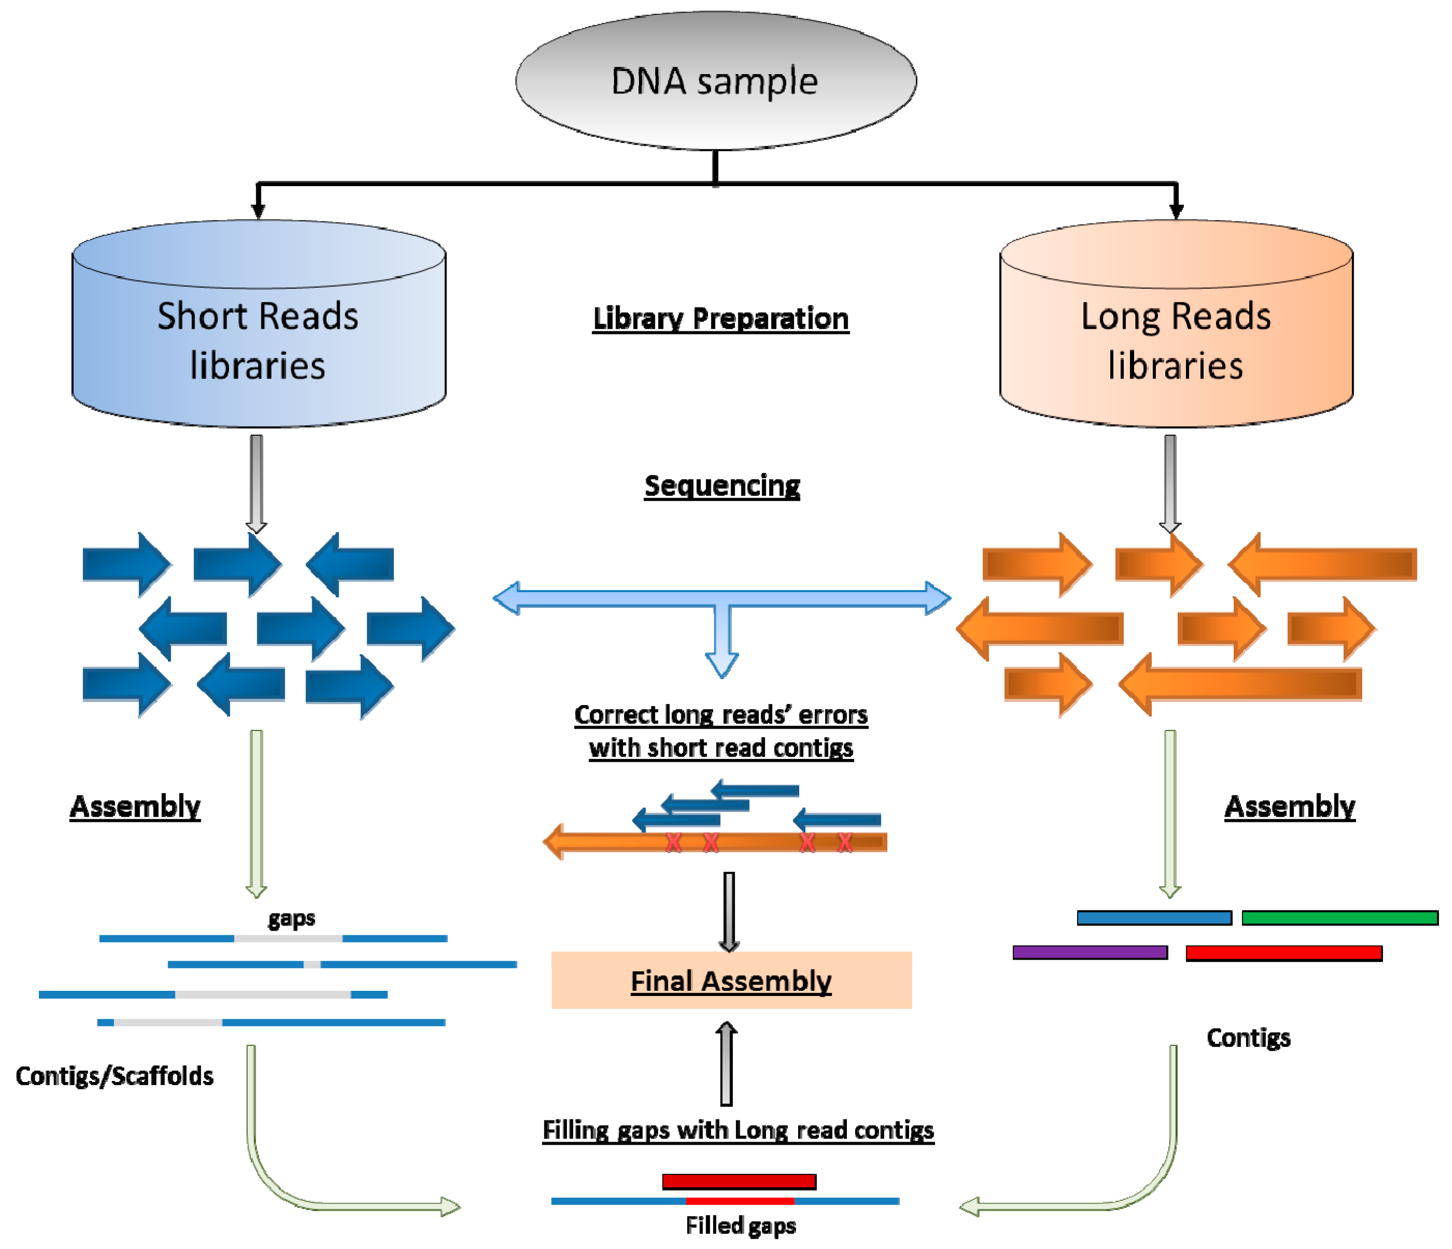
Hybrid assembly
Using long (e.g. PacBio) and short (e.g. Illumina) reads combined to get improved genomes
Two major approaches:
Short read assembly with long read gap filling
Long read backbone with short read correction
Xiao et al Pharmaceutics 2016

Slide 19
Tasks 1
What is the sequencing depth of the two positions highlighted in blue?
What is the resulting sequence after the de bruijn-based joining of these two reads? (k=3)
TTAACCA
CCAAAAT

Slide 20
Break

Slide 21
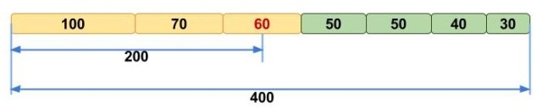
Quality measures of an assembly
Genome assembly statistics
Number of contigs/scaffolds
Ideally <100
Per base coverage
How many reads cover each base?
Ideally >100x (short reads)
Usually accept >30x
N50
Procedure:
Line up all contigs by length
Calculate total bp in genome (400bp in example below)
Calculate 50% of total (200bp in example)
Go from longest to shortest contig and add up lengths
Stop when you reach the 50% mark (i.e. 200bp in example)
The length of that contig you stopped on is the N50
Ideally >1MB
https://www.molecularecologist.com/2017/03/29/whats-n50/

Slide 22

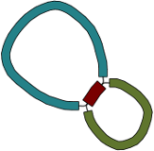
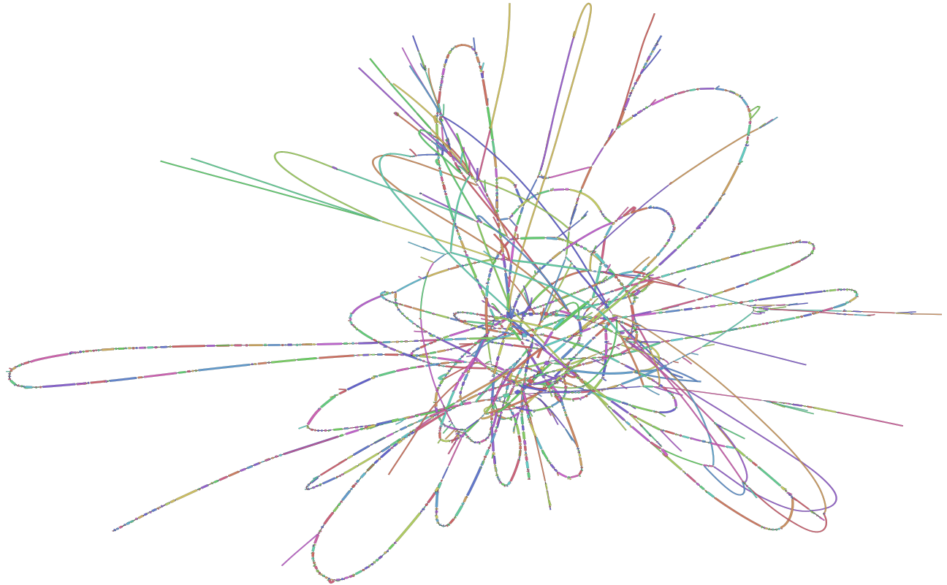
Assembly graph
Ideally genome is resolved into a single contig per chromosome/plasmid
If not, an assembly graph shows the possible connections
Links between contigs and repeat regions
Bandage is main program to do this
Can be used to see how good assembly is
Lots of loops means lots of repeat regions
Most common in short read only assemblies
https://albertvill.com/posts/nodeseqs_oral/
https://www.molecularecologist.com/2017/12/18/visualize-your-genome-assemblies/

Slide 23
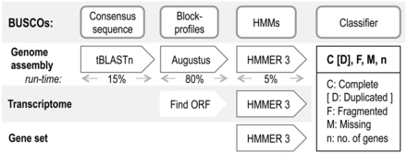
Quality control of assemblies
Assemblies need to be checked for completeness and reliability
BUSCO or CheckM are primary tools
BUSCO
Looks for a set of single copy universal orthologs
Genes that should be present in every bacterial genome only once
Can use phylum-specific sets
Can work on microbial eukaryotes and some viruses
Aim for >95% C
Low F and M
High n is good
# of genes used

Slide 24
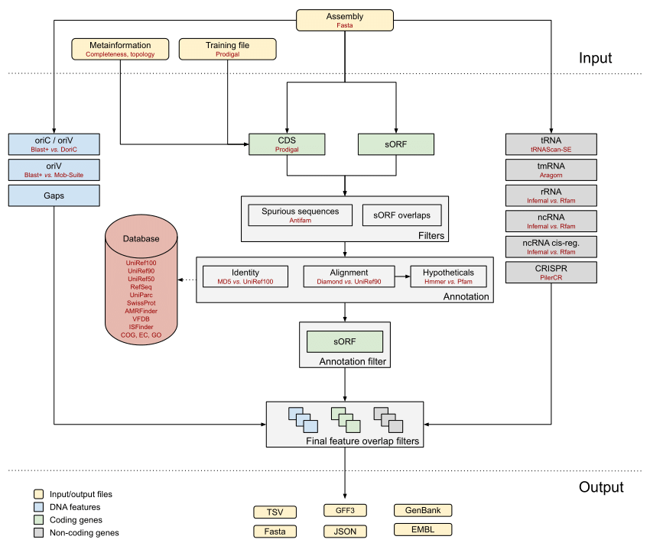
Genome annotation
From a clean assembly, we can predict gene presence and absence
Need to predict:
Where genes start and end
Open reading frames
Coding vs non-coding genes
Coding: produce proteins
Non-coding: tRNAs, ncRNAs etc
Best tools (prokaryotic)
Bakta
Replaced Prokka
Easy and quick
PGAP
NCBI tool
Slow and accurate
Schwengers et al MGEN 2021

Slide 25
From reads to genes
Reads
Read QC
Assemble
Short or long
Preferably paired
FastQC
Trimmomatic
De novo (e.g. SPAdes)
Mapping (e.g. Snippy)
Assembly QC
BUSCO
Bandage
Annotate
Bakta
PGAP

Slide 26
Reference-based mapping
Reference sequence

Slide 27
Reference-based mapping
Reference sequence
Fragmented sequenced sample

Slide 28
Reference-based mapping
Reference sequence
Mapped reads ⬆️
Unmapped reads ⬇️
(Can’t be placed unambiguously)
Fragmented sequenced sample

Slide 29
Reference-based mapping
Reference sequence
Mapped reads ⬆️
Unmapped reads ⬇️
(Can’t be placed unambiguously)
Assembled sequenced sample
Unknown region
Unknown region
SNP

Slide 30
Reference mapping
Ideal when you have a good reference genome
No ambiguous bases
Single contig
Primary function is to find single variants
Wont find new genes not present in reference
Can de novo assemble unaligned reads
Most pipelines don’t report large genome deletions
Repetitive regions result in ambiguous mapping
Reads cannot be placed
Usually mask these out of final dataset

Slide 31
Read mapping vs assembly
Mapping is quick, easy and most downstream tools are made for this
If you have a good reference genome and want to understand small changes, this is the best option
De novo requires more computational power and QC to ensure it is useable
For new species or research into structural and gene presence/absence, this is the best option
If you have:
Short reads: mapping
Long reads: assembly
Combine with short reads (for now)

Slide 32
Tasks 2
Which of these is a good maximum number of contigs in an assembly?
100
500
1000
tRNAs are a type of coding or non-coding gene?

Slide 33
Learning outcomes
Describe the primary steps in de novo assembly
Implement basic assembly quality control and metrics
List the primary outputs of genome annotation
Describe the primary steps in reference mapping
Compare the pros and cons of assembly and mapping approaches

