Slide 1
Predicting pathogenic features
Conor Meehan (he/they)
conor.meehan@ntu.ac.uk
@con_meehan

Slide 2
Learning outcomes
Discuss the basis of antimicrobial resistance mechanisms and ays to detect them from genomic data
Identify the primary virulence factors and ways to detect them from genomic data
Define plasmids and their primary contents and ways to detect them from genomic data

Slide 3
Pathogenic features
Large part of public health genomics is detecting characteristics of pathogens:
Antimicrobial resistance (AMR) genes/mutations
Virulence factors such as toxins, siderophores etc.
Plasmids and associated genes (e.g. toxins or AMR)
Each of these has a set of specific associated knowledge base and bioinformatics tools

Slide 4
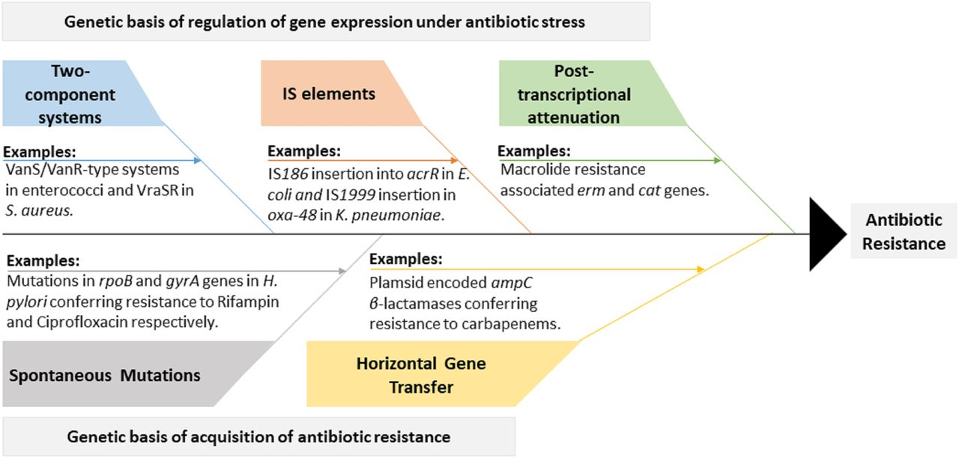
Genetic basis of antimicrobial resistance (AMR)
Genetic basis:
genome analysis (focus here)
Regulatory basis:
Transcriptome/proteome analysis
Ghosh et al (2020); AAC

Slide 5
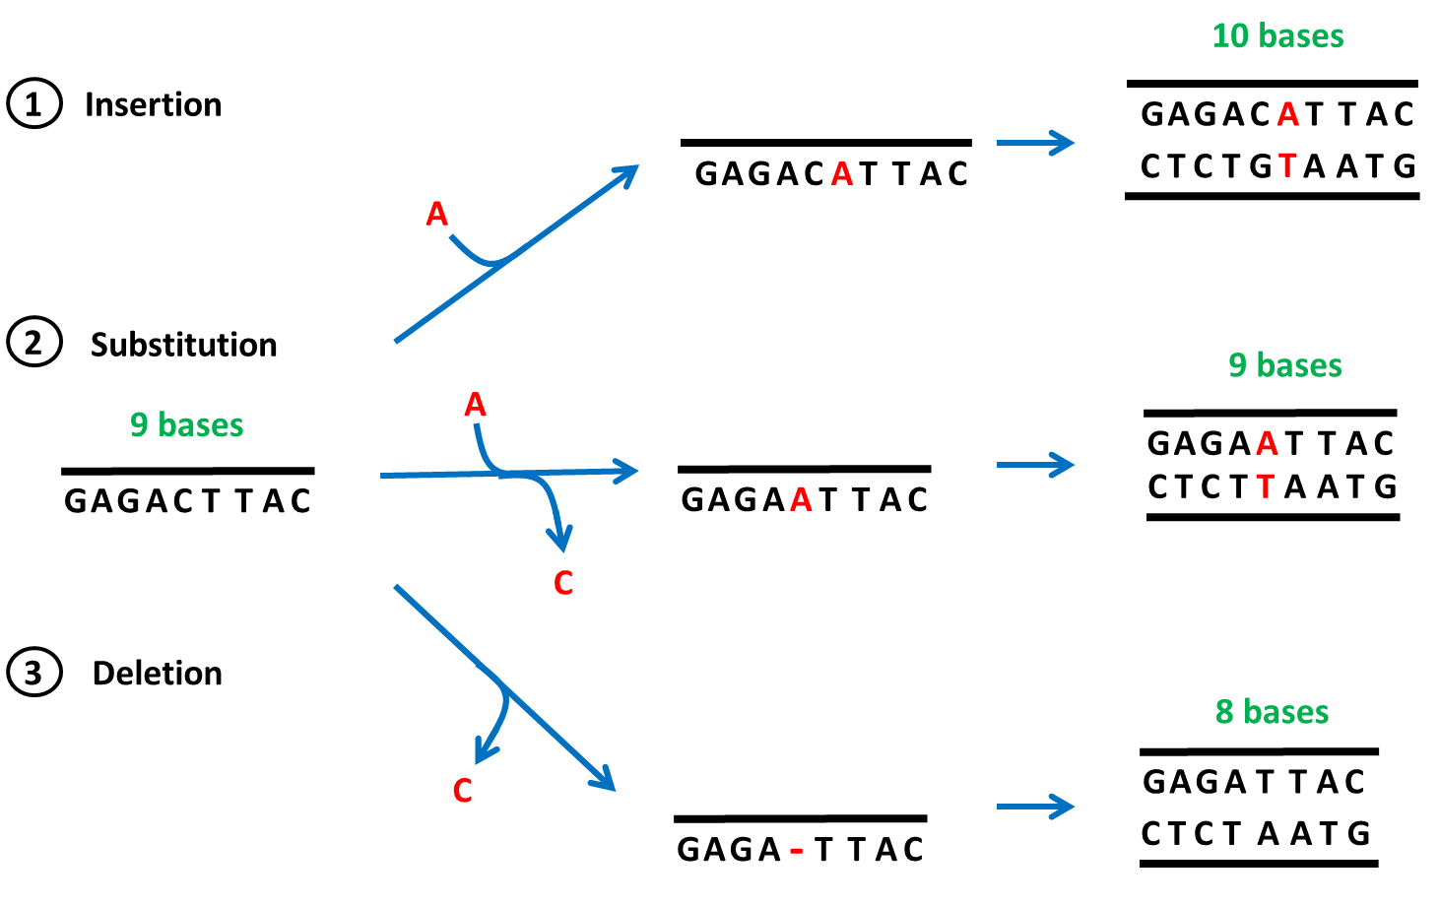
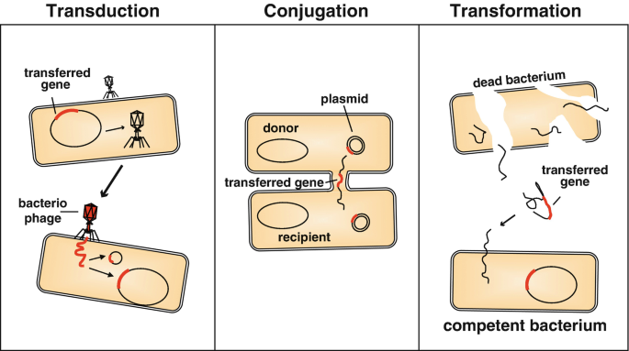
Mutations and horizontal gene transfer (HGT)
https://le.ac.uk/vgec/topics/gene-mutations-and-cancer/school-and-colleges
Blokesch (2015); Springer Protocols

Slide 6
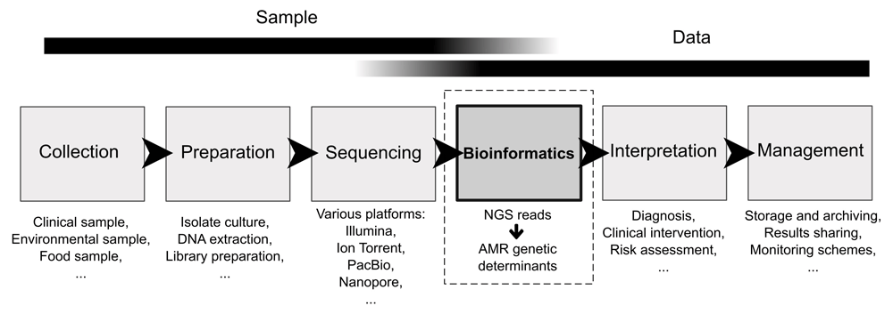
Bioinformatics in AMR research
Angers-Loustau et al (2018); F1000Research

Slide 7
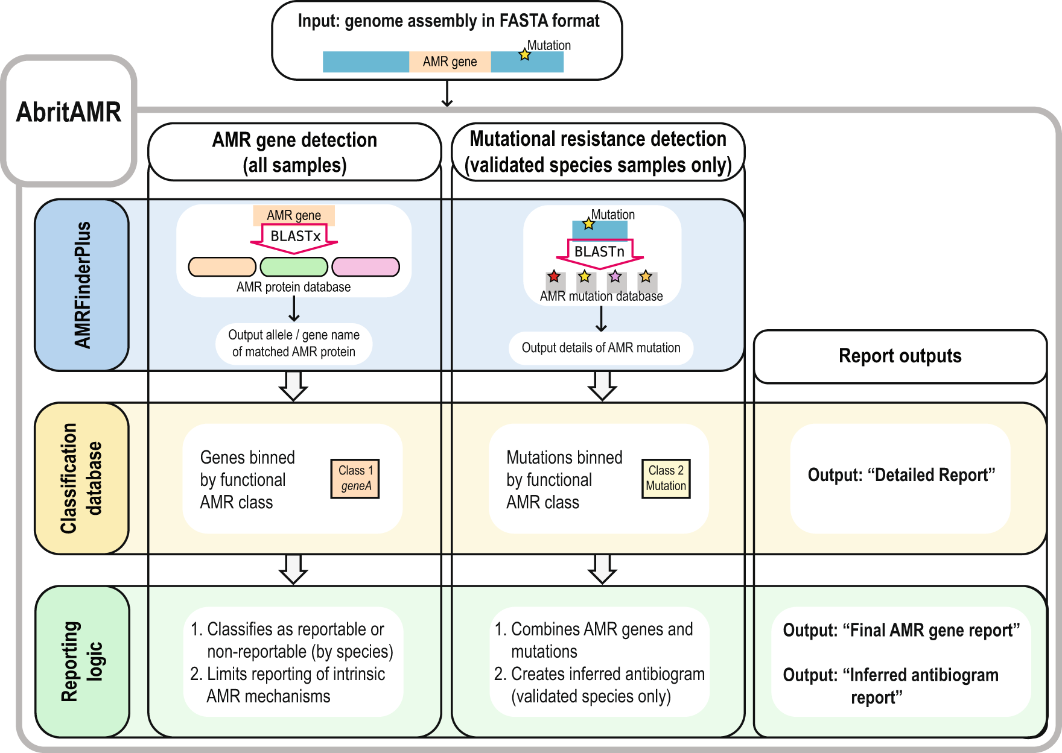
Detecting genomic changes (AbritAMR example)
Sherry et al (2023); Nat Comm

Slide 8
Virulence factors
Pathogens ability to infect and/or damage host tissue
Often present on plasmids and acquired horizontally
Good overview:
https://openstax.org/books/microbiology/pages/15-3-virulence-factors-of-bacterial-and-viral-pathogens

Slide 9
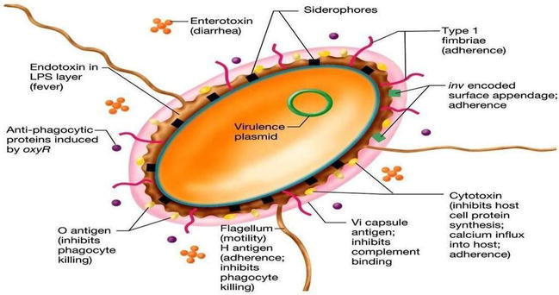
VF of Salmonella typhi
Prediction difficult as can be species-specific
https://www.intechopen.com/chapters/74829

Slide 10
Virulence factor prediction
VFDB:
Virulence factor database
http://www.mgc.ac.cn/VFs/
AbritAMR:
Looks for antimicrobial resistance and virulence factors
Will search the VFDB and others
ABRicate:
Looks for antimicrobial resistance and virulence factors
Will search the VFDB and others
Cannot find point mutations, only whole gene presence/absence

Slide 11
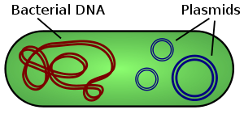
Plasmids
Small circular DNA found in bacteria and other microorganisms
Significantly smaller than chromosomes
Carry specific genes
rep for initiative replication
Mobility (MOB) genes for conjugation
Often contain AMR- and virulence-related genes
Several types of plasmid
Species/genus-specific
Classified with multi-locus sequence typing
Explained in strain typing tutorial
Wikipedia

Slide 12
Predicting plasmids
Easiest from long read technology
Short read technology have difficulty with repetitive regions
Many tools to undertake this:
PlasmidFinder
PLACNET
Mostly homology based detection against database
PlasForest using a random forest approach to overcome this but can be (comparatively) difficult to install

Slide 13
Learning outcomes
Discuss the basis of antimicrobial resistance mechanisms and ways to detect them from genomic data
Identify the primary virulence factors and ways to detect them from genomic data
Define plasmids and their primary contents and ways to detect them from genomic data

