Slide 1
Strain typing and genomic epidemiology
Conor Meehan (he/they)
conor.meehan@ntu.ac.uk
@con_meehan

Slide 2
Learning outcomes
State the different levels at which bacterial typing occurs
Explain the basis of ANI and MLST for species and strain typing
State the differences between MLST and cgMLST in terms of resolution and use
Recognise MinHash and MST approaches for genomic epidemiology

Slide 3
Molecular typing
The assignment of a sample to a group
or
The separation of samples into different groups
Look at genetic material and assign to a group
Define:
Species
Sub-species
‘Type’ (e.g. lineage)
Transmission cluster

Slide 4
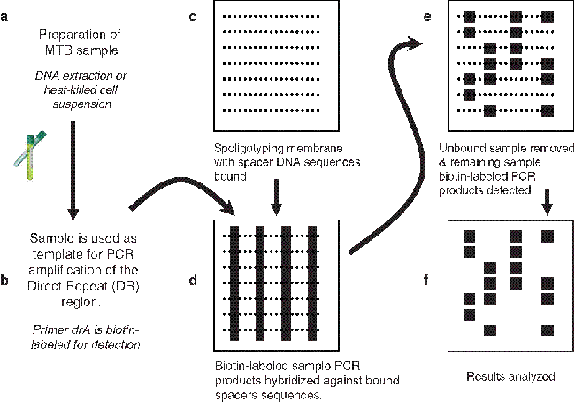
Simple example: spoligotyping
Presence absence of CRISPR spacers
Spacer oligo typing
Same pattern: same type
https://link.springer.com/protocol/10.1007/978-1-60327-999-4_10

Slide 5
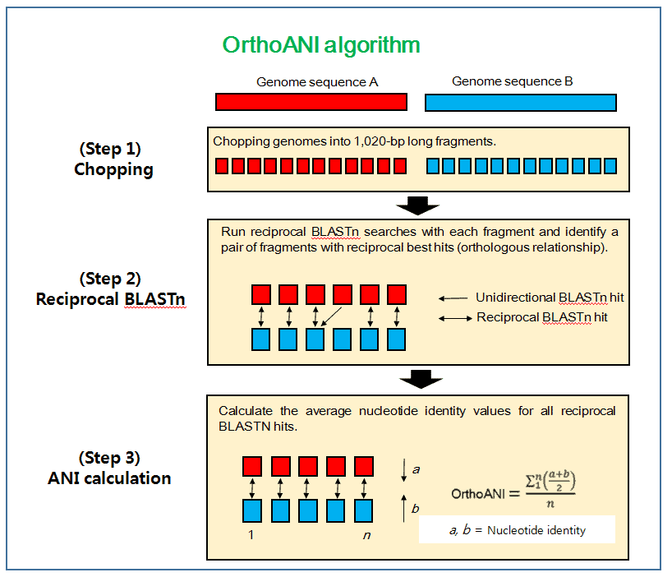
Species typing: ANI
Average nucleotide diversity
Find all the homologous (shared) sections of two genomes
How many nucleotides are identical in those shared sections?
Divide by the length of the shared sections of DNA
This is the ANI
https://link.springer.com/protocol/10.1007/978-1-60327-999-4_10

Slide 6
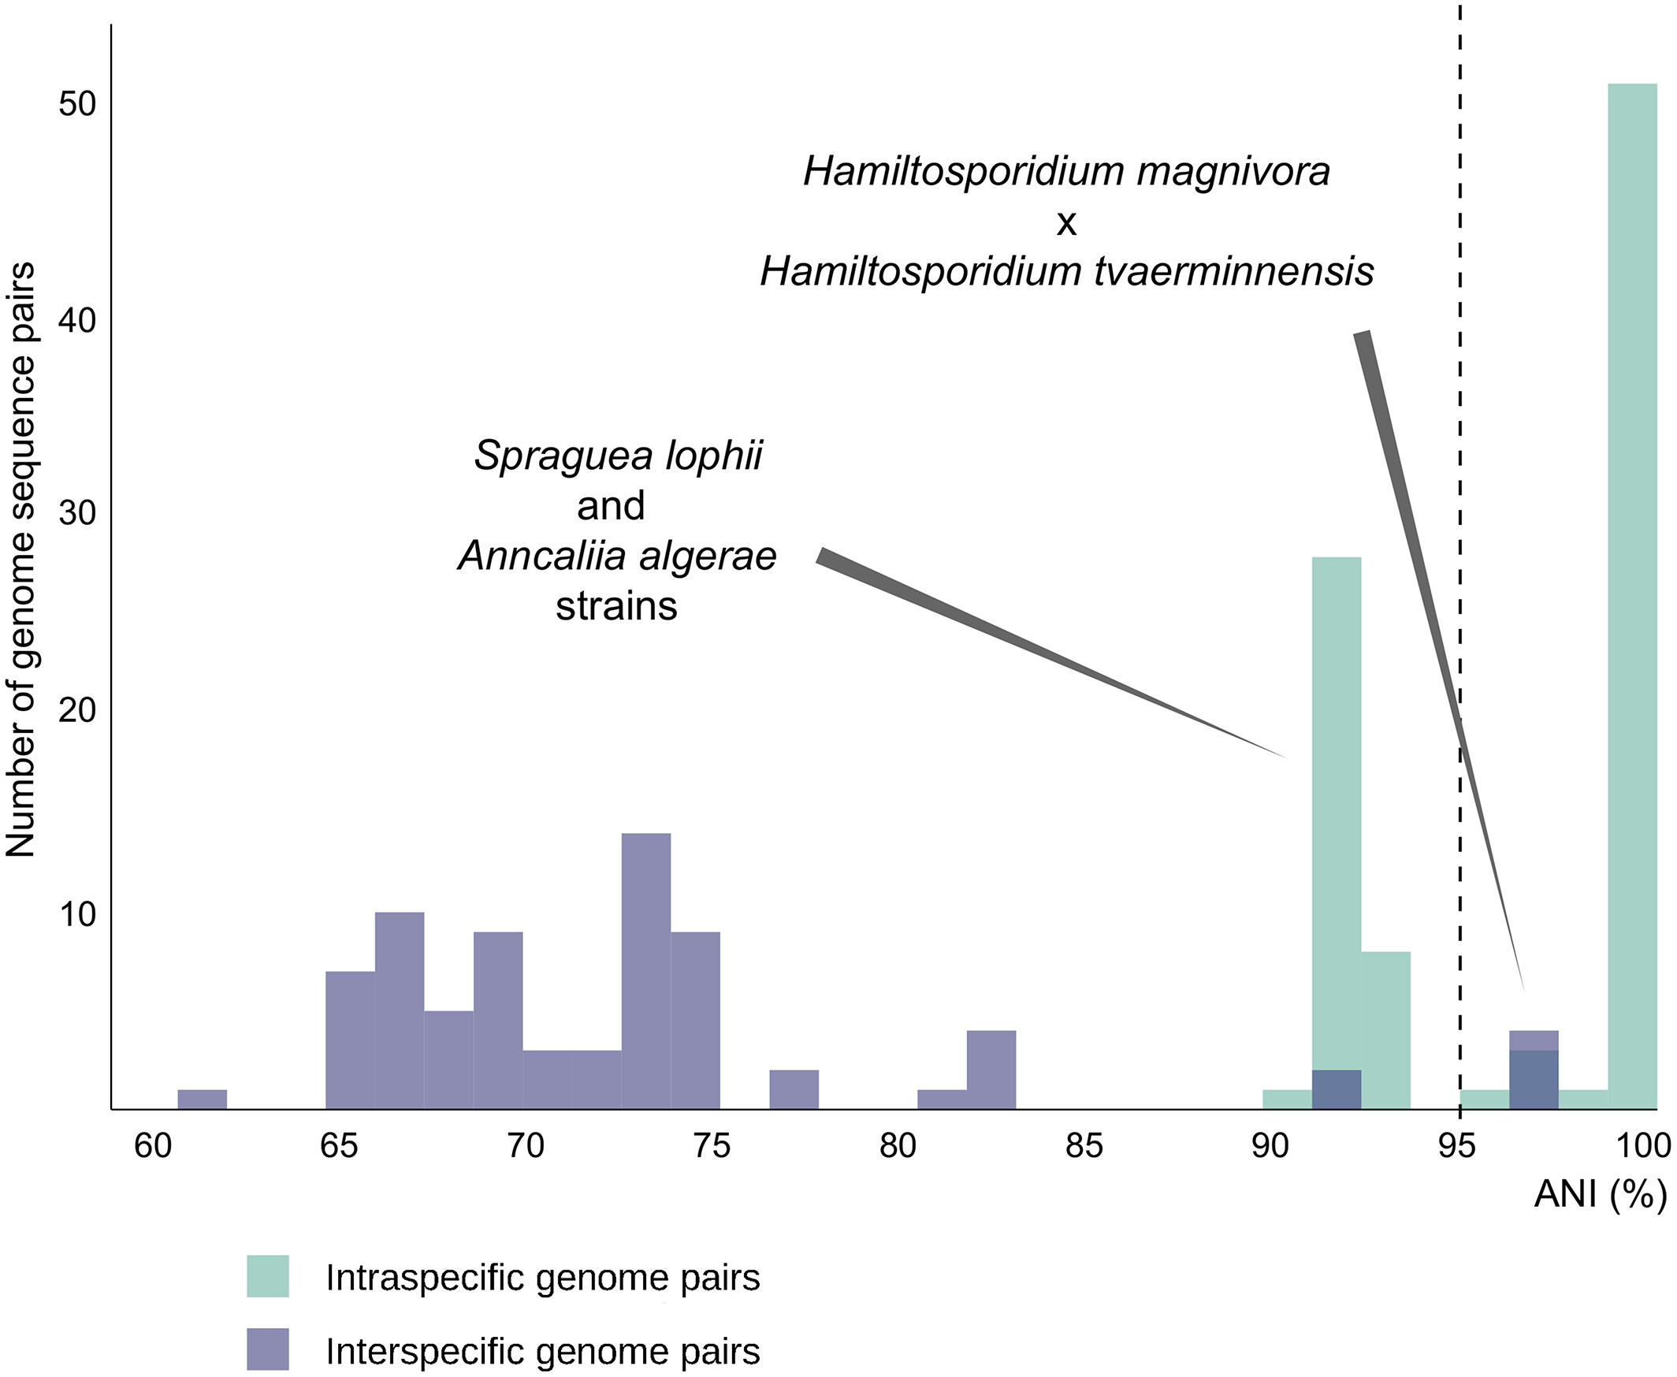
Species typing: ANI
ANI ≥ 95%:
Same species
Often make exceptions for clinical characteristics
ANI≥98%:
Same subspecies
Not a standard cut-off
Programs:
fastANI
OrthoANI
Albuquerque & Haag, Euk Micro 2022

Slide 7
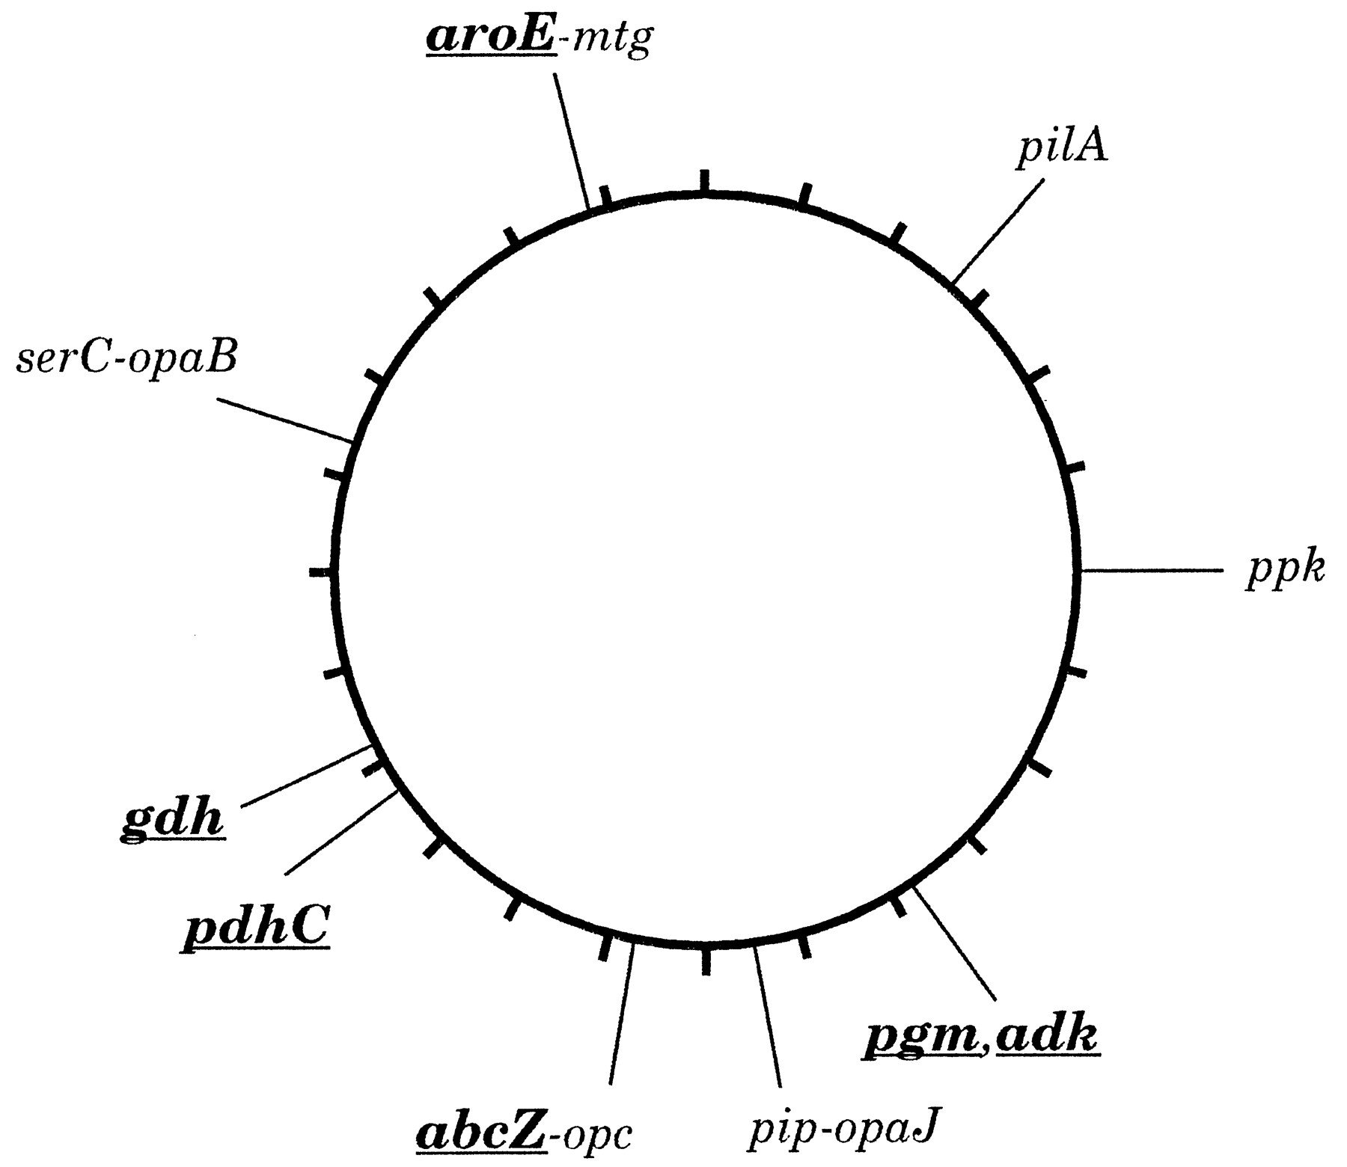
MLST
Multi-locus sequence typing
Used to define groups within a species
A set of housekeeping (universal genes) is selected for the species
Usually 7-10 genes
Maiden et al PNAS 1998

Slide 8
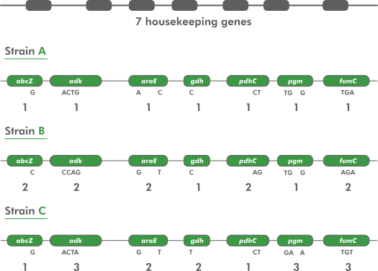
MLST assignment
Alleles are assigned a type code based on unique sequences across all genes in the scheme
Often SNPs in each gene
Query sequences are assigned to allele types if they match the sequence of that allele
https://www.applied-maths.com/applications/mlst

Slide 9
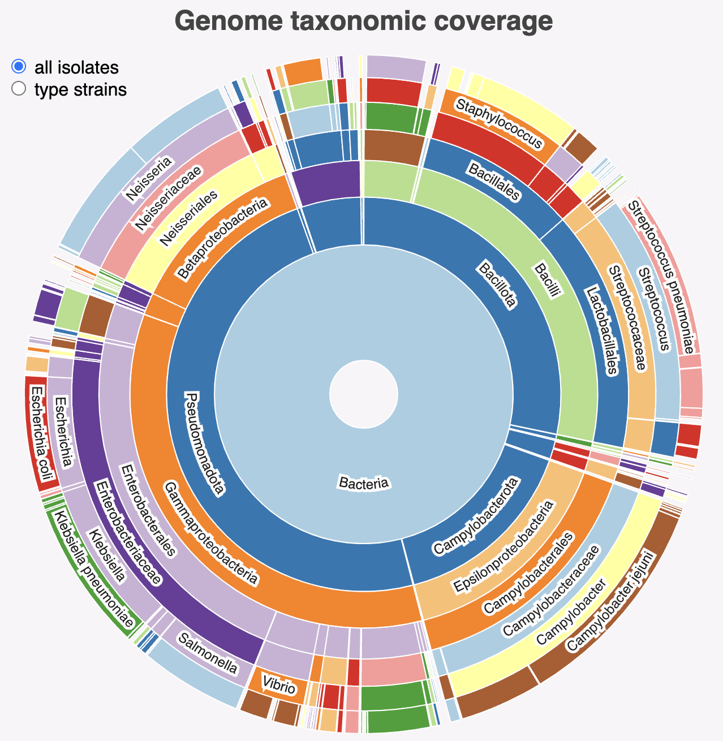
MLST schemes
Schemes exist for many common bacterial species
PubMLST contains most schemes
135 organisms included
Can create your own and include if not present
https://pubmlst.org/mlst
MLST tool will scan contigs against these schemes and type your sample
https://github.com/tseemann/mlst
https://pubmlst.org/species-id

Slide 10
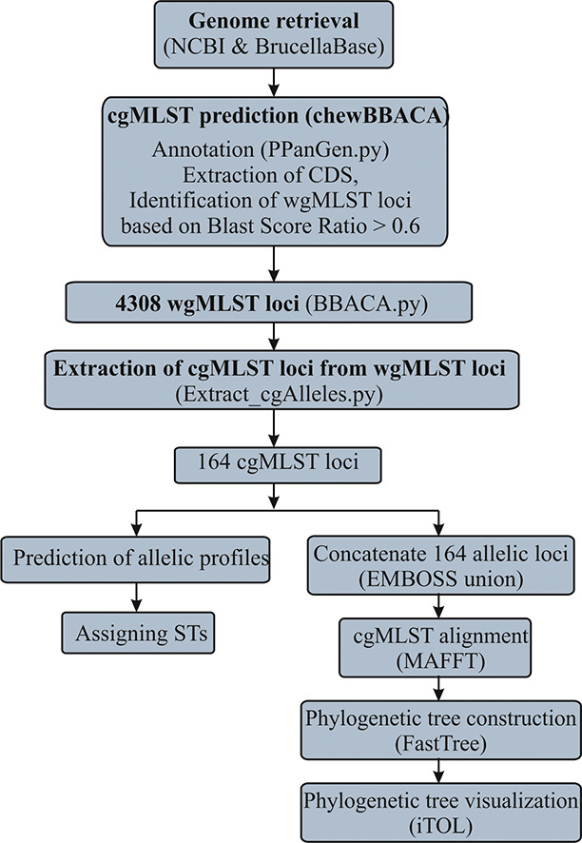
cgMLST
MLST relies on a few genes to type a sample
May not be enough signal
Doesn’t work for very monomorphic species
Can create an expanded MLST using all genes shared by all strains within a species
Tends to be hundreds or even thousands
Core genome MLST (cgMLST)
https://www.cgmlst.org/ncs contains many cgMLST schemes
Can create own with tools like chewBBACA
Sankarasubramanian et al IGE, 2019

Slide 11
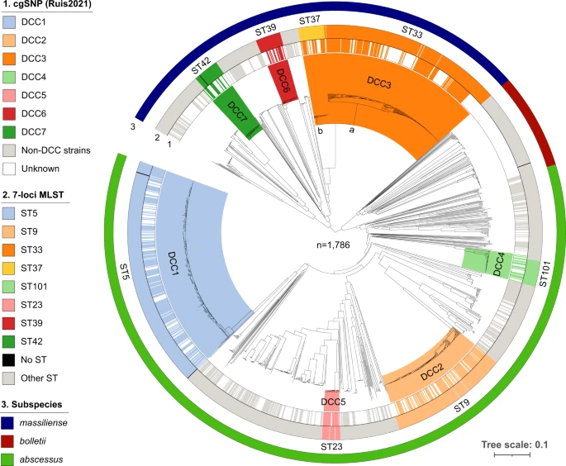
cgMLST for defining strains
MLST will split species/subspecies into a few groups
Not informative enough for local clustering
Useful for tracking circulating types as doesn’t not over split data
cgMLST will split MLST into more granular groups
Good for tracking bacteria with variable genomes
May not find specific transmission cluster
Diricks et al Nat Comm 2022

Slide 12
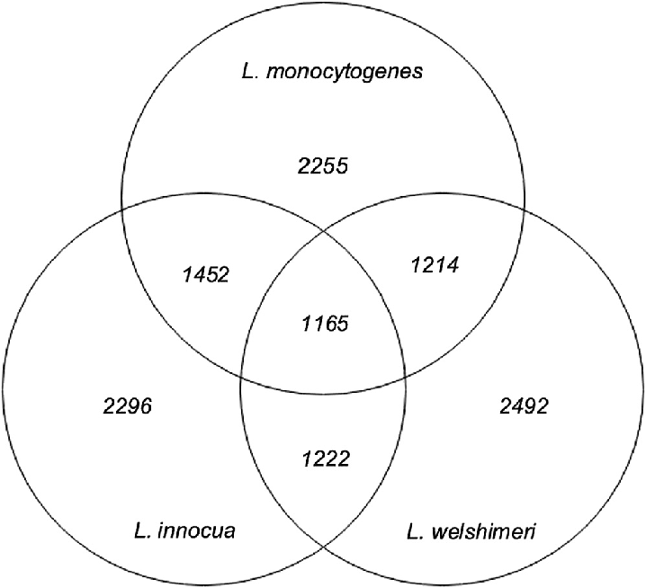
Scheme-free typing
Many species have no scheme associated
Build your own?
cgMLST usually does not give enough resolution for outbreaks
Disregards all non-core (intersection) parts of genomes
Outbreaks don’t always need a scheme
Want to know what samples are closely related
Mufana et al Micro Spectr 2022

Slide 13
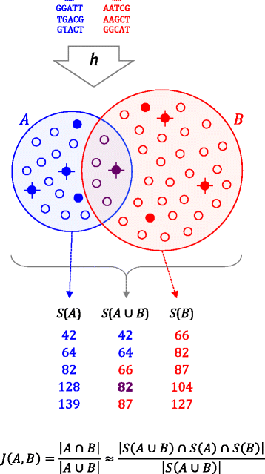
MinHash-based approaches
Mash (based on MinHash)
Use k-mers to get a distance between two samples
Reduces sequences down to ‘sketches’
Easy to search and get distances
Tools built on Mash can find highly relates sequences
Look for shared accessory gene
PopPUNK
Are there transmission clusters in my data?
Do my sequences belong to existing clusters/types?
SourMash
Does a new sequence belong to my outbreak cluster?
Do my sequences belong to existing clusters/types?
Ondov et al Genome Biology 2016

Slide 14
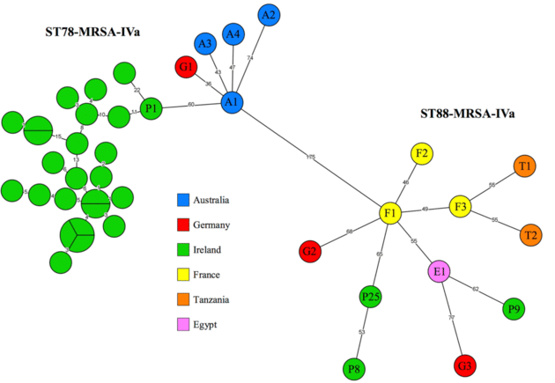
Minimum spanning trees
Parsimony or distance tree based on MLST/cgMLST allele or SNP differences between isolates
Has all the issues of parsimony/distance approaches
Useful for visualising very closely related strains
E.g. Hospital outbreaks
Identical isolates are grouped on a single node and node size is increased
Can be made in PopPUNK or Bionumerics
Earls et al Frontiers in Micro 2018

Slide 15
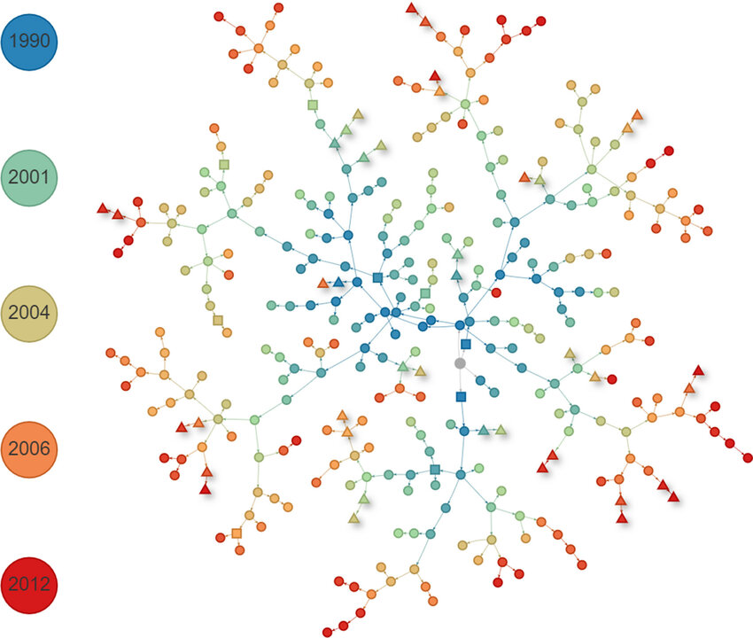
Bayesian phylogenetics-based clustering
Estimate time relationships between samples
Transphylo
Convert phylogenies into transmission trees
Predict unsampled cases
Predict secondary case contact rates
Optimal data:
Dense sampling
Accurate date of sampling
Phylogenetically informative datasets
More SNPs the better
Earls Xu et al MGEN 2020

Slide 16
Learning outcomes
State the different levels at which bacterial typing occurs
Explain the basis of ANI and MLST for species and strain typing
State the differences between MLST and cgMLST in terms of resolution and use
Recognise MinHash and MST approaches for genomic epidemiology

