Slide 1
Strain typing and genomic epidemiology
Conor Meehan (he/they)
conor.meehan@ntu.ac.uk
@con_meehan

Slide 2
Learning outcomes
Typing bacterial strains
ANI
MLST
Species-specific schemes
cgMLST
Lineages
Lineage defining SNPs
Matching samples
Sourmash and sketches
Minimum spanning trees
MRSA example
PopPUNK in variable populations

Slide 3
Molecular typing
The assignment of a sample to a group
or
The separation of samples into different groups
Look at genetic material and assign to a group
Define:
Species
Sub-species
‘Type’ (e.g. lineage)
Transmission cluster

Slide 4
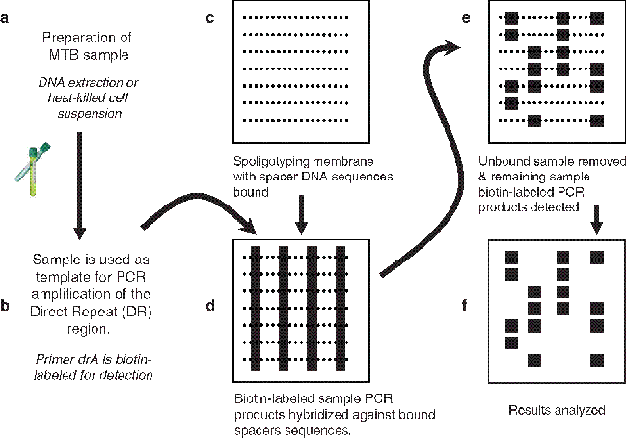
Simple example: spoligotyping
Presence absence of CRISPR spacers
Spacer oligo typing
Same pattern: same type
https://link.springer.com/protocol/10.1007/978-1-60327-999-4_10

Slide 5
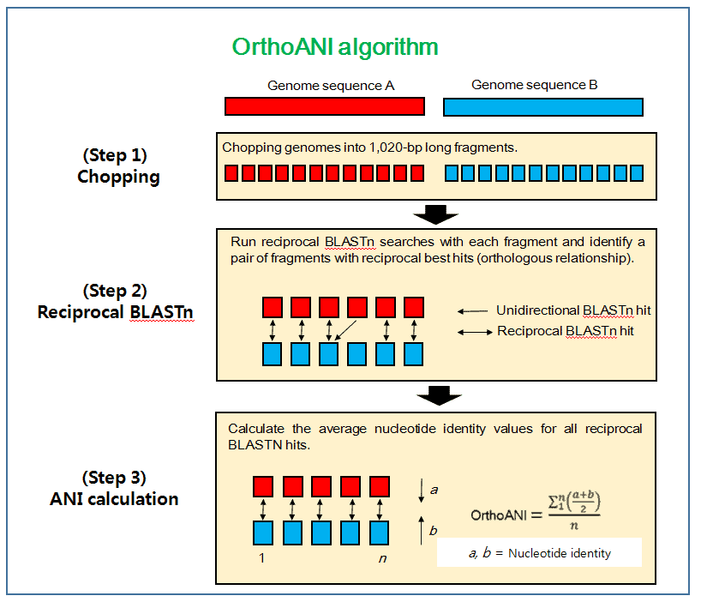
Species typing: ANI
Average nucleotide diversity
Find all the homologous (shared) sections of two genomes
How many nucleotides are identical in those shared sections?
Divide by the length of the shared sections of DNA
This is the ANI
https://link.springer.com/protocol/10.1007/978-1-60327-999-4_10

Slide 6
Species typing: ANI
ANI ≥ 95%:
Same species
Often make exceptions for clinical characteristics
ANI≥98
Same subspecies
Not a standard cut-off
Programs:
fastANI
OrthoANI
https://help.ezbiocloud.net/orthoani-genomic-similarity/

Slide 7
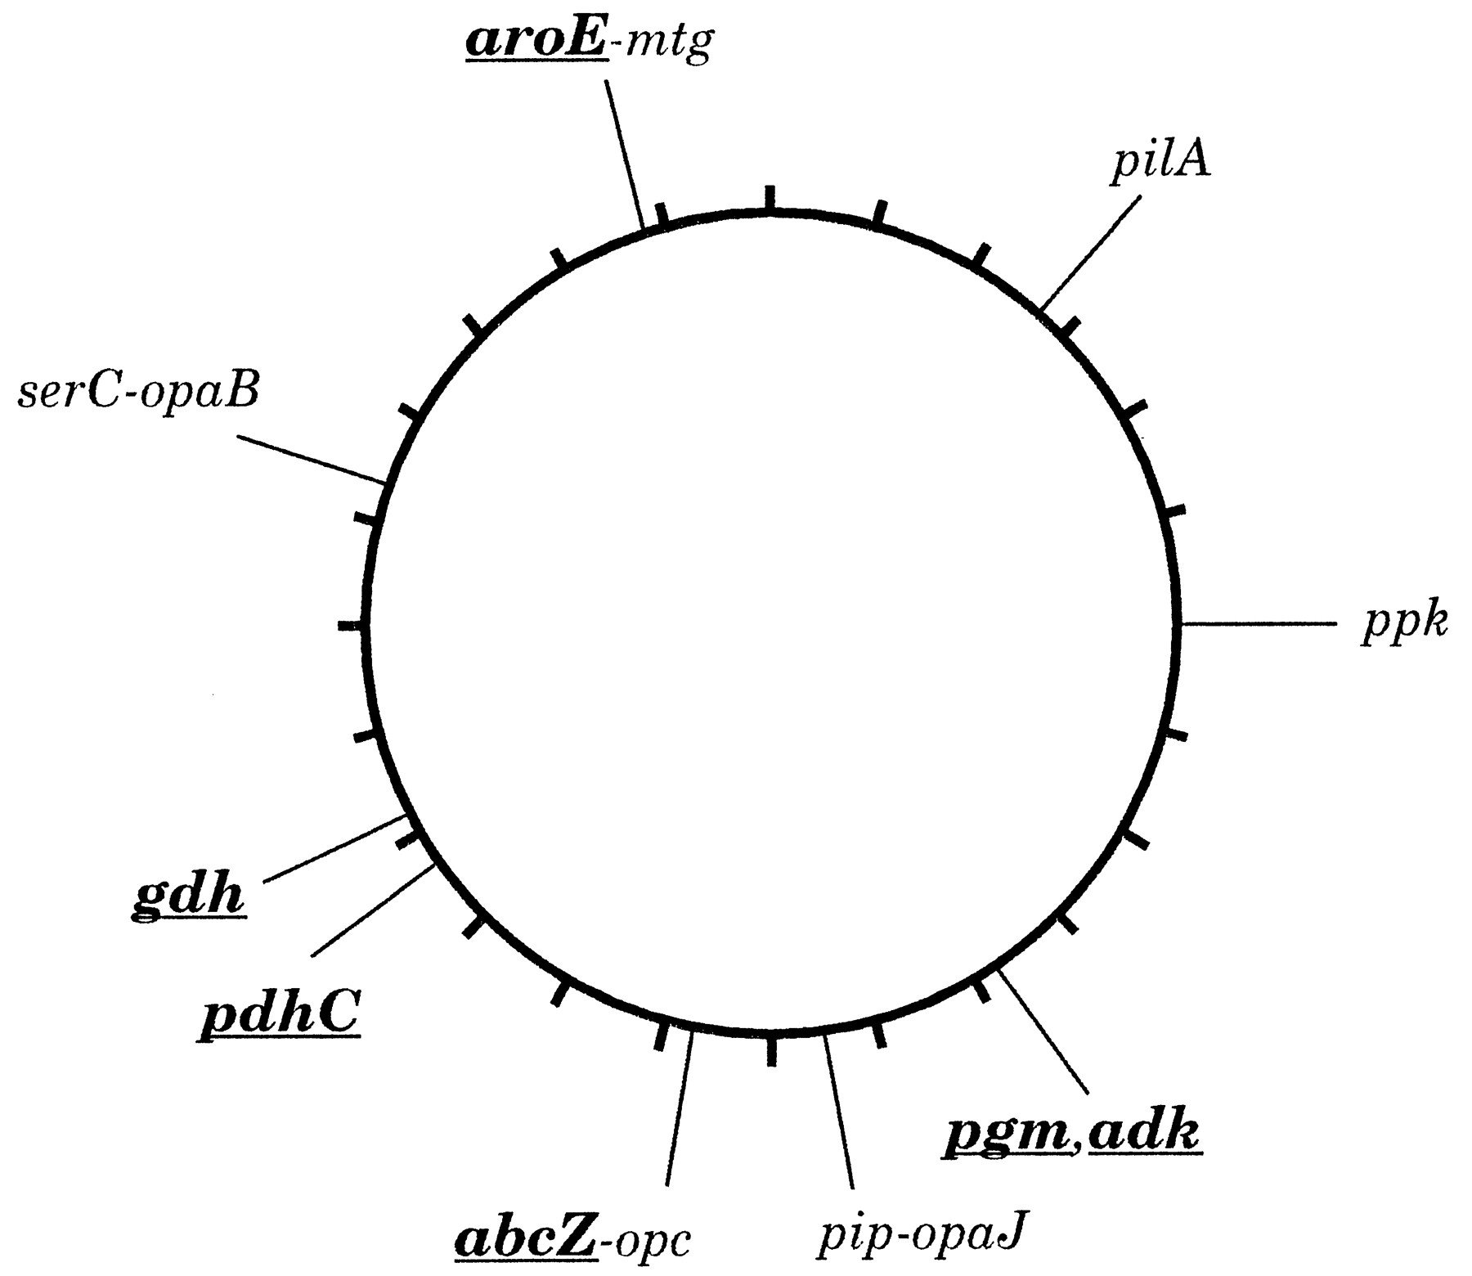
MLST
Multi-locus sequence typing
Used to define groups within a species
A set of housekeeping (universal genes) is selected for the species
Usually 7-10 genes
Maiden et al PNAS 1998

Slide 8
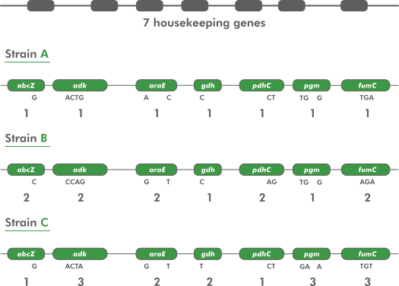
MLST assignment
Alleles are assigned a type code based on unique sequences across all genes in the scheme
Often SNPs in each gene
Query sequences are assigned to allele types if they match the sequence of that allele
https://www.applied-maths.com/applications/mlst

Slide 9
MLST schemes
Schemes exist for many common bacterial species
PubMLST contains most schemes
135 organisms included
Can create your own and include if not present
https://pubmlst.org/mlst
MLST tool will scan contigs against these schemes and type your sample
https://github.com/tseemann/mlst
https://www.applied-maths.com/applications/mlst

Slide 10
Tree Terminology
Internal nodes also called ancestors or parents
The node labelled (internal) node is the most recent common ancestor (MRCA) or A, B and C
(internal) node
Root
Peripheral branch
Taxon (plural: taxa)
or Terminal node
Internal branch

Slide 11
Writing trees on a computer
Trees are represented in a text file using parentheses and commas (newick format)
Every internal node is a comma and the leaf nodes that connect to that internal node have ( ) around them
This tree is represented as:
(((A,B),C),(D,(E,F)))
If we know the lengths of the branches, they are written after each label or ) after a colon
(((A:0.5,B:0.1):0.2,C:0.5):0.3,(D:0.1,(E:0.2,F:0.2)))

Slide 12
Phylogenetic tree representation
Cladogram: Branch lengths have no meaning
(Sometimes have straight or curved lines)
Phylogram: Branch lengths have meaning
(e.g. estimated/expected/observed amount of change or time)
Unrooted: No common ancestor is known or time is not known

Slide 13
Phylogenetic relationships terminology
Monophyletic
A group of taxa that contains an ancestor and all its descendants
Monophyletic group is also referred to as a clade
Polyphyletic
A group of taxa brought together by convergent evolution
Paraphyletic
A monophyletic group where a subgroup has been removed

Slide 14
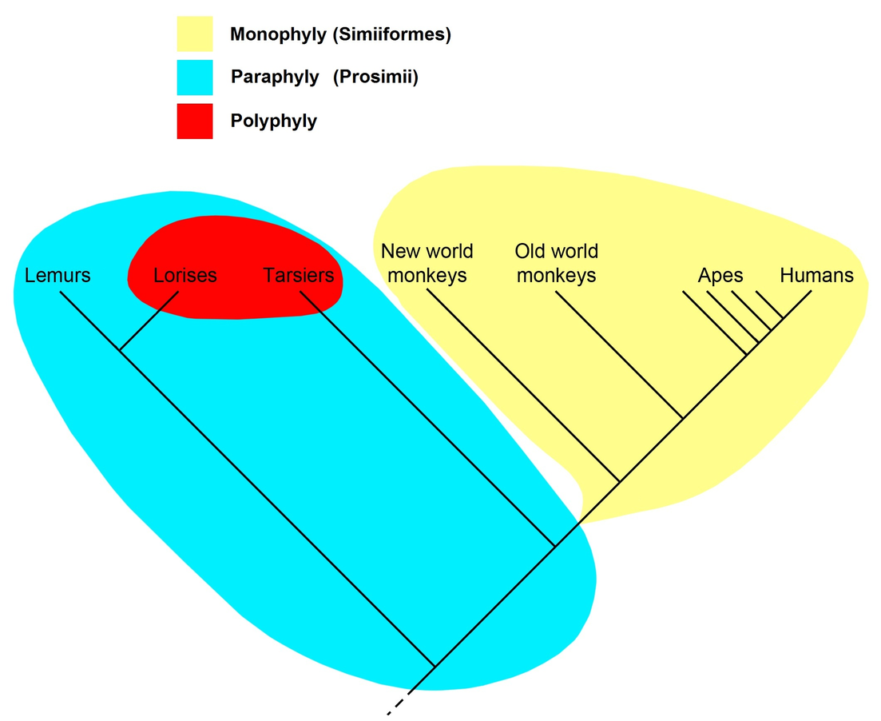
Phylogenetic relationships terminology
Wikipedia

Slide 15
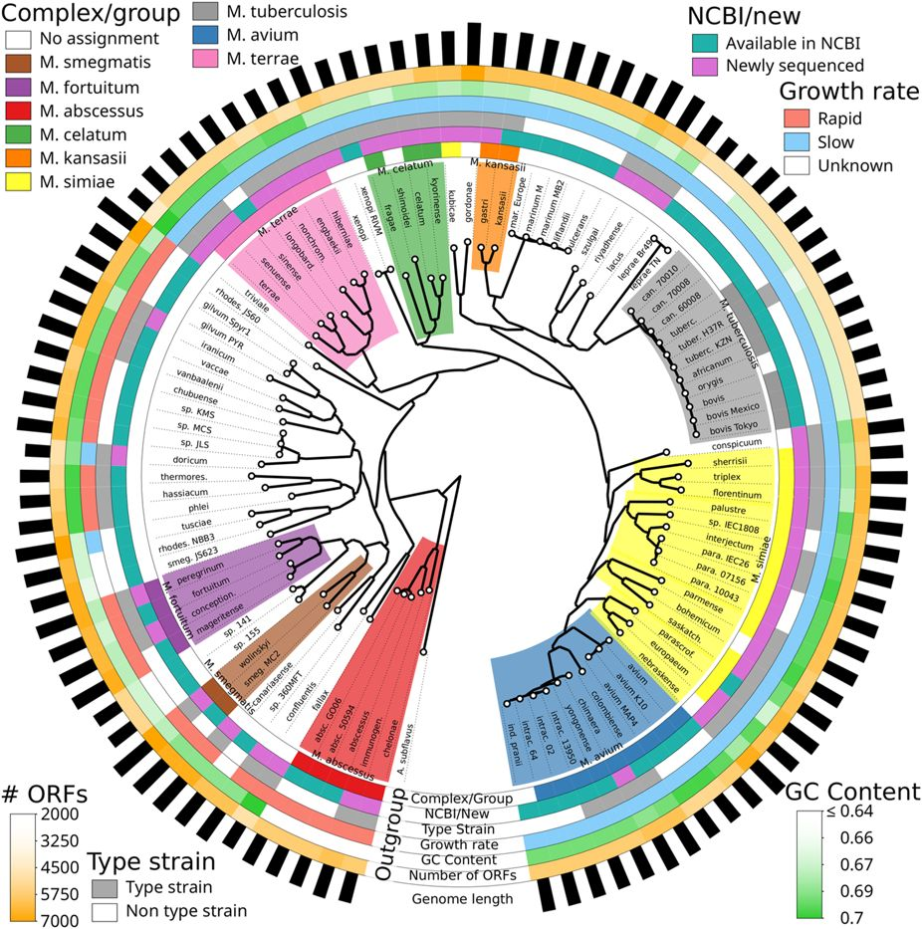
Phylogenetic terminology
Monophyletic
M. avium
Polyphyletic
M. simiae
(M. kubicae separate)
Paraphyletic
M. simiae without M. kubicae
(M. avium shares the same ancestor)
Fedrizzi, Meehan et al, Sci Rep 2017

Slide 16
Phylogenetic nodes terminology
Bifurcating
A node that connects only 2 branches
Multifurcating (polytomy)
A node in a tree which connects more than two branches
In-group/out-group
In-group is the set of taxa of interest. Assumed to be monophyletic
Out-group is a related set of taxa to the in-group, used for rooting

Slide 17
Phylogenetic nodes terminology
Multifurcating node
In-group
Bifurcating node
Out-group
(if we only used
it to place root)

Slide 18
In-group vs out-group example
Research into L8 and its relationshop to L1-L7
In-group
M. canettii used as outgroup
Allows us to see placement of L8 samples
Ngabonziza et al, Nat Comms 2020

Slide 19
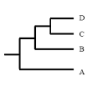
Tasks 1
Do sampled taxa sit at the end of internal or external branches of a phylogenetic tree?
What does monophyletic mean?
How many offspring does a bifurcating node have?
How do you write this tree in newick format?
I.e. using the ( X, Y ) format

Slide 20
How do we create a phylogeny?
Use an optimality criterion to define how we measure the fit of the data to a solution
Tree-search method: how do we decide between possible solutions?
Simplest is parsimony
Referred to as non-parametric
The tree that represents the minimum number of character changes between taxa is the optimal solution

Slide 21
A morphological example
Feature | Lamprey | Antelope | Bald eagle | Alligator | Sea bass
Lungs
Jaws
Feathers
Gizzard
Fur

Slide 22
A morphological example
Feature | Lamprey | Antelope | Bald eagle | Alligator | Sea bass
Lungs | 0 | + | + | + | 0
Jaws | 0 | + | + | + | +
Feathers | 0 | 0 | + | 0 | 0
Gizzard | 0 | 0 | + | + | 0
Fur | 0 | + | 0 | 0 | 0

Slide 23
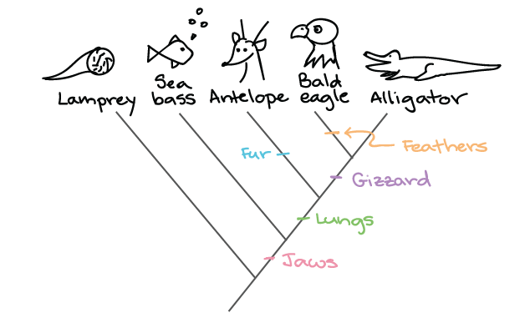
A morphological parsimony example
Parsimony looks for the least amount of changes that explain the relationships
https://www.khanacademy.org/science/biology/her/tree-of-life/a/building-an-evolutionary-tree

Slide 24
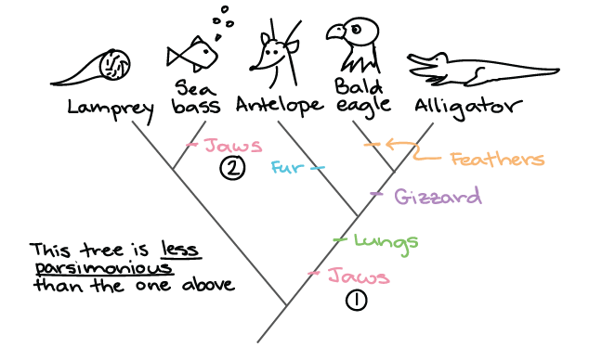
A morphological parsimony example
Parsimony looks for the least amount of changes that explain the relationships
https://www.khanacademy.org/science/biology/her/tree-of-life/a/building-an-evolutionary-tree

Slide 25
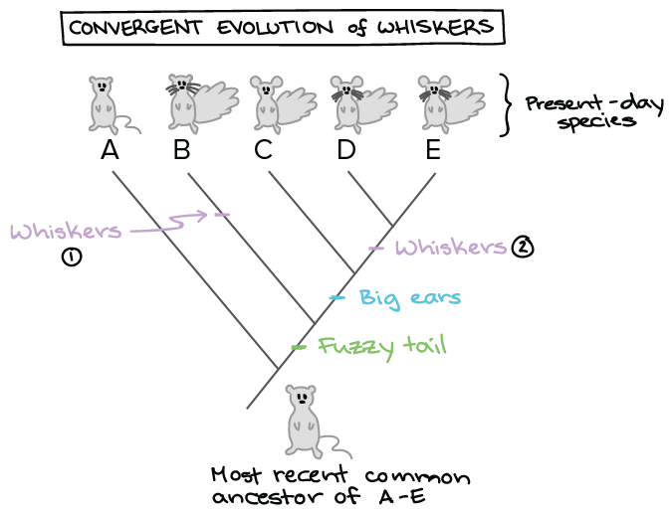
The primary problem with parsimony
Convergent evolution: the evolution of the same trait multiple times
E.g. wings in bats and birds
https://www.khanacademy.org/science/biology/her/tree-of-life/a/building-an-evolutionary-tree

Slide 26
Use of molecular data in phylogenetics
Phylogeny is most often undertaken using molecular data
Nucleotides/DNA sequence (sometimes RNA sequences)
Amino acids/Protein sequence
Less sensitive to convergent evolution
Parsimony also can be used on molecular data
Use G, T, C, A or amino acids as the characters
Fine on very closely related isolates (e.g. local transmission cluster seperated by a couple of SNPs)
Early tree building used distance based methods
Semi-parametric
Get a distance between 2 sequences
Sequences with shortest distance are most related
Most often uses UPGMA or neighbour joining method

Slide 27
UPGMA (sequences)
S1: TTCAG
S2: TTCGG
S3: TTTTG
S4: TTATG
S5: AACTG

Slide 28
UPGMA (distance matrix)
S1: TTCAG
S2: TTCGG
S3: TTTTG
S4: TTATG
S5: AACTG
 | S1 | S2 | S3 | S4 | S5
S1
S2
S3
S4
S5
Note: count as differences, not as number of characters in common
Dissimilarity is differences/total sites

Slide 29
UPGMA (filled distance matrix)
S1: TTCAG
S2: TTCGG
S3: TTTTG
S4: TTATG
S5: AACTG
 | S1 | S2 | S3 | S4 | S5
S1 | - | 0.2 | 0.4 | 0.4 | 0.6
S2 | 0.2 | - | 0.4 | 0.4 | 0.6
S3 | 0.4 | 0.4 | - | 0.2 | 0.6
S4 | 0.4 | 0.4 | 0.2 | - | 0.6
S5 | 0.6 | 0.6 | 0.6 | 0.6 | -
Note: count as differences, not as number of characters in common
Dissimilarity is differences/total sites

Slide 30
UPGMA tree building steps
Start with every sequence in its own cluster
Select the smallest distance between clusters
Create a new cluster by joining these two
Branch lengths are distance/2
Get the distance from that cluster to all others
Use a proportional average distance (i.e. using size of cluster*distance)
Repeat steps 2 and 3 until complete
We will do this in the hands on session

Slide 31
UPGMA tree building steps
S1-S2 and S3-S4 are both smallest so randomly choose S1-S2
New distances to S3 is (0.4+0.4)/2= 0.4
Repeat for all sequences
Get smallest distance and repeat 1 and 2 to build entire tree
S1: TTCAG
S2: TTCGG
S3: TTTTG
S4: TTATG
S5: AACTG
 | S1 | S2 | S3 | S4 | S5
S1 | - | 0.2 | 0.4 | 0.4 | 0.6
S2 | 0.2 | - | 0.4 | 0.4 | 0.6
S3 | 0.4 | 0.4 | - | 0.2 | 0.6
S4 | 0.4 | 0.4 | 0.2 | - | 0.6
S5 | 0.6 | 0.6 | 0.6 | 0.6 | -

Slide 32
UPGMA tree building steps
What about unobserved back mutations over long periods of time?
A->G->A in a sequence
Underestimated distances
Are all substitutions equal?
Some more likely than others
Transitions vs transversions
Need to correct distances
Use a model of evolution
See optional separate lecture
S1: TTCAG
S2: TTCGG
S3: TTTTG
S4: TTATG
S5: AACTG

Slide 33
Tasks 2
Is parsimony a non-parametric or semi-parametric method?
What is the main drawback of parsimony methods?
Is UPGMA a non-parametric or semi-parametric method?
Do you pick the samples with the smallest or largest distance at each step of the distance approach?

Slide 34
Break

Slide 35
Parametric methods of phylogenetic inference
Previously seen methods take 2 sequences and calculate a distance and continue in a pairwise manner through the whole set of sequences
Parametric methods take a column in an alignment and calculate the optimality criterion per position in alignment
Positions are independent
There are two main parametric methods of phylogenetic inference:
Maximum likelihood
Bayesian analysis
Both methods:
Search tree space to find the best tree
Require an explicit model of evolution
Usually GTR
Can incorporate rate heterogeneity

Slide 36
Tree space searching
Imagine a blind person is dropped randomly in the world and told to find Mount Everest (the global maximum)
They walk in a random direction until they find a section that is sloped upwards
They continue to walk upwards until every direction around them is a downwards slope
They conclude that since they are at the highest point, they must be on Everest
Thus, the highest position they stand at has the maximum likelihood of being Everest, given the data and starting point

Slide 37
Tree space searching
Likelihood
Trees

Slide 38
Tree space searching
Likelihood
X
Random starting tree
Trees

Slide 39
Tree space searching
Likelihood
Search for better trees
X
Trees

Slide 40
Tree space searching
X
Reach the maximum likelihood tree
(In theory, closest to true true)
Likelihood
X
Trees

Slide 41
Tree space searching
Likelihood
X
Random starting tree
Trees

Slide 42
Tree space searching
Likelihood
Search for better trees
X
Trees

Slide 43
Tree space searching
A local maximum tree is better than those that are close by (maybe only differ by one or two branch positions) but is not the best overall tree.
Likelihood
Stuck in local maximum
X
X
Trees

Slide 44
Tree space searching
X
Maximum likelihood tree
(Global maximum)
Likelihood
Local maximum
X
Trees

Slide 45
Tree space searching
The problem is that if they only walk upwards they could get stuck in a local maximum
Computer programs will implement different strategies to try and get around this
Multiple starting points
Multiple searches at once; can switch between searching chains
Allow large and small rearrangements
Allow some steps backwards to try improve score

Slide 46
Maximum Likelihood (ML)
A tree topology is proposed
A likelihood score is calculated for each position and added up to get an overall likelihood score for the data for a given tree topology
Uses P(v) for the proposed branches (see models of evolution lecture)
Searches tree space and tries to find the tree that has the maximum likelihood of generating the given data
Compare topologies through optimising variables for each to fit data
Example programs: RAxML, IQ-TREE, PAUP*, PhyML
S1: TTCAG
S2: TTCGG
S3: TGTTG
S4: TGATG
S5: AACTG
Total likelihood: 1225
Repeat for new topology
100
350
etc…

Slide 47
Bootstrapping
Bootstrapping is a method to test the reliability of an inferred tree
Algorithm (for an alignment of M taxa and N columns):
Create a new alignment of length N from original, sampling columns at random with replacement
Create a new topology for this using the same method
Often in ML analysis this is done with some extra heuristics to speed up the process
Compare topology to original
Every branch that is the same is given a score of 1, any that are not present are given a score of 0
Repeat hundred(s) of times and report as a percentage found for each branch
S1: TTCAG
S2: TTCGG
S3: TGTTG
S4: TGATG
S5: AACTG
S1: GACAC
S2: GGCGC
S3: GTTTT
S4: GTATA
S5: GTCTC

Slide 48
Phylogenetic tree building summary
Can be done on morphological or molecular data
Molecular less likely to be affected by convergent evolution
Many methods for building trees exist, each with its own criteria for the best fit for the data
Parsimony
Distance
Maximum Likelihood/Bayesian
Most methods require a model of evolution to give information on how the sequences evolved (see models of evolution learning package)
Complex algorithms such as ML or Bayesian require efficient searching of the tree space

Slide 49
Tasks 3
What are the main ways to avoid getting stuck in a local maximum in tree searching?
Does maximum likelihood go sequence by sequence or column by column?
In ML, at each step do you change the alignment or the tree?
In bootstrapping is sampling done with or without replacement?

Slide 50
Learning outcomes
Identify the various sections of a phylogenetic tree
Define various phylogenetic terminology
Describe the process of parsimony tree building
Translate a distance matrix into a phylogeny
Discuss the drawbacks of non- and semi-parametric phylogenetic methods
Describe the process of tree space searching
Recognise the maximum likelihood and bootstrap approaches

