Slide 1


What’s in a name? Bacterial nomenclature bioinformatics workshop
Conor Meehan (He/They)
conor.meehan@ntu.ac.uk
@con_meehan

Slide 2
Defining a species

Slide 3
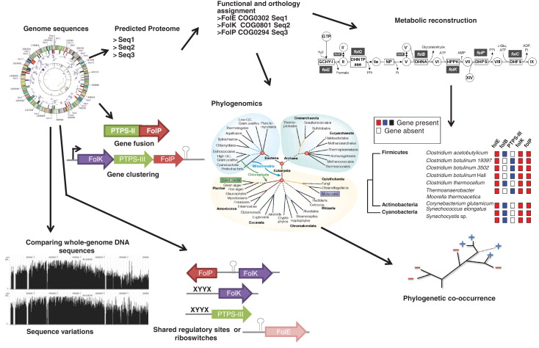
Comparative genomics
Delsuc et al Nat Rev Gen 2005

Slide 4
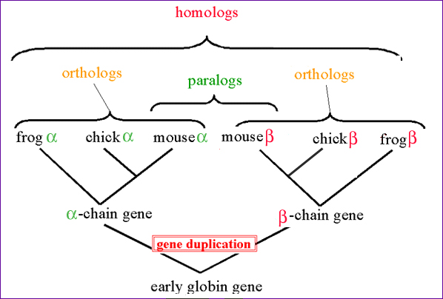
Homologs
Two genes are said to be homologs if they share an ancestor
3 types:
Ortholog
Paralog
Xenolog
http://www.discoveryandinnovation.com/bioinformatics/glossary_detail/homolog.html

Slide 5
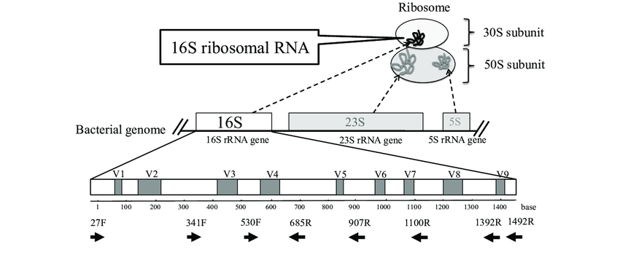
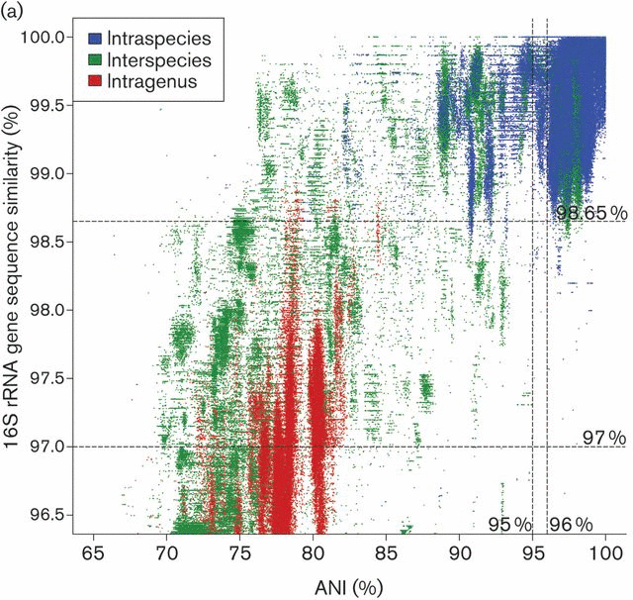
16S rRNA gene
Core gene for prokaryotic taxonomy
Sequence similarity
Compare whole gene sequences
>98% similar
Same species
Difficulties for species with large pangenomes
Kim et al IJSEM 2014
Fukuda et al JUOEH 2016

Slide 6
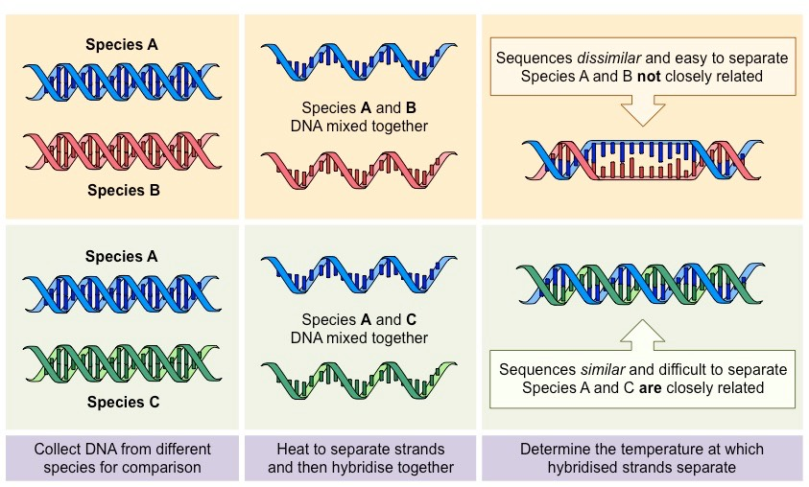
DNA:DNA Hybridisation (DDH)
DNA similarity of 70%
5°C melting
Same species
DNA similarity of 79%:
Same subspecies
Build phylogenies from distance matrices
Paralogs cause issues
https://ib.bioninja.com.au/standard-level/topic-5-evolution-and-biodi/54-cladistics/in-situ-hybridisation.html

Slide 7
Species typing: dDDH
In silico version of DDH
Comparison of genomes X and Y using BLAST
Find orthologous stretches of DNA
High-scoring segments pair (HSPs)
Calculate how much of genome X and Y are covered by HSPs
dDDH coverage formula:
Implemented in TYGS webserver
Henz et al Bioinformatics 2004

Slide 8
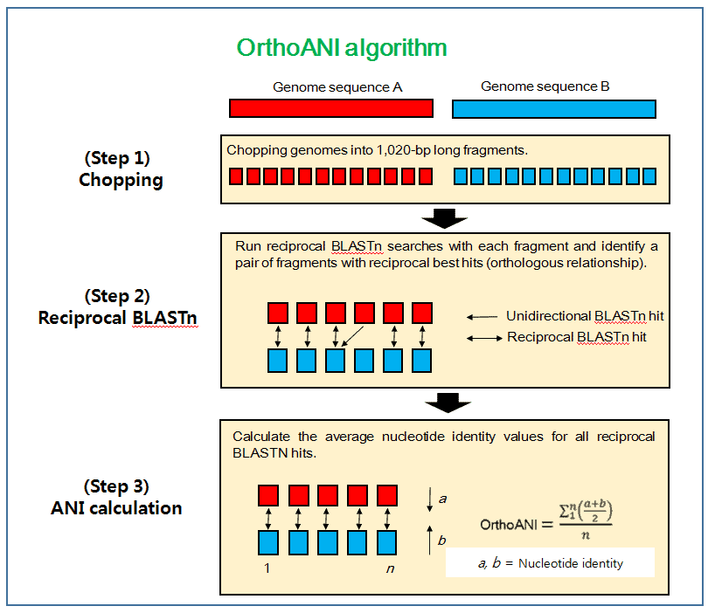
Species typing: ANI
Average nucleotide diversity
Find all the homologous (shared) sections of two genomes
How many nucleotides are identical in those shared sections?
Divide by the length of the shared sections of DNA
This is the ANI
https://link.springer.com/protocol/10.1007/978-1-60327-999-4_10

Slide 9
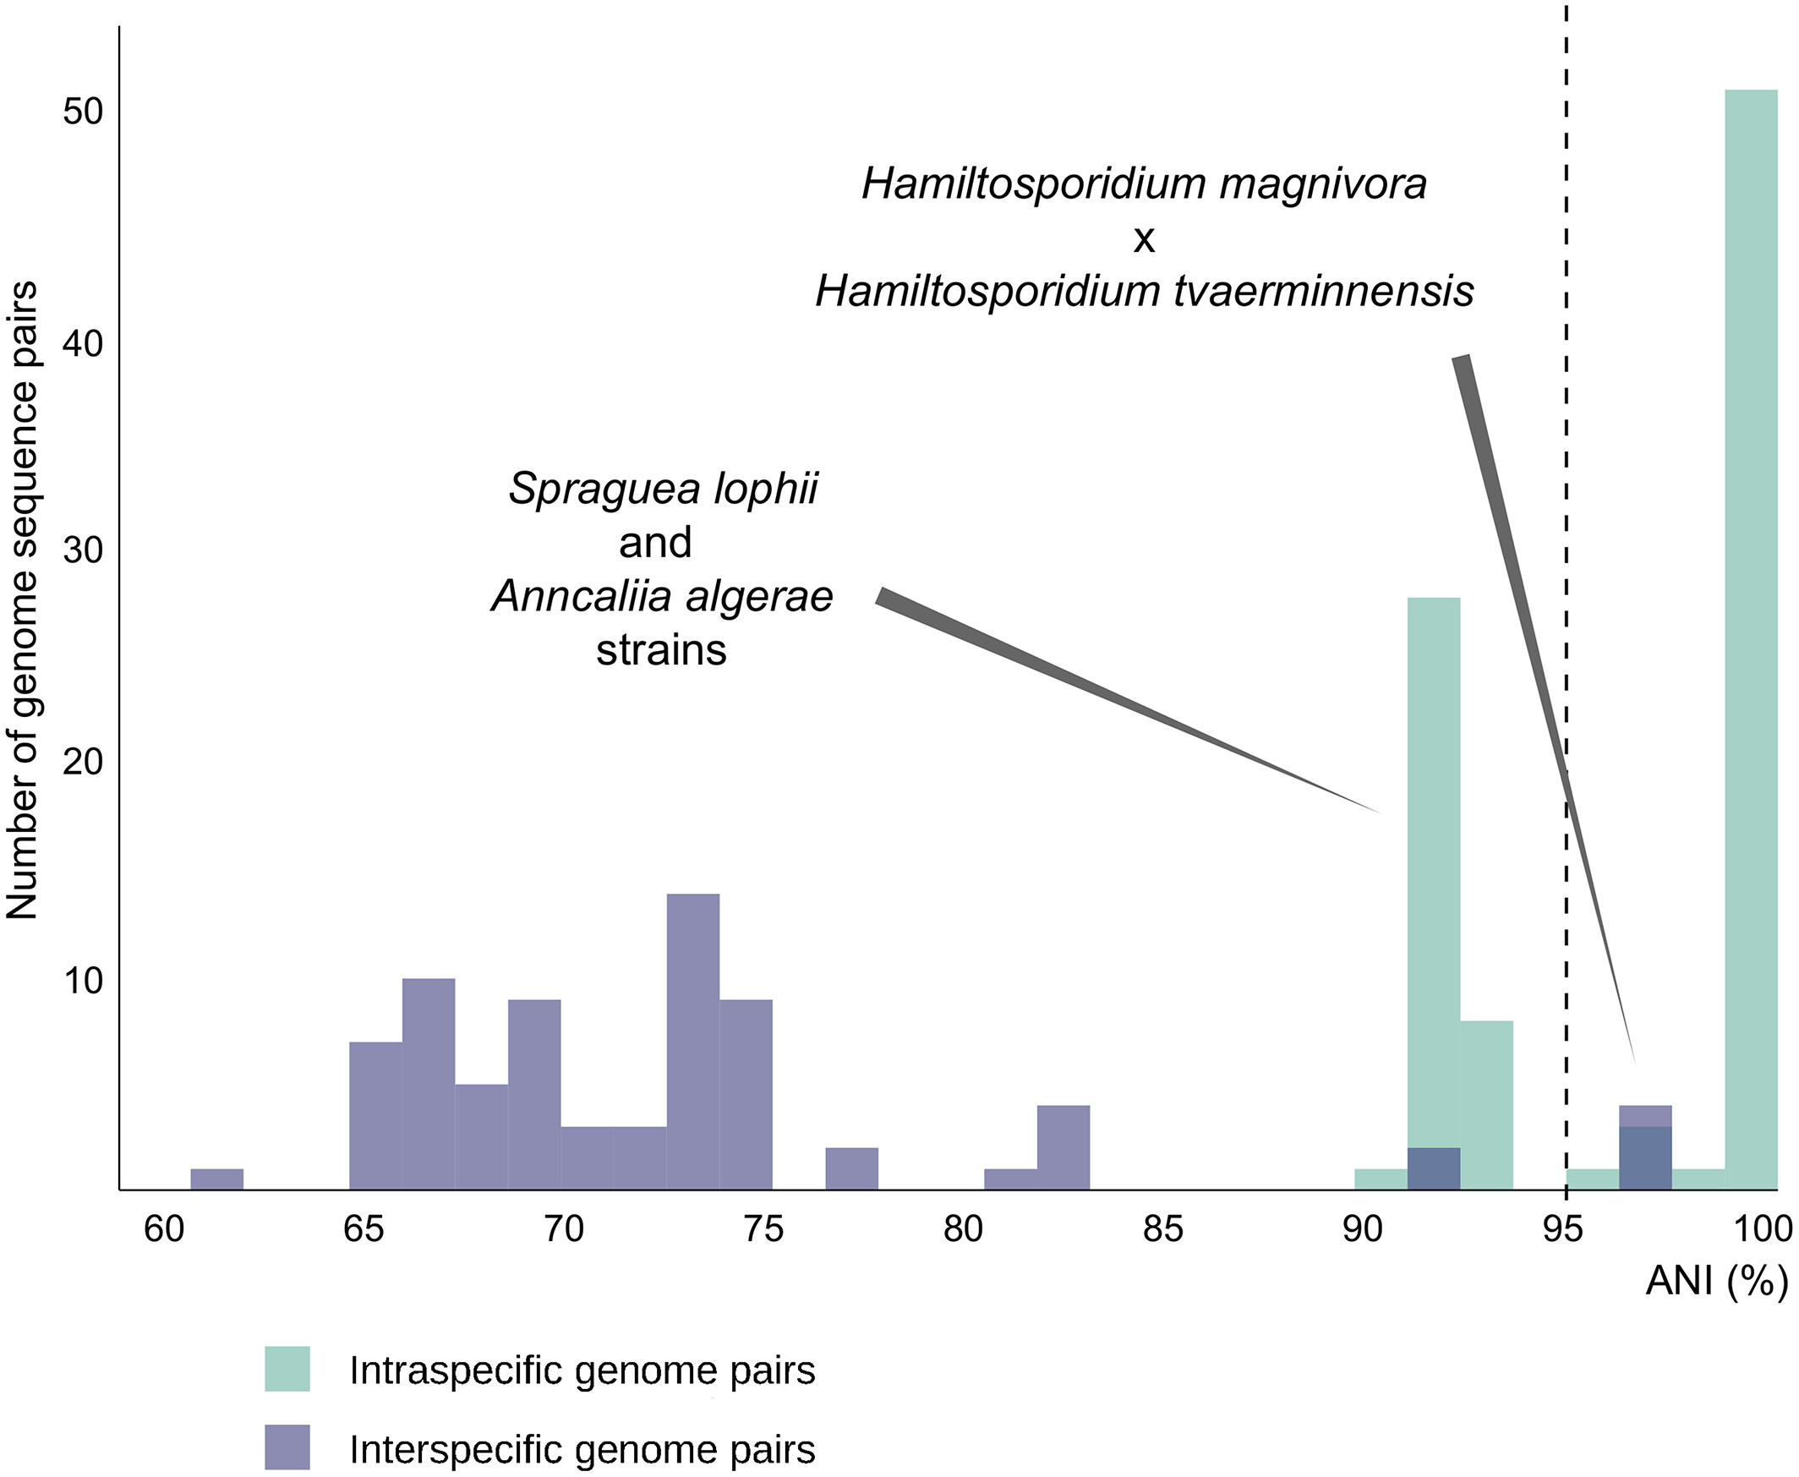
Species typing: ANI
ANI ≥ 95%:
Same species
Often make exceptions for clinical characteristics
ANI ≥ 98%:
Same subspecies
Not a standard cut-off
Programs:
fastANI
OrthoANI
Albuquerque & Haag, Euk Micro 2022

Slide 10
Questions? Workshop time!
https://conmeehan.github.io/NomenclatureWorkshop/NomenclatureWorkshop.html

Slide 11
Defining within a species

Slide 12
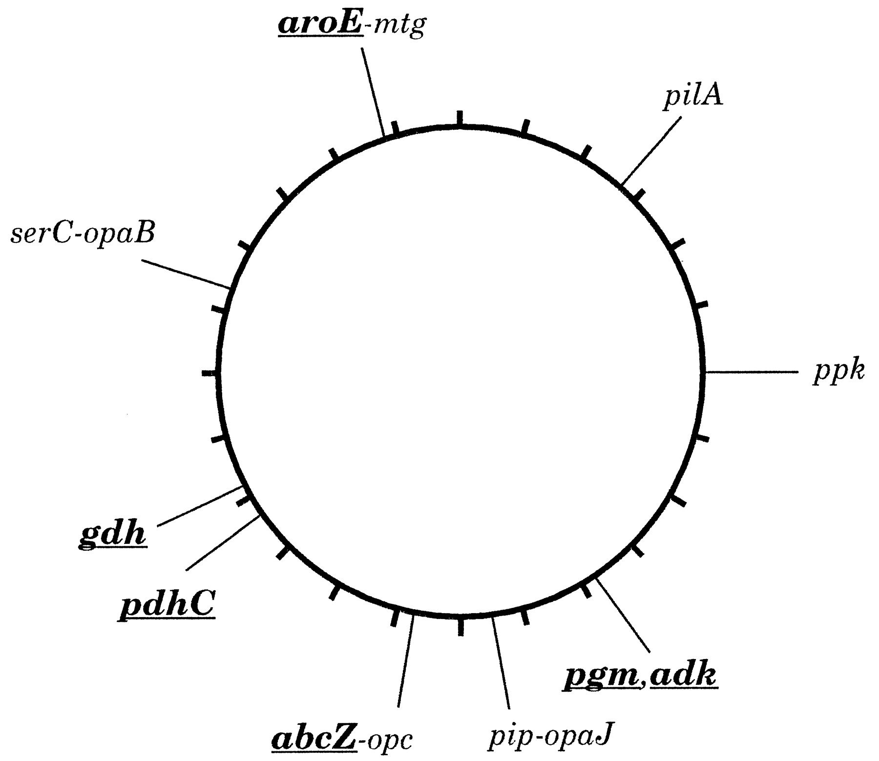
MLST
Multi-locus sequence typing
Used to define groups within a species
A set of housekeeping (universal genes) is selected for the species
Usually 7-10 genes
Maiden et al PNAS 1998

Slide 13
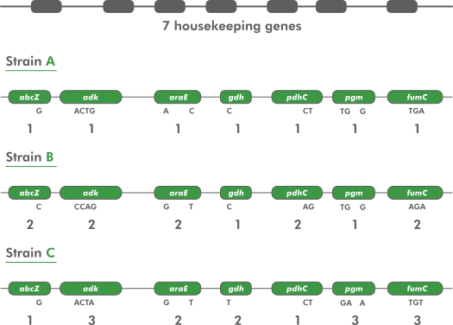
MLST assignment
Alleles are assigned a type code based on unique sequences across all genes in the scheme
Often SNPs in each gene
Query sequences are assigned to allele types if they match the sequence of that allele
https://www.applied-maths.com/applications/mlst

Slide 14
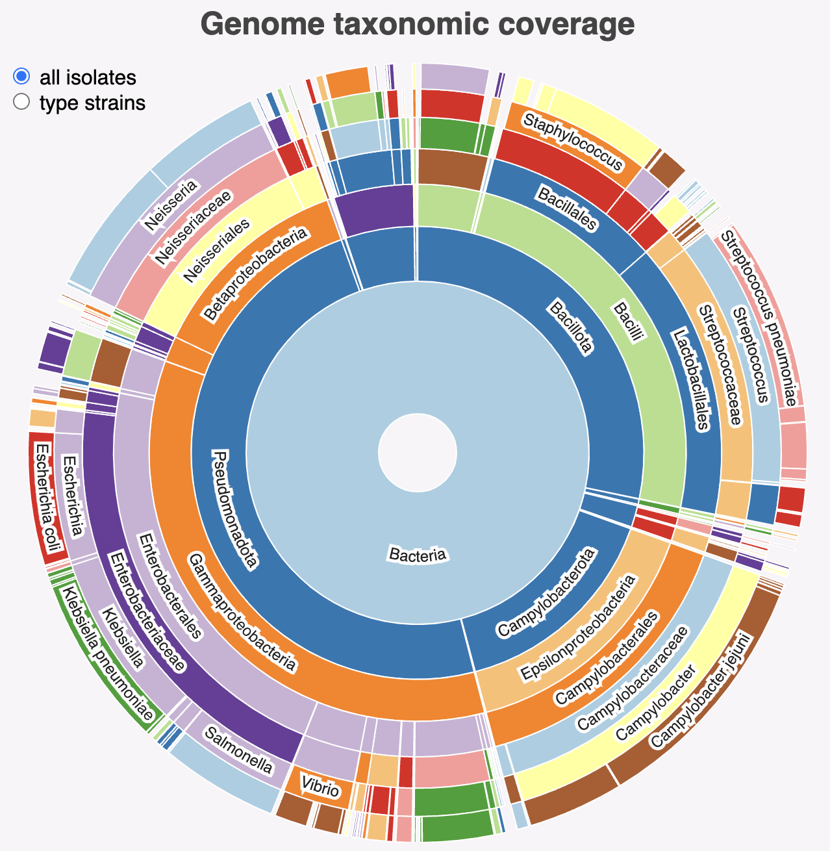
MLST schemes
Schemes exist for many common bacterial species
PubMLST contains most schemes
135 organisms included
Can create your own and include if not present
https://pubmlst.org/mlst
MLST tool will scan contigs against these schemes and type your sample
https://github.com/tseemann/mlst
https://pubmlst.org/species-id

Slide 15
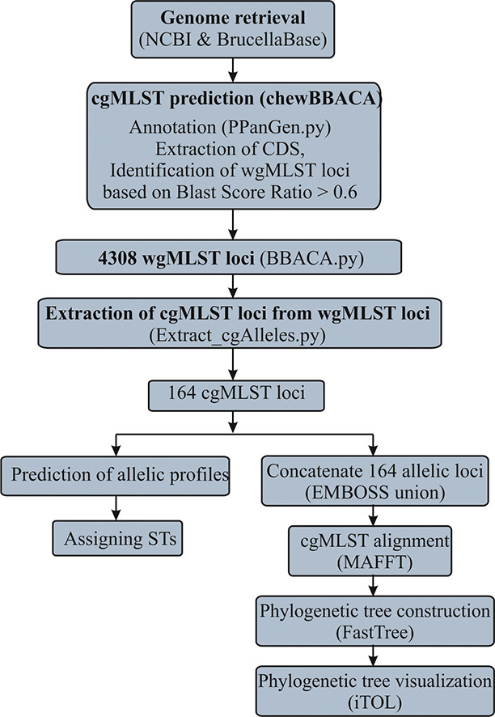
cgMLST
MLST relies on a few genes to type a sample
May not be enough signal
Doesn’t work for very monomorphic species
Can create an expanded MLST using all genes shared by all strains within a species
Tends to be hundreds or even thousands
Core genome MLST (cgMLST)
https://www.cgmlst.org/ncs contains many cgMLST schemes
Can create own with tools like chewBBACA
Sankarasubramanian et al IGE, 2019

Slide 16
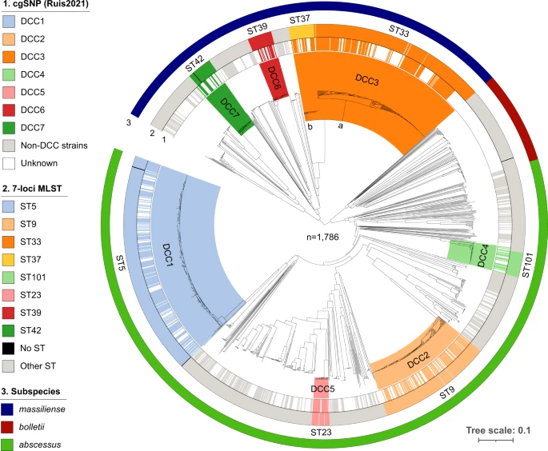
cgMLST for defining strains
MLST will split species/subspecies into a few groups
Not informative enough for local clustering
Useful for tracking circulating types as doesn’t not over split data
cgMLST will split MLST into more granular groups
Good for tracking bacteria with variable genomes
May not find specific transmission cluster
Diricks et al Nat Comm 2022

Slide 17
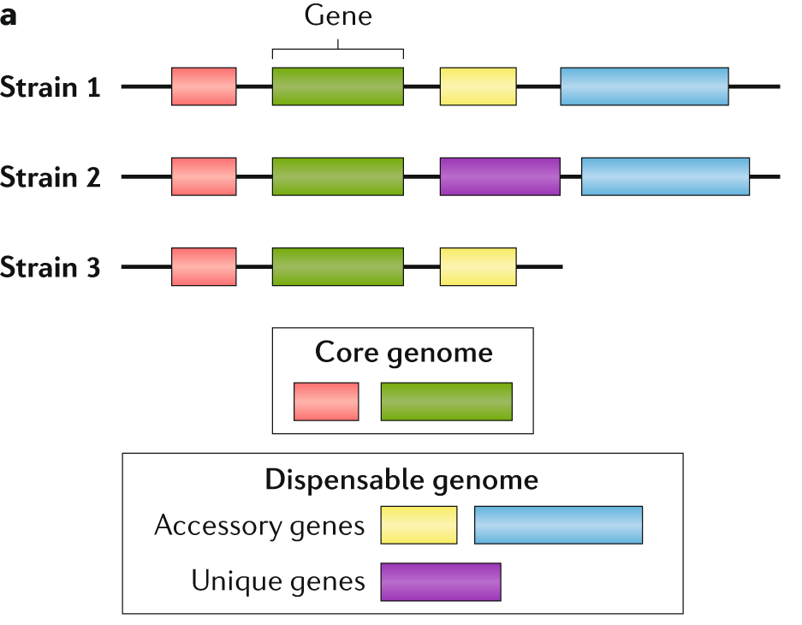
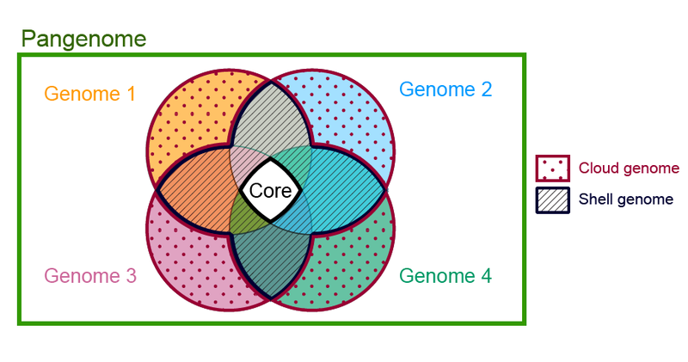
Pangenome
Wikipedia
Sherman & Salzberg Nat Rev Genetics 2020

Slide 18
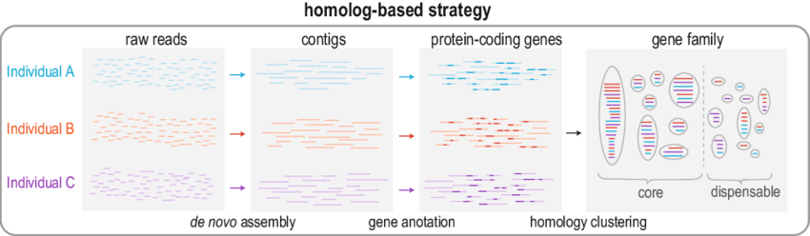
Pangenome construction
Many approaches but homology strategy is common
Example programs:
Panaroo, Roary, Pagoo etc.
Sensitive to inputs (e.g. genome assembly quality) and settings (e.g. cut-offs)
Hu et al The Pangenome 2020

Slide 19
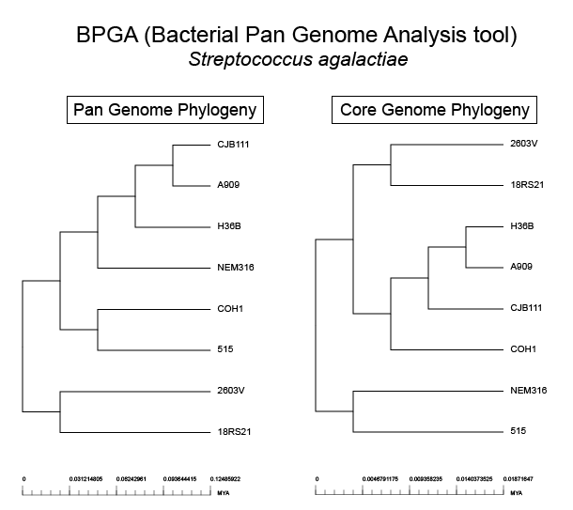
Pangenome phylogenetics
Usually use core genes to create a super-alignment
A concatenated alignment of individual gene alignments
Usually excludes intergenic regions
Can use full pangenome data
Messy if open pangenome
Recombination removal run on this core alignment
Ensures vertical inheritance signal only
Build phylogenetic tree
RAxML, IQ-TREE, BEAST etc.
Wikipedia

Slide 20
Questions? Workshop time!
https://conmeehan.github.io/NomenclatureWorkshop/NomenclatureWorkshop.html

