Slide 1
Concepts in computer programming
Conor Meehan (he/they)
conor.meehan@ntu.ac.uk
@con_meehan

Slide 2
Learning outcomes
Recognise data types and variables
Describe arithmetic, relational and logic operators
Execute selection and iteration workflows
Express algorithms in pseudocode
Implement regular expressions

Slide 3
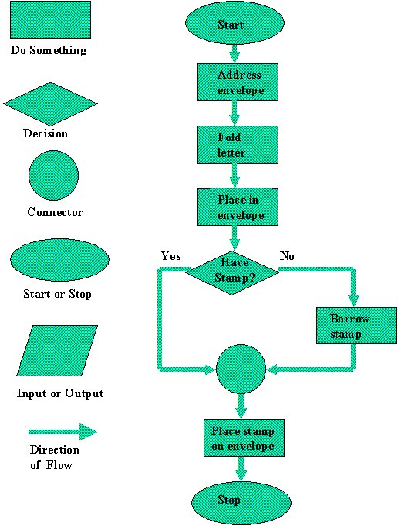
Computer programming
The process of instructing a computer to carry out tasks
Task-oriented
What is the task you need performed?
Step-by-step instructions
Precise
No interpretation possible
What type of data is input?
What steps need to be taken to achieve task?
Sequential
One step, then next step
Guide computer through task
https://homepage.cs.uri.edu/faculty/wolfe/book/Readings/Reading13.htm

Slide 4
Basic data types
How the computer processes and interacts with the data
Data type | Description | Example
Integer | Whole numbers, positive or negative | 0, -1000, 1234
Real (float) | Any number with decimal places, positive or negative | 0.0, -1.254, 1.234
Boolean | Logic types, true or false only | True, False
Char | Single character, e.g. letter, digit, symbol. Digits stored this way will be handled as text, not numbers. | A, a, 1, $, ;
String | Text, which is a collection of characters and includes spaces, punctuation, digits and any other symbols. Digits stored this way will be handled as text, not numbers. | “Hi”, “$^123”, “;4fghju.”
Null | Single type, indicating nothing | Null

Slide 5
Composite data types (structures)
Combinations of data types, stored together with some relationships
Many different types, these are just the most common
Data structure | Description | Example
Array | Ordered collection of items; can have repeated elements; only contain one data type; can be changed during a programme | [“Hello”, “Name”, “Name”] [0, 1, 2, 0, 4]
Set | Unordered collection of items; cannot have repeated elements | (“Hello”, “Name”) (0, 1, 2, 4)
Dictionary | A set of keys (basic data types, unordered, all unique) each of which links to a data structure (array, set, list, basic data type) | {“key1”: “value1”; “key2”: [0, 3]}
List | Same as array but can store multiple data types | [“Hello”, 1, “Name”, 0]

Slide 6
Which is which?
Combinations of data types, stored together with some relationships
Many different types, these are just the most common
Data structure
Array
Set
Dictionary
List
Integer
Real (float)
Boolean
Char
String
Null
Content | Type?
“My name is:”
TRUE
0.432918
[“element1”, 2, “element3”]
{“Rwanda”: “Africa”; “Ireland”: “Europe”}

Slide 7
Which is which?
Combinations of data types, stored together with some relationships
Many different types, these are just the most common
Data structure
Array
Set
Dictionary
List
Integer
Real (float)
Boolean
Char
String
Null
Content | Type?
“My name is:” | String
TRUE | Boolean
0.432918 | Real
[“element1”, 2, “element3”] | List
{“Rwanda”: “Africa”; “Ireland”: “Europe”} | Dictionary

Slide 8
Variables
Storing data types and structures for later use
Assignment usually by = or <-
Declaration may be needed first, assigning type
When declare it has type Null
input = “Please type your name here:”
samples = [[“Patient1”, “Freezer 1”], [“Patient2”, “Freezer 1”]]
int var1; var1 = 0.321
Can modify, add to, and retrieve
A=1
B=2
C=A+B

Slide 9
Arithmetic operators
Calculations performed on numbers (integers, real numbers)
Operator | Function | Example | Result
+ | Addition | 1+5 | 6
- | Subtraction | 5-1 | 4
* | Multiplication (don’t use x) | 5*4 | 20
/ | Division (exact on real, floor on integer) | 2.0/5; 4/3 | 0.4; 1
^ | Power | 2^3 | 8
% | Modulo or remainder | 9%3; 9%4 | 0; 1

Slide 10
Relational operators
Compare data types; outcome is true or false (Boolean)
Operator | Function | Expressions that are true | Expressions that are false
< | Less than | 1<5 “a” < “c” | 3.2 < 1.0 “z” < “a”
> | Great than | 3.2 > 1.0 “z” > “a” | 1 > 5 “a” > “c”
== | Equal to (note use of double equals) | 1 == 1 “hello” == “hello” | 5 == 2 “word1” == “word2”
!= | Not equal to | 5 != 2 “word1” != “word2” | 1 != 1 “hello” != “hello”
<= | Less than or equal to | 1<=1 1<=5 | 3.2 <= 1.0 “z” <= “a”
>= | Great than or equal to | 1>=1 1>=5 | 3.2 >= 1.0 “a” >= “z”

Slide 11
Logical (Boolean) operators
Evaluate combinations of operators
Use brackets to give precedence
In these examples, var1 = 20 and var2 = “a”
Operator | True when | Alternative notation | Expressions that are true | Expressions that are false
AND | All operations are true | && | var1 < 30 AND var2 == “a” | var1 < 30 AND var2 == “b”
OR | At least one operation is true | || | var1 < 30 OR var2 == “b” | var1 < 10 OR var2 > “d”
NOT | The operation result is false | ! | NOT var1 == var 2 | NOT var1 == 20

Slide 12
True or false?
“d” < “f”
“d” == “D”
0.1 >= 0
Var3=3; Var4=Var3^3; Var5=Var3*Var4
Var3<10 AND Var5<10
Var3<10 || Var5<10
!((Var4==27) && (Var5%8=1))

Slide 13
True or false?
“d” < “f” TRUE
“d” == “D” FALSE
0.1 >= 0 TRUE
Var3=3; Var4=Var3^3; Var5=Var3*Var4
Var3<10 AND Var5<10 FALSE
Var3<10 || Var5<10 TRUE
!((Var4==27) && (Var5%8=1)) FALSE

Slide 14
Break

Slide 15
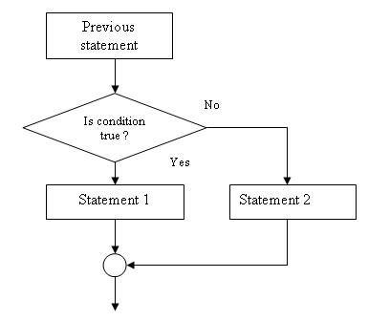
Selection
Decision made on if a condition is met
Set up decision trees
If… else statements
If <operation> == true:
Do task 1
Else:
Do task 2
Can have multi decisions with elseif statements
If <operation1> == true:
Do task 1
Elseif <operation2> == true:
Do task 3
Else:
Do task 4
https://www.jobilize.com/course/section/one-way-selection-selection-statements-by-openstax

Slide 16
Iteration
Also called looping
Doing same tasks on a set of inputs
Requires 3 things:
Set of items to iterate through
List, dictionary, array etc
Variable to store item from set being processed in current iteration
Basic data type
Condition to finish loop
Two types of loops:
Condition controlled
Infinite loop that stops when a certain condition is met
Count controlled
Repeat a specific number of times

Slide 17
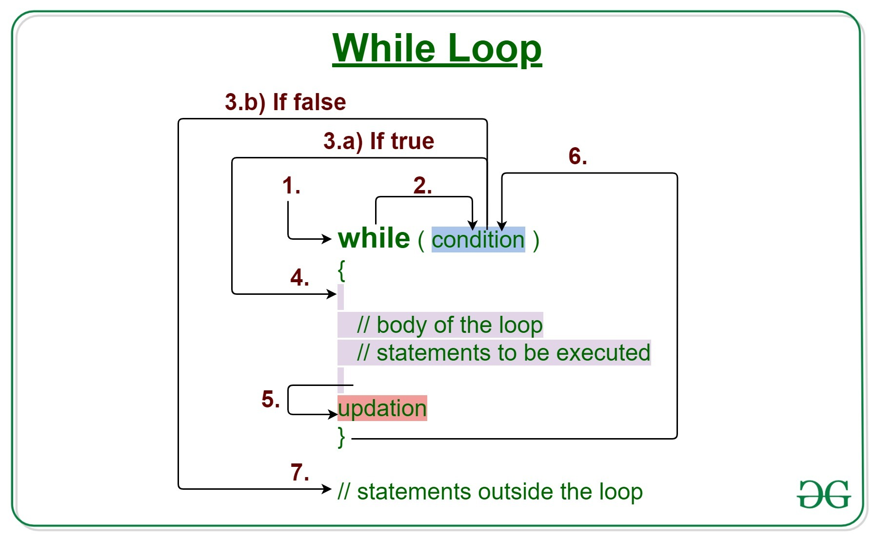
Condition controlled
Indefinite loops
Types:
While
Do while
Repeat until
General format:
While variable doesn’t meet condition
Do
Set of tasks
Update variable
Done
https://www.geeksforgeeks.org/java-while-loop-with-examples/

Slide 18
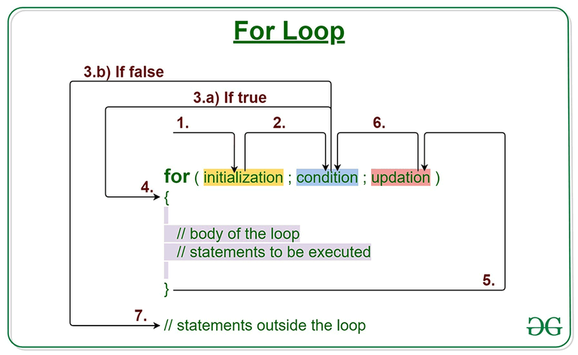
Count controlled
Definite loops
Types:
For
For each
General format:
For variable in set of numbers
Do
Set of tasks
Done
For each item in list
Do
Set of tasks
Done
https://www.geeksforgeeks.org/java-for-loop-with-examples/

Slide 19
Sequence and iteration tasks
Also written on github website, with example answers
Initialise a variable with a certain real value. Write a statement that will add 10 to the variable if it is less than 10 and divide the variable by 10 if it is greater than or equal to 10
Write a for loop that will iterate from 1 to 10 and at each stage get the modulus 2 of the variable
Initialise a variable to be value 1. Write a while loop that continues until that variable is 100. Inside the loop, if the number is less than 10, get the number to the power of itself. If it is between 10 and 50, take away 5 from the number. If it is above 50, add 1 to the number

Slide 20
Break (Download Notepad++ or BBEdit)

Slide 21
Pseudocode
Writing the steps of an algorithm without using the syntax of a specific programming language
Unambiguous step by step process that then can be translated to computer programme for execution
No correct syntax in pseudocode
Must be unambiguous
Must cover all steps in the process

Slide 22
Pseudocode example 1
Check if a number is divisible by 4
Assign number to variable
Get modulus 4 of variable and store in another variable
If modulus variable equals 0
Print ‘Number is divisible by 4’
Else
Print ‘Number is not divisible by 4’

Slide 23
Pseudocode example 2.1
Add up all the even numbers between 0 and a defined stopping point
Assign stopping point to variable
Initialise variable to store the answer with value 0
For every integer between 0 and the stopping point
If the integer modulus 2 equals zero
Add to the answer variable
After loop finishes print answer variable

Slide 24
Pseudocode example 2.2
Add up all the even numbers between 0 and a defined stopping point
Assign stopping point to variable
Initialise variable to store the answer with value 0
For every even integer between 0 and the stopping point
Add to the answer variable
After loop finishes print answer variable

Slide 25
Pseudocode tasks
Also written on github website, with example answers
Ask the user for 2 numbers and print out their product (i.e. multiply them together)
Read in a string of letters and check if it is a valid DNA string
Check if a string conforms to the pattern “patient_000000” where the 6 digits can be any numbers between 0-9
Hint: use phrases like ‘starts with’, ‘ends with’, ‘followed by’
Do the following steps
Read in 5 separate numbers
Calculate the average of the five numbers
Find the smallest (minimum) and largest (maximum) of the five entered numbers.
Write out the three results found with a message describing what they are

Slide 26
Regular expressions
Patterns that you wish to find (and replace) in blocks of text
Can search for specific strings of text but also special characters such as newline, tabs, any set of numbers followed by any set of letters etc.
Used in most programing languages
Can also be used directly on text files in Notepad++, BBEdit or others
Syntax differs between programs but we will use grep syntax here as used in BBEdit
Should be the same in Notepad++

Slide 27
RegEx basics
File contents for examples:
Hello everyone
Hello everybody
Count 123
Find:
Hello
Will return two instances
Find:
every
Will return two instances
Case be case sensitive (hello different from Hello) or insensitive

Slide 28
RegEx sets
File contents for examples:
Hello everyone
Hello everybody
Count123
Sets allow you to match any (combination of) characters
Use [] around the set to match
A-Z matches any upper case character
a-z any lower case
0-9 any number
Can combine to find any alphanumeric [A-Za-z0-9]
A ^ inside the [] will find everything except that set
Find:
every[a-z]
Will find ‘everyo’ and ‘everyb’
Find:
every[^a-z]
Will find nothing because all ‘every’ is followed by a lower case letter
Find:
Count[0-9]
Will find ‘Count1’
Find:
Count[3-6]
Will find nothing because 1 is not in the range 3-6

Slide 29
RegEx tokens
A token is a character combination that represents a set of characters
Token | Matches | Equivalent set
\n | Newline character
\t | Tab character
\b | Word boundary (explained next slide)
\d | Any digit | [0-9]
\w | Any ‘word’ character | [A-Za-z0-9]
\s | Any whitespace character | [ \t\n\r\f]
\D | Any character except a digit | [^0-9]
\W | Any character except a word | [^A-Za-z0-9]
\S | Any character except whitespace | [^ \t\n\r\f]

Slide 30
RegEx tokens examples
\b finds only matches that are at the end of a word
I.e. the pattern before the \b must then be followed by whitespace
Find:
every\w
Will find ‘everyo’ and ‘everyb’
Find:
Count\D
Will find nothing
Find:
o\b
Will find two instances (ends of the Hello)
File contents for examples:
Hello everyone
Hello everybody
Count123

Slide 31
Wildcard and start/end
. (period) will find any character
^ (not inside []) will find the start of the line
$ will find the end of the line
Use a \ before any of these to find that actual character
\$ finds the dollar sign, not the end of line
Find:
.
Will find all characters
Find:
n.
Will find ‘ne’ and ‘nt’
Find:
\D$
Will find ’e’ and ‘y’
File contents for examples:
Hello everyone
Hello everybody
Count123

Slide 32
Alternative matches
Use | to find one match or the other
Find:
on|ev
Will find 3 matches
Find:
\d|e$
Will find ‘1’ ‘2’ ‘3’ and the ‘e’ at end of everyone
File contents for examples:
Hello everyone
Hello everybody
Count123

Slide 33
RegEx tasks 1
Also written on github website, with example answers
Use Notepad++ or BBEdit to check
Find all sequence names (i.e. seq followed by a number)
Sequence names are lines that begin with >
Find the first nucleotide of each sequence
File contents for examples:
>seq1
ACTGC
>seq2
AACTG
>seq3
TTTCC
>seq4
AACCC

Slide 34
Repeated matches
Can specify to find the same (set of) characters repeatedly with control symbols
File contents for examples:
Hello everyone
Hello everybody
Count123
Symbol | Matches | Example | Finds
+ | Match 1 or more instance | e[lr]+ | ell, ell, er, er
? | Match 0 or 1 instance | e.? | el, el, ev, ev, er, er, e
* | Match 0 or more instances (is greedy so finds as much as possible that matches) | H.* | Hello everyone Hello everybody
{\d} | Match a specific number of times | el{2} | ell, ell
{\d,\d} | Match a minimum of first number and maximum of second number | o.{1,3} | o ev, o ev, one, ody, ount

Slide 35
Grouping
To match a set of characters in sequence, or capture a set for further use, use () around the set
Find:
(e..)*
Will find ell, eve, ell, eve
Note: doesn’t find ery as that final e is already in a pattern.
Not always the case, can be program specific
Find:
(e..o)*
Will find ell, eryo, ell
File contents for examples:
Hello everyone
Hello everybody
Count123

Slide 36
Replacement
So far we have only done find statements
Can also do replace statements
Cannot use special characters like \d in the replace, only in the find
Find:
e..
Replace
z
Find:
\d{2}
Replace
0
File contents for examples:
Hello everyone
Hello everybody
Count123
File contents after replace:
Hzo zryone
Hzo zrybody
Count123
File contents after replace:
Hello everyone
Hello everybody
Count03

Slide 37
Replacement with groups
Groupings can be used to keep matches and paste them in the replace
Use \1 to refer to first group, \2 to refer to 2nd group etc in the replace
Find:
[a-z](\d\d)
Replace
\1
Find:
([a-z]{2})(\d\d)
Replace
\2newText_\1
File contents for examples:
Hello everyone
Hello everybody
Count123
File contents for examples:
Hello everyone
Hello everybody
Coun123
File contents for examples:
Hello everyone
Hello everybody
Cou12newText_nt3

Slide 38
RegEx tasks 2
Replace all ‘seq’ in sequence names with ‘sample’
Sequence names are lines that begin with >
Add a tab character followed by ‘function’ to the end of each sequence name
Find an AA at the start of a line and move it to the end of the line
File contents for examples:
>seq1
ACTGC
>seq2
AACTG
>seq3
TTTCC
>seq4
AACCC

Slide 39
Test yourself See github page for more complex tasks

Slide 40
Learning outcomes
Recognise data types and variables
Describe arithmetic, relational and logic operators
Execute selection and iteration workflows
Express algorithms in pseudocode
Implement regular expressions

