Slide 1
Experimental Design and Statistics
Open menti.com and use the code 4062 3440
Conor Meehan (he/they)
conor.meehan@ntu.ac.uk
@con_meehan

Slide 2
Learning outcomes
Compare different types of research design
Identify various research variable types
Implement different types of descriptive statistics
Identify appropriate sample types
Explain the statistical assumptions and how to test each one
Utilise inferential statistics flowcharts to select the appropriate test for your experiment

Slide 3
Research types
Many ways to answer a research question
Design of the experiment influences the answers you can obtain
Various definitions of research
Qualitative vs quantitative
Cross sectional vs longitudinal
Experiment vs correlation

Slide 4
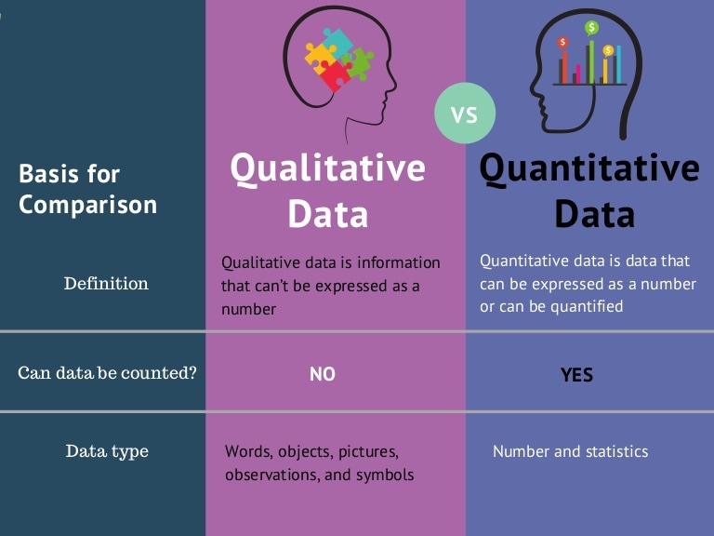
Qualitative vs quantitative
https://www.slideshare.net/Intellspot/qualitative-vs-quantitative-data-infographic

Slide 5
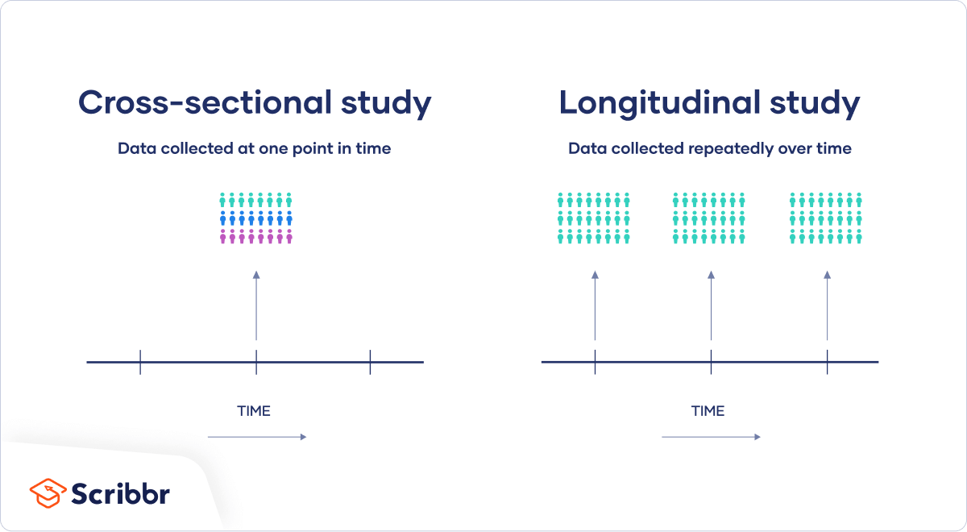
Cross sectional vs longitudinal
https://www.scribbr.com/methodology/cross-sectional-study/

Slide 6
Experiment vs correlation
 | Correlational research | Experimental research
Purpose | Used to test strength of association between variables | Used to test cause-and-effect relationships between variables
Variables | Variables are only observed with no manipulation or intervention by researchers | An independent variable is manipulated, and a dependent variable is observed
Control | Limited control is used, so other variables may play a role in the relationship | Extraneous variables are controlled so that they can’t impact your variables of interest
Validity | High external validity: you can confidently generalize your conclusions to other populations or settings | High internal validity: you can confidently draw conclusions about causation
https://www.scribbr.com/methodology/correlational-research/

Slide 7
What type of research?
Qualitative vs quantitative
A survey of mask wearing habits in a student population
Assessing the impact of low GI diets on insulin production
Cross sectional vs longitudinal
The number of new cases of coronavirus globally on a single day?
The change in vaccination rates between January and December 2021
Open menti.com and use the code 4062 3440

Slide 8
What type of research?
Experiment vs correlation
The relationship between the amount of glucose and level of insulin in the local population
The amount of insulin produced by mice based on a defined range of glucose intake
The impact of a plasmid presence/absence on tetracycline resistance in E. coli
The presence of a plasmid in bacterial strains sensitive or resistant to tetracycline
Open menti.com and use the code 4062 3440

Slide 9
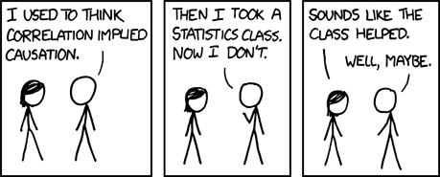
Correlation does not equal causation
100% of people who wear socks die
A correlation needs more experimental proof to determine causation
https://xkcd.com/552/

Slide 10
Variable types
An attribute of the study
What is the data?
Number of samples
Age of patient
Growth yes/no
What part of the experiment is this variable in?
Input data
Output data
Control
Technical/biological replicate

Slide 11
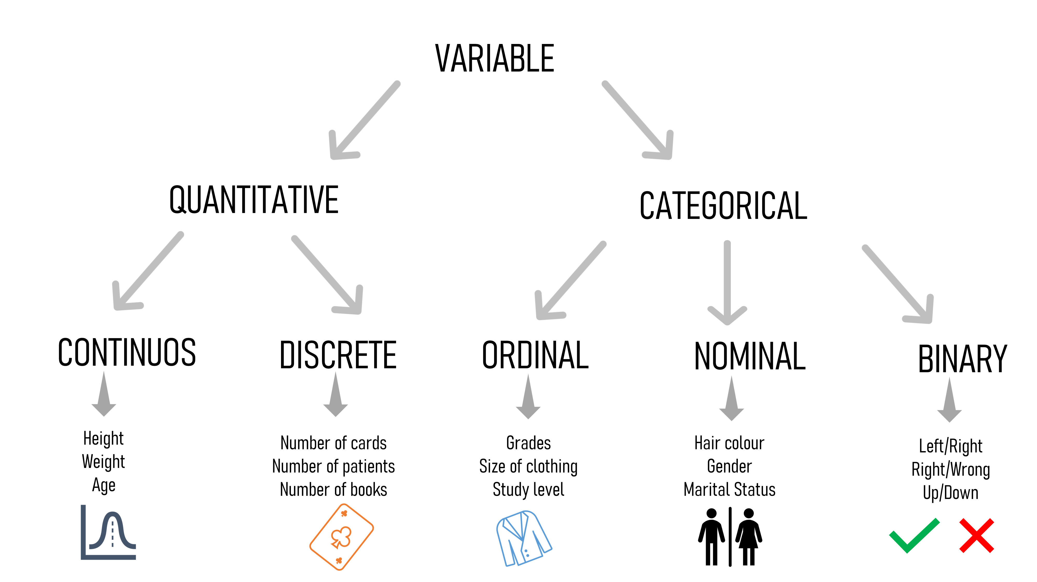
Variable types
https://towardsdatascience.com/statistical-testing-understanding-how-to-select-the-best-test-for-your-data-52141c305168

Slide 12
Quantitative data
Amounts of things
Continuous
Also called Ratio
Measurements of potentially infinite values
E.g. MIC, age, amount of glucose produced/consumed
Discrete
Also called Interval
Counts
Cannot be divided less than 1
Number of patients, cell count

Slide 13
Categorical data
Groups of things
Ordinal
Rankings
Something with an order
E.g. Disease stage, BMI category
Nominal
Names
E.g. species counts, blood group, symptoms
Binary
Yes/No
E.g. symptom present/absent, alive/dead

Slide 14
Which type?
Number of white blood cells in a sample
Presence of inflammation
Sodium consumption split into low/medium/high
Gram stain result
Open menti.com and use the code 4062 3440

Slide 15
Variables in an experiment
Experiment is trying to find out effect of one variable on another
Level of antibiotic on bacterial growth rate
BMI category on diabetes occurrence
Independent
Predictor variable
Cause
What you manipulated in the experiment
Dependent
Outcome variable
Effect
What was measured in or resulting from the experiment
Control
Constants during the experiment

Slide 16
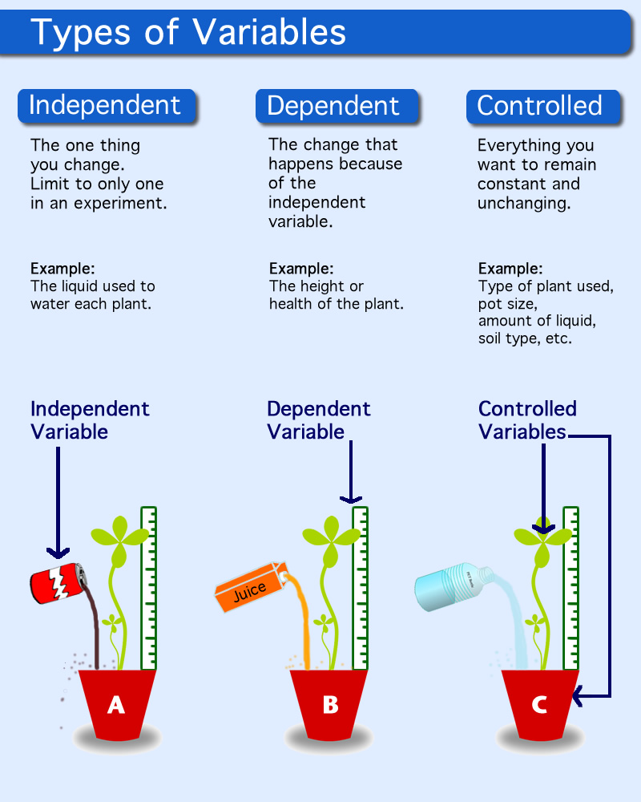
Variables in an experiment
http://edtech2.boisestate.edu/angelacovil/506/procedure.html

Slide 17
Which type?
Independent, dependent or control?
The number of cells left after disinfecting
The constant temperature throughout the experiment
The amount of glucose added to the petri dish
Open menti.com and use the code 4062 3440

Slide 18
Correlation variables
Looking for association, not cause and effect
Predictor
Variable that comes first
Glucose level
Outcome
Variable that comes afterwards
Insulin level

Slide 19
Questions and break

Slide 20
Summary statistics
Also called descriptive statistics
Not testing a hypothesis, just describing/summarising the data
Cannot infer anything about larger population
3 main types
Distribution
Central tendency
Variability
Can apply to
1 variable: univariate analysis
2 variables: bivariate analysis
3 or more variables: multivariate analysis

Slide 21
Frequency distribution
Ages of participants:
18, 19, 21, 20, 17, 18, 16, 16, 21, 18
Simple table
Grouped table
Age | Number
16 | 2
17 | 1
18 | 3
19 | 1
20 | 1
21 | 2
Age | Number
16-17 | 30%
18-19 | 40%
20-21 | 30%

Slide 22
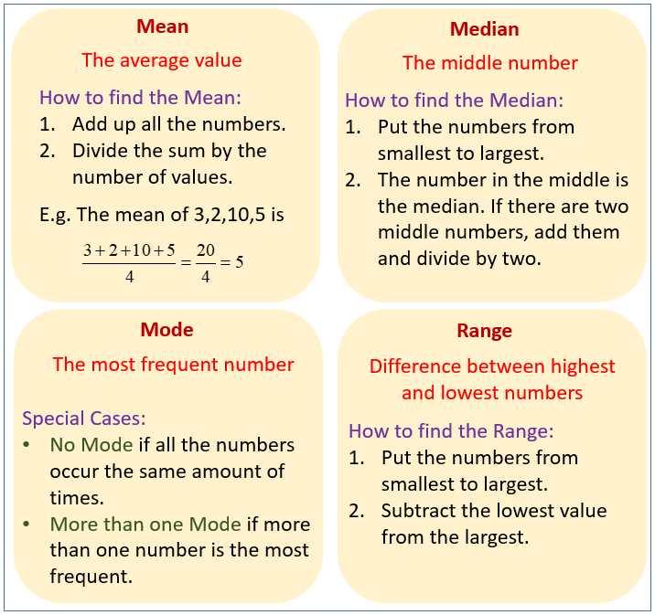
Central tendency
Estimate the average or centre of a dataset
https://www.onlinemathlearning.com/mode-mean-median.html

Slide 23
Variability
How spread out is the data?
Range:
What is the difference between the minimum and maximum values?
Max – min = range
Standard deviation:
On average, how far is each point from the mean?
Variance:
The amount of spread in the data
Square the standard deviation

Slide 24
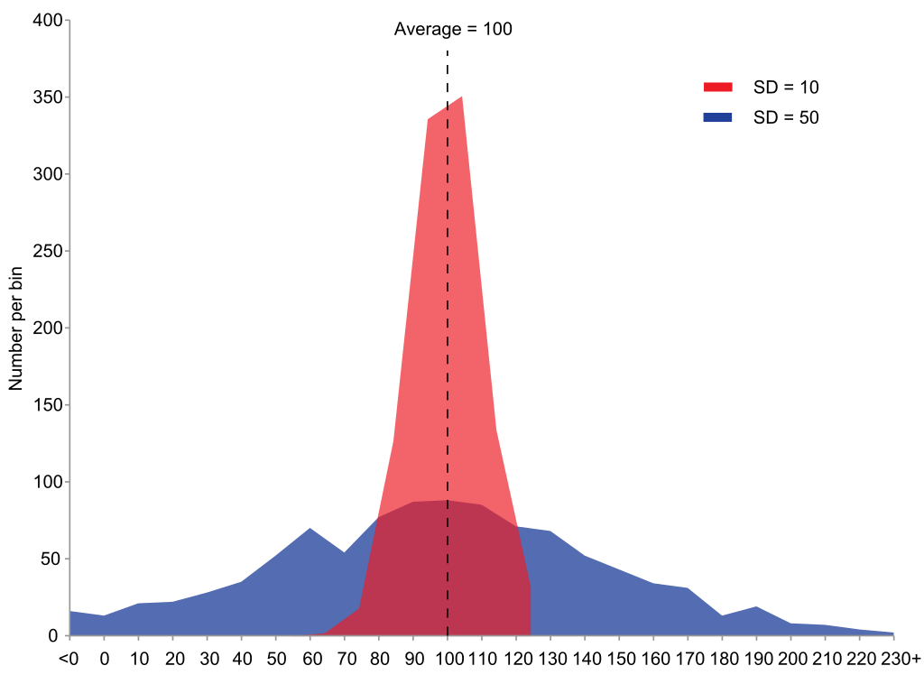
Variability
Wikipedia

Slide 25
Bivariate/Multivariate analysis
Compare descriptive statistics between 2 or more groups
Contingency tables
Intersection between 2 variables
Can be input for inferential statistics
Species A
 | Present | Absent | Total
Present | 15 | 3 | 18
Absent | 20 | 10 | 30
Total | 35 | 13 | 48
Species B

Slide 26
Collecting samples
The samples you use must allow you to test your hypothesis
They must be:
Appropriate
Related to the hypothesis and measurable
Representative
Randomly chosen or specific characteristics?
Sufficient sample size
More variable populations need larger sample sizes

Slide 27
Sample types
Independent
Observations in one data point do not influence those in another datapoint
Single observation from a sample
Comparing groups that are separate from each other
E.g. One set of patients takes diet 1 and another takes diet 2
Paired
Observations in one data point are influenced by those in another datapoint
Multiple observations from the same sample
Comparing same group in different conditions
E.g. Same patients take diet 1 and then take diet 2

Slide 28
Which type?
2 different growth conditions on the same set of bacterial strains
Mice in litter A given drug 1 and mice in litter B given drug 2
Difference in glucose levels in the morning and in the evening in a patient
qPCR expression data is compared between clinical samples and a negative control sample
5 patient samples treated separately with a negative control and a drug
Open menti.com and use the code 4062 3440

Slide 29
Controls and replicates
Controls:
Same conditions but no change in variable
Negative/positive control
Known outcome
Replicates
Can’t control for every variable
Use replicates to try buffer out other variables
Small differences in temperature between days
Slightly different handling abilities
Different ‘identical’ cells might behave slightly differently
Grubbs test for outliers can then be used to remove bad replicates

Slide 30
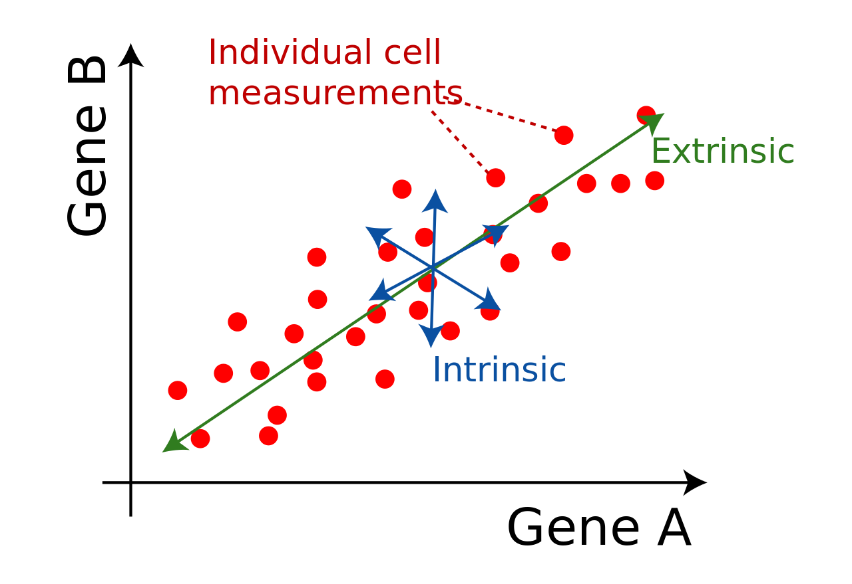
Data Variability
When we see a difference between populations, is it true or an error or noise?
Error:
Machine fluctuation
Technician fluctuation
Noise:
Stochastic effects
Extrinsic
Intrinsic
Wikipedia.org

Slide 31
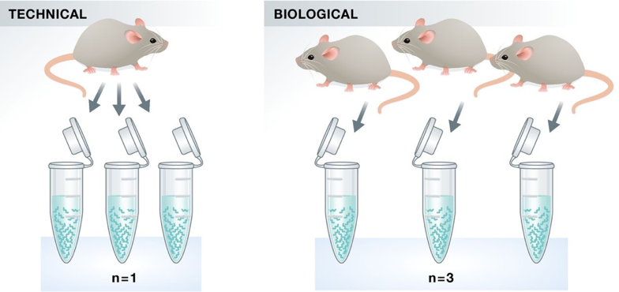
Technical and biological replicates
Technical:
Same sample, multiple runs
Biological
Different ‘identical’ samples
https://hbctraining.github.io/Intro-to-rnaseq-hpc-salmon/lessons/experimental_planning_considerations.html

Slide 32
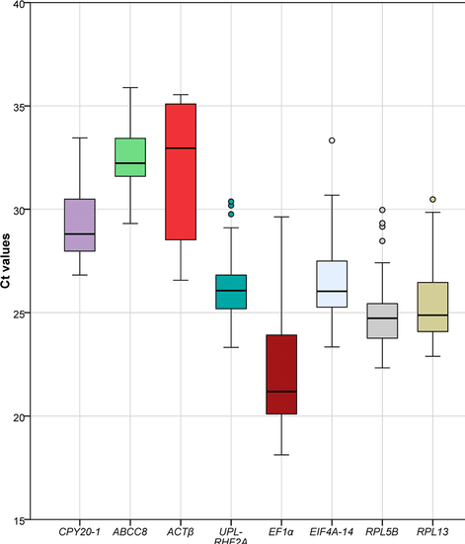
Replicates and outliers
Liang et al Sci Rep 2020

Slide 33
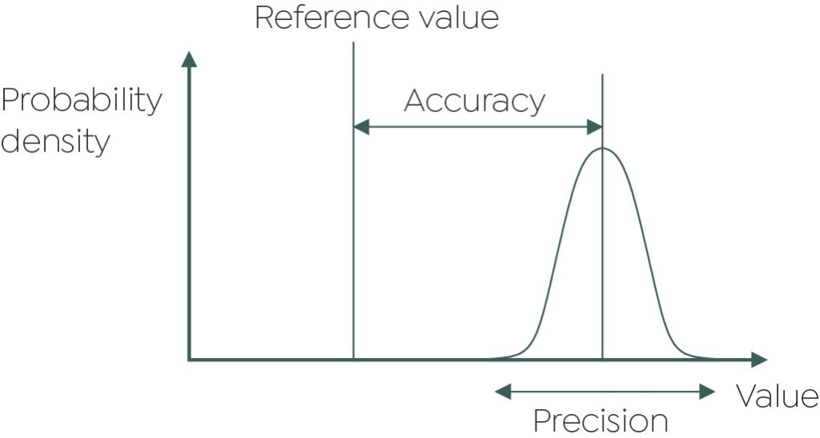
Accuracy and precision
Accuracy: how alike are your measurements to the true value?
Precision: how alike are your measurements to each other?
Replicates should be accurate and precise
Good lab practice
https://grantinstruments.com/measurement-accuracy-and-precision-of-data

Slide 34
Questions and break

Slide 35
Inferential statistics
Using a statistical test to infer a significant relationship
Usually involves a p-value
2 types of inferential statistics:
Parametric
Non-parametric
Need to test for statistical assumptions before selecting a type

Slide 36
Statistical assumptions
Parametric tests make specific assumptions about data
Independence of observations
Experimental design
Homogeneity of variance
Levene’s or Bartlet’s test
Normality of data
Shapiro-Wilk test
If any are violated, use a non-parametric test

Slide 37
Independence of observations
The measurement of one sample is not influenced by the measurement of another sample
Part of experimental design
Example violations:
Including technical/biological replicates as separate samples
Get average and include 1 data point
Identical control/treatment conditions
Must be a change to be measured
Multiple entries of the same sample/person
Single datapoint per sample

Slide 38
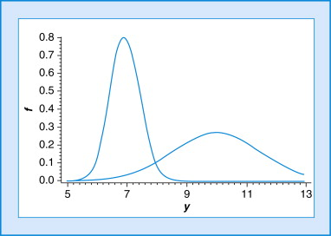
Homogeneity of variance
Is the variance in dataset A similar to the variance in dataset B?
Bartletts test or Levene’s test
If significant, then need to use non-parametric test

Slide 39
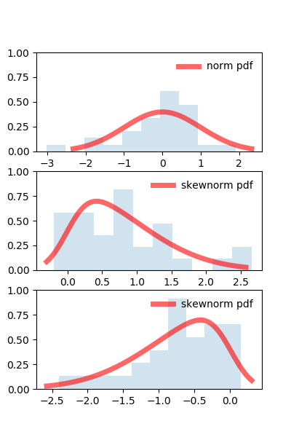
Normality of data
Does the data follow a normal distribution?
Shapiro-Wilk test
If significant, then need to use non-parametric test
https://scientificallysound.org/2018/06/21/test-normal-distribution-r-part-3/

Slide 40
Selecting the right inferential statistic
Parametric or non-parametric?
Paired or independent samples?
What’s the independent/predictor variable
What’s the dependent/outcome variable?

Slide 41
Parametric tests flowchart

Slide 42
Categorical predictor variable parametric tests flowchart

Slide 43
Categorical predictor variable parametric tests flowchart
Open menti.com and use the code 4062 3440
Do 3 different drugs each have the same or different effects on insulin levels in mice?

Slide 44
Categorical predictor variable parametric tests flowchart
Open menti.com and use the code 4062 3440
Is there a difference in cell size at the start and end of a 12-hour period of treatment?

Slide 45
Non-parametric tests flowchart

Slide 46
Post-hoc testing
ANOVA only tells you there is significance in the data
Doesn’t say which groups are significantly different
When there are more than 2 groups, a further test is needed
Cannot just use t-tests as experimental error increases

Slide 47
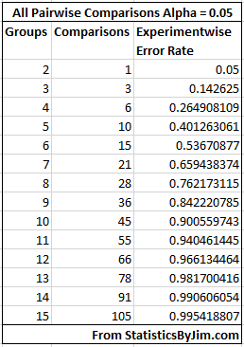
Experimental error
Any statistical test has a chance of producing a false positive
Type I error (experimental error)
Single tests counteract this with the significance value
Significance value = Type 1 error rate
0.05 means 5% chance of false positive
Every additional test increases the type I error
Cant just continually do t-tests
Comparisons of multiple groups must correct for this
https://statisticsbyjim.com/anova/post-hoc-tests-anova/

Slide 48
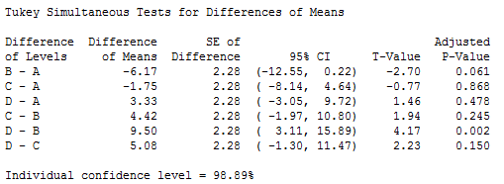
Post-hoc testing
ANOVA only tells you there is significance in the data
Doesn’t say which groups are significantly different
When there are more than 2 groups, a further test is needed
Cannot just use t-tests as experimental error increases
Post-hoc tests are performed to look within the dataset and compare the groups
All vs all: Tukeys method
All vs control: Dunnett’s method
Find the best: Hsu’s MCB
https://statisticsbyjim.com/anova/post-hoc-tests-anova/

Slide 49
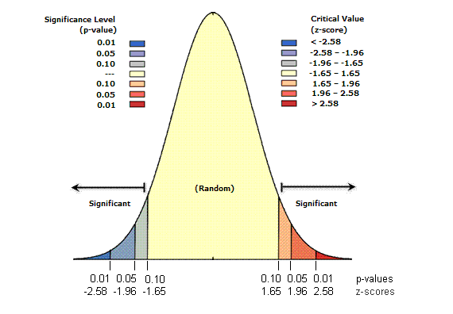
Interpreting a statistical result
Most tests will produce a p-value
Probability that this result is observed under the null hypothesis
Small p-values mean unlikely result is observed under H₀
Can reject H₀
Still need to prove H_{a} is correct
P-value <0.05
95% probability H₀ is false
https://pro.arcgis.com/en/pro-app/latest/tool-reference/spatial-statistics/what-is-a-z-score-what-is-a-p-value.htm

Slide 50
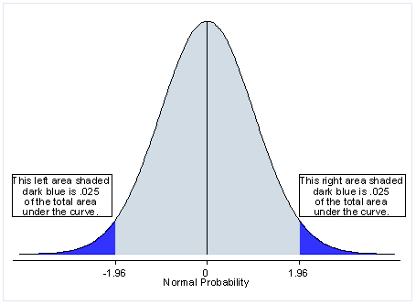
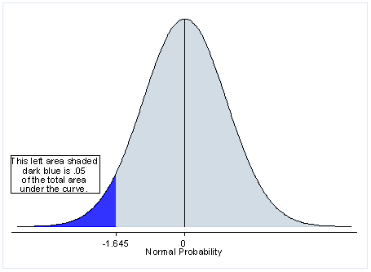
One-tailed vs two-tailed tests
A p-value is testing the presence of your data in the extremes of the distribution
2 tailed test splits it evenly between the 2 tails
0.025 on the right, 0.025 on the left
1 tailed test disregards one side in favour of more power on the other
Can only use 1 tailed test if sure that the other direction is extremely unlikely
Cannot use to boost significance in one direction
https://hbctraining.github.io/Intro-to-rnaseq-hpc-salmon/lessons/experimental_planning_considerations.html

Slide 51
Learning outcomes
Compare different types of research design
Identify various research variable types
Implement different types of descriptive statistics
Identify appropriate sample types
Explain the statistical assumptions and how to test each one
Utilise inferential statistics flowcharts to select the appropriate test for your experiment

