Slide 1

Walchand College of Engineering
(Government Aided Autonomous Institution)
Vishrambag, Sangli, 416415
Department of Computer Science & Engineering
Presentation on
1947
Flower Diseases Detection
AY:2021-22
Team Members:
2019btecs00022 : Prachi Chaubhare
2019btecs00053 :Kshitija Jadhav
2019btecs00108: Anushka Taware
Under the guidance of
Miss. Aprupa Pawar
Date: 08/09/2021

Slide 2
Agenda
Abstract
Problem statement
Objectives
Methodology
Flow chart
Outcomes/Applications
Technology stack
Conclusion
References

Slide 3
Abstract
This presents an automatic identification of flower diseases based on image processing techniques. In view of this, normal and diseased flower images are acquired to create a knowledge base where images are pre-processed and segmented to identify the region of interest. Texture features of images are extracted using Gabor feature extraction, from which we computed seven different measures of dispersion and central tendency with the purpose of reducing the dimensionality of features. Then, an artificial neural network is trained with seven input features extracted from individual images and eight output nodes representing 38 classes of diseases considered in this work. Unkown samples of flower images.

Slide 4
Problem statement
System that identifies Flower diseases using convolutional neural network provide prediction mechanism for unknown samples as well.

Slide 5
Objectives
*Identify the flower disease by simply scanning image of effected flower.
*Explaining in detail about disease.
*Describe type and cause of disease.
*Describe way the disease are managed.

Slide 6
Methodolgy
Pre-processing techniques.
Segmentation
Feature Extraction.
Convolutional Neural Network.
Vgg19 Model
Gradio Ml.

Slide 7
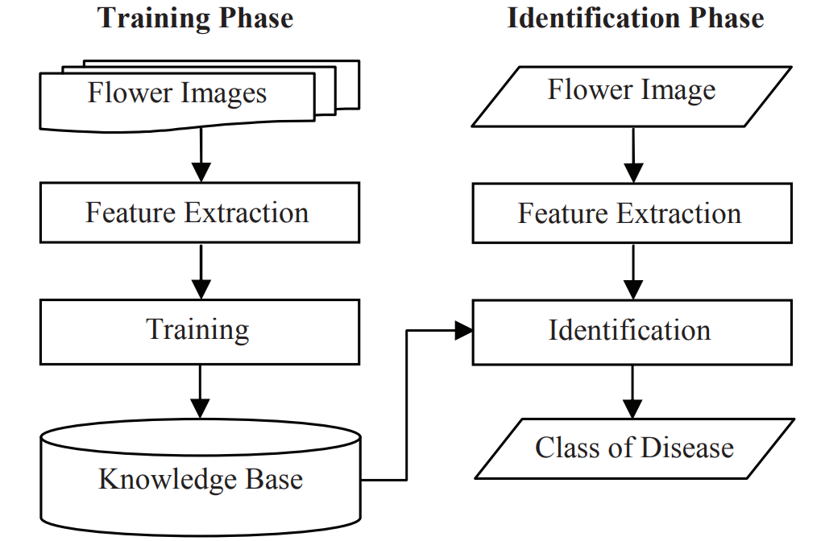
Flow chart

Slide 8
Outcomes/Applications
Useful for detecting flower diseases.
It will be helpful prevent disease in early stage.
Reduce deficiency of expert.
Good quality Flower Production.
Prevents loss of Farmers.

Slide 9
Technology Stack
SOFTWARE & HARDWARE SPECIFICATION
Software: Python, Scikit Learn, VS Studio, Pandas Liabray, Numpy Liabrary. Hardware: Camera

Slide 10
Conclusion
We described a system that automatically identifies flower diseases which would help flower growers to apply relevant measures at the early stage of the disease. This is important when there are no or limited experts which closely monitor the flowers. Being an emerging export sector in developing economies, the system can assist the sustainability of the floral industry. Better results could be achieved by training the system with large dataset with a variety of diseases. Moreover, the performance of the system can be enhanced by applying other machine learning techniques. Thus, future work is directed at the use of hybrid systems to take advantage of the synergy effects of two or more classifiers.

Slide 11
references
[1] H. Al-Hiary, S. Bani-Ahmed, M. Reyalat, M. Braik and Z. AlRahamneh, “Fast and Accurate Detection and classification of plant diseases”, International Journal of Computer Applications.
[2] J. McMaugh, What garden pest or disease is that? New Holland Publishing, Sydney, 2001.
[3] A. Coolen, R. Kühn, and P. Sollich, Theory of neural information processing systems. Oxford University Press, 2005.
[4] E. R. Davies, "The application of machine vision to food and agriculture: a review", The Imaging Science Journal , Vol. 57, No. 4, pp. 197- 217,2009
[5] Ethiopian Horticulture Development Agency, Ethiopian Horticulture Sector Statistical Bulletin, Issue 01, 2012.

Slide 12
Thank You

