Slide 1



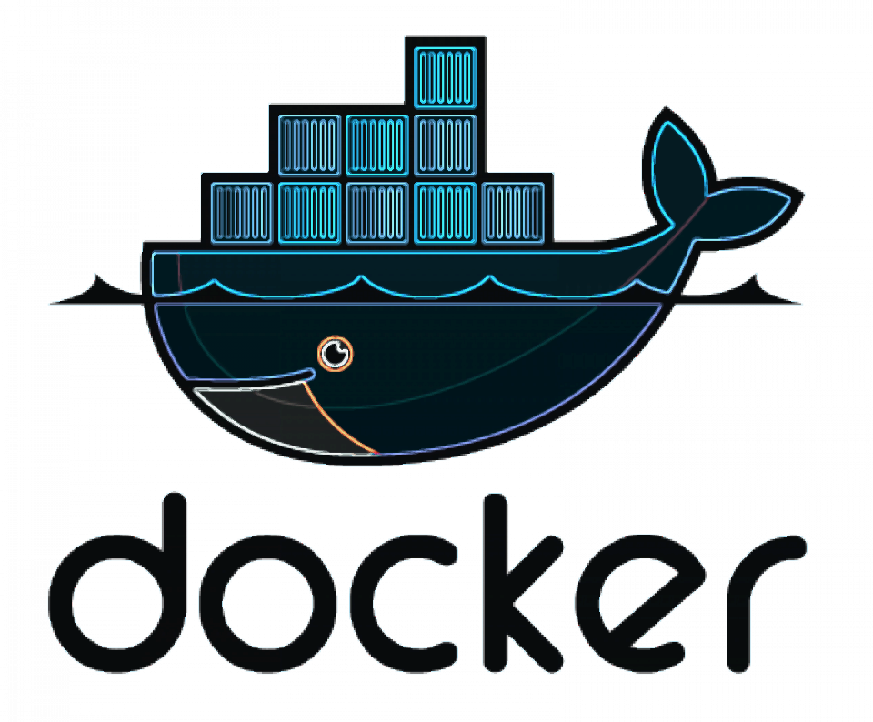


Setting up Infrastructure Monitoring Platform using Terraform, Ansible, Docker & GitLab CI/CD
Infrastructure as Code | AWS | DevOps | Monitoring | Automation
Presented by Sazad Ahemad
gitlab.com/connect2sazad/prometheus-grafana-infra-setup

Slide 2

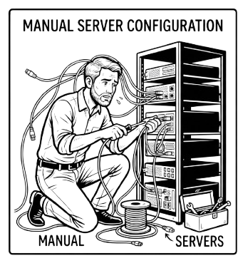
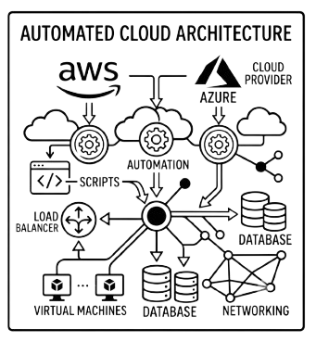
Problem Statement
Traditional Infrastructure deployment has problems:
Manual Deployment
Human Errors
No Monitoring
Difficult Scaling
No Automation
Difficult Resource Management
Difficult Tracking Resources in case of Large Infrastructure Plans

Slide 3

Project Objectives
GitLab CI/CD
Project is made to satisfy the below goals:
CI/Cd to setup the whole infra
Implement IaC to provision infra in a cloud provider (AWS in this case)
Configuring Monitoring Server
Setting up Monitoring tools
Alert Management
Dashboard Setup
Terraform
AWS
Ansible
Docker
Monitoring Server

Slide 4


Technology Stack

Slide 5

High Level Architecture
Developer
Git Push
GitLab Pipeline
Terraform
AWS EC2
Ansible
Docker
Prometheus
Grafana

Slide 6
AWS Infrastructure
Internet
Internet Gateway (IGW)
VPC
(attached IGW)
Public Route Table
(0.0.0.0/0 -> IGW)
Security Group
(attached to EC2)
AWS EC2 Instance
(Public IP)
Public Subnet
(from associated public route table)

Slide 7
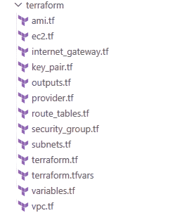
Terraform Infrastructure
.tfstate file + lock
prevents concurrent runs + save state
Local .tf files
vpc.tf, ec2.tf,sg.tf…
GitLab CI/CD
Push triggers pipeline
HCP Terraform Cloud
Remote plan & apply
AWS Infrastructure
VPC, IGW, subnet, SG
EC2 instance
Public IP, Key Pair, AMI
terraform.tfvars
get values of variables
Terraform App Token
get token from GitLab ci/cd variables
AWS Key Variables
get access & secret key from terraform cloud variables

Slide 8
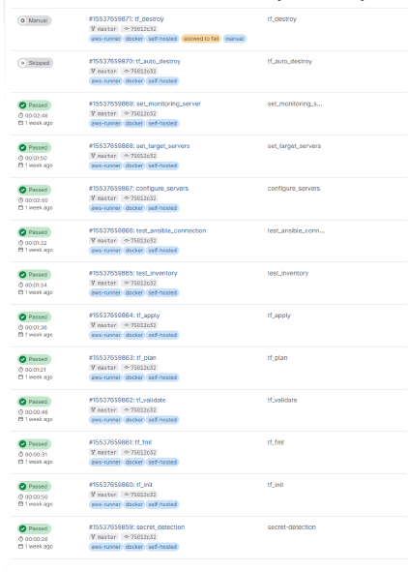
GitLab CI/CD Flow
secret-detection Detects if any secret key is pushed to gitlab
tf_init
Initializes the terraform backend
tf_fmt
Checks if the .tf files are formatted correctly
tf_validate
Checks if the .tf files are valid or not
tf_plan
Creates plan file as per the tf configuration
tf_apply
Applies the infra in aws as per the plan
test_inventory
Checks if the ansible dynamic inventory is valid or not
test_ansible_connection
Checks if ansible does ssh connection successfully to servers
configure_servers
Installing pre-requisites on all servers
set_target_servers
Installs exporters in target servers
set_monitoring_server
Installs tools to monitor target servers
tf_auto_destroy Runs only if the pipeline fails (skipped if all previous jobs succeed)
tf_destroy
Destroy monitoring server infra manually
Please Note: This project uses self hosted GitLab runner

Slide 9
Ansible Configuration & Automation
Terraform creates EC2
SSH Connection
Install Docker
Dynamic Inventory
Deploy Exporters
Configure Monitoring Server
Prometheus + Grafana + Alert Manager
roles/
docker
│
|── install docker
|── docker compose
node_exporter
│
|── docker compose
|── start exporter
apache_exporter
│
|── docker compose
cadvisor
│
|── docker compose
prometheus
│
|── prometheus.yml
|── alert rules
grafana
│
|── datasource
|── dashboards
alertmanager
│
|── alertmanager.yml
Terraform
│
▼
AWS EC2
│
▼
Dynamic Inventory
│
▼
Ansible
│
┌────┴────────────┐
│ │
▼ ▼
Monitoring Server Target Servers
│ │
▼ ▼
Grafana Node Exporter
Prometheus Apache Exporter
Alertmanager cAdvisor

Slide 10
Docker Deployment
Ansible
Deploy Containers
Install Docker
Prometheus
Grafana
Alertmanager
cAdvisor
Docker Engine
Prometheus
Grafana
Alertmanager
✔ Lightweight containerized deployment
✔ Consistent runtime environment
✔ Simplified application management
✔ Easy scaling and maintenance

Slide 11

Monitoring Architecture
Target Server 1 Target Server 2
(Node + Apache) (Node + Apache)
\ /
\ /
▼ ▼
Prometheus Server
/ \
▼ ▼
Grafana Alertmanager
Target Server 1
Node Exporter
Apache Exporter
Prometheus
Grafana Dashboard
(Visualization)
Alertmanager
(Alerts)
Metrics
Monitoring Flow
Exporters collect system metrics
Prometheus scrapes metrics
Grafana visualizes dashboards
Alertmanager handles alerts

Slide 12
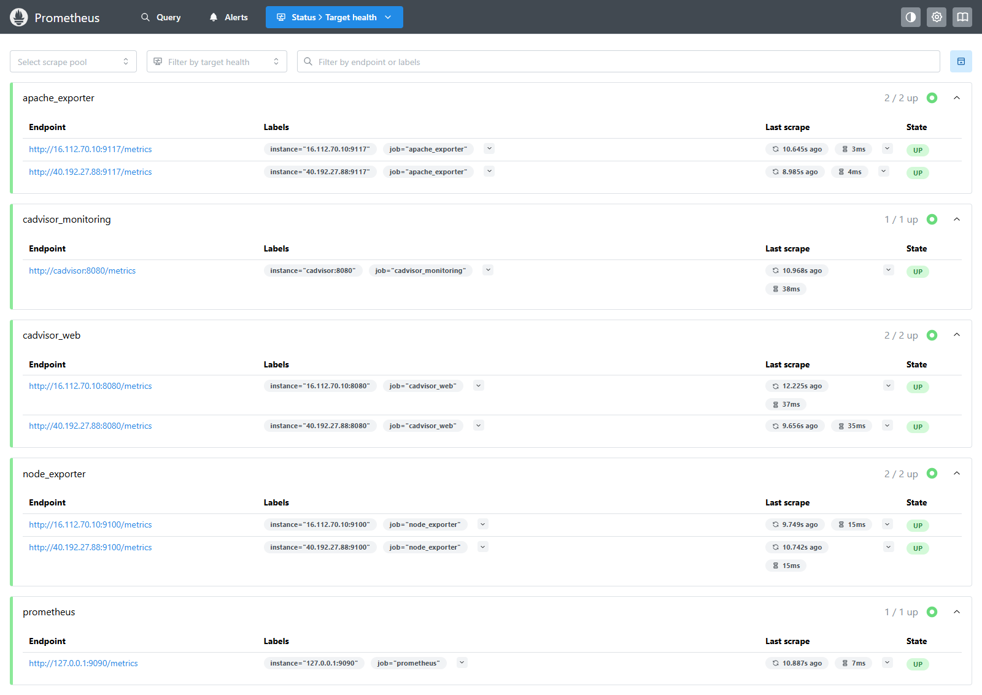
Prometheus
Responsibilities
✔ Collect Metrics
✔ Store Time-series Data
✔ Evaluate Alert Rules
✔ Serve Data to Grafana
Node Exporter
Apache Exporter
cAdvisor
│
▼
Prometheus
│
▼
Stores Metrics

Slide 13

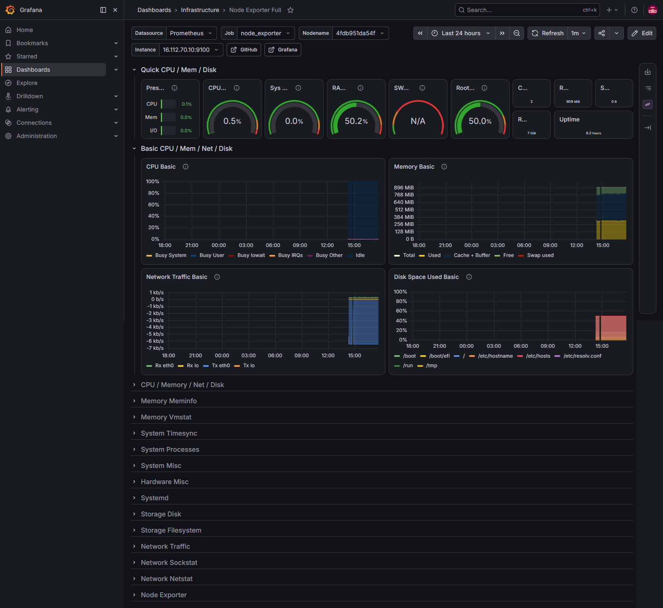




Infrastructure Monitoring Dashboard
Key Monitoring Metrics
✔ CPU Utilization
✔ Memory Usage
✔ Disk Space
✔ Network Traffic
✔ Real-time Infrastructure Visualization

Slide 14
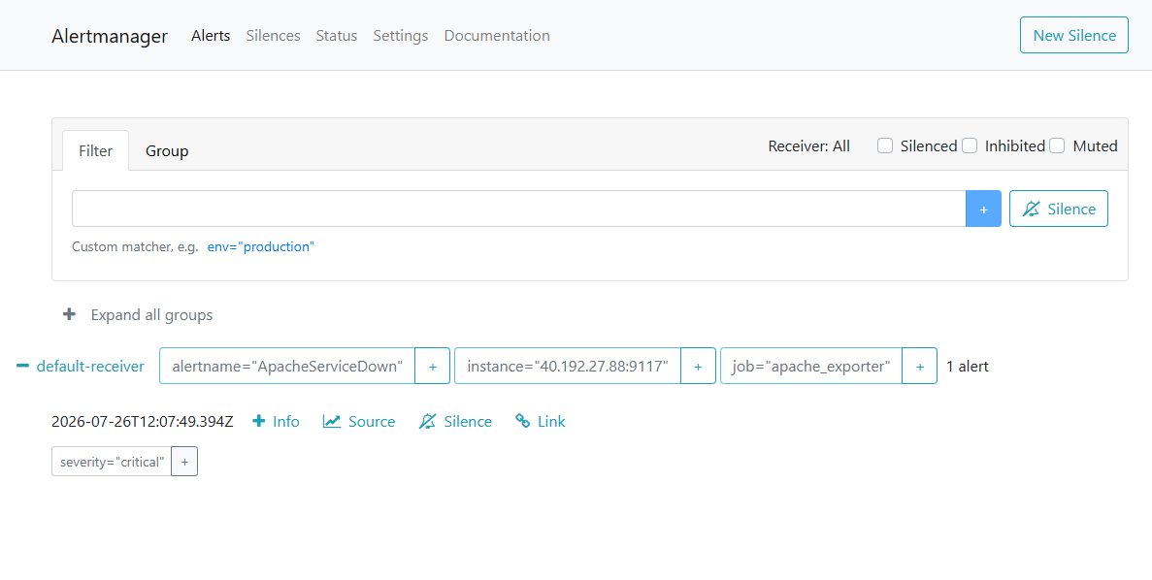
Alertmanager
Alert Management
✔ Evaluates alert rules
✔ Detects service failures
✔ Sends alert notification
✔ Reduces downtime
Example Alerts
✔ Apache Service Down
✔ Node Exporter Down
✔ High CPU Usage
✔ Target Unreachable
Prometheus
Evaluates Rules
Alertmanager
Alert Notification

Slide 15


Challenges Faced
Challenge | Solution
Dynamic Inventory Configuration | Implemented Ansible Dynamic Inventory
SSH Authentication Issues | Configured SSH Keys & Security Groups
Terraform Remote State Management | Used Terraform Cloud for Remote State
Prometheus Scrape Configuration | Validated Prometheus Targets & Metrics
GitLab CI/CD Pipeline Debugging | Optimized GitLab CI/CD Pipeline
Docker Container Networking | Configured Docker Networking & Compose

Slide 16

Future Enhancements
Current Project
Kubernetes
Slack Alerts
Loki + Tempo
Multi-Region Monitoring
✔ Kubernetes-based Deployment
✔ Slack & Email Alert Notifications
✔ Auto Scaling Support
✔ Centralized Log Management (Loki)
✔ Distributed Tracing (Tempo)
✔ Multi-Region Monitoring
Kubernetes → Modern container orchestration
Slack/Email → Production alerting
Loki → Centralized log aggregation
Tempo → Distributed tracing for microservices
Auto Scaling → Dynamic infrastructure support
Multi-Region → High availability and disaster recovery

Slide 17

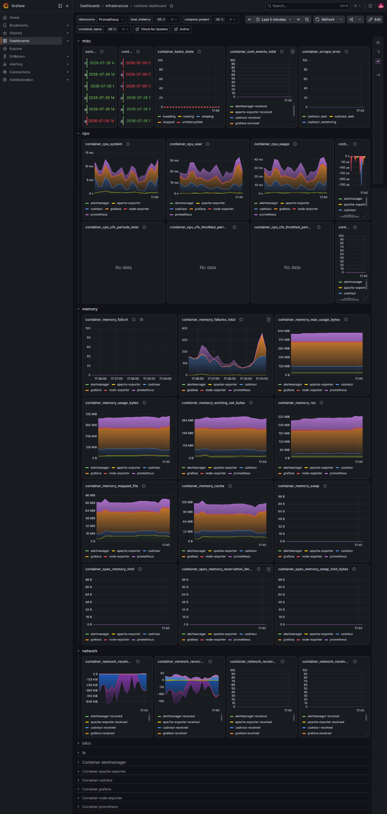
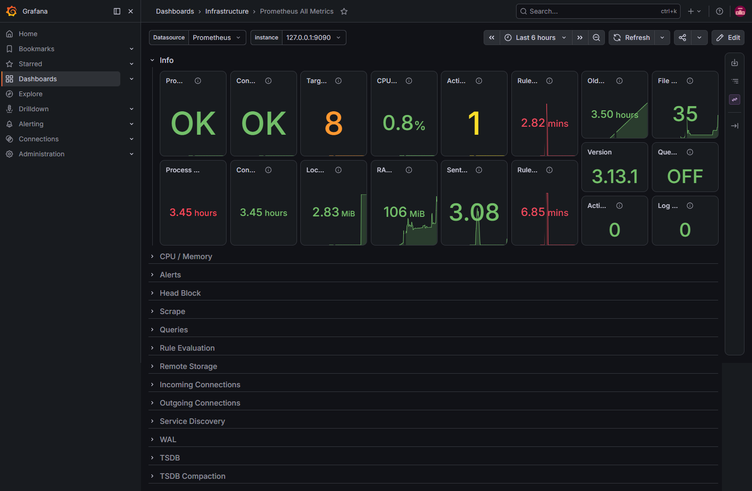
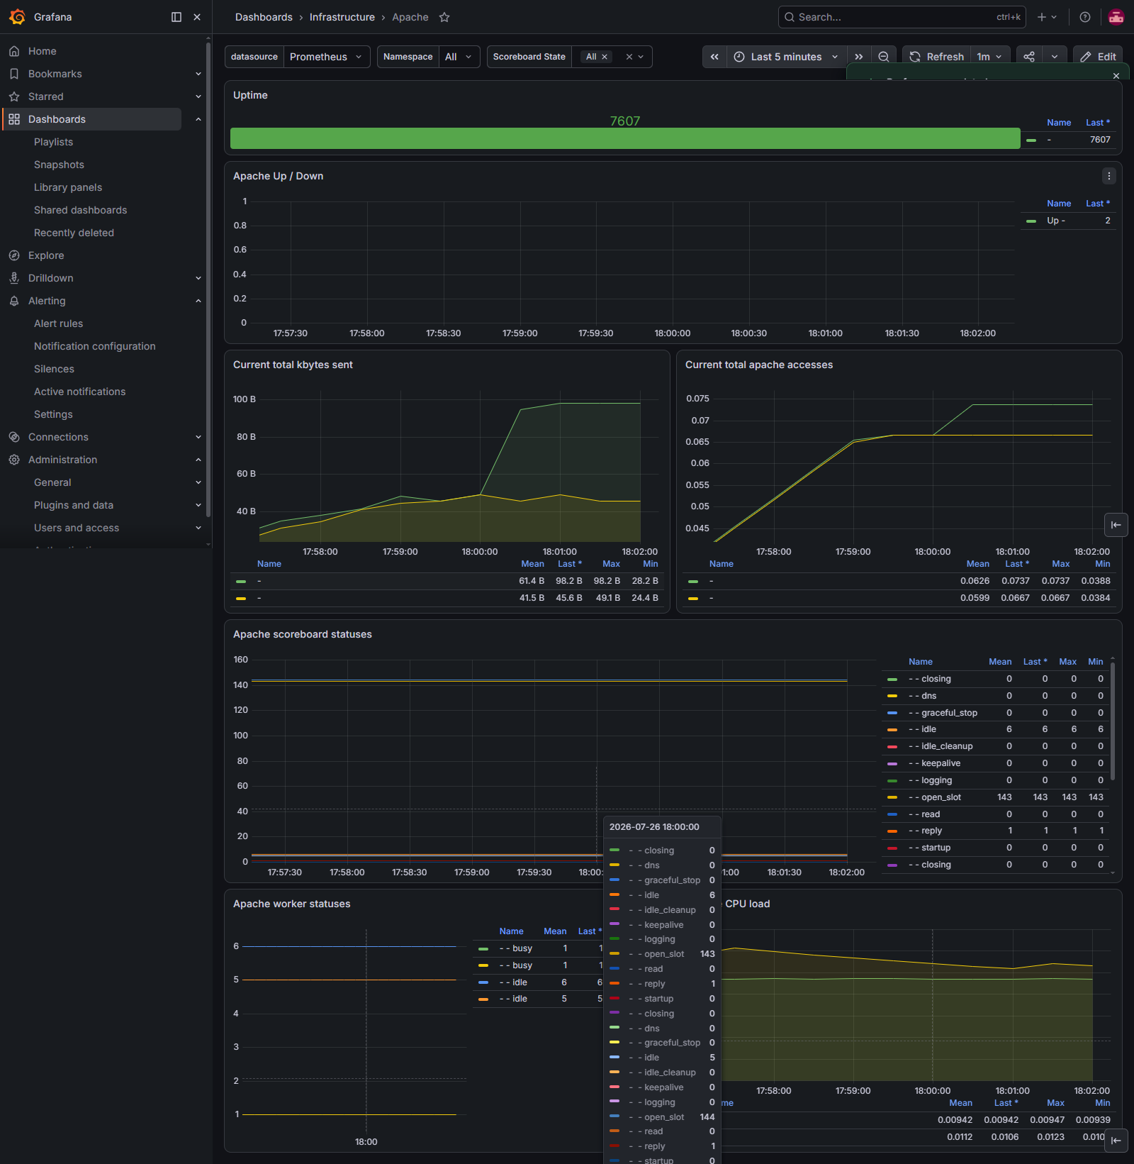
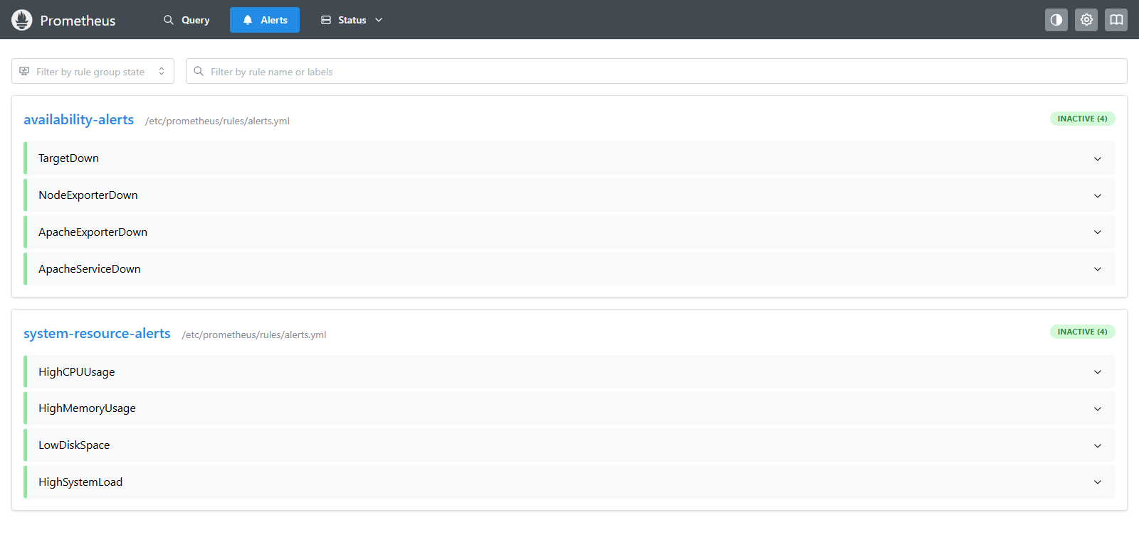

Demonstration

Slide 18


Thank you
- Sazad Ahemad

