Slide 1

Guardian AI Control Plane
Enterprise AI Governance
and Lifecycle Management
Convergence 2026
Guardian AI
01
Notes:
Opening: Guardian AI provides a shared enterprise platform for agent development and operations. The Control Plane coordinates governance and lifecycle management across teams and AWS execution environments. Today we will walk through the operating model and an agent journey.
Source: User-supplied Guardian presentation and application screenshots.
Delivery status is not independently verified. Present platform design as design, and roadmap capabilities as planned.

Slide 2
The enterprise AI challenge
A repeatable path from an agent use case to a governed deployment
Teams need
2–3 days
Approved enterprise tools
Clear ownership and access
A consistent deployment workflow
Visibility after deployment
Target time to agent deployment
For a standard agent with ready access, dependencies, and timely approvals.
Guardian AI
02
Notes:
Explain the target as approximately two to three days for a standard agent deployment through the platform. This is a user-provided planning estimate, not a measured SLA. Timing depends on use-case readiness, integration work, access, evaluation and approvals. It does not promise that a new enterprise integration can be built in that period.
Source: User-provided two-to-three-day estimate and supplied platform materials.
Delivery status is not independently verified. Present platform design as design, and roadmap capabilities as planned.

Slide 3
Guardian AI platform overview
One enterprise experience for shared resources, agent delivery, and operations
Organization administrators
Project teams
Business and platform owners
Connect AWS accounts.
Discover resources.
Curate approved tools.
Grant project access.
Configure agents.
Select granted tools.
Submit for approval.
Deploy and test.
Review deployment requests.
Establish accountability.
Oversee runtime activity.
Guide adoption.
Guardian AI
03
Notes:
Introduce the platform through people and responsibilities. The application groups the experience into organization governance, project delivery, and runtime. This model supports enterprise reuse while keeping ownership clear.
Source: User-supplied Guardian presentation and application screenshots.
Delivery status is not independently verified. Present platform design as design, and roadmap capabilities as planned.

Slide 4
Organization and project operating model
Shared resources with explicit access boundaries
Organization
Ownership and administration
Connected AWS accounts
Resource discovery
Approved tool catalog
Review and registration
Project workspaces
Agents and deployments
Projects receive selected tools from the organization catalog.
Guardian AI
04
Notes:
The organization represents a business unit or team. It owns connected accounts, projects and the shared tool catalog. Projects are application or AI initiative workspaces. Tool grants establish which catalog tools project agents can use. This is the operating model described in the application.
Source: User-supplied Guardian presentation and application screenshots.
Delivery status is not independently verified. Present platform design as design, and roadmap capabilities as planned.

Slide 5
Enterprise resources become reusable agent tools
Discover once, review centrally, and grant access where needed
1 Connect
2 Discover
3 Approve
4 Grant
AWS account and
deployment role
Candidate Lambda
and API resources
Review and register
in the tool catalog
Make selected tools
available to projects
Platform value
Reusable integrations reduce repeated setup across agent teams.
Guardian AI
05
Notes:
Describe discovered resources as candidate tools, not automatically approved tools. Organization review and project grants are distinct decisions. The app describes gateway target reuse and secret references as part of its design. Do not imply every possible AWS service is automatically discoverable.
Source: User-supplied Guardian presentation and application screenshots.
Delivery status is not independently verified. Present platform design as design, and roadmap capabilities as planned.

Slide 6
Agent development and deployment lifecycle
A consistent workflow with ownership and version history
01
02
03
Configure
Register
Validate and evaluate
Prompt, model, tools
Owner and version
Policy and quality checks
04
05
06
Approve
Deploy
Test and observe
Business and platform review
Approved runtime configuration
Runs, traces, and outcomes
Guardian AI
06
Notes:
This is the intended lifecycle. The draft describes immutable versions and validation/evaluation gates. Confirm their implementation status before presenting them as enforced today. A version connects the submitted configuration to its review and deployment evidence.
Source: User-supplied Guardian presentation and application screenshots.
Delivery status is not independently verified. Present platform design as design, and roadmap capabilities as planned.

Slide 7
Control Plane and Execution Plane
Guardian coordinates governance. Runtime components enforce execution controls.
Guardian Control Plane
AWS Execution Plane
UI and backend API
Organization and project registry
Access and approval orchestration
Deployment coordination
Agent harness and hosting runtime
Amazon Bedrock model access
AgentCore Gateway tool access
Runtime enforcement and telemetry
Approved configuration and deployment requests
Run status, traces, and usage evidence
Guardian AI
07
Notes:
The control plane manages configuration and coordinates enterprise integrations. It integrates with enterprise identity rather than replacing it. The agent harness is application execution software, distinct from the service hosting it. This architecture separates governance administration from runtime execution. The arrow represents management requests, not a requirement for a synchronous control-plane call on every invocation. Runtime evidence returns to the operational view through integrations.
Source: User-supplied Guardian presentation and application screenshots.
Delivery status is not independently verified. Present platform design as design, and roadmap capabilities as planned.

Slide 8
Governance throughout the lifecycle
Control objectives for platform-managed agent workloads
Before deployment
During execution
Record owner and version.
Grant approved tools.
Validate configuration.
Evaluate and obtain approval.
Authenticate the caller.
Authorize tool access.
Resolve managed secrets.
Capture trace context.
Enterprise identity integration and runtime policies support these controls.
Guardian AI
08
Notes:
Frame this slide as control objectives. The application specifies business-owner and platform-admin approval. Runtime tool authorization must be configured at the enforcement point. Claims such as fail-closed authorization or universal gateway routing require implementation evidence. Avoid claiming that API calls inherently lack security if they are not through this platform.
Source: User-supplied Guardian presentation and application screenshots.
Delivery status is not independently verified. Present platform design as design, and roadmap capabilities as planned.

Slide 9
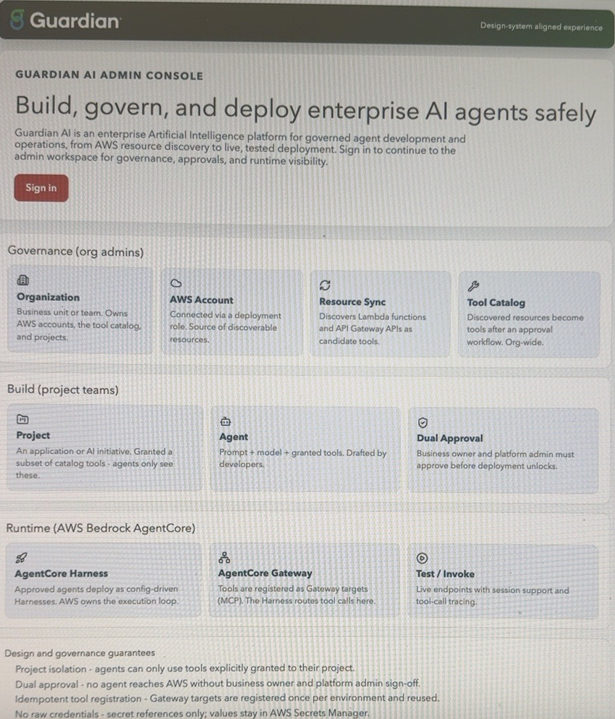
Guardian AI application walkthrough
Follow one example agent through the enterprise workflow
Example: internal knowledge assistant
1. Select organization and project
2. Choose a granted knowledge tool
3. Configure the agent and submit
4. Review the approval decision
5. Deploy and inspect a test run
Illustrative demo journey
Guardian AI
09
Notes:
Use one prepared internal knowledge assistant example with an approved tool. Show the corresponding application pages during a live demonstration where available. The embedded image is a supplied application overview, not evidence of a completed deployment. Do not present invented run data. Explain organization, project, approval and runtime transitions as you navigate.
Source: User-supplied Guardian presentation and application screenshots.
Delivery status is not independently verified. Present platform design as design, and roadmap capabilities as planned.

Slide 10
Operational visibility and accountability
An enterprise view of deployed agents and their activity
Deployment record
Execution evidence
Usage attribution
Which agent version runs?
Who owns it?
Who approved the release?
Which tools did it call?
What succeeded or failed?
Which trace explains the run?
Which team owns the usage?
How much did the agent consume?
Where should cost be attributed?
Target reporting scope. Validate trace coverage and cost allocation in the pilot.
Guardian AI
10
Notes:
Separate deployment metadata, runtime observability, and financial attribution. The draft proposes these capabilities but supplied screenshots do not show completed reports. Cost allocation requires agreed attribution rules. Show actual evidence if available and otherwise describe this as target reporting scope.
Source: User-supplied Guardian presentation and application screenshots.
Delivery status is not independently verified. Present platform design as design, and roadmap capabilities as planned.

Slide 11
Lifecycle management after deployment
Roadmap scope for continuous operation
Change and promote
Monitor and respond
Retire responsibly
Version updates
Environment promotion
Dependency checks
Approval evidence
Quality and runtime monitoring
Failure investigation
Access changes
Rollback procedures
Disable invocation
Revoke tool access
Preserve required evidence
Remove unused resources
Guardian AI
11
Notes:
These are proposed roadmap capabilities, not a claim of completed implementation. Lifecycle management continues after the first successful deployment. Explain promotion, operations and retirement at a high level without committing to dates or implementation details.
Source: User-supplied Guardian presentation and application screenshots.
Delivery status is not independently verified. Present platform design as design, and roadmap capabilities as planned.

Slide 12
Pilot milestones and success measures
Delivery plan with evidence at each milestone
M1 Foundation
M2 Governance
M3 Runtime
M4 Pilot readiness
Registry, schema, and
AWS integration foundation
Validation, evaluation, and
approval workflow
Approved deployment and
trace propagation
One agent completes the
governed deployment journey
Pilot measures
2–3 day deployment target Tool reuse Approval turnaround
Ownership records and trace completeness
Guardian AI
12
Notes:
The four milestones come from the supplied phase-one plan. No milestone completion status or delivery date has been supplied, so this slide presents a plan rather than an achieved progress report. The two-to-three-day figure is a target for ready standard agent use cases, subject to access, dependencies and approvals. Establish a consistent measurement start and end point in the pilot.
Source: User-supplied Guardian presentation and application screenshots.
Delivery status is not independently verified. Present platform design as design, and roadmap capabilities as planned.

Slide 13
Questions and discussion
Which use case should join the pilot?
Discuss onboarding needs, enterprise integrations,
and the evidence needed for production readiness.
Guardian AI
13
Notes:
Close by inviting pilot use cases and feedback. Ask participants what would make onboarding easier and what evidence they need before production. Reinforce the platform goal of shared enterprise capabilities and a repeatable governed deployment path.
Source: User-supplied Guardian presentation and application screenshots.
Delivery status is not independently verified. Present platform design as design, and roadmap capabilities as planned.

