Slide 1
Reference Architecture
Web Browser, Smartphone App
Web App
http
Soft Endpoints
http/REST
Server
CoAP
IP Device
IP Device
BLE
BLE Device
APP
Android Device
HW Device Endpoints

Slide 2
Protocol Layers and IoT Standards
Application Software
Application
IPSO Objects
Data Models
OMA LWM2M
API
CoAP
HTTP
Application Protocol
6LowPAN
IPV4/IPV6
Routing
802.15.4
WiFi, Ethernet
HW Network
MCU – 16KiB RAM
MPU
Hardware

Slide 3
Protocol Layers Work Together
IPSO Smart Objects are based on OMA LWM2M
Defines application objects composed of resources using the LWM2M Object Model
Complex objects can be composed from simple objects
Easy to add new resource and object types as needed
OMA LWM2M is based on CoAP
Provides a server profile for IoT middleware
Defines a simple reusable object model
Defines management objects and reuses REST API for onboarding and device life cycle management
CoAP and related standards from IETF
CoAP Protocol (RFC 7252) provides a REST API for device abstraction and data compatibility layer for constrained networks and devices
HTTP Proxy provides application abstraction through standard web APIs
Core-link-format (RFC 6690) provides a way to add semantic descriptors in the form of web links and enables local resource discovery through the REST API
Resource Directory provides an API for scalable discovery and linking using core-link-format primitives

Slide 4
Internet of Things
CoAP Protocol

Slide 5
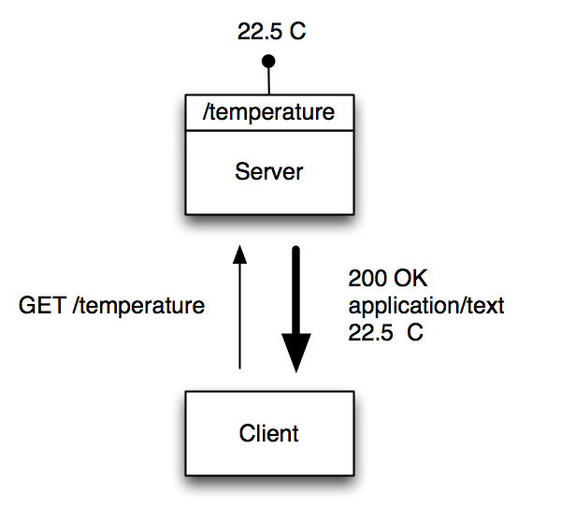
CoAP is REST for Constrained Devices
Makes each device a lightweight server that exposes a REST API
A CoAP device can be both client and server
Roles can be reversed and the sensor, as a client, can update a REST API at another node, device or server

Slide 6
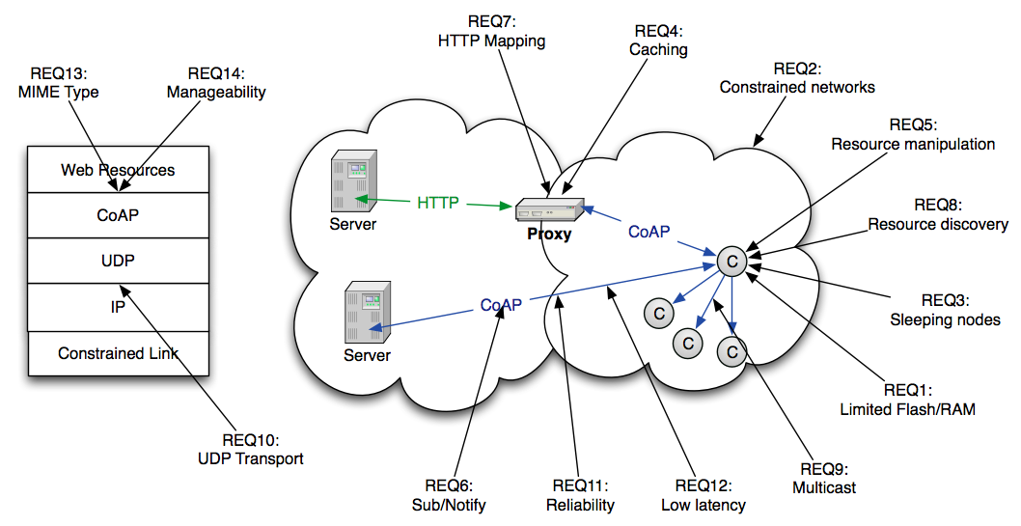
CoAP Use Case Requirements
REST API
Less Constrained
Resource Constrained

Slide 7
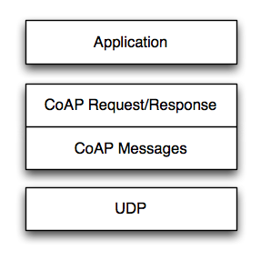
Transport Model
Transport
CoAP currently defines:
UDP binding with DTLS security
CoAP over SMS or TCP possible
Base Messaging
Simple message exchange between endpoints
Confirmable or Non-Confirmable Message
Answered by Acknowledgement or Reset Message
REST Semantics
REST Request/Response mapped onto CoAP Messages
Method, Response Code and Options (URI, content-type etc.) define REST exchanges, very similar to HTTP (HTTP 404 response semantics (not found) mapped to CoAP 4.04 response code)
Asynchronous Notifications
Observer option for GET allows asynchronous state update responses from a single request

Slide 8
CoAP Header – Binary Protocol Mapping

Slide 9
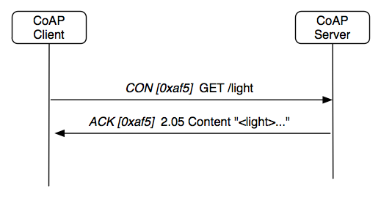
CoAP Request - Response
Confirmable Request
Response with Data Payload

Slide 10
CoAP Caching
CoAP includes a simple caching model
Cacheability determined by response code
An option number mask determines if it is a cache key
Resource Discovery returns links to cache/proxy
Freshness model
Max-Age option indicates cache lifetime
Validation model
Validity checked using the Etag Option
A proxy often supports caching
Usually on behalf of a constrained node,
a sleeping node, a node behind a firewall,
or to reduce network load and battery drain

Slide 11
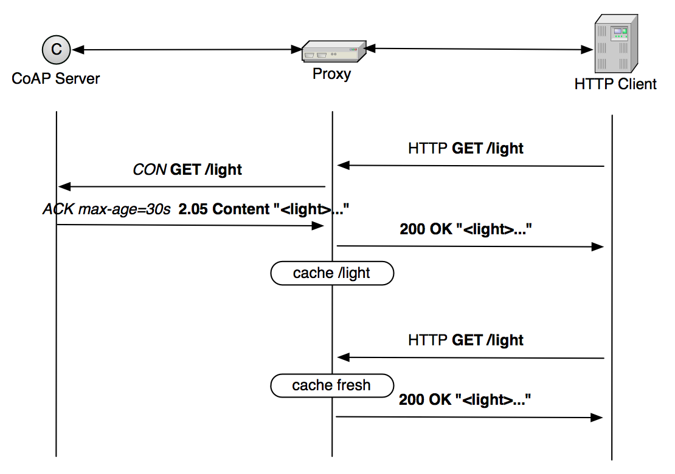
CoAP Proxy Caching

Slide 12
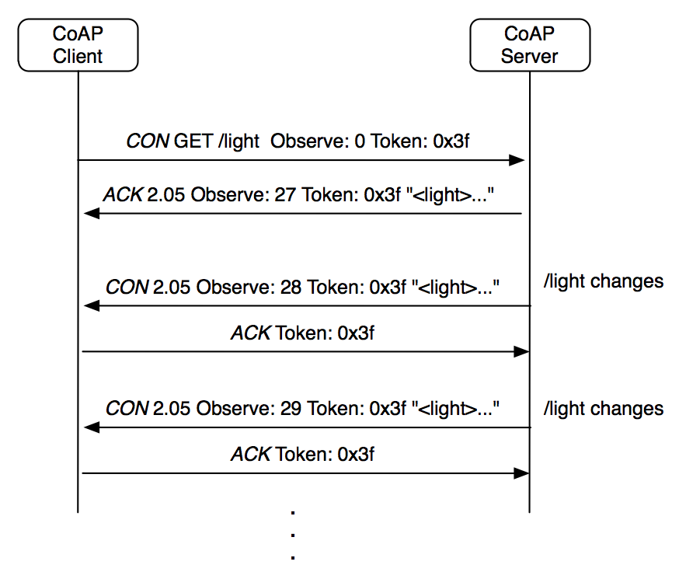
CoAP Observe – Asynchronous Notification
See draft-ietf-core-observe

Slide 13
Internet of Things
CoAP Semantic Links & Discovery

Slide 14
Discovery
Service Discovery
What services are available in the first place?
Goal of finding the IP address, port and protocol
Can be performed by e.g. DNS-SD when DNS is available
CoAP Services can be discovered using Resource Discovery
Resource Discovery
What are the Web resources I am interested in?
Goal of finding URLs to link into applications
Performed using Web Linking and REST API
CoRE Link Format is designed to enable resource discovery

Slide 15
Web Linking for Machines
RFC6690 is aimed at Resource Discovery for M2M
Defines semantic link serialization and content-types suitable for M2M
Defines a well-known resource where links are stored
Enables query string parameters for discovery by attribute and relation
Can be used with unicast or multicast (CoAP)
Resource Discovery with RFC6690
Discovering the links hosted by CoAP (or HTTP) servers
GET /.well-known/core?optional_query_string
Returns a link-format document
URL, resource type, interface type, content-type, size are some basic relations

Slide 16
Local Network Discovery
CoAP Client
CoAP Server
Could use multicast
DISCOVERY
GET /.well-known/core
2.05 Content
Could return a link-format document:
</3//9>;obs;rt=“urn:X-ipso:batt-level”;ct=”50”,
</3//0>;rt=”urn:X-ipso:dev-mdl”;ct=”50”,
</3//1>;rt=”urn:X-ipso:dev-mfg”;ct=”50”,
</3305/0/5800>;obs;rt=”urn:X-ipso:pwr-w”;ct=”50”,
</3305/0/5805>;obs;rt=”urn:X-ipso:pwr-accum-wh”;ct=”50”,
</3303/0/5700>;obs;rt=”urn:X-ipso:temp-C”;ct=”50”

Slide 17
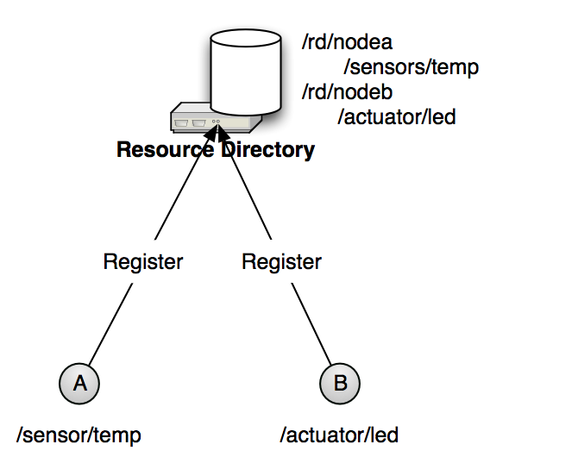
Resource Directory Discovery
CoRE Link Format defines
The link format
Peer-to-peer discovery
A directory approach is also useful
Supports sleeping nodes
No multicast traffic, longer battery life
Remote lookup, hierarchical and federated distribution
CoRE Link Format is used in Resource Directories
Nodes POST (register) their link-format to an RD
Nodes PUT (refresh) to the RD periodically
Nodes may POST to add links to the RD
Nodes may DELETE (remove) their RD entry
Nodes may GET (lookup) the resources of other nodes
Web Applications Discover
Registered Resources
See draft-ietf-core-resource-directory

Slide 18
Resource Directory
Endpoint
Endpoint
core.rd service
REGISTRATION
POST /rd?ep=‘235598376’&lt=19999
</3303/0/5700>;rt=“urn:X-ipso:temp-C”
2.01 Created Location:/rd/235598376
DISCOVERY
GET /rd-lookup?ep&rt=“urn:X-ipso:temp-C”
2.05 Content
</235598376/3303/0/5700>;rt=“urn:X-ipso:temp-C”
See draft-ietf-core-resource-directory

Slide 19
Internet of Things
OMA LWM2M

Slide 20
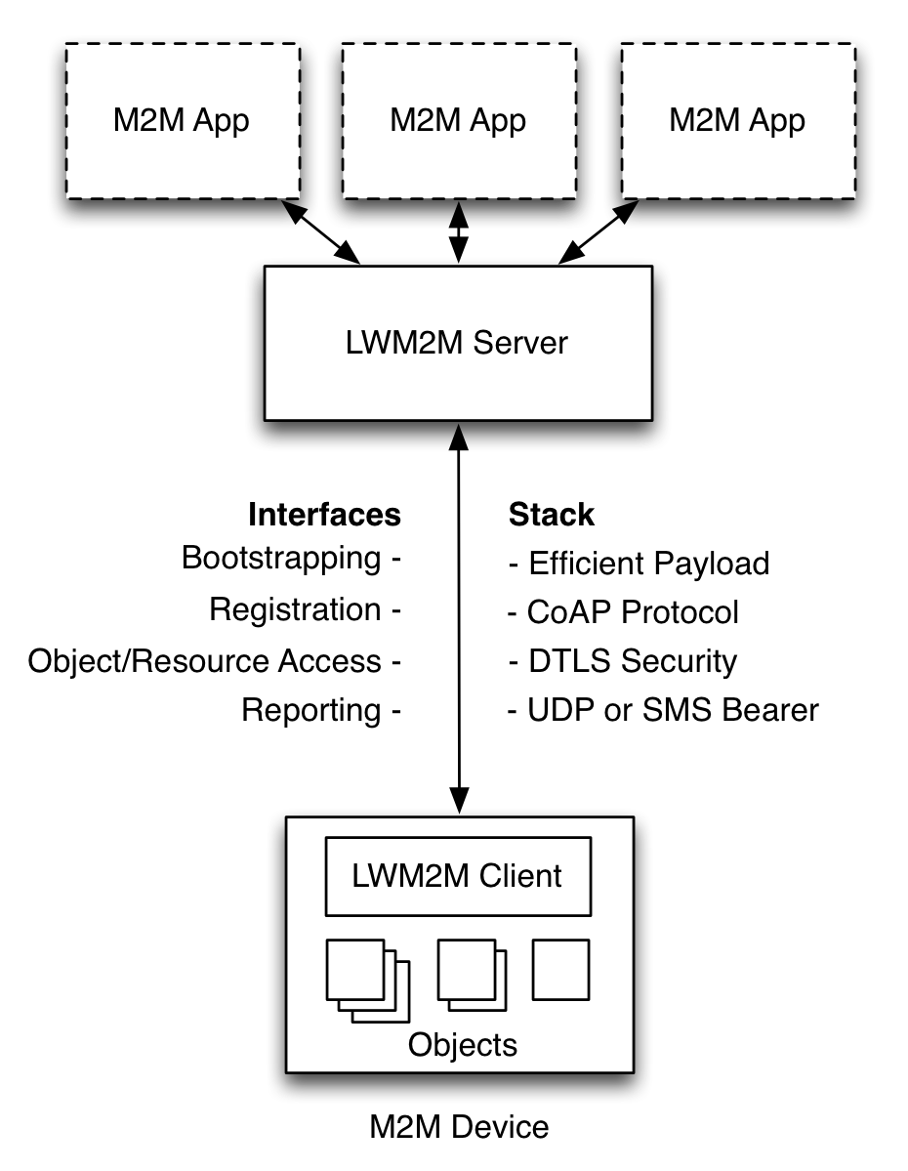
LWM2M Architecture
Web Applications
Application abstraction through REST API
Resource Discovery and Linking
LWM2M Server
CoAP
HTTP Caching Proxy
Resource Directory
Gateway and Cloud deployable
LWM2M Clients are Devices
Device abstraction through CoAP
LWM2M Clients can be CoAP Servers
Any IP network connection

Slide 21
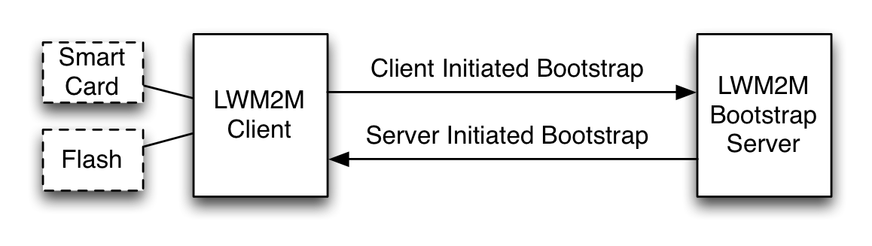
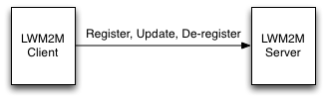
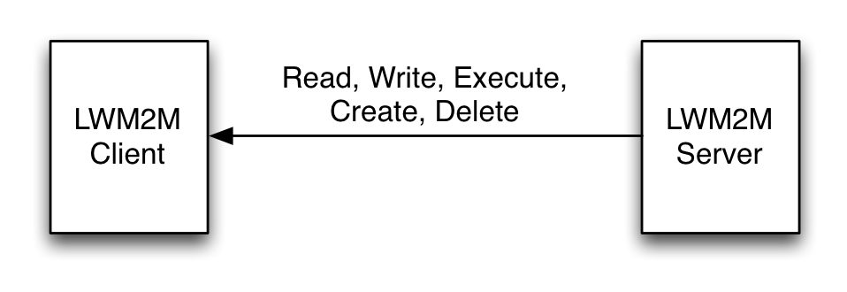
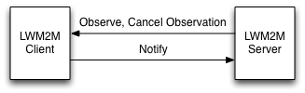
LWM2M Interfaces
Bootstrap Interface
Configure Servers & Keying
Pre-Configure, Smart Card, Server Initiated Bootstrap
Registration Interface
RFC6690 and Resource Directory
Management Interface Using Objects
Management Objects and Resources
Uses the CoAP REST API
Reporting Interface
Subscription to Object Instances and Resources
Asynchronous notification using CoAP

Slide 22
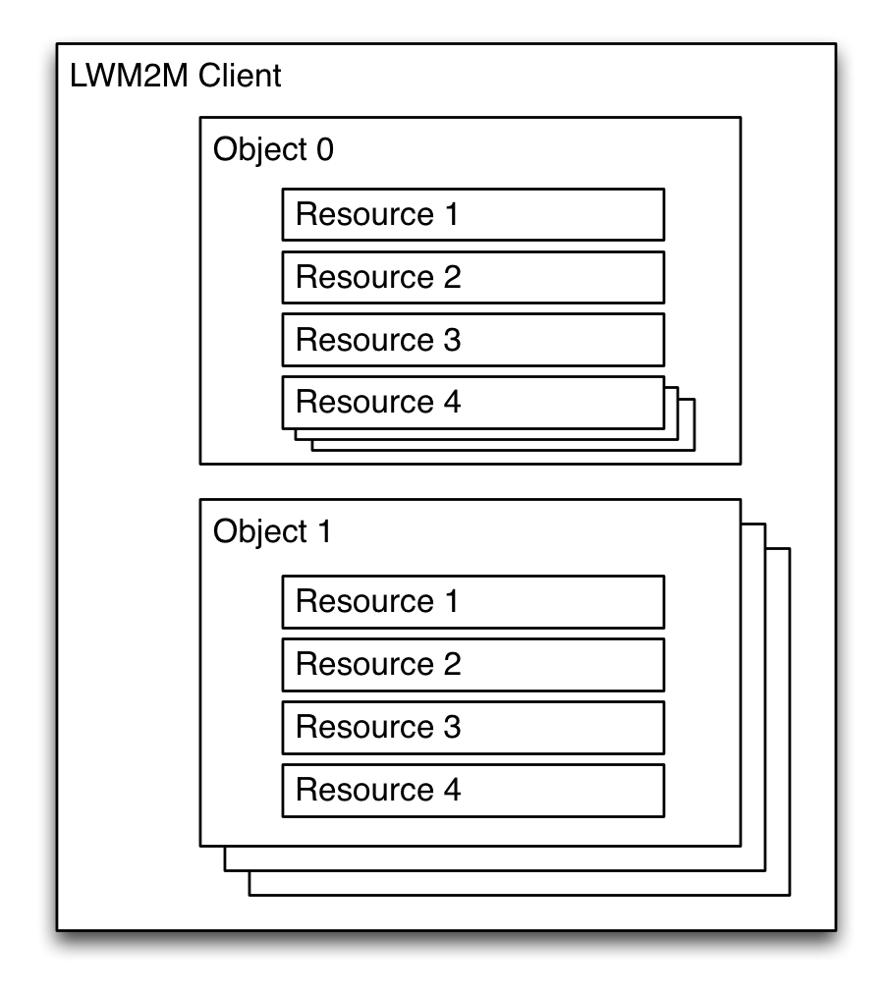
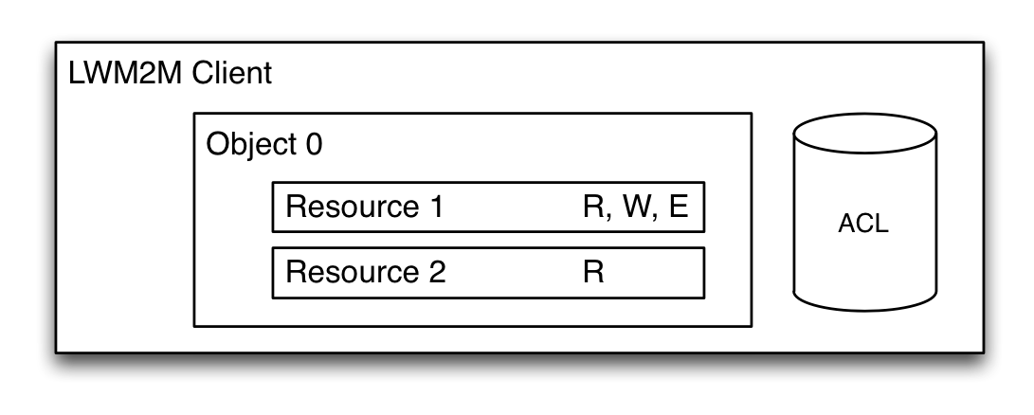
LWM2M Object Model
A Client has one or more Object Instances
An Object is a collection of Resources
A Resource is an atomic piece of information that can be
Read, Written or Executed
Resources can have multiple instances
Objects and Resources are identified by a 16-bit Integer, Instances by an 8-bit Integer
Objects/Resources are accessed with simple URIs:
/{Object ID}/{Object Instance}/{Resource ID}
Ex: /3/0/1 (Object Type=Device, Instance=0, Resource=Device Mfg.)

Slide 23
LWM2M Management Objects

Slide 24
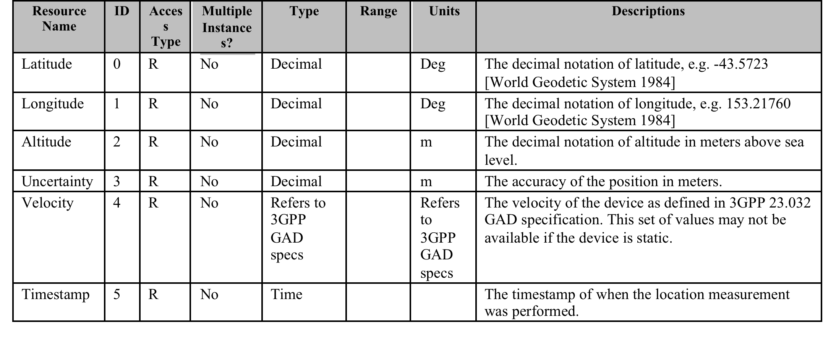
Example Object – Position Object

Slide 25
Internet of Things
IPSO Smart Objects

Slide 26
IPSO Alliance
IPSO Alliance - semiconductor, device, and system manufacturers
Smart Object Committee meets every 2 weeks, recently completed the Smart Objects 1.0 IPSO Technical Guideline
Uses the OMA LWM2M Object Model to define application objects
Resource IDs and Object IDs are registered with the OMNA
Provides a framework for Application Level Interoperability
Builds common definitions of web objects for use with standard web protocols (CoAP, HTTP)
Defines reusable resources and objects that map to physical sensors, actuators, objects

Slide 27
IPSO Smart Objects
IPSO Smart Objects provide a common data model across different sensor types, enabling application level interoperability
Interoperability between end devices and applications
Allows decoupling of devices from dedicated application services
Repurposing and multi-purposing of devices, reusability of application software
Interoperability across platforms and M2M protocols
Enables developers of embedded device and web services to focus on the value endpoints

Slide 28
IPSO Smart Object
Common representations and units
Refers to well-known namespaces like ucum
Default units e.g. Celsius, kPa
Object, object instances, and resource instances are addressable using paths constructed from object and resource type IDs
Example: GET /sensors/3303/0/5700
Returns a representation of the current value of the ‘5700’ resource (Current Value) from instance ‘0’ of Object Type ‘3303’ (Temperature)

Slide 29
Example Smart Object - Temperature
Object with
Internal
resources

Slide 30
Object Annotation
Semantic annotation (not part of LWM2M Standard) uses core-link-format metadata for semantic description
Described in IETF CoRE Interfaces document (http://datatracker.ietf.org/doc/draft-ietf-core-interfaces) enables GET by relation and attribute
For example, GET /rd-lookup?ep&rt=“urn:X-ipso:temp-C”
Returns: </sensors/3303/0/5700>;obs;if=“urn:X-ipso:sensor”;rt=“urn:X-ipso:temp-C”;ct=50;u=“ucum:degC”
Refers to qualified, resolvable namespaces and concepts
Supports CoRE Resource Discovery

Slide 31
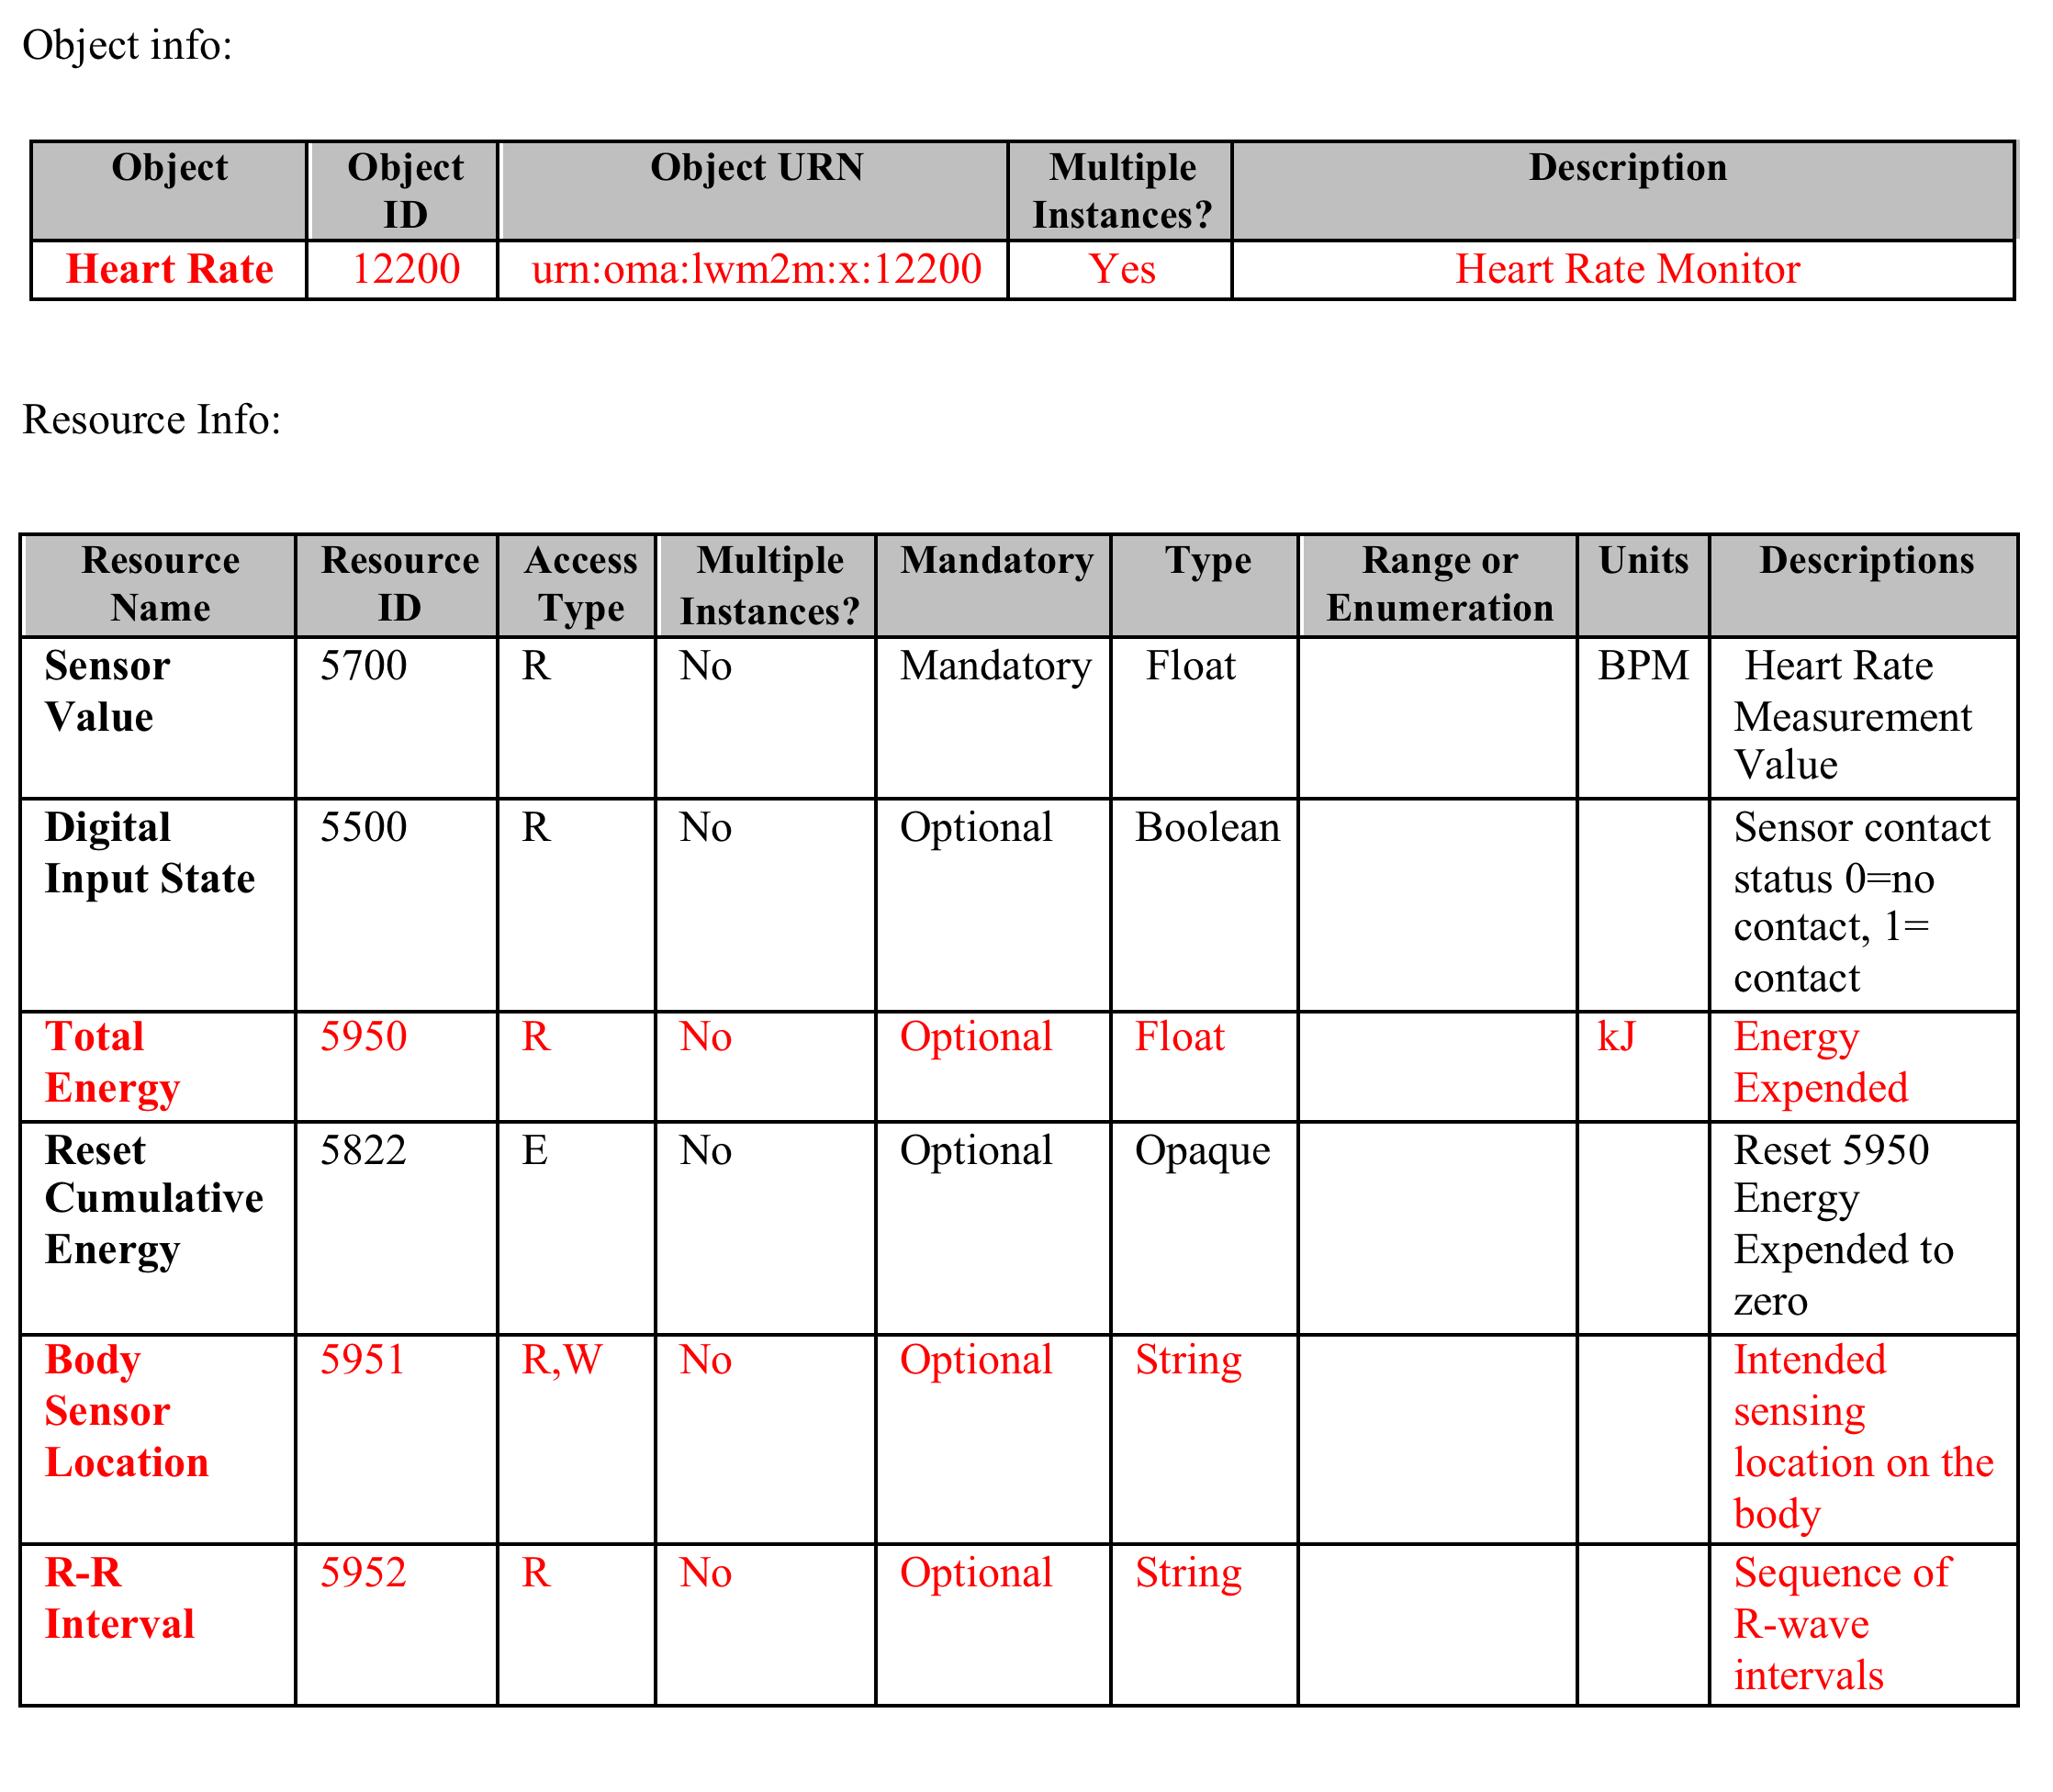
Example Smart Obejct Ad-Hoc binding

Slide 32
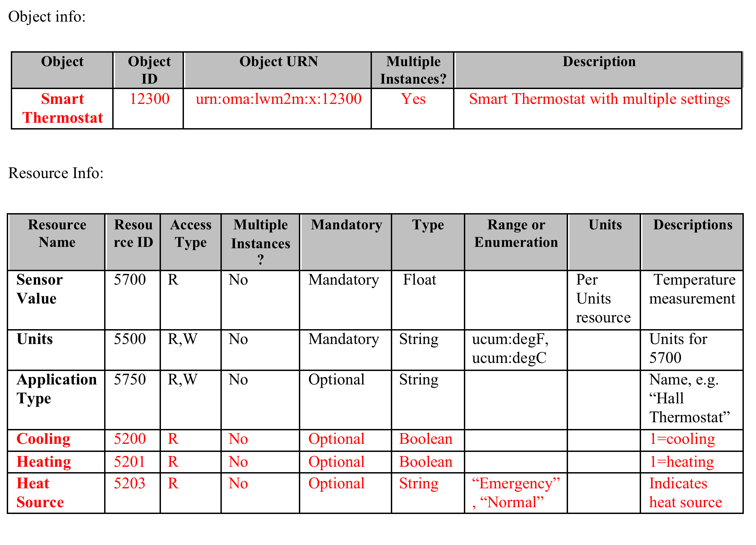
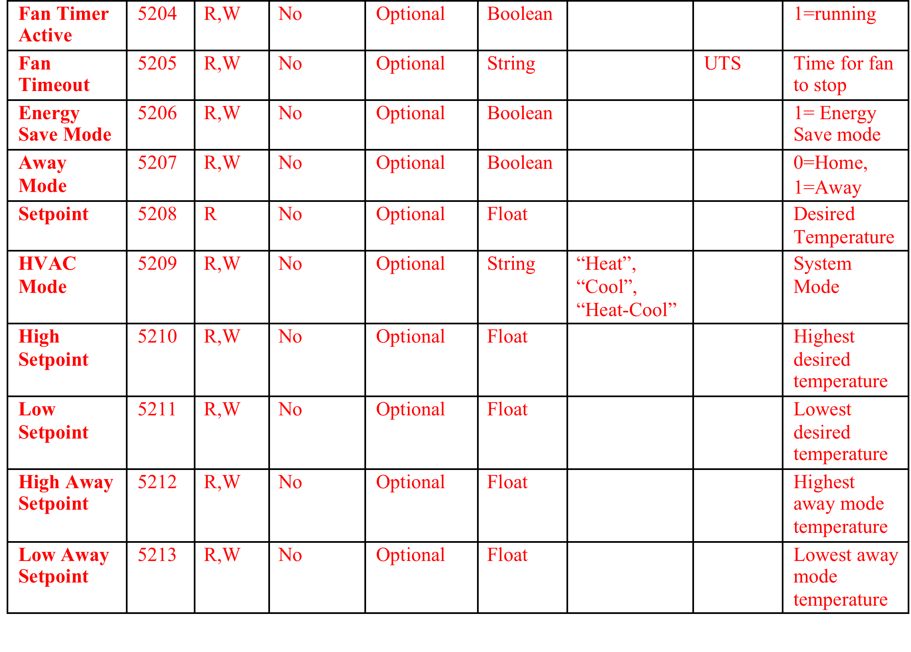
Binding to Smart Thermostat

Slide 33
Smart Object Summary
Simple web objects that represent common sensors, actuators, and data elements exposed for Internet of Things applications
Based on Internet and Industry Standards
Objects can be composed into more complex objects; for example a temperature object, set point object, and load control object can be combined to create a thermostat object
About to publish the first set of objects to cover some common Smart Home and Sensor use cases
New objects are easy to create; we are planning a developer-friendly process for creating and registering new objects

Slide 34
Layered Standards
Application Software
Not tied to specific device or protocol
Any Programming Language
Runs on devices, gateways, and services
Application Level Interoperability
Reusable Device to Application API
Not tied to any specific protocol
IPSO Smart Objects
Service Layer Specification
Device Management over CoAP
Object Model for DM and Applications
OMA LWM2M
REST protocol for constrained devices
IETF Standard (RFC 7252)
Uses TCP or UDP, any IP connection
Discovery using IP Multicast or Directory
CoAP

Slide 35
Standards References
IPSO Smart Object Guideline
http://www.ipso-alliance.org/technical-information/ipso-guidelines
OMA LWM2M Specification
http://openmobilealliance.hs-sites.com/lightweight-m2m-specification-from-oma
IETF CoAP and Related Specifications
CoAP (RFC 7252):
http://tools.ietf.org/html/rfc7252
CoRE Link-Format (RFC 6690):
http://tools.ietf.org/html/rfc6690
CoRE Resource Directory: http://tools.ietf.org/html/draft-ietf-core-resource-directory-01
CoAP Community Site
http://coap.technology/

Slide 36
Internet of Things
OMA LWM2M and ARM mbed

Slide 37
mbed Mapping to Reference Architecture
Web Browser, Smartphone App
Web App
http
Soft Endpoints
http/REST
mbed
Device Server
CoAP
mbed OS
IP Device
IP Device
BLE
BLE Device
APP
Android Device
HW Device Endpoints
mbed Java Client

Slide 38
Registration
Web Browser, Smartphone App
Web App
http
Soft Endpoints
http/REST
mbed
Device Server
CoAP
REGISTER
REGISTER
REGISTER
mbed OS
IP Device
IP Device
BLE
BLE Device
APP
Android Device
HW Device Endpoints
mbed Java Client

Slide 39
Discovery
Web Browser, Smartphone App
Web App
http
Soft Endpoints
DISCOVER
DISCOVER
http/REST
DISCOVER
mbed
Device Server
CoAP
mbed OS
IP Device
IP Device
BLE
BLE Device
APP
Android Device
HW Device Endpoints
mbed Java Client

Slide 40
Example Transaction
Web Browser, Smartphone App
Web App
http
Soft Endpoints
1. GET
http/REST
4. REPLY
mbed
Device Server
CoAP
3. REPLY
mbed OS
2. GET
IP Device
IP Device
BLE
BLE Device
APP
Android Device
HW Device Endpoints
mbed Java Client

Slide 41
Asynchronous Notification
Web Browser, Smartphone App
Web App
http
Soft Endpoints
NOTIFY
http/REST
mbed
Device Server
CoAP
mbed OS
NOTIFY
IP Device
IP Device
BLE
BLE Device
APP
Android Device
HW Device Endpoints
mbed Java Client

Slide 42
mbed Java Client in BLE-CoAP Proxy
Web Browser, Smartphone App
Web App
http
Soft Endpoints
REPLY
GET
http/REST
mbed
Device Server
CoAP
REPLY
mbed OS
GET
BLE
IP Device
REPLY
BLE Device
IP Device
APP
READ
Android Device
HW Device Endpoints
mbed Java Client

