Slide 1
Reference Architecture
Web Browser, Smartphone App
Web App
http
Soft Endpoints
http/REST
Server
CoAP
IP Device
IP Device
BLE
BLE Device
BR
Android Device
Border Router
HW Device Endpoints

Slide 2
Protocol Layers and IoT Standards
Application Software
Application
IPSO Objects
Data Models
OMA LWM2M
API
CoAP
HTTP
Application Protocol
6LowPAN
IPV4/IPV6
Routing
802.15.4
WiFi, Ethernet
HW Network
MCU – 16KiB RAM
MPU
Hardware

Slide 3
mbed Mapping to Reference Architecture
Web Browser, Smartphone App
Web App
http
Soft Endpoints
http/REST
mbed
Device Server
CoAP
mbed OS
IP Device
IP Device
BLE
BLE Device
BR
Android Device
HW Device Endpoints
BLE Border Router

Slide 4
Registration
Web App
Soft Endpoints
http/REST
CoAP
REGISTER
REGISTER
IP Device
IP Device
Android Device
HW Device Endpoints

Slide 5
Discovery
Web App
Soft Endpoints
DISCOVER
DISCOVER
http/REST
mbed
Device Server
CoAP
IP Device
IP Device
HW Device Endpoints

Slide 6
Example Transaction
Web App
Soft Endpoints
1. GET/PUT
4. REPLY
http/REST
mbed
Device Server
CoAP
2. GET/PUT
3. REPLY
IP Device
IP Device
HW Device Endpoints

Slide 7
Asynchronous Notification
Web App
Soft Endpoints
NOTIFY
http/REST
mbed
Device Server
CoAP
NOTIFY
IP Device
IP Device
HW Device Endpoints

Slide 8
Device Server API – Endpoint Discovery
Device Server Endpoint Discovery URL
http://10.10.10.10:8080/my_domain/endpoints
Domain Name
Endpoints can be discovered using the Device Server discovery interface
Endpoint discovery returns a JSON array of endpoint objects

Slide 9
Device Server API – Endpoint Discovery
GET http://10.10.10.10:8080/my_domain/endpoints
0: {
name: "MBED-061590140030"
type: "LWM2M test client"
status: "ACTIVE"
}-
1: {
name: "mbed-6230600c000f"
type: "mbed_device"
status: "ACTIVE"
}

Slide 10
Device Server API – Resource Discovery
Device Server Resource Discovery URL
http://10.10.10.10:8080/my_domain/endpoints/my_ep_name
Domain Name
Endpoint Name
Resources can be discovered using the Device Server discovery interface
Resource discovery returns a JSON array of resource objects

Slide 11
Device Server API – Resource Discovery
GET http://10.10.10.10:8080/my_domain/endpoints/my_ep_name
0: {
uri: "/3304/0/5700"
rt: "urn:X-ipso:humidity"
obs: false
type: ""
}-
1: {
uri: "/3303/0/5700"
rt: "urn:X-ipso:temperature"
obs: false
type: ""
}-
2: {
uri: "/3302/0/5500"
rt: "urn:X-ipso:presence"
obs: true
type: ""
}-

Slide 12
Device Server API – Resource URL
Device Server Resource URL
http://10.10.10.10:8080/my_domain/endpoints/my_ep_name/3303/0/5700
Domain Name
Endpoint Name
Object ID, defines object type
Object Instance, one or more
Resource ID, defines resource type
Web API URLs are constructed from the resource URIs registered by the device, the endpoint name of the registered device, and a preconfigured domain name

Slide 13
Device Server API – Resource URL
GET http://10.10.10.10:8080/my_domain/endpoints/my_ep_name/3303/0/5700
Returns -> 71.2

Slide 14
Web Application Server
Web App Server
Soft Endpoints
http/REST
Server
CoAP
IP Device
IP Device
IP Device

Slide 15
Web Application Server
The Device Server has REST interfaces for resource discovery, resource access, and asynchronous notification
Web Application Server runs an application that interacts with the device through the Device Server interfaces
Application server can run on it’s own instance or node, and connect to the device server over the network
Applications can be programmed in web-friendly languages like Python, Nodejs, Ruby
This example will focus on nodejs and Node-RED

Slide 16
Application Server Setup
Each team will have a dedicated application server instance available – see the lab notes for details
Sign up on the Rackspace “iwantaserver” page and get your server’s IP address and root login
Follow the instructions in the lab note for setting up the server environment and Node-RED
Test the demo application with your mbed board running the LED Demo project

Slide 17
Node-RED
Node-RED is a visual programming system based on node.js
Drag and drop programming using pre-configured and custom function nodes
Event driven data flow programming paradigm with MQTT-style messages consisting of a topic and a payload
Built-in nodes for HTTP, MQTT, JSON templates, and many other useful functions
A Node-RED Flow is a collection of nodes linked together

Slide 18
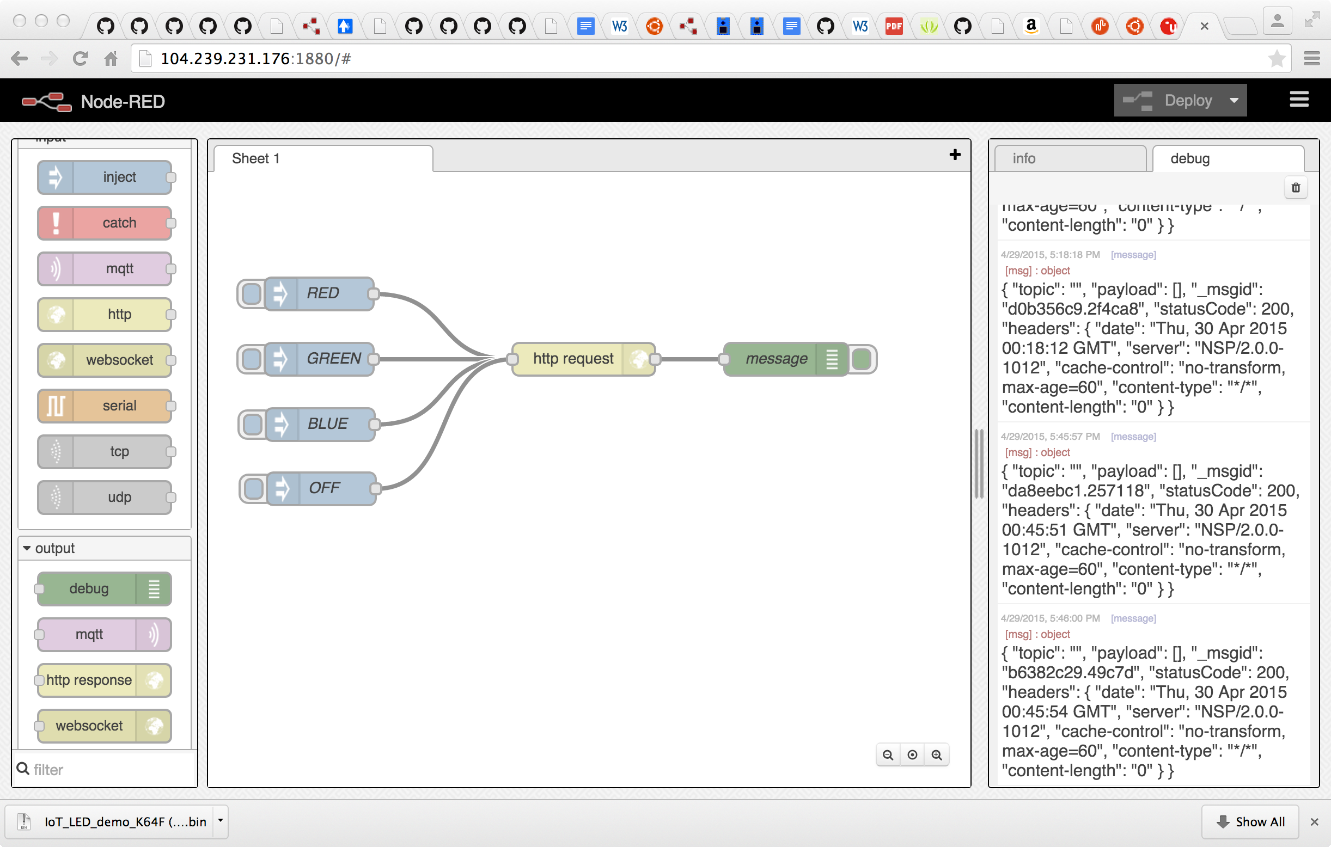
Node-RED Demo Example Flow
Inject node creates a node-red message with a pre defined payload
Debug node reports the http response from the server
http request node builds a request using the injected payload and sends it to a server
(Device Server)

Slide 19
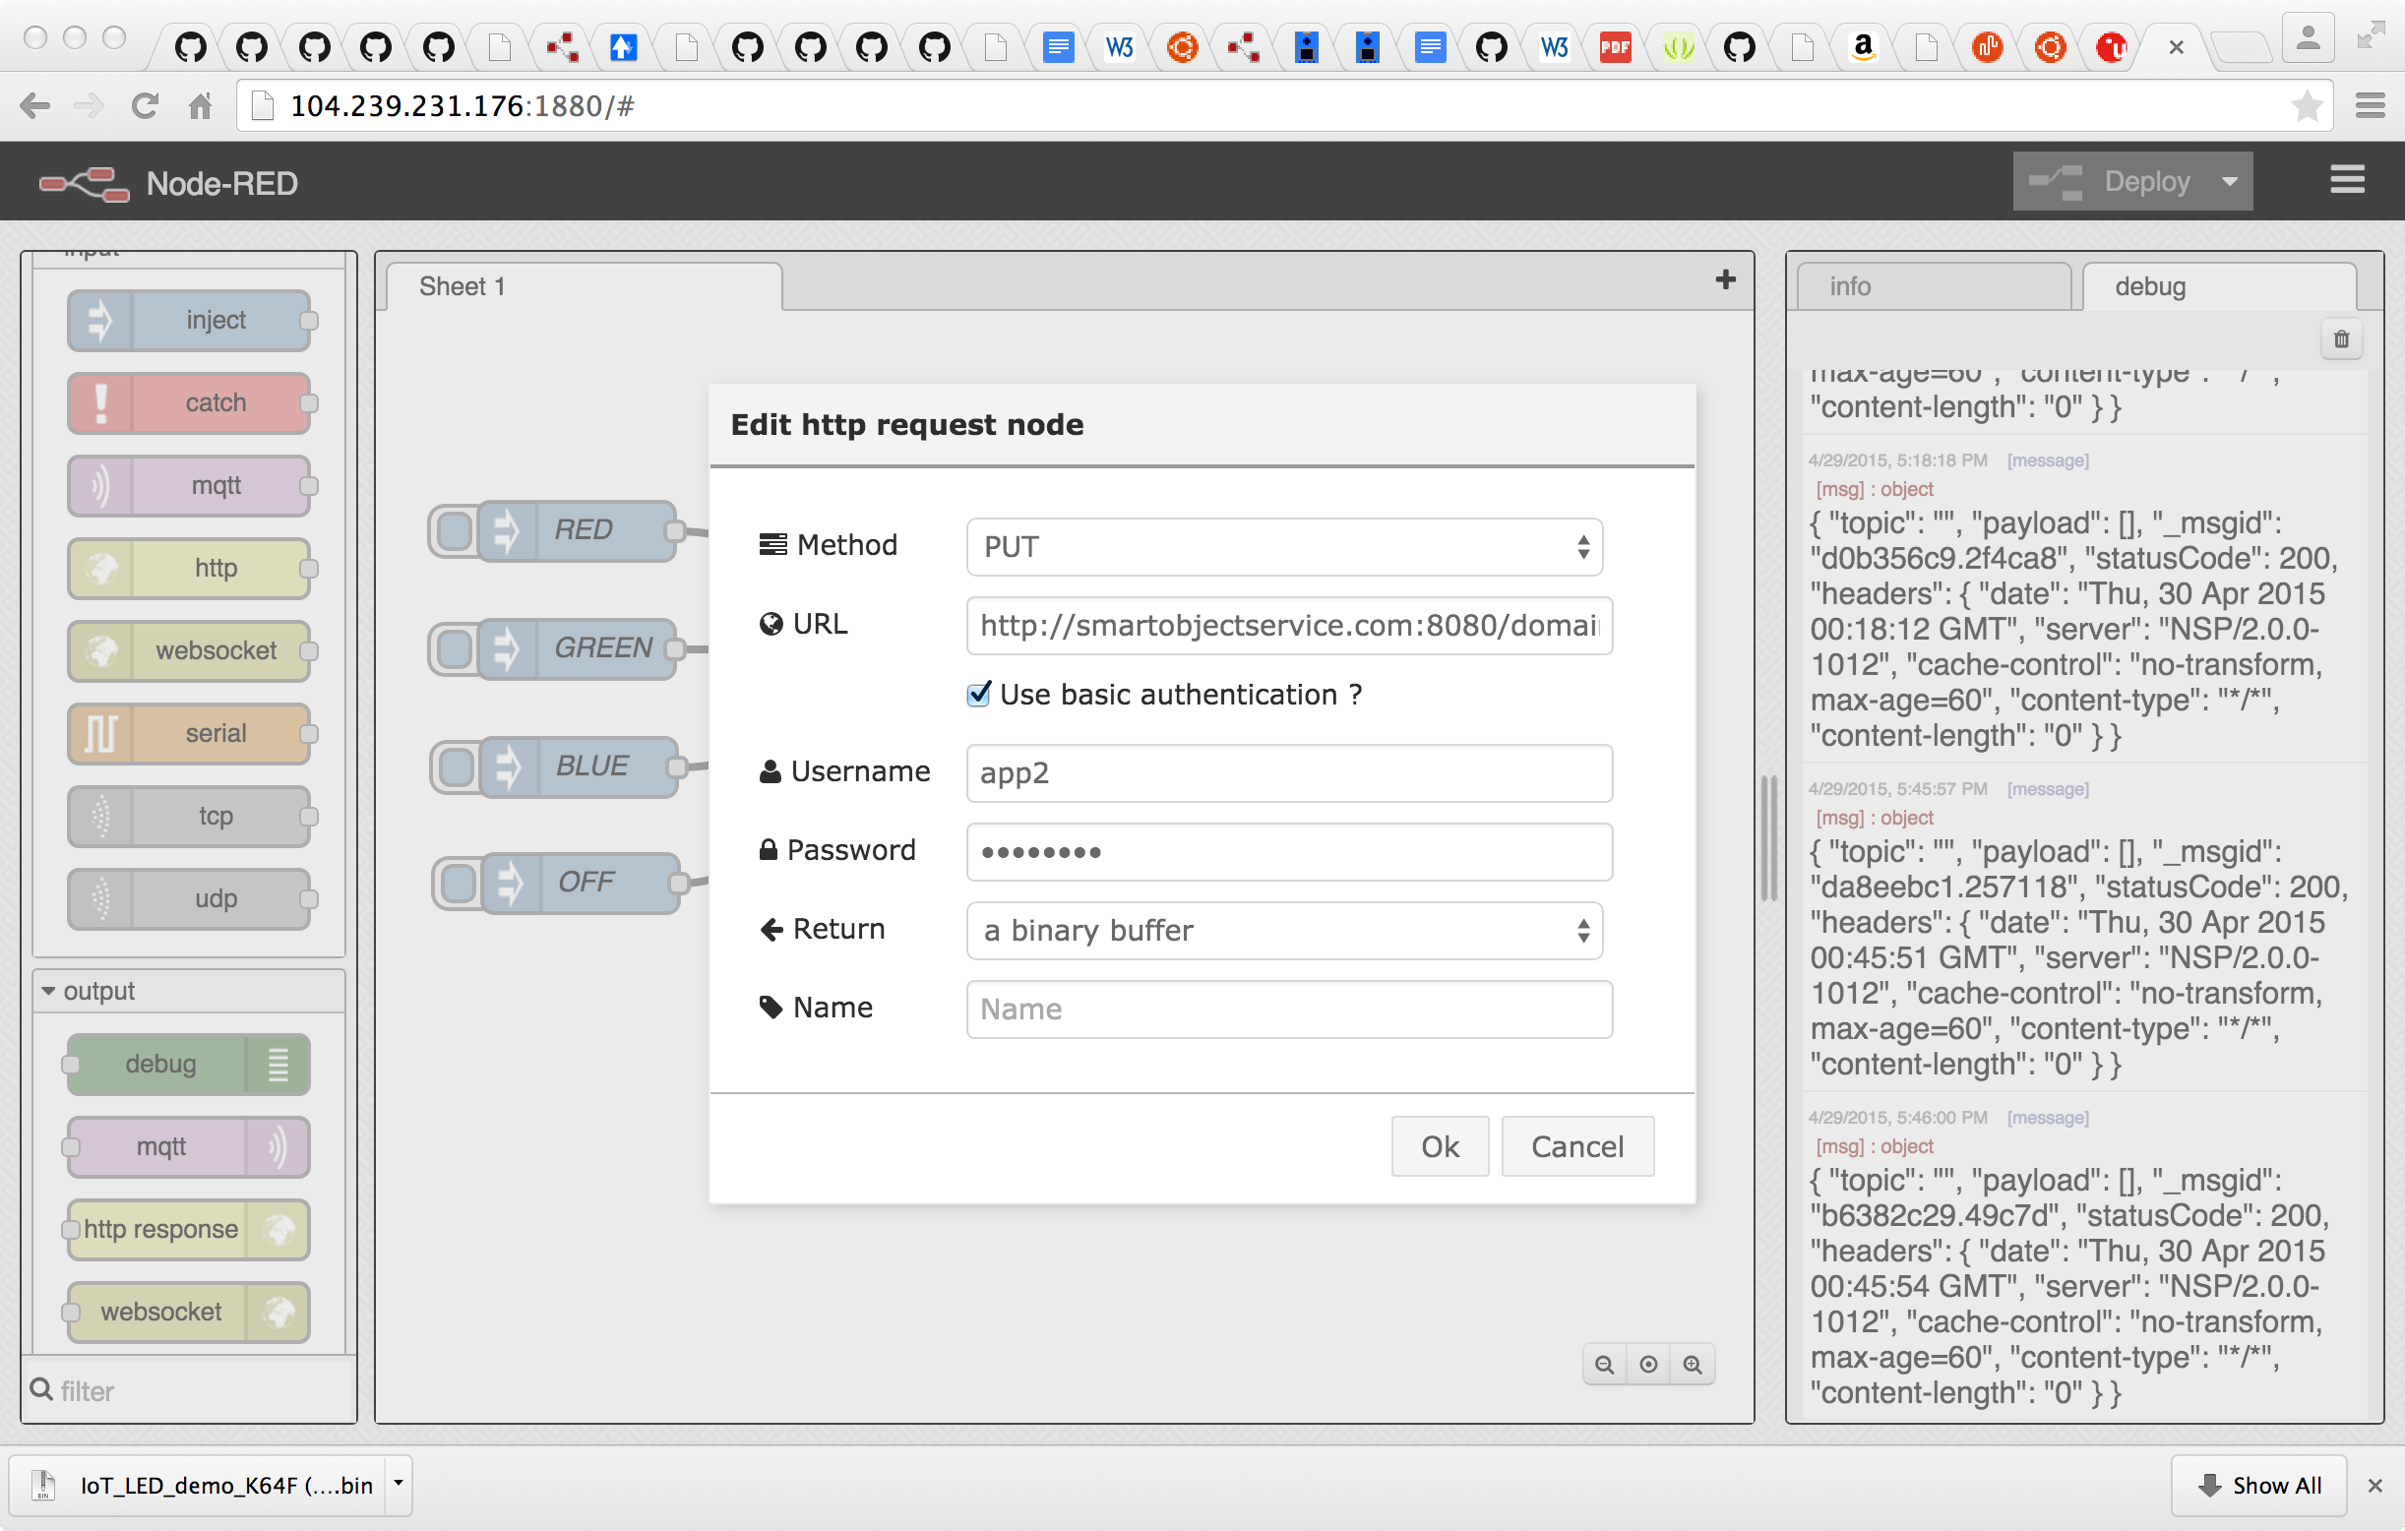
Node-RED Configuration

Slide 20
References
IPSO Smart Object Guideline
http://www.ipso-alliance.org/technical-information/ipso-guidelines
Node-RED
http://nodered.org/
mbed Device Server API reference (User Guide)
https://github.com/connectIOT/SpringIotCourse/blob/master/Documents/NanoService_Platform_UserGuide.pdf
Some live examples of mbed Device Server and Node-RED, also MQTT
http://smartobjectservice.com:1880/

