Slide 1
Reference Architecture
Web Browser, Smartphone App
Web App
http
Soft Endpoints
http/REST
Server
CoAP
IP Device
IP Device
BLE
BLE Device
BR
Android Device
Border Router
HW Device Endpoints

Slide 2
Protocol Layers and IoT Standards
Application Software
Application
IPSO Objects
Data Models
OMA LWM2M
API
CoAP
HTTP
Application Protocol
6LowPAN
IPV4/IPV6
Routing
802.15.4
WiFi, Ethernet
HW Network
MCU – 16KiB RAM
MPU
Hardware

Slide 3
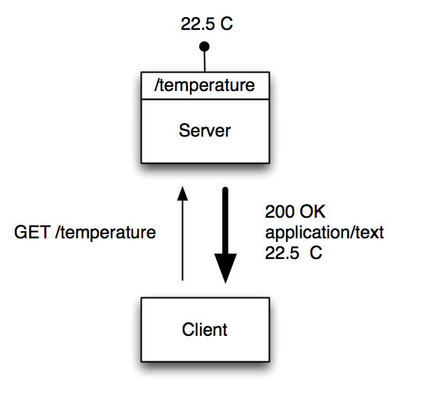
CoAP is REST for Constrained Devices
Makes each device a lightweight server that exposes a REST API
A CoAP device can be both client and server
Roles can be reversed and the sensor, as a client, can update a REST API at another node, device or server

Slide 4
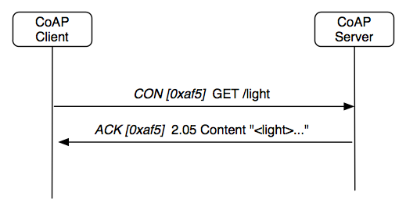
CoAP Request - Response
Confirmable Request
Response with Data Payload

Slide 5
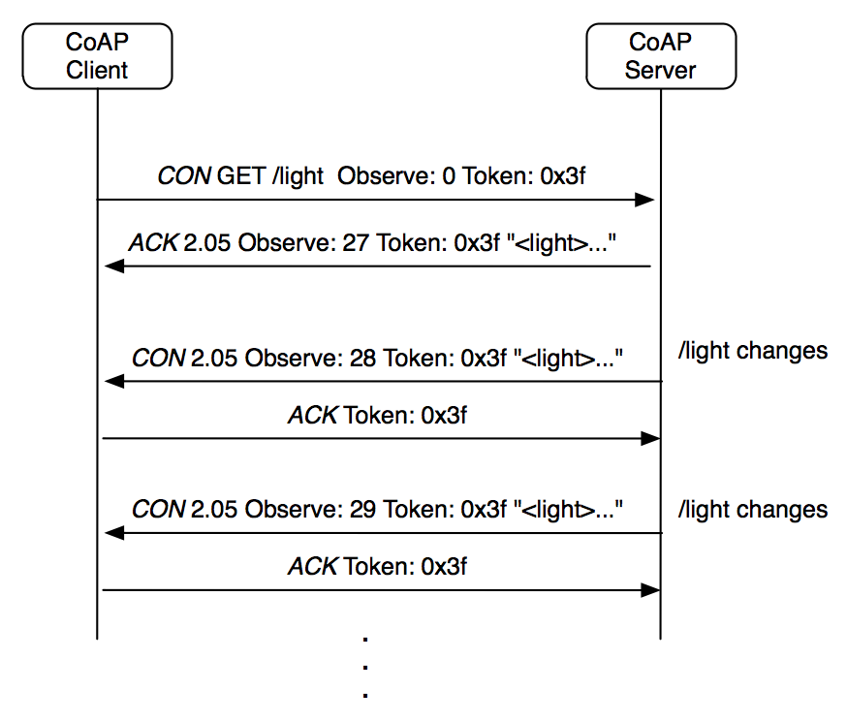
CoAP Observe – Asynchronous Notification
See draft-ietf-core-observe

Slide 6
mbed Mapping to Reference Architecture
Web Browser, Smartphone App
Web App
http
Soft Endpoints
http/REST
mbed
Device Server
CoAP
mbed OS
IP Device
IP Device
BLE
BLE Device
BR
Android Device
HW Device Endpoints
BLE Border Router

Slide 7
Registration
Web Browser, Smartphone App
Web App
http
Soft Endpoints
http/REST
mbed
Device Server
CoAP
REGISTER
REGISTER
REGISTER
mbed OS
IP Device
IP Device
BLE
BLE Device
BR
Android Device
HW Device Endpoints

Slide 8
Discovery
Web Browser, Smartphone App
Web App
http
Soft Endpoints
DISCOVER
DISCOVER
http/REST
DISCOVER
mbed
Device Server
CoAP
mbed OS
IP Device
IP Device
BLE
BLE Device
BR
Android Device
HW Device Endpoints

Slide 9
Example Transaction
Web Browser, Smartphone App
Web App
http
Soft Endpoints
1. GET
http/REST
4. REPLY
mbed
Device Server
CoAP
3. REPLY
mbed OS
2. GET
IP Device
IP Device
BLE
BLE Device
BR
Android Device
HW Device Endpoints

Slide 10
Asynchronous Notification
Web Browser, Smartphone App
Web App
http
Soft Endpoints
NOTIFY
http/REST
mbed
Device Server
CoAP
mbed OS
NOTIFY
IP Device
IP Device
BLE
BLE Device
BR
Android Device
HW Device Endpoints

Slide 11
Resources and Data Models
Web App
Resource:
An addressable element of a REST API
Has a path or URI
May represent a sensor or actuator
Has a set of operations e.g. GET, PUT
Exposed by devices, registered with server
Consumed by applications through server
The Data Model defines:
How the path is constructed - URI template
Which operations are allowed
Other properties like data type
HTTP
Device Server
Resources
CoAP
IP Device
Sensors

Slide 12
Smart Object Data Model - Temperature
Object with
Internal
resources

Slide 13
Smart Object Resource Design
Smart Object Data Model URI
3303/0/5700
Object ID, defines object type
Object Instance, one or more
Resource ID, defines resource type
Objects represent single points of interest, for example a temperature senor
An object may have multiple instances
Resources represent attributes of the object, for example the last measured value, the smallest measured value, the greatest measured value
Object and resource IDs are meant to be reusable, representing common measurements and concepts
Please see the IPSO Smart Object Guideline

Slide 14
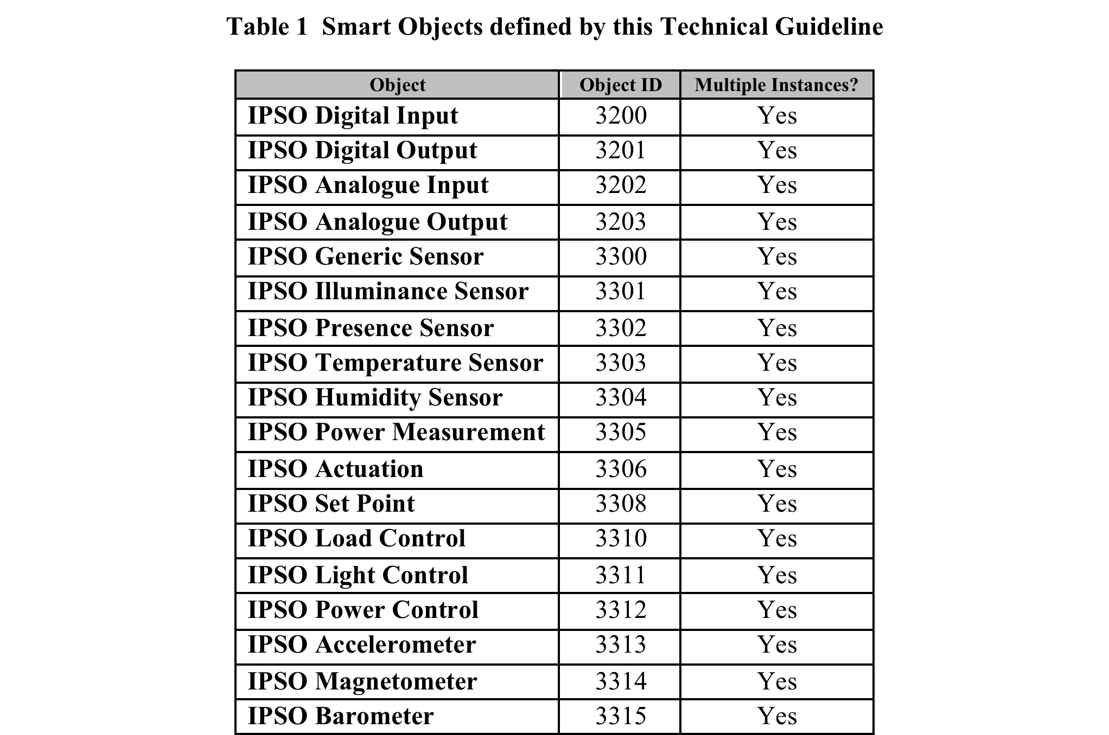
Smart Object Starter Pack

Slide 15
Device Programming for Resources
The mbed library for LWM2M and Smart Objects provides resource classes (e.g. DynamicResource)
Two files are involved in resource programming
Resources are implemented in a <resource>.h file for each addressable resource, which is a wrapper for the generic class constructor and resource-specific code
Resources are configured and created in the main program (e.g. main.cpp)
Resources are registered with the Device Server when the endpoint start() is called, usually in main.cpp

Slide 16
Device Programming for Resources
Refer to the lab note on resource programming for specific instructions
Some attributes and parameters need to be customized for each device
Endpoint Name
Registration Domain
Device Server IP address
And for each resource
Resource.h file
Resource path
Max-age to control cache lifetime - optional
Observation sample time - optional

Slide 17
Device Server API
Devices register resources with a Device Server by uploading links
Registrations have a lifetime and are refreshed periodically by the device
The Device Server is a proxy for resources that are registered by devices
Applications can access device resources by using the HTTP proxy, which exposes a web style REST API
Each registered device resource has a corresponding web API resource
Refer to the mbed Device Server User Guide

Slide 18
Device Server API – Endpoint Discovery
Device Server Endpoint Discovery URL
http://10.10.10.10:8080/my_domain/endpoints
Domain Name
Endpoints can be discovered using the Device Server discovery interface
Endpoint discovery returns a JSON array of endpoint objects

Slide 19
Device Server API – Endpoint Discovery
GET http://10.10.10.10:8080/my_domain/endpoints
0: {
name: "MBED-061590140030"
type: "LWM2M test client"
status: "ACTIVE"
}-
1: {
name: "mbed-6230600c000f"
type: "mbed_device"
status: "ACTIVE"
}

Slide 20
Device Server API – Resource Discovery
Device Server Resource Discovery URL
http://10.10.10.10:8080/my_domain/endpoints/my_ep_name
Domain Name
Endpoint Name
Resources can be discovered using the Device Server discovery interface
Resource discovery returns a JSON array of resource objects

Slide 21
Device Server API – Resource Discovery
GET http://10.10.10.10:8080/my_domain/endpoints/my_ep_name
0: {
uri: "/3304/0/5700"
rt: "urn:X-ipso:humidity"
obs: false
type: ""
}-
1: {
uri: "/3303/0/5700"
rt: "urn:X-ipso:temperature"
obs: false
type: ""
}-
2: {
uri: "/3302/0/5500"
rt: "urn:X-ipso:presence"
obs: true
type: ""
}-

Slide 22
Device Server API – Resource URL
Device Server Resource URL
http://10.10.10.10:8080/my_domain/endpoints/my_ep_name/3303/0/5700
Domain Name
Endpoint Name
Object ID, defines object type
Object Instance, one or more
Resource ID, defines resource type
Web API URLs are constructed from the resource URIs registered by the device, the endpoint name of the registered device, and a preconfigured domain name

Slide 23
Device Server API – Resource URL
GET http://10.10.10.10:8080/my_domain/endpoints/my_ep_name/3303/0/5700
Returns -> 71.2

Slide 24
Standards References
IPSO Smart Object Guideline
http://www.ipso-alliance.org/technical-information/ipso-guidelines
OMA LWM2M Specification
http://openmobilealliance.hs-sites.com/lightweight-m2m-specification-from-oma
IETF CoAP and Related Specifications
CoAP (RFC 7252):
http://tools.ietf.org/html/rfc7252
CoRE Link-Format (RFC 6690):
http://tools.ietf.org/html/rfc6690
CoRE Resource Directory: http://tools.ietf.org/html/draft-ietf-core-resource-directory-01
CoAP Community Site
http://coap.technology/

