Slide 1

We All Grow

Slide 2

NUALFAS
Nualfas is the fastest growing business solution firm where we aim to
provide business growth to companies irrespective of their size.
The underlying philosophy of Nualfas is to leverage our own skills
to support all our clients. These will enable companies to rapidly develop and provide them a chance to expand their business scope. Nualfas ensures that the whole business cooperation process
is fully supervised and controlled, making the cooperation easier for all the Clients.

Slide 3
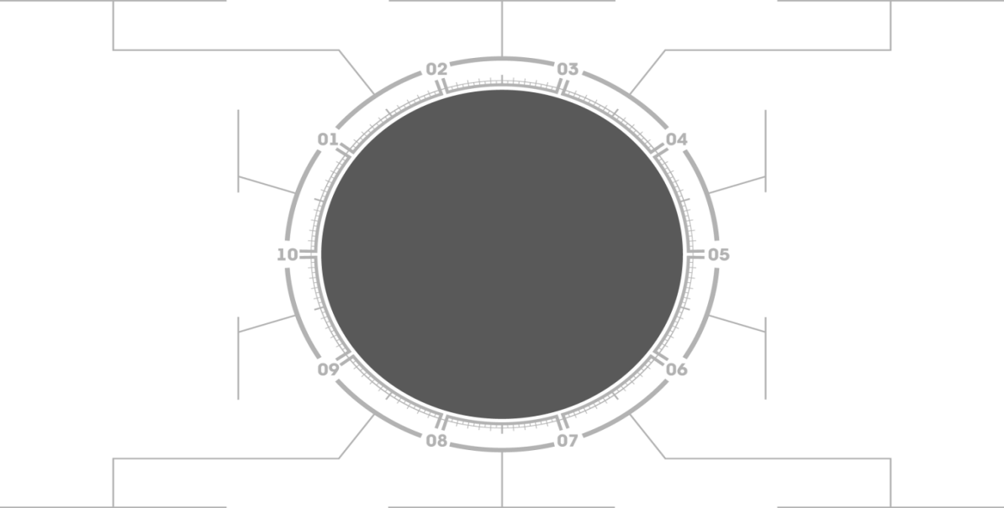
NUALFAS Services
Staffing and Recruitment
IT Managed Services
Facility Management Services
Nualfas
Digital Media and Production house
IT Project Outsourcing
Vertical Garden

Slide 4
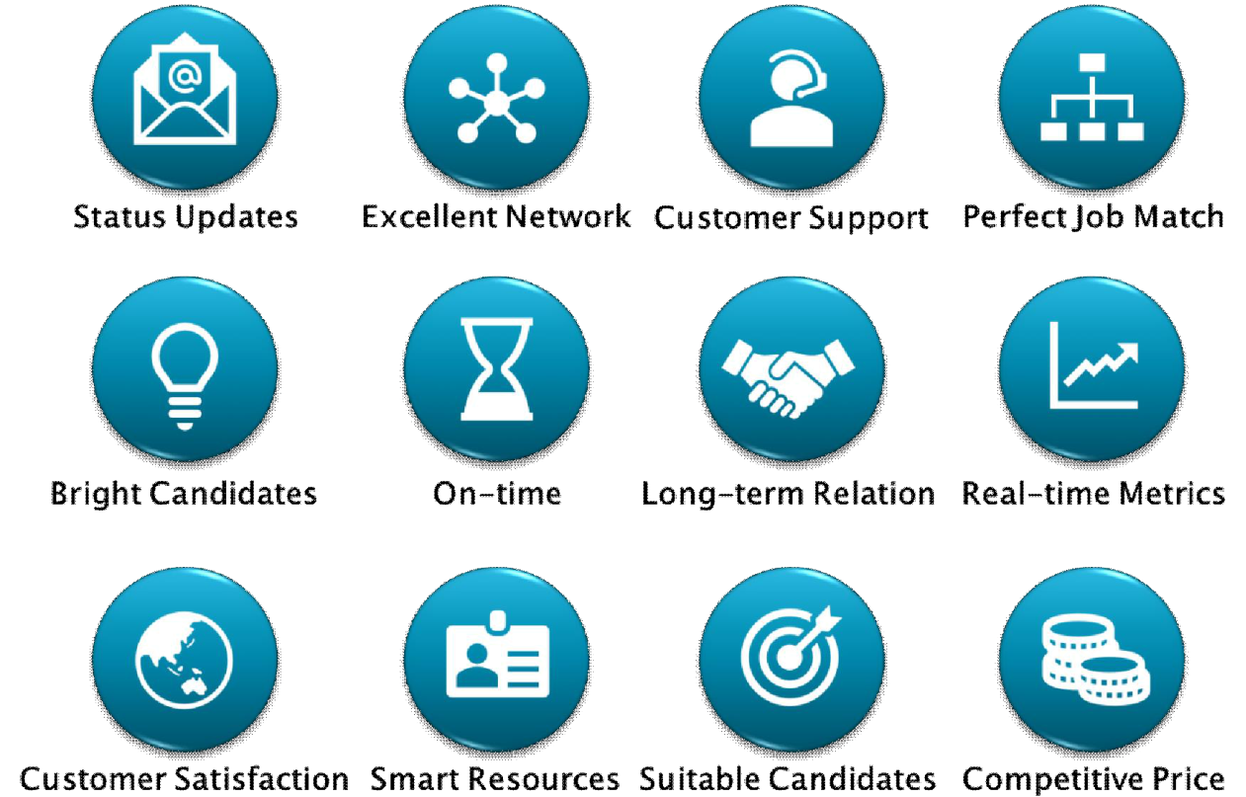
Recruitment and Staffing
Bridging the requirements between the Employer and the Employee has been a constant challenge in the ever-changing trends. Key to any organization's growth is believed to be in the strength of its staff. Getting right candidates for the right job is crucial for any Business.

Slide 5
Our Services and USP
Quality Staffing Process
Good Client Relationships and service
Match Right People to Right Skillsets
Hire-Train-Deploy
Contracts Process Outsourcing
Quality Staffing Process
Pyramid Model

Slide 6

IT Managed Services
We can provide highly tailored managed services to
our customers to supplement their internal IT support
resources and skills to meet the demanding SLAs
required by their business. These range from our 7x24
NoC and SoC to monitor the health, performance and
security status of their networks and systems, helpdesk support for specific applications or business functions, and other tailored services augmenting specific skillsets our users require. Furthermore, our managed services can extend to support hybrid cloud and even multiple cloud environment easing our customers’ efforts to administer the provisioning, performance management and overall management of such complex computing environment

Slide 7

Our Services and USP – IT Managed Services
Infrastructure Assessments and Deployments
Server and End User Virtualization
Strategic Information Technology Planning
Server and Storage planning, installation and migration
Network design, implementation, staging and rollout
Enterprise Security services, including end-to-end
Security Posture, Penetration Testing

Slide 8

Facility Management Services
Nualfas Facilities Management pledge to ensure that all services provided will be underpinned by technology and robust policies and procedures which will at all times reflect good industry practice within an environment of continuous improvement. We are proud to be able to respond
to all our customers and clients needs quickly and efficiently.
Our aim is to exceed our clients expectations at every stage
of contact with them..

Slide 9

Our Services and USP – Facility Managed Services
Integrated Facilities Management Services
Sewage tinkering
Pest control
Buildings maintenance
Cleaning and waste removal.
Beach cleaning.
Street/road cleaning.
Drainage/storm water cleaning.
Cleaning Services for buildings
Landscaping.

Slide 10

Digital Media and Production House
INNOVATING A NEW LEVEL OF SUCCESS!
The mission is endless, as Nualfas will never
stop growing and we honestly don’t foresee limits to
internet technologies. Our mission is to serve
knowledge and expertise globally. We are on a mission
of adopting new technologies, methodologies
& innovations to attain customer satisfaction.
Nualfas has ingenious expertise and highly educated
& experienced resources to devise this unique mission.

Slide 11

Our Services and USP – Digital Marketing
Search engine optimization
Social media marketing company
PPC management services
App marketing company
Website analytics services
Brand consulting firm

Slide 12
Vertical Garden
Vertical gardens are the perfect solutions to introduce greenery to urban homes, which are generally crunched by space. It creates a refreshing green corner which uplifts the overall ambience and quality of living. Besides its beauty, a vertical garden also reduces stress, enhance indoor air quality, improve mental health, reduce employee sick days or demonstrate your commitment to sustainability.
We will design, create and maintain your vertical garden. With our affordable maintenance package, you will have trained professionals visiting your home to ensure it remains lush & green always.

Slide 13
We Always Believe in Delivering the “BEST”
Thank You

