Slide 1

Course Code: CSE - 422 Course Title: Artificial Intelligence Lab Predicting Air Quality: A Machine Learning Approach using the UCI Air Quality Dataset
Presented by
Israt Jahan ID: 222-115-173
Ahmed. ID: 222-115-190 Department of Computer Science & Engineering Metropolitan University
Presented to
Khulud Binte Harun
Lecturer
Department of Computer Science & Engineering
Metropolitan University

Slide 2
Presentation Outline
Introduction
Dataset Overview
Data Preprocessing
Exploratory Data Analysis (EDA)
Feature Engineering
Data Splitting – Train & Split
Machine Learning Models Implemented
Deep Learning Models Implemented
Hyper parameter Tuning & Cross Validation
Model Comparison
Result
222-115-173

Slide 3
1. Introduction
Air pollution is a major global concern with significant impacts on public health and the environment. Accurate prediction of air quality is crucial for issuing timely warnings and informing policy decisions.
222-115-173

Slide 4

Objective
To leverage machine learning models to analyze the relationship between various chemical sensor responses and environmental factors to predict the concentration of key pollutants.
222-115-173

Slide 5

Methodology
We will walk through the entire machine learning pipeline, from data cleaning and exploration to training and evaluating advanced models.
222-115-173

Slide 6
2. Dataset Overview: Air Quality UCI Dataset
This project utilizes the Air Quality UCI Dataset from the UCI Machine Learning Repository. It is a multivariate time-series dataset comprising 9,471 hourly instances. The data, collected from March 2004 to February 2005 in a polluted urban area in Italy, includes 15 raw features from five metal oxide chemical sensors (PT08.S1(CO) to PT08.S5(O3)) and environmental variables such as Temperature (T), Relative Humidity (RH), and Absolute Humidity (AH). Ground truth pollutant concentrations include Carbon Monoxide (CO(GT)), NMHC(GT), Benzene (C6H6(GT)), NOx(GT), and NO2(GT). Initial inspection revealed issues like inconsistent data formats, use of commas as decimal separators, the presence of -200 as a missing value indicator, and unnecessary columns, which required thorough cleaning.
222-115-173

Slide 7
2. Dataset Overview: Air Quality UCI Dataset
After preprocessing, the dataset was transformed into a structured format with 12 numerical features used as predictors. The target variable is CO(GT), representing Carbon Monoxide concentration in mg/m³. All features were standardized for comparability and optimized for machine learning model training, including deep learning regression techniques.
222-115-173

Slide 8
3. Data Preprocessing
Initial Challenges: Discuss raw data issues such as semicolon delimiters, commas for decimals, the -200 missing value indicator, and incorrect data types.
Cleaning Steps:
Handling missing values with forward-fill (ffill).
Correcting data types.
Converting Date and Time into a single date time index.
222-115-173

Slide 9
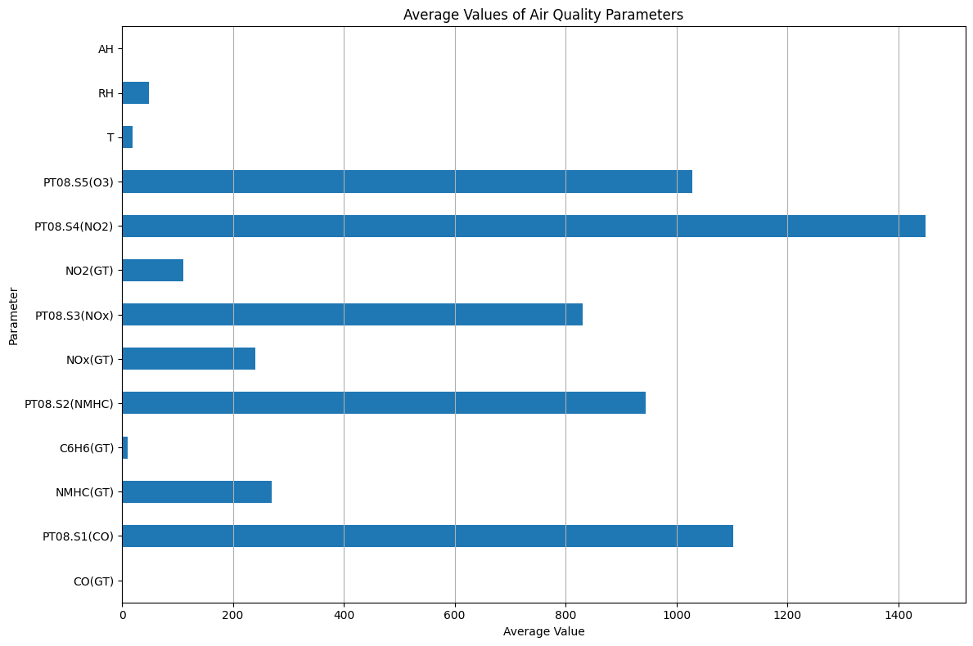
4. Exploratory Data Analysis (EDA)
Fig: Average Values of Air Quality Parameters
222-115-173

Slide 10
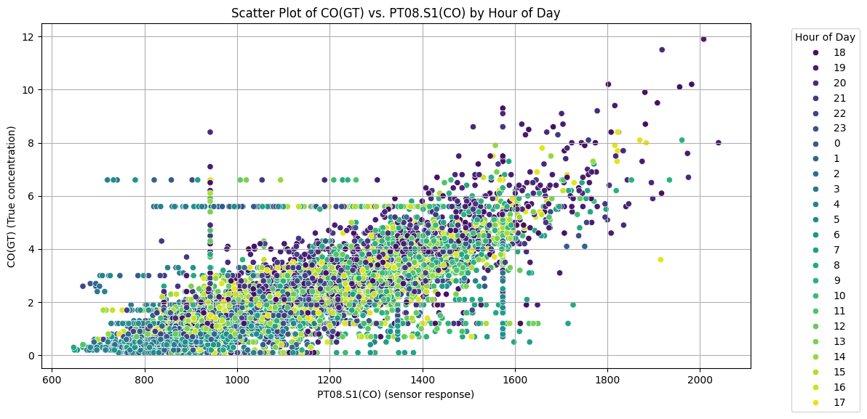
4. Exploratory Data Analysis (EDA)
Fig: Scatter Plot of CO(GT) vs PT08.S1(CO) Colored by Hour of Day
222-115-173

Slide 11
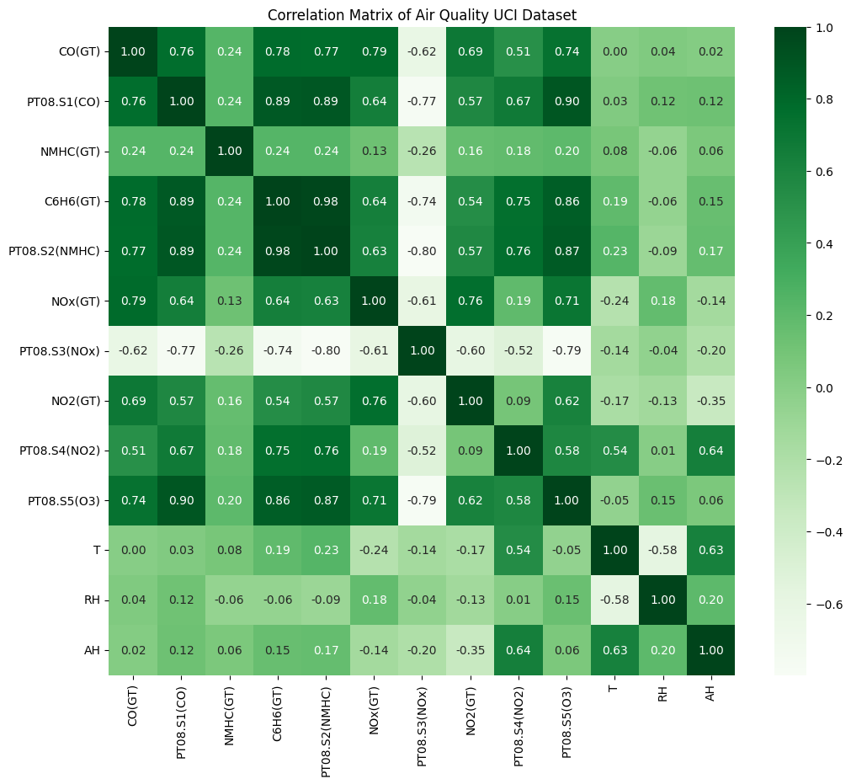
4. Exploratory Data Analysis (EDA)
Fig: Correlation Matrix of Air Quality UCI Dataset
222-115-173

Slide 12
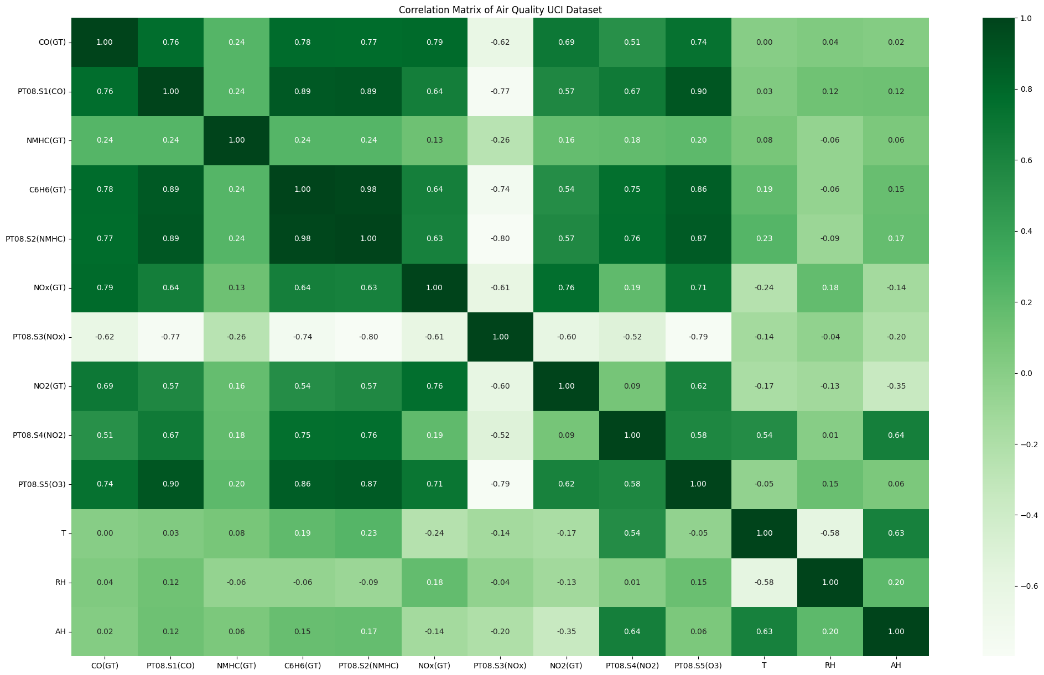
Fig: Correlation Matrix of Air Quality UCI Dataset
222-115-173

Slide 13
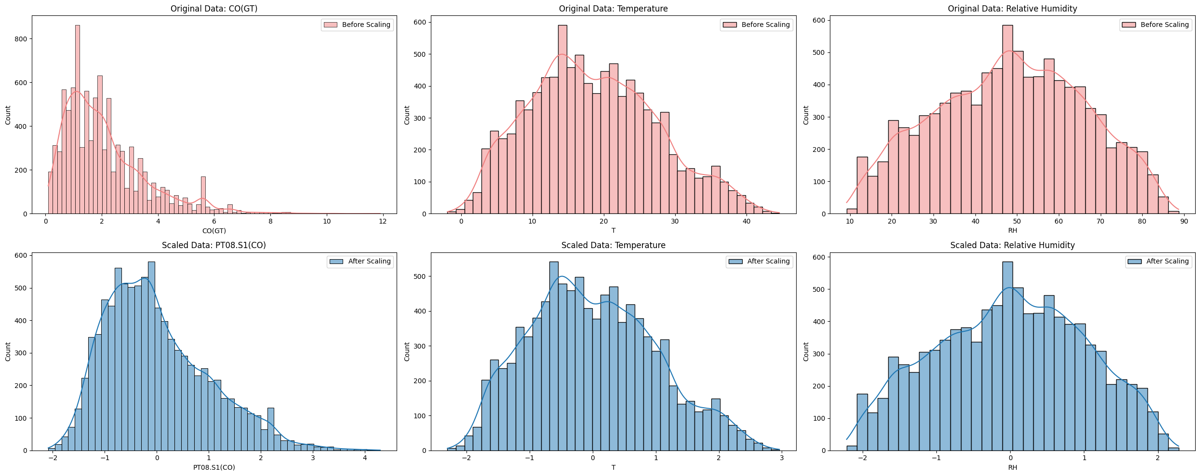
5. Feature Engineering
Fig: Visualize data distribution before and after scaling with histograms for key features
222-115-190

Slide 14
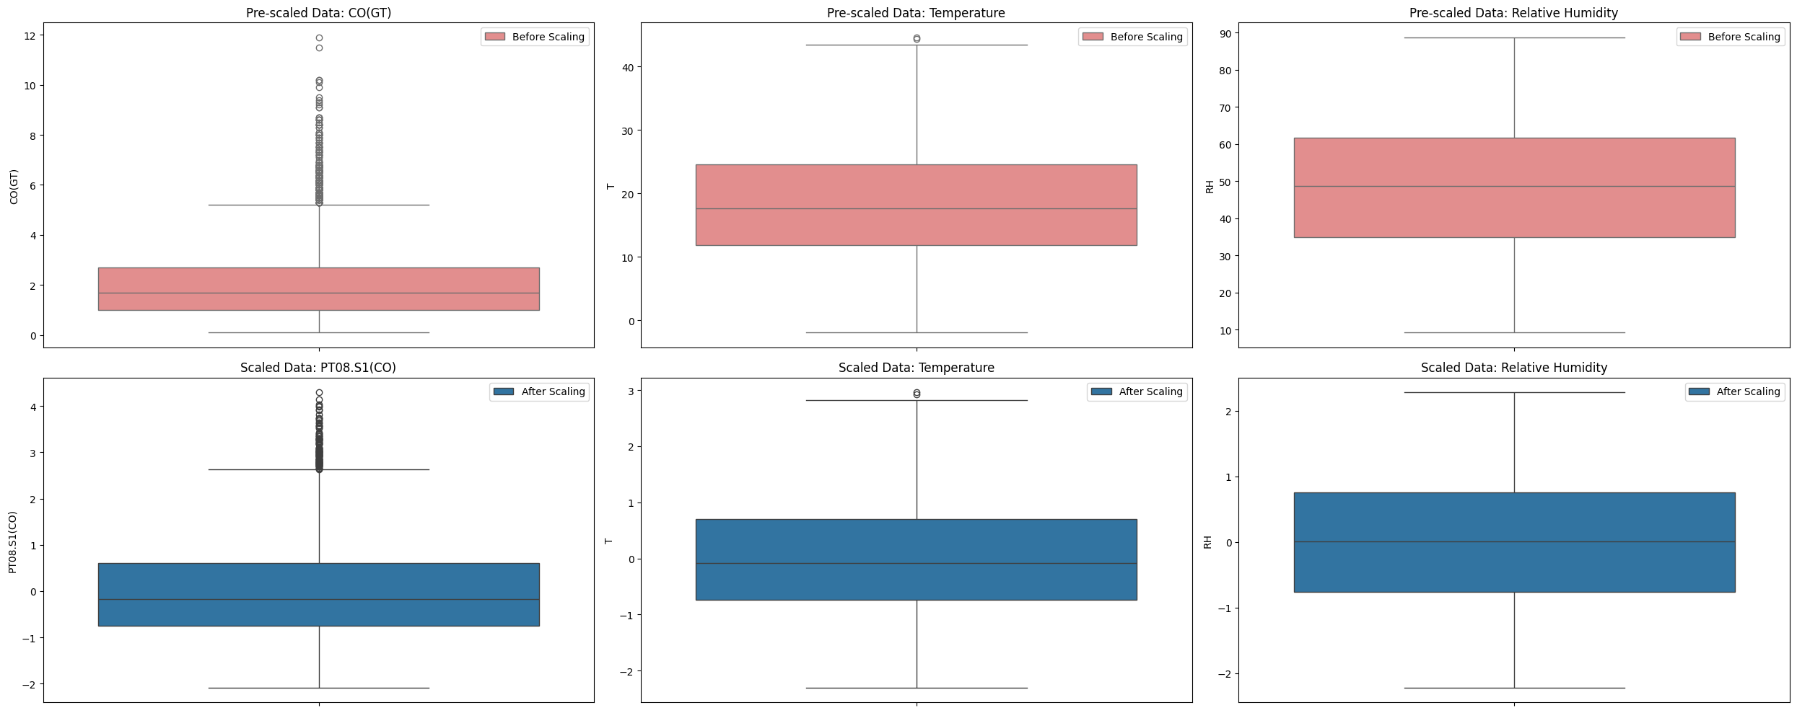
5. Feature Engineering
Fig: Visualize data distribution before and after scaling with box plots for key features
222-115-190

Slide 15
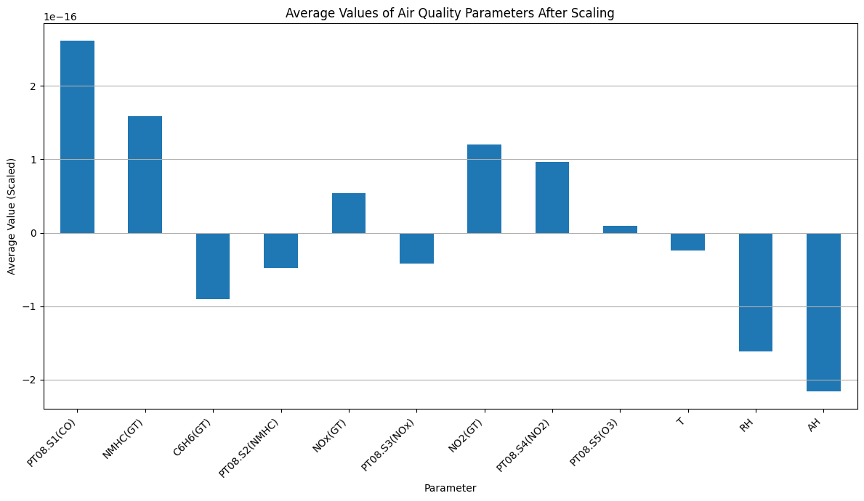
5. Feature Engineering
Fig: Average Values of Air Quality Parameters After Scaling
222-115-190

Slide 16
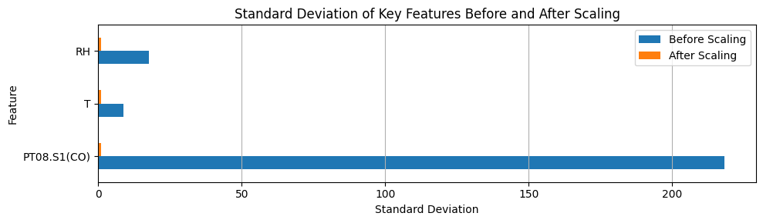
5. Feature Engineering
Fig: Standard Deviation of Key Features Before and After Scaling
222-115-190

Slide 17
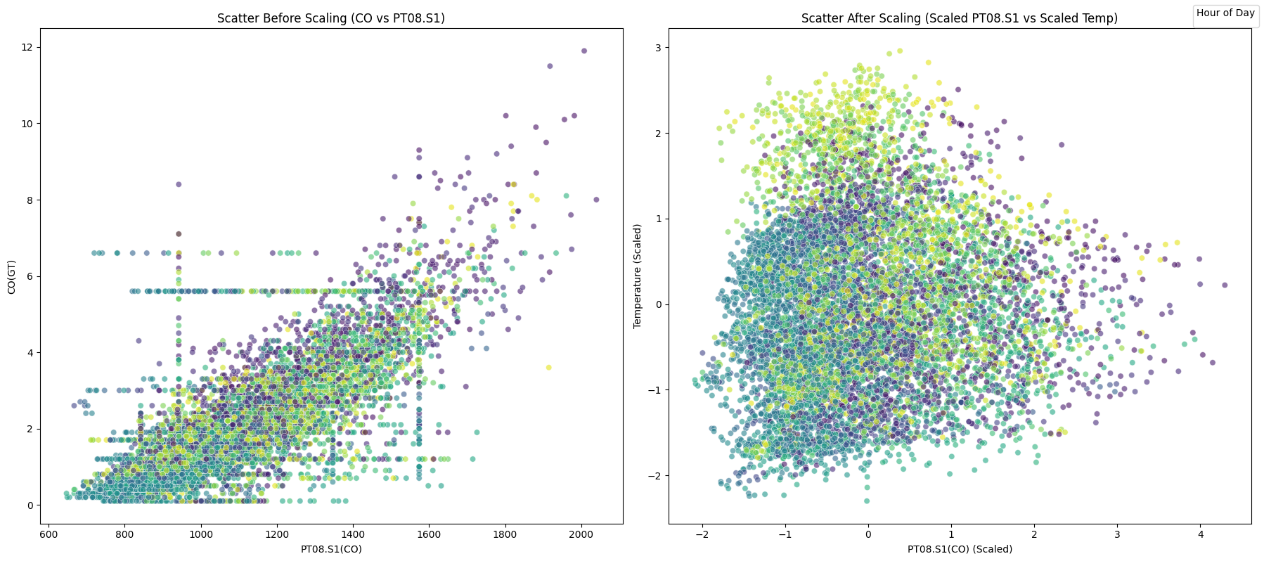
5. Feature Engineering
Fig: Scatter Plot Before and After Scaling
222-115-190

Slide 18
6. Data Splitting – Train & Test
Purpose: To evaluate model performance on unseen data and prevent overfitting.
Method: Dataset divided into two parts.
Split Ratio: 80% for Training, 20% for Testing.
Tool: train_test_split (from scikit-learn).
222-115-190

Slide 19
7. Machine Learning Models Implemented
Linear Regression – for simple linear relationships
Random Forest – reduces overfitting, good accuracy
SVR (SVM) – handles non-linear, high-dimensional data
XGBoost – fast, accurate boosting algorithm
Ensemble Methods – combines models (Averaging, Voting)
Parameter Tuning – via Grid Search, Cross-Validation
222-115-190

Slide 20
7. Deep Learning Models Implemented
ANN – captures complex non-linear patterns
Architecture Overview:
Model: Sequential
Input Layer: Dense(64), ReLU
Hidden Layer: Dense(32), ReLU
Output Layer: Dense(1), Linear
222-115-190

Slide 21
8. Deep Learning Models Implemented
Training Configuration:
Optimizer: Adam
Loss: Mean Squared Error (MSE)
Epochs: 50
Batch Size: 32
Validation Split: 20%
222-115-190

Slide 22
9. Hyper parameter Tuning & Cross-Validation
Hyperparameter tuning was done using GridSearchCV with K-Fold Cross-Validation for SVR and XGBoost.
Performance was evaluated using Mean Squared Error (MSE) and R-squared (R²) to ensure accuracy and generalization.
222-115-190

Slide 23
9. Hyper parameter Tuning & Cross-Validation
Model | MSE | R-squared
Best Cross-Validated SVM | 0.6180 | N/A
Best Tuned XGBoost | 20.1% | 90%
222-115-190

Slide 24
10. Models Comparison
Model | Accuracies
Best Tuned XGBoost | 90.08%
Ensemble (Weighted Averaging) | 89.74%
Ensemble (Averaging) | 89.25%
XGBoost Regressor | 88.96%
SVM Regressor | 88.27%
Random Forest Regressor | 87.97%
ANN | 86.79%
222-115-190

Slide 25
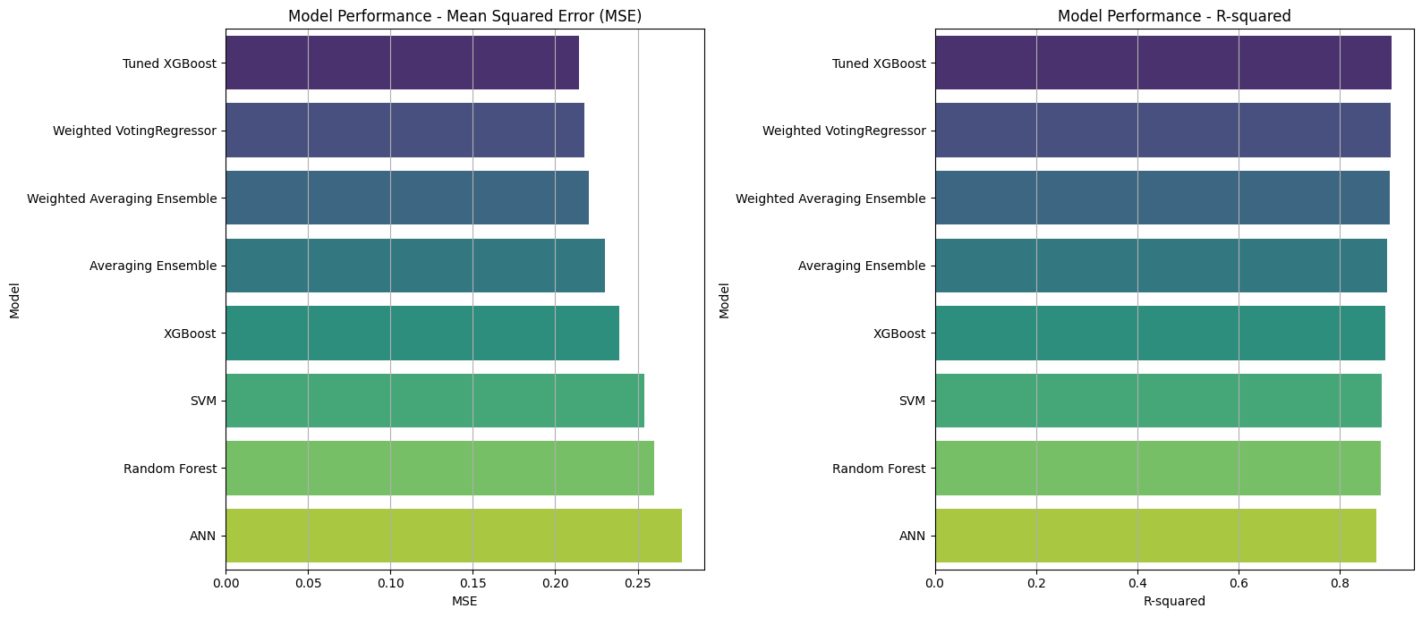
Fig: Model comparison
222-115-190

Slide 26
11. Results & Discussion
Our models were evaluated using Mean Squared Error (MSE) and R-squared (R2), a metric indicating the proportion of variance in the dependent variable that is predictable from the independent variables.
Model | MSE | R-squared
XGBoost Regression | 0.2387 | 0.8896
SVM Regression | 0.2536 | 0.8827
Best Cross-Validated SVM | 0.6180 | N/A*
ANN | 0.2856 | 0.8679
Random Forest Regression | 0.2601 | 0.8797
Best Tuned XGBoost | 0.2145 | 0.9008
Ensemble (Averaging) | 0.2325 | 0.8925
Ensemble (Weighted Averaging) | 0.2219 | 0.8974
222-115-190

Slide 27
11. Results
The Best Tuned XGBoost Regressor emerged as the top-performing individual model, achieving an impressive R-squared of 0.9008 (90.08%). This indicates it explains over 90% of the variance in Carbon Monoxide concentrations.
Model | MSE | R-squared
XGBoost Regression | 0.2387 | 0.8896
SVM Regression | 0.2536 | 0.8827
Best Cross-Validated SVM | 0.6180 | N/A*
ANN | 0.2856 | 0.8679
Random Forest Regression | 0.2601 | 0.8797
Best Tuned XGBoost | 0.2145 | 0.9008
Ensemble (Averaging) | 0.2325 | 0.8925
Ensemble (Weighted Averaging) | 0.2219 | 0.8974
222-115-190

Slide 28
Reference
Air Quality,UCI
222115173, 222115190

Slide 29
Thank You
222115173, 222115190

Slide 30

Q&A
222115173, 222115190

