Slide 1

WEATHER FORECASTING SYSTEM
Major Project - I
CS- 706
Problem Statement: Design and Deployment of Weather Forecasting System
Project Group Number: 7
Group Member Details:
1.Baishnavi Sharma (0187CS211048)
2.Aleena Khanam (0187CS211018)
3.Diksha Rupani (0187CS211065)
Guide Details :Prof. Shumali Gupta

Slide 2
Idea/Approach Details
Introduction
The project aims to design and implement a comprehensive system capable of collecting real-time data on various weather parameters. This involves the deployment of sensors strategically positioned to monitor critical variables such as temperature, humidity, wind speed, and air quality continuously. The system's ability to gather data in real-time ensures that stakeholders have access to up-to-date information, facilitating informed decision-making and proactive responses to changing weather conditions.

Slide 3
Technology Stack
Technology Stack
HTML
CSS
JavaScript
C++
API
Machine Learning
Python

Slide 4
Project Requirements
Functional Requirements
Non-Functional Requirements
Data Collection
Data Processing
Integration
Alerting and Notification Systems
Performance
Reliability
Security
Compatibility
Usability
Compatibility

Slide 5
Project Requirements
Hardware Requirements
Software Requirements
Nodemcu board
Rain sensor
BMP180 sensor
DHT11 sensor
ArduinoIDE
ThingSpeak Platform
Web Platform
VS Code

Slide 6
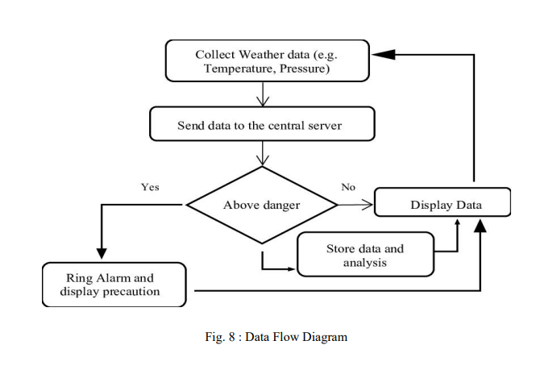
Design
Data Flow Diagram

Slide 7
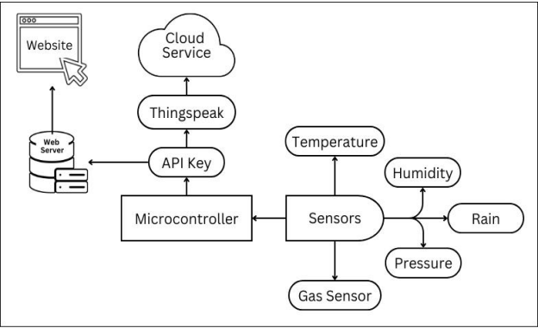
Design
Architecture of Project Implementation

Slide 8
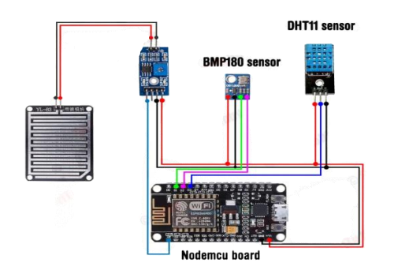
Circuit Diagram

Slide 9
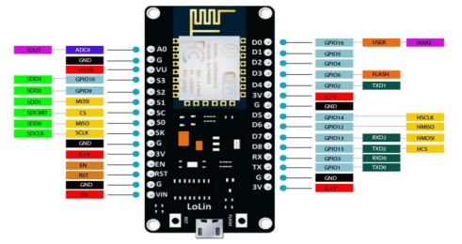
WiFi Module
The ESP8266 WiFi Module is a self-contained SOC with in an integrated TCP/IP protocol stack that can give any microcontroller access to your WiFi network.

Slide 10
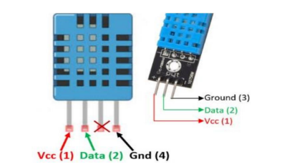
DHT11(Temperature & Humidity sensor)
The DHT-11 Digital Temperature and Humidity Sensor is a basic, ultra-low-cost digital temperature and humidity sensor. It uses a capacitive humidity sensor and a thermistor to measure the surrounding air and spits out a digital signal on the data pin.

Slide 11
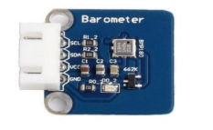
BMP180 (Pressure Sensor)
BMP180 sensor senses that pressure and provides that information in digital output. 9Also, the temperature affects the pressure and so we need temperature compensated pressure reading. To compensate, the BM180 also has good temperature sensor.

Slide 12
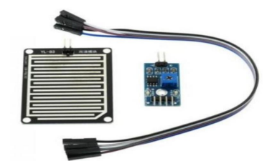
Rain Sensor
A rain sensor is one kind of switching device which is used to detect the rainfall. It works like a switch and the working principle of this sensor is, whenever there is rain, the switch will be normally closed.

Slide 13

Machine Learning Integration
In our IoT-based weather monitoring project, we use Machine Learning to improve data analysis. We predict temperature and humidity using historical data. ML also detects sensor faults and classifies weather conditions (e.g., sunny, rainy, cloudy), making the system more accurate and reliable.

Slide 14
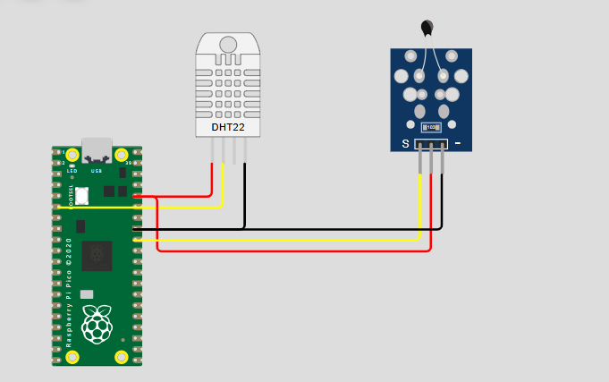
Wokwi
Wokwi is an online simulator that allows you to design, prototype, and test embedded systems without needing physical hardware. It supports Arduino, ESP32, Raspberry Pi Pico (RP2040), and other microcontrollers, making it a great tool for IoT projects.
It is an excellent tool for IoT development, allowing you to simulate, debug, and test microcontroller projects without physical hardware.

Slide 15
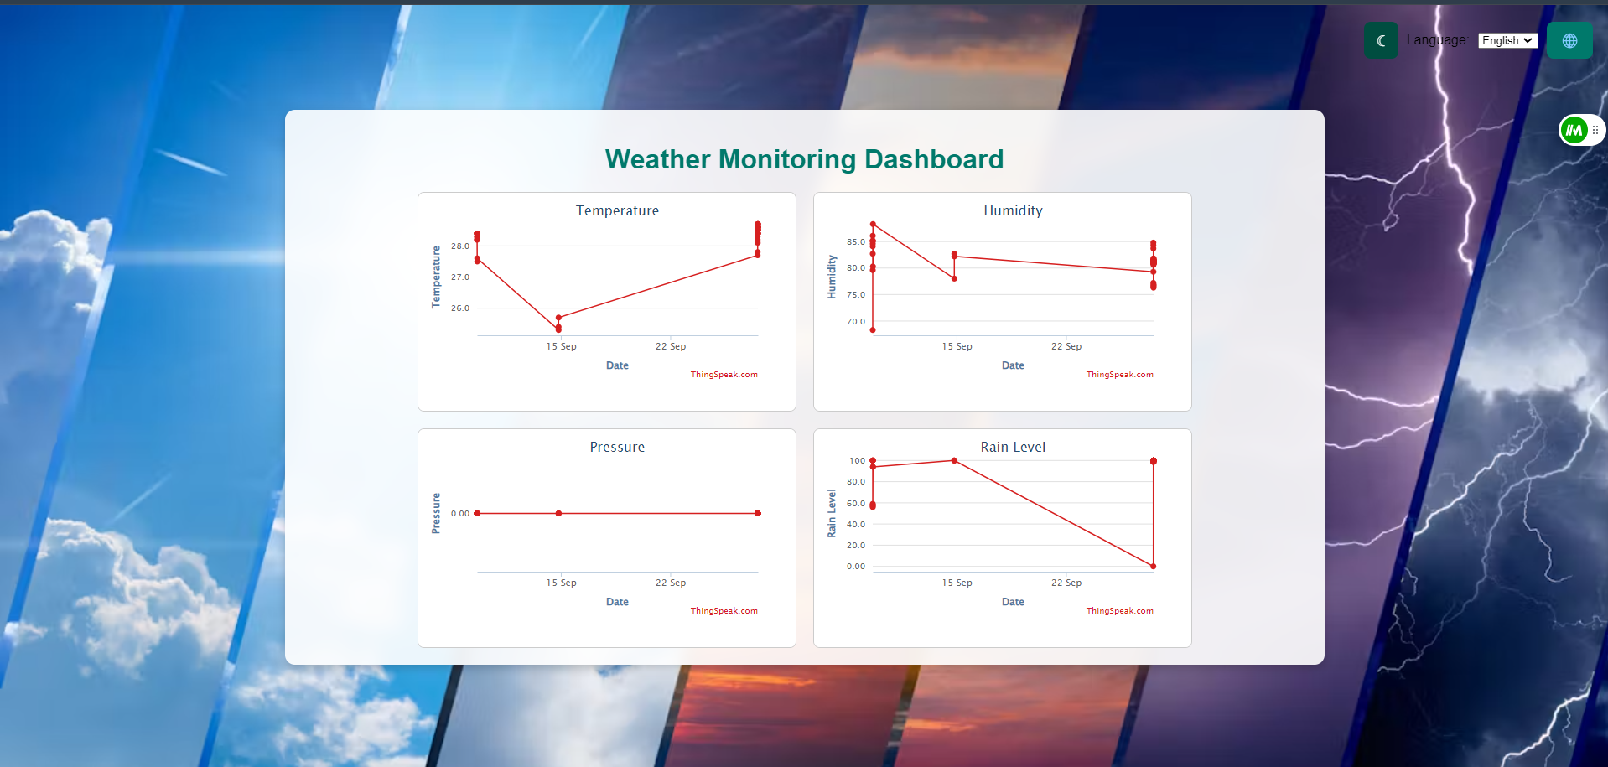
Project Screen shots
Home Page

Slide 16
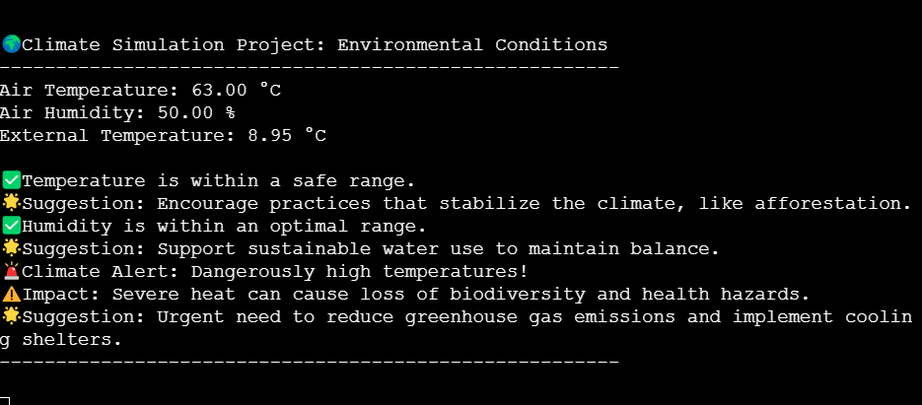
Project Screen shots
Notification Window

Slide 17
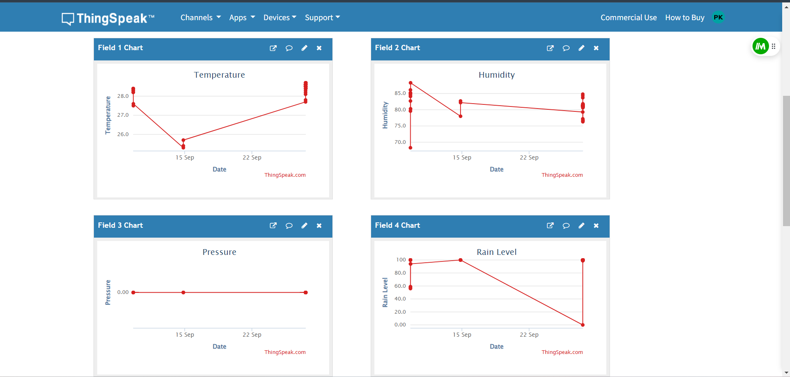
Project Screen shots
ThingSpeak Website

Slide 18
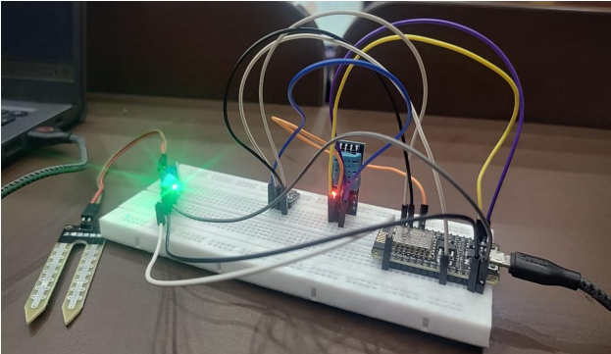
Project Screen shots
Hardware

