Slide 1
A Survey of Affective Computing for Stress Detection
Shalom Greene, Himanshu Thapliyal, and Allison Caban-Holt, 2016

Slide 2
Contribution
Evaluates technologies in stress detection for better health.
Reviews approaches to physiological and Physical Stress–Based stress-based affective computing.
Introduces one of the most heavily used stress-detection methods via ECG.

Slide 3
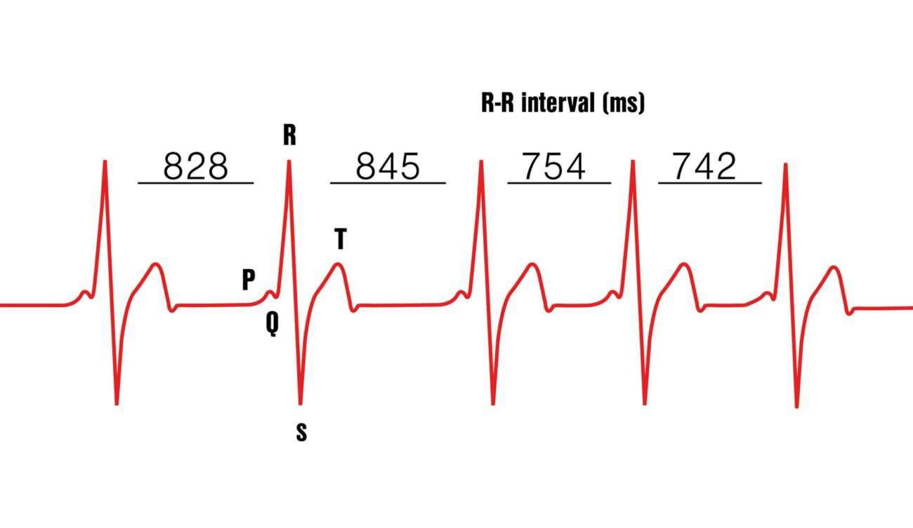
Reviewed Literature in Manuscript
Heart rate variability, trait anxiety, and perceived stress among physically fit men and women
Detection through heart rate (HR) and heart rate variability (HRV)

Slide 4
Accuracy and Weaknesses
Accuracy is not exactly quantified but the method provides an efficient and indirect way to detect stress.
it relies on multiple sensors leading to high cost, low portability, flexibility.
Non invasive techniques are preferred

Slide 5
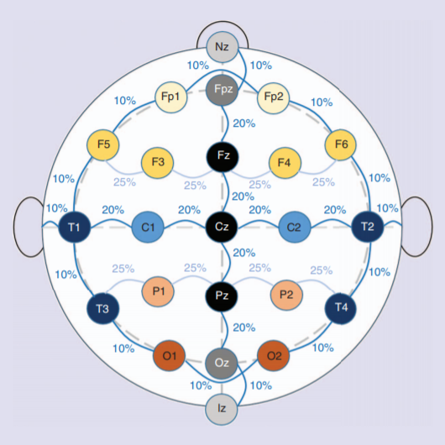
Harvard Health Publications. Understanding the stress response. [Online]
Based on the brain activity and EEG
This system is based on 19 electrode placements spaced at 10% and 20% intervals across the cranium

Slide 6
Accuracy and Weaknesses
Accuracy is not exactly quantified but the method provides an efficient and indirect way to detect stress.
it relies on multiple sensors leading to high cost, low portability, flexibility.
Non invasive techniques are preferred

Slide 7
Skin Conductance and GSR
Skin conductance is the susceptibility of the skin to conduct electricity.
This conductivity is based on sweat gland activity that often activates in response to high stress or fight-or-flight situations [24].
During increased stress, perspiration increases, causing resistance to current flow to drop

Slide 8
Blood Activity and PPG
Blood volume pulse (BVP) is the phasic change in blood volume that corresponds to each heartbeat interval [23].
Furthermore, BVP is also used to determine changes in blood pressure in correspondence with blood volume.
Variability in blood pressure is due to vasodilation and vasoconstriction of arteries, capillaries, and other vasculature, which can be discerned by BVP measurements [23].
These fluctuations of blood pressure and blood volume are direct products of heart activity. Therefore, another means of stress measurement is made available by way of BVP.

Slide 9
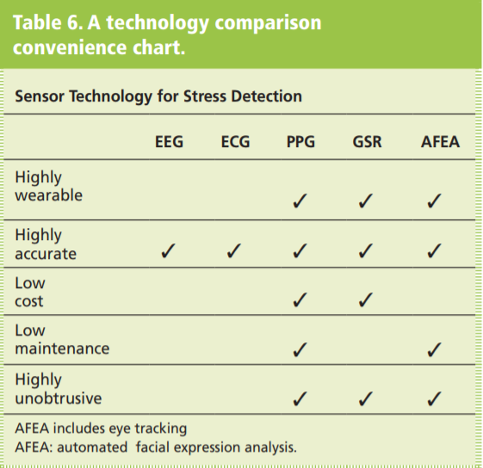
COMPARISON OF SOLUTIONS

Slide 10
Facial Features and Behavior
Facial Features and Behavior
Eye Tracking
Behavior and Gesturing

Slide 11
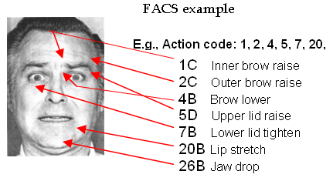
Facial Action Code System (FACS) Paul Ekman and Wallace Friesen 2002 [76], [78]

Slide 12
Facial Action Code System (FACS) Paul Ekman and Wallace Friesen 2002 [76], [78]
This rule-based coding approach
Many investigators have used facial expression analysis organically to detect sadness, anger, happiness, and deceit
This system objectively measures the frequency and intensity of facial expressions and deduces what is referred to as an action unit (AU).
AUs are the smallest discriminable movements detectable in a facial expression [76].

Slide 13
Facial Action Code System (FACS) Paul Ekman and Wallace Friesen 2002 [76], [78]
Facial expression recognition systems such as FACS have enabled the possibility for AFEA. Lien et al. demonstrated an AFEA system based on FACS with up to 93% accuracy [79].

Slide 14
Eye Tracking M. Haak, S. Bos, S. Panic, and L. J. M. Rothkrantz, “Detecting stress using eye blinks and brain activity from EEG signals 2008.
Eye activity, specifically pupil dilation and blink rate, has been used in some stress studies to correlate with physiological measures of individuals experiencing stress .
A study done by Haak et al. shows a strong relationship between eye-blink frequency and emotional stress via correlation with EEG measurements.

Slide 15
Eye Tracking M. Haak, S. Bos, S. Panic, and L. J. M. Rothkrantz, “Detecting stress using eye blinks and brain activity from EEG signals 2008.
This study used driving simulations to assess blink rate under stress and non stress conditions, showing that eye blink frequency tends to increase positively with stress

Slide 16
A survey on mobile affective computing
Eugenia Politou *, Efthimios Alepis, Constantinos Patsakis

Slide 17
Contribution
Documents all the to-date relevant literature on affect recognition through smartphone modalities.
Argues for the full potential of smartphone use in the inference of affect.
demonstrates the current research trends towards mobile affective computing.

Slide 18
Affective Computing R. W. Picard
This paper presents and discusses key issues in “affective computing,” computing that relates to, arises from, or influences emotions.
Models are suggested for computer recognition of human emotion, and new applications are presented for computer assisted learning, perceptual information retrieval, arts and entertainment, and human health and interaction.
Discusses the possibility of Affective computing, coupled with new wearable computers, to provide the ability to gather new data necessary for advances in emotion and cognition theory.

Slide 19
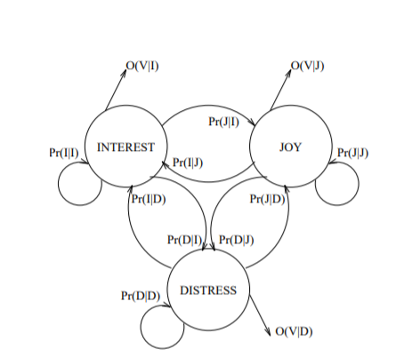
Hidden Markov Model for Emotions

Slide 20
Results
Eight emotions could be distinguished at levels significantly higher than chance: pattern recognition algorithms that attained 81% classification accuracy instead of the predicted 12.5% of a random classifier.

Slide 21
Open Issues
The range of means and modalities of emotion expression is so broad, with many of these modalities being inaccessible (e.g., blood chemistry, brain activity, 2 neurotransmitters.
This makes it unlikely that collecting the necessary data will be possible or feasible in the near future.
People’s expression of emotion is so idiosyncratic and variable, that there is little hope of accurately recognizing an individual’s emotional state from the available data.

Slide 22
Continuous Prediction of Spontaneous Affect from Multiple Cues and Modalities in Valence-Arousal Space
fuses facial expression, shoulder gesture, and audio cues for dimensional and continuous prediction of emotions in valence and arousal space
compares the performance of two state-of-the-art machine learning techniques applied to the target problem, (BLSTM-NNs), and Support Vector Machines for Regression (SVR)
proposes an output-associative fusion framework that incorporates correlations and covariances between the emotion dimensions.

Slide 23
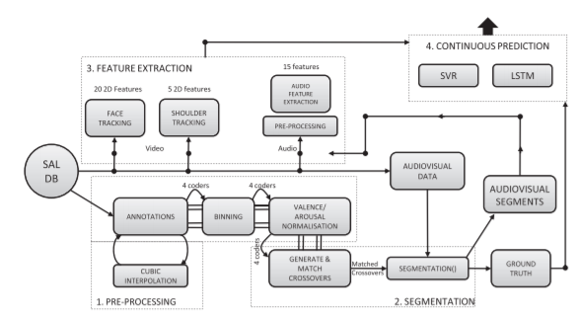
Methodology
The methodology proposed in this paper consists of preprocessing, segmentation, feature extraction, and prediction components.

Slide 24
Open Issues
Achieving agreement among the coders (or observers) that provide annotations in a dimensional space is very challenging .
The second issue is known as the baseline problem. This is also known as the concept of having “a condition to compare against” .
The third issue refers to unbalanced data. In naturalistic settings, it is very difficult to elicit balanced amount of data for each emotion dimension.

Slide 25
Introduction to Emotion Recognition
Algorithmia, Source: Frontiers in Psychology.
FEBRUARY 28, 2018

Slide 26
Contribution
Identification of issues that have held back meaningful progress in affective computing.
The training/labelling problem.
Which classes of emotions are there?
How do we classify a particular emotion?
Availability of data.
The feature engineering problem.
What is the best possible inputs for our model?

Slide 27
Contribution
In which form should our input data be in?
Text
Speech
Image/Video(Recommended)

Slide 28
Method of Detection
Neural Networks
Neural networks do feature engineering automatically.
ConvNets further feature engineer the input images and can help achieve greater accuracy.

Slide 29
Automatic Analysis of Facial Actions: A Survey
Brais Martinez, Member, IEEE, Michel F. Valstar, Senior Member, IEEE, 3 Bihan Jiang, and Maja Pantic, Fellow, IEEE
2017

Slide 30
Contribution
Provides an up-to-date review of the existing literature.
Challenges and opportunities faced by researchers.
Image pre-processing including face and facial point detection and tracking.
Facial feature extraction
Automatic facial action coding based on the extracted features.

Slide 31
Preprocessing-Face detection.
Viola & Jones detection algorithm is widely used.
The public availability of pre trained models (e.g., in OpenCV or Matlab), its reliability for frontal faces and its computational simplicity makes it the reference face detection algorithm.
Another popular open-source face detector is the one provided with the dlib library.
Some recent works have successfully adapted the deformable parts model (DPM) to perform face detection

Slide 32
Facial Landmark Localization
Generative and discriminative facial landmarking algorithms
Generation model reduces the dimensionality of the data and tries to reconstruct the data.
Discriminative model detects patches of the action units.
All of the resulting descriptors are concatenated into a single vector to create the face representation. They then proceed by training a classifier or regressor on those features.

Slide 33
Feature Extraction
Reduction of the dimensionality of the data and reduction of the variance of the data.
appearance-based, geometry-based, motion-based and hybrid methods.
Appearance based
Appearance features describe the colour and texture of a facial region and are nowadays the most commonly used features.
Geometry based
Position of facial muscles at a particular point.

Slide 34
Mode of Detection
Artiﬁcial Neural Networks (ANN), Boosting techniques, and Support Vector Machines (SVM).
SVMs are most widely used.
Boosting techniques are easier to train and less prone to overfitting than ANNSs and SVMs
ANNs are hard to optimize but scale very well to large datasets.
SVMs provide good performance, can be non-linear, parameter optimisation is relatively easy, efﬁcient implementations are readily available (e.g., the libsvm library).

Slide 35
Weakness
Problems of occlusion, illumination etc.
Having a wide range of available data(wild dataset).
The way in which systems are trained and evaluated can differ significantly, leading to incomparable results.
There was no quantitative performance comparison of existing systems.

Slide 36
Open Issues
Head-pose normalization while preserving facial expression changes is still an open problem that needs to be addressed.
Handling occlusions, non-frontal head poses, co-occurring AUs and speech, varying illumination conditions, and the detection of low intensity AUs.
Detection of individual AUs is still an open challenge.
Absence of a benchmark.

