Slide 1

How Does Town Meeting Work? Two Big Decisions in Natick

Slide 2
What Is Town Meeting?
In Massachusetts, many towns let elected Town Meeting members vote on big decisions.
Elected Town Meeting members do the voting — but any resident can come and speak their mind.
Towns vote on how to spend money, what rules to make, and important local projects.
Town Meeting happens at least once a year, usually in the spring or fall.
Residents
Town Meeting
Vote
Decision

Slide 3
The Town Moderator
The Town Moderator keeps Town Meeting fair and organized.
In Natick, the Moderator is Jeff Alderson.
His job is like a referee: he makes sure everyone follows the rules and gets a chance to speak.
The Moderator explains each question and calls the vote at the end.
He does not take sides — he stays neutral and fair.
Moderator Jeff Alderson — Natick Town Meeting

Slide 4
Two Big Questions Before Town Meeting
Gas Leaf Blowers
Artificial Turf
Should Natick phase out gas blowers?
Article 32 — Fall 2024
Should Natick pause new turf fields?
Article 33 — Fall 2025

Slide 5
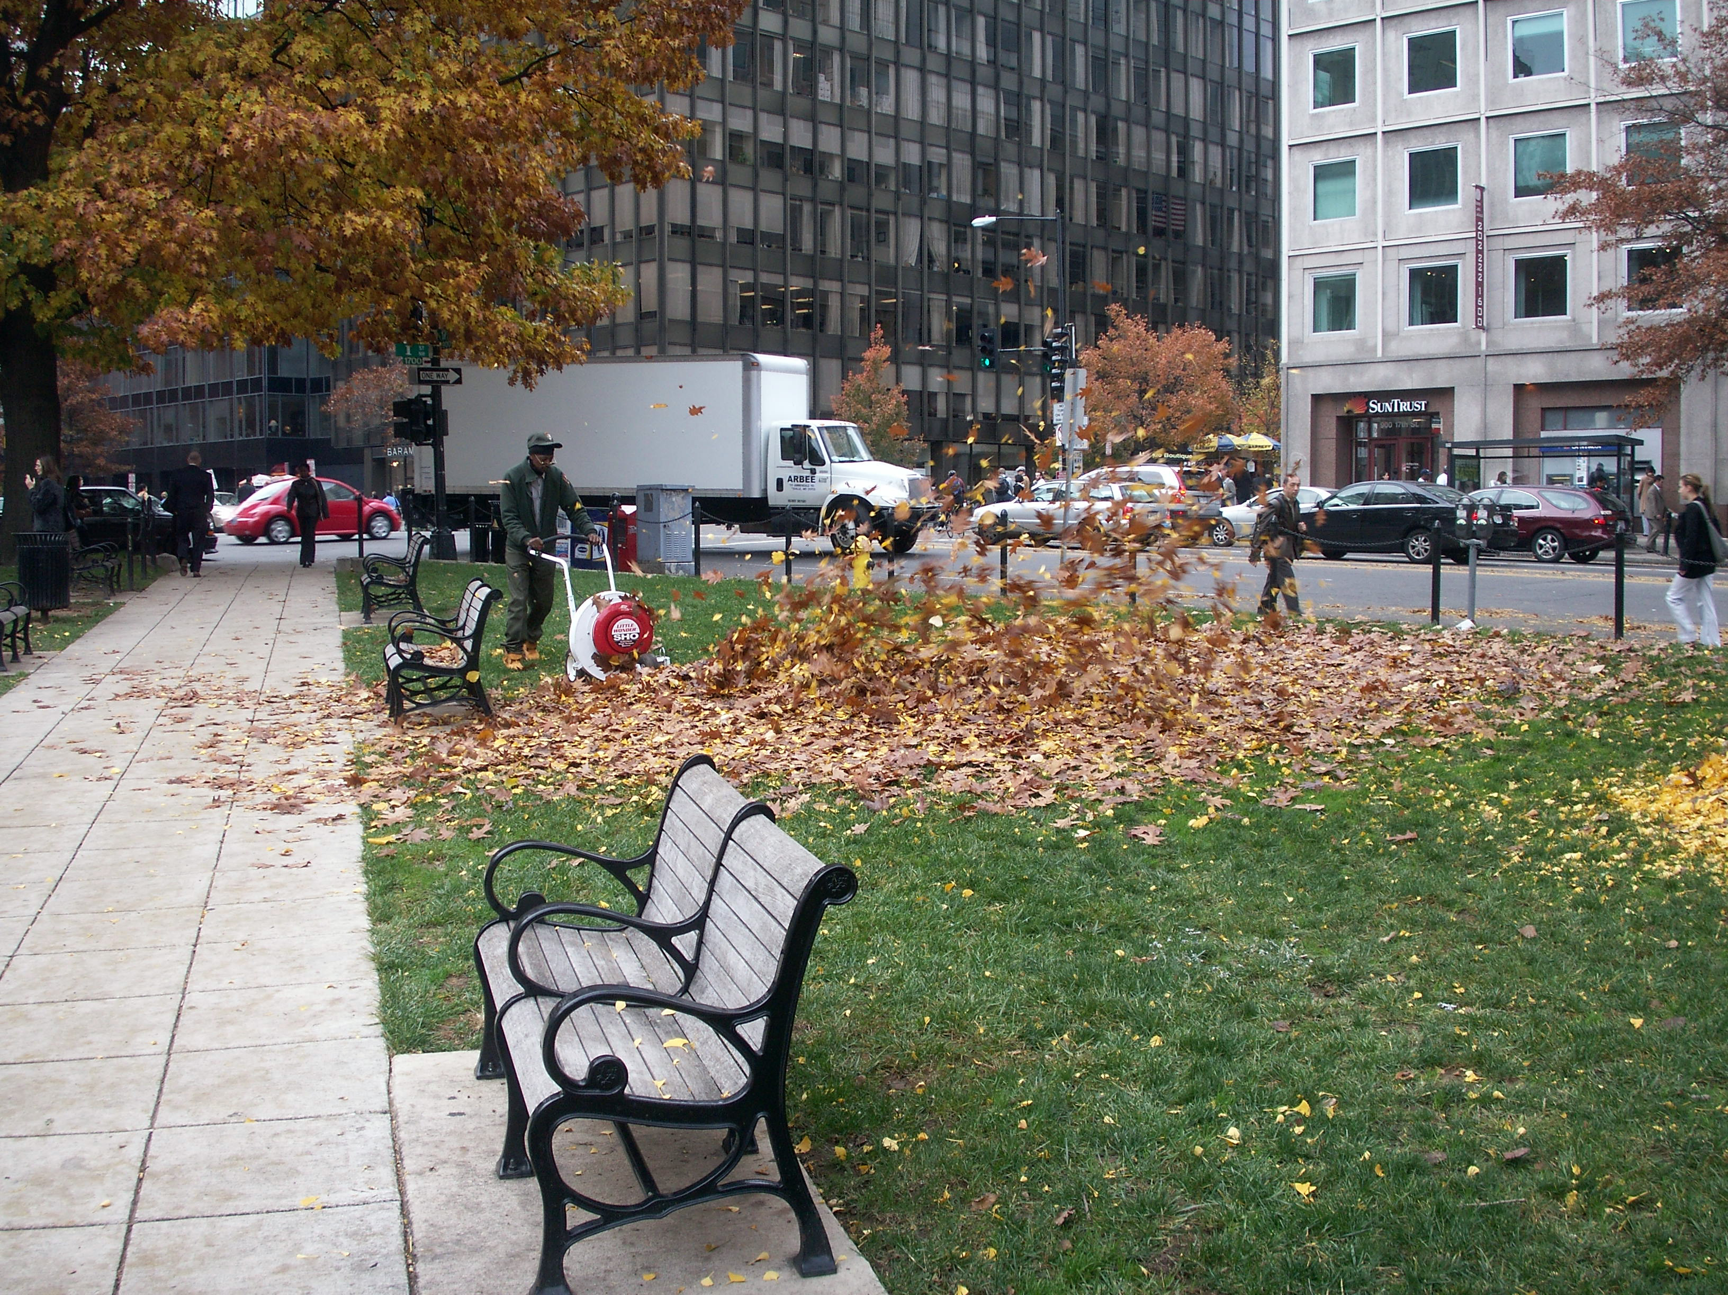
Question 1: Gas Leaf Blowers
In 2024, a group called EcoNatick asked Town Meeting to phase out gas-powered leaf blowers.
Their reasons: leaf blowers are loud, pollute the air, and can cause health problems like asthma.
They wanted people to switch to quieter, electric blowers — or just use a rake!

Slide 6
The Debate: Leaf Blowers
FOR a Phase-Out
AGAINST a Phase-Out
Better for health — less air pollution
Quieter neighborhoods
Better for the environment
Electric technology is improving
Battery blowers not powerful enough yet
Too expensive for small landscaping businesses
Some called it ‘government overreach’
Need more time to switch over

Slide 7
Outcome: Sent for Study
79 — 27 — 1
Yes (refer) No Abstain
Town Meeting voted to refer — send — the question to a committee for more study.
The leaf blower rules were NOT decided yet.
The Select Board, Board of Health, and the article sponsor will work together on next steps.

Slide 8
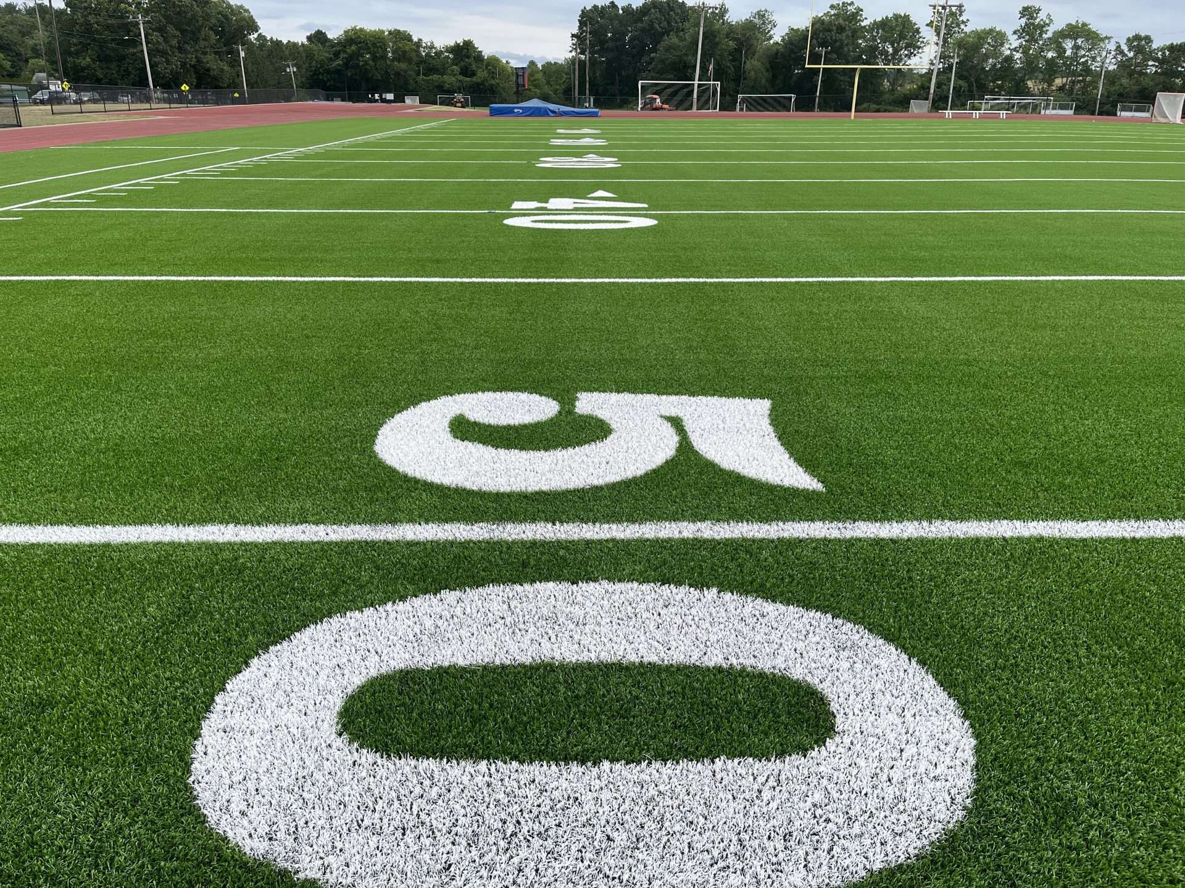
Question 2: Artificial Turf
In 2025, residents asked for a three-year moratorium — a pause — on new artificial turf fields.
Artificial turf is plastic grass used on sports fields like soccer and football.
Supporters wanted time to study health and environmental risks before building more.

Slide 9
The Debate: Artificial Turf
FOR the Moratorium
AGAINST the Moratorium
Microplastics may be harmful to health
PFAS ‘forever chemicals’ in turf
Fields can get very hot in summer
Artificial turf is hard to recycle or dispose of
Not enough grass fields for kids to play
Turf fields can be used more hours than grass
A 3-year delay could push back important projects
Some said health risks are not proven yet

Slide 10
Outcome: Moratorium Passed!
74 — 28 — 3
Yes (moratorium) No Abstain
Town Meeting voted YES — the three-year moratorium was adopted!
No new artificial turf fields will be built in Natick for three years.
The town will use this time to study the issue and make a careful decision.
Existing turf fields (like Cole Center and Memorial Field) are not affected.

Slide 11
What Can We Learn?
1. Anyone can speak up
In Town Meeting, any resident can bring an idea or share their opinion.
2. Debating helps us make better decisions
Hearing different sides of an argument helps the whole town think carefully.
3. Every vote counts
Everyone’s vote is equal. That’s democracy in action!

