Slide 1
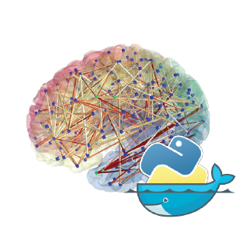



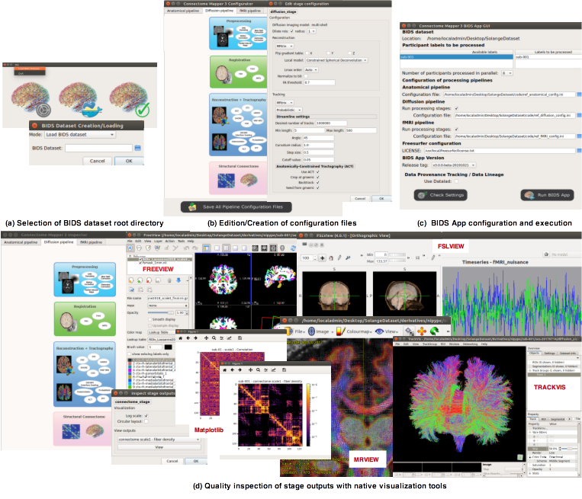
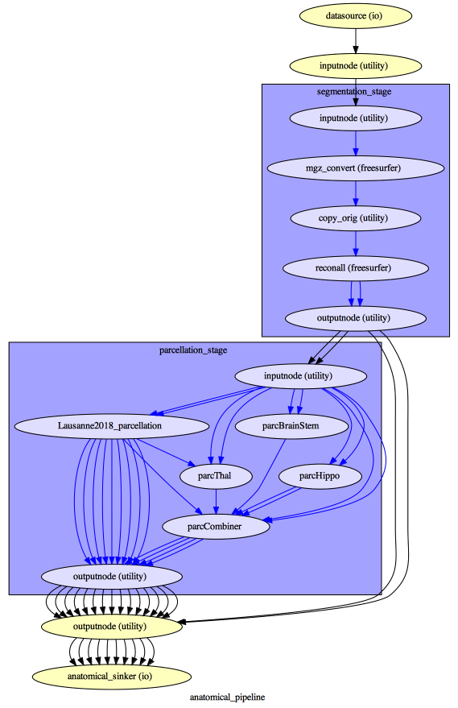
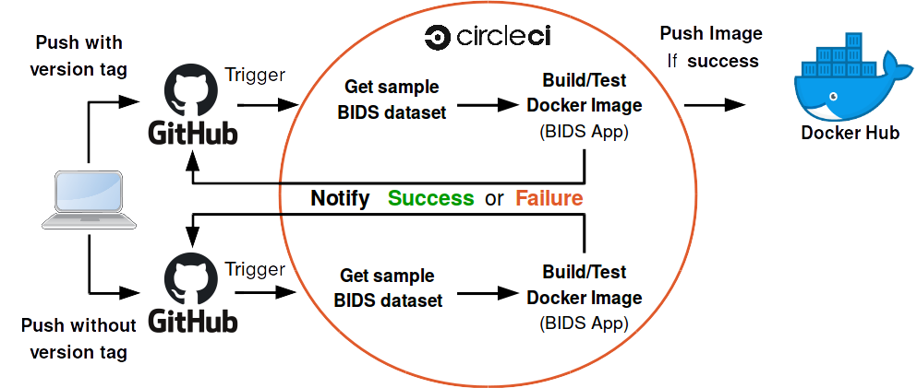
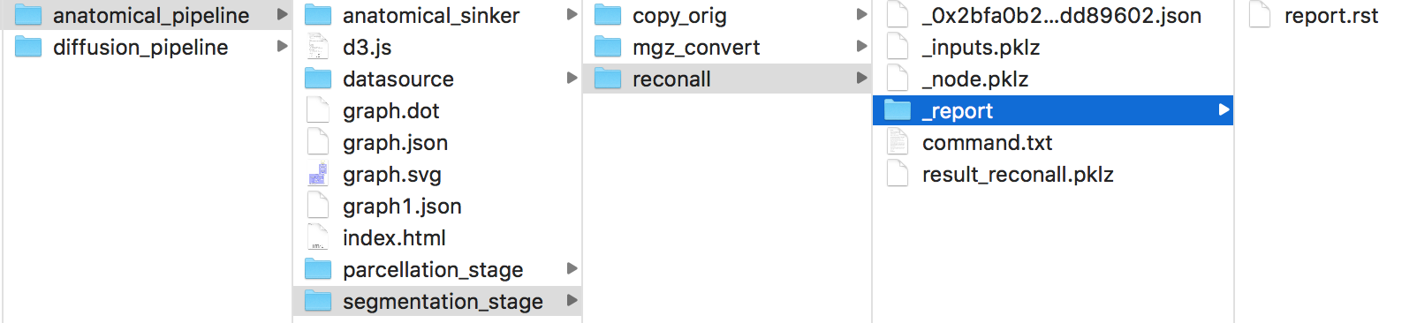
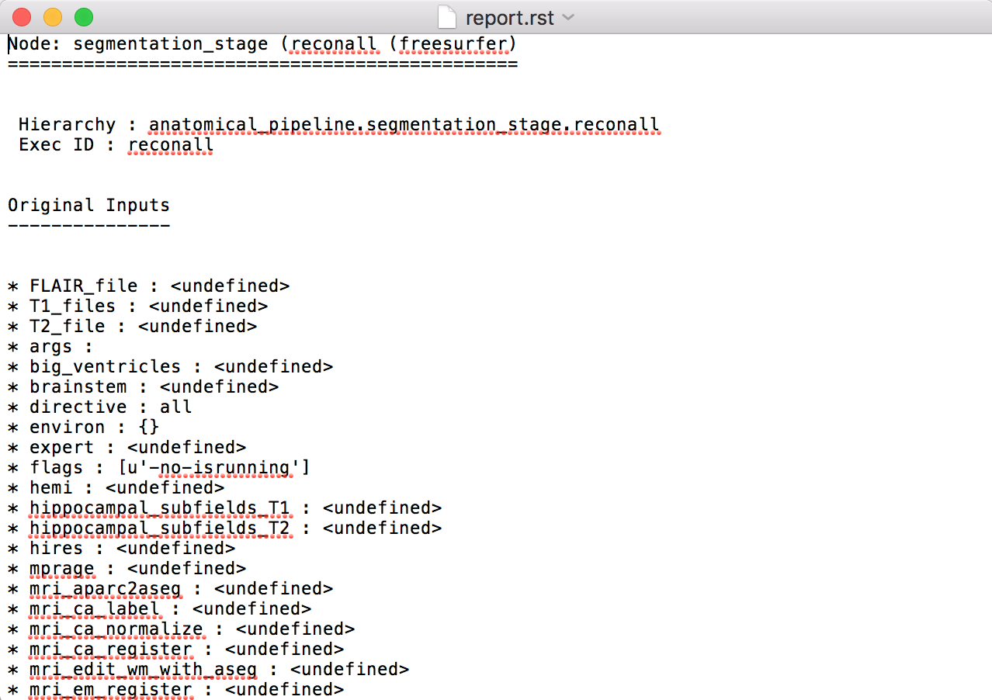
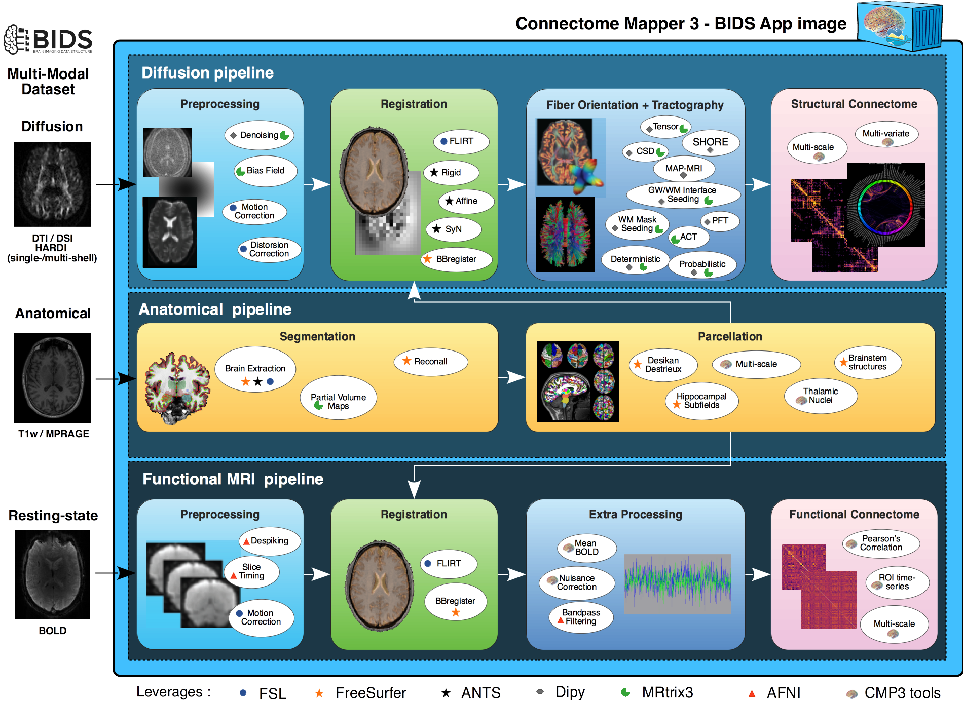
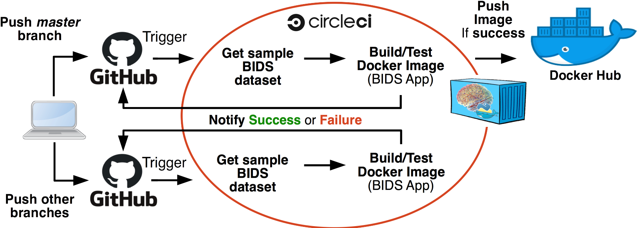






DESIGN PRINCIPLES
Robust
Transparent
Easy
Reproducible
Interoperable
1892
Connectome Mapper 3: a software pipeline
for multi-scale connectome mapping of multimodal MR data
Configurable
Modular
S. Tourbier¹, Y. Alemán-Gómez^{1,4}, E. Mullier¹, A. Griffa², M. Bach Cuadra^{1,3}, P Hagmann¹
Portable
1. Department of Radiology, University Hospital of Lausanne (CHUV) and University of Lausanne (UNIL), Lausanne, Switzerland
2. Medical Image Processing Lab (MIPLAB), Ecole Polytechnique Fédérale de Lausanne (EPFL), Lausanne, Switzerland
Medical Image Analysis Laboratory (MIAL), Centre d’Imagerie BioMédicale (CIBM), Lausanne, Switzerland
Contact:
sebastien.tourbier@alumni.epfl.ch
MOTIVATION
GRAPHICAL USER INTERFACE
Support
BIDS
Derivatives
PROCESSED DATA (DERIVATIVES)
Connectome Mapper (CMP): open-source software pipeline, written in Python with a Graphical User Interface (GUI) historically designed to help researchers in all the organization and processing steps needed to compute, from raw structural MRI (sMRI) and diffusion MRI (dMRI) data, a hierarchical multi-scale brain parcellation and the corresponding structural connectomes [X,Y].
Designed with ease-of-use, modularity, configurability, re-executability and transparency in mind.
But two previous versions limited in terms of interoperability and reusability, portability, and reproducibility, with dependencies not easy to install.
A typical procedure consist of:
  the selection of the root directory of the BIDS dataset to be analyzed,
  the creation/edition of the different pipeline configuration files,
  the configuration of the BIDS App run and its execution, and
  the inspection of the stage outputs using either fslview, or freeview, or mrview or trackvis depending on the software involved in the stage. Connectivity matrices are visualized using the matplotlib library.
Connectome Mapper 3 Derivatives
    Main derivatives written to <bids_dataset/derivatives>/cmp/sub-<subject_label>/
      Pipeline options and parameters summarized in respective configuration .ini files:
        sub-<subject_label>_anatomical/diffusion/fMRI_config.ini
      Each of the five different brain parcellations is saved as::
        anat/sub-<subject_label>_label-L2018_desc-<scale_label>_atlas.nii.gz
      Each of the five different structural brain connectome is saved as:
        connectivity/sub-<subject_label>_label-L2018_desc-<scale_label>_atlas_conndata-snetwork_connectivity.<extension>
      Each of the five different structural brain connectome is saved as:
        connectivity/sub-<subject_label>_label-L2018_desc-<scale_label>_atlas_conndata- fnetwork_connectivity.<extension>
where
<scale_label> : scale1, scale2, scale3, scale4, scale5 is the parcellation scale
<extension> : is one of the available output formats (gpickle, mat, graphml)
Nipype Derivatives
    Nipype pipeline execution details and outputs of each pipeline
    stored in <bids_dataset/derivatives>/nipype/sub-<subject_label>/
    in its respective <anatomical/diffusion/fMRI>_pipeline/ folder:
Freesurfer Derivatives
    A Freesurfer subjects directory is created in <bids_dataset/derivatives>/freesurfer
    The fsaverage subject distributed with the running version of Freesurfer is copied into this directory
See for more details.
Adopt recent advances in the standardization of neuroimaging data organization [] and processing [] that have proven to be capable of effective large scale collaborationn.
→ Provide a unique software pipeline solution with a GUI for researchers to easily, reliably and transparently create a hierarchical multi-scale connectome representation of the structural and functional brain systems.
Extend the 5-scale brain gray matter parcellation [2] derived from the Desikan-Killiany atlas [3] with a subdivision of the thalamus into 7 nuclei [4], the hippocampus into 12 subfields [5] and the brainstem into 4 sub-structures [6].
BIDS APP DEVELOPMENT AND VERSION RELEASE
  Connectome Mapper 3 uses CircleCI for Continous Integration Testing
IMPLEMENTATION
  Connectome Mapper 3 uses the Nipype dataflow library [9] to implement a modular processing workflow composed of pipelines, each dedicated to one modality (anatomical, diffusion, fMRI), that interface with tools from FSL, Freesurfer, ANTs, Dipy, MRtrix3, AFNI, and the in-house Connectome Mapper library (cmtklib) → facilitates integration of new stages or pipelines.
  Processing workflow encapsulated in a BIDS App [10], a framework based on light container technologies (Docker [11] and Singularity [12] on HPC) → promotes portability and reproducibility.
  Extension of pipeline and stage classes with GUI components using the traitsUI (https://docs.enthought.com/traitsui/), a toolkit-independent GUI abstraction layer library → facilitates integration of new stages or pipeline in the GUI for configuration and output inspection.
Example of pipeline execution graph obtained
for the anatomical pipeline
(anatomical_pipeline/graph.svg)
Figure 3: Continous integration flow for the development and version release of the Connectome Mapper. Each change committed to GitHub repository triggers a “build and test” on CircleCI. When ready to release a version, the version is “tagged” and push to GitHub repository. A version tag will not only trigger a “build and test” on CircleCI but also deploy the new “tagged” docker image to Docker Hub.
Figure 2: The Graphical User Interface of the Connectome Mapper 3.
SOFTWARE DEVELOPMENT AND VERSION RELEASE
LINKS
  Connectome Mapper 3 uses CircleCI for Continuous Integration Testing
RELATED WORK @ OHBM 2019
License
BIDS App
Code
Docs
Demo
  See Poster #T135 “A unified multi-scale probabilistic atlas of the human gray matter” by Dr. Alemán-Gómez for application of the Multi-Scale Brain Parcellator in the creation of a multi-scale probabilistic atlas of the human gray matter.
Click me
This work was supported in part by the Swiss National Science Foundation
under Sinergia Grant under Grant CRSII5_170873.
Figure 3: Continuous integration flow for the development and version release of the Connectome Mapper. Each change committed to GitHub repository triggers a “build and test” on CircleCI to detect adverse effects that might arise from code changes. When ready (1) to update the image corresponding to the latest version of the master branch, or (2) to release a specific version, the image is appropriately “version-tagged” and push to GitHub repository. A version tag will not only trigger a “build and test” on CircleCI but also deploy the new “version-tagged” docker image to Docker Hub.
REFERENCES
[1] Daducci et al., PLos ONE 2013; [2] Cammoun et al., J. Neuro. Methods 2012;
[3] Desikan et al., Neuroimage 2004; [4] Najdenovska et al., Scientific Data 2018;
[5] Iglesias et al., NeuroImage 2015; [6] Iglesias et al., NeuroImage 2015;
[7] Gorgolewski et al., Scientific Data 2016; [8] Avants et al., MIA 2018;
[9] Gorgolewski et al., Front. Neuro. 2011; [10] Gorgolewski et al., PLos CB 2017;
[11] Merkel et al., Linux Journal 2014 ; [12] Kurtzer et al., PLos ONE 2017.
Figure 1: Connectome Mapper 3 Workflow - The processing workflow integrates all the processing steps needed to compute from raw MRI data a multi-scale brain parcellation and the corresponding connectomes. It takes as input BIDS datasets (Gorgolewski 2016) that include at least an anatomical scan (T1w or MPRAGE) and a diffusion scan (DTI, DSI, single/multi-shell HARDI) and/or a resting-state fMRI scan. Available output formats of connectome files are .gpickle, .mat, .graphml.

