Slide 1


INTERNAL PLAYBOOK
How to export a Sales Navigator list to CSV
Open the list. Ask Cursor. Get the file.
Manzar Imam
SDR · Taboola · Connexity
Internal · prepared by Manzar Imam
1 / 5

Slide 2


WHY THIS EXISTS
Finding leads in Sales Nav is the job. Pulling a bulk list out is the grind.
The problem
How we solve it
The impact
You search, filter and save 50–130 people into a list. Then you still need them in a sheet or CRM.
There is often no Download. 25 names per page. Copy-paste into Excel. Titles break. LinkedIn links get lost. Easy to skip a page.
A 129-person list is six pages of clicking — time you are not writing InMails.
Leave the saved list open in Chrome.
In Cursor Agent, send one sentence.
Cursor reads every page and writes a CSV to Downloads: name, title, company, location, LinkedIn URL.
No Chrome extension. No copy-paste.
Minutes, not a half-hour of clicking.
Full list, not a partial one.
Nicole 2: 129/129
SIMILAR MERCHENT V2: 49/49
Same file goes into Sheets, Salesforce or a sequence the same day. Repeat on every new list.
Internal · prepared by Manzar Imam
2 / 5

Slide 3
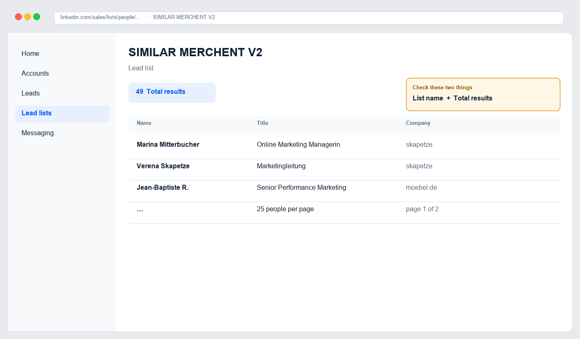
BEFORE YOU START
You only need four things.
1 Chrome
2 A saved list
3 Cursor
4 One Chrome tick
Logged in to Sales Navigator
Open in a Lead lists tab
Install once from cursor.com
Shown on the next slide
Internal · prepared by Manzar Imam
3 / 5

Slide 4
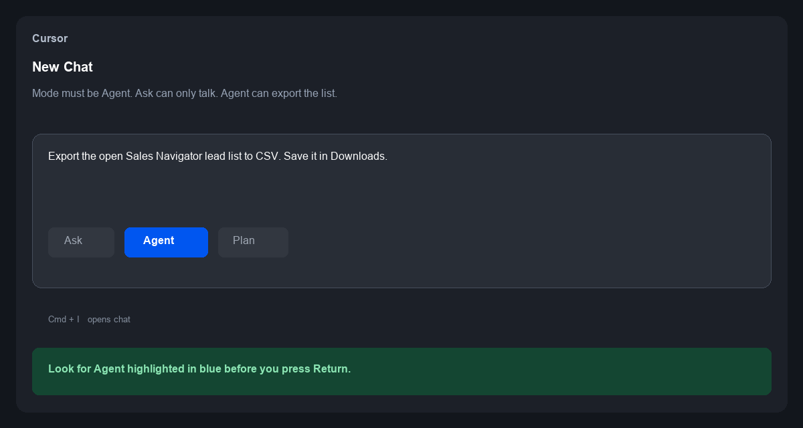
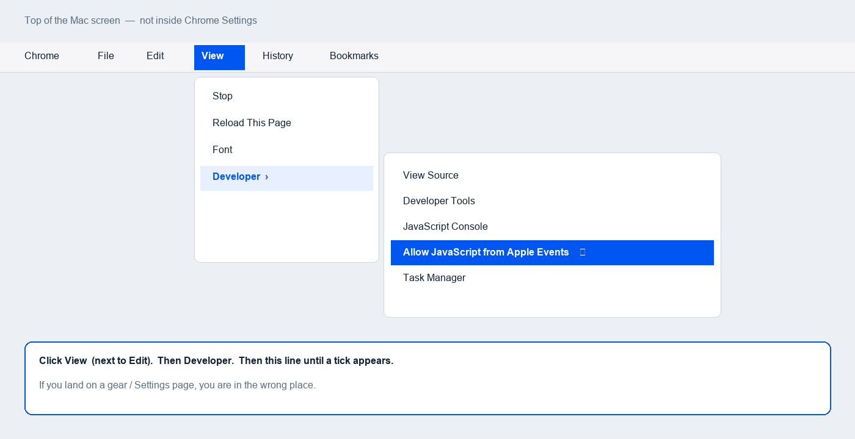
ONE-TIME SETUP
Do this once. Then skip it next time.
1 Install Cursor from cursor.com and sign in. 2 Open chat (Cmd+I) and set mode to Agent. 3 Turn on the Chrome tick below.
Cursor · Agent, not Ask
Chrome · View → Developer
Internal · prepared by Manzar Imam
4 / 5

Slide 5
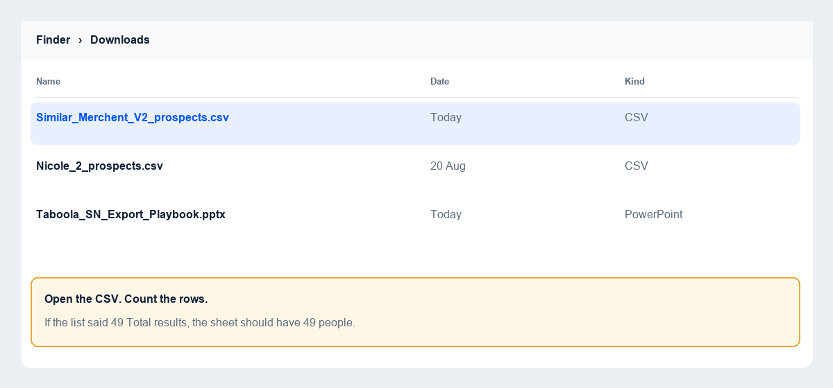
EVERY LIST AFTER THAT
Three steps. Follow the pictures.
1 Open the list
2 Ask Cursor
3 Check Downloads
Lead lists → your list. Check the total.
Agent mode. Paste the sentence. Return.
Open the CSV. Rows must match the total.
Paste this in Cursor
Export the open Sales Navigator lead list to CSV. Save it in Downloads.
If Cursor says the Chrome switch is off, do setup step 3, then reply: go
Internal · prepared by Manzar Imam
5 / 5

