Slide 1
CSC148 “Modeling and Experiment Design”
Prof. Mitchell
Computer Science Department
CSUS
Fall 2025

Slide 2
Introduction
1. Course homePage URL: http://athena.ecs.csus.edu/~mitchell/csc148
2. Course syllabus (on homePage) syllabus_148_f25.docx - briefly discuss on first day
Class Survey passed around class on Day#1 – please fill in the requested items
Defs - A simulation is a representation of behaviors and actions of some system;
a simulation is implemented by executing programs and / or by manual calculations
= > a simulation can be Computer based or Non computer based (or a combination of both)
Prior to next class: First reading assignment: on course homePage, file named: DES_overview_Wikipedia.html
(= Overview of structure of a computer-based discrete event system simulator, and How It Works)
Simulation models
A (simulation) Model of a system “S” is used to mimic/approximate S’s behavior
+ A system model provides for Better understanding of the system
+ A system model provides predictions & insights about future behavior of S
{generate predictions by conducting ‘WHAT IF’ simulation executions}
Example: spread of an infectious disease:
An accurate simulation of such a system can generate predictions
Models predict location and rate of disease spread
In this example, we could compare different strategies in reaction to the threat, such as:
No Quarantine vs. Selective Quarantine vs. Total lockdown vs. region-specific policy
Simulation is useful even for a system S that does not yet exist
- In this case, simulation will be the first tangible “prototype” of the S
- A simulation prototype is generally much less costly than physically building a version of S
Simulation as a problem-solving methodology
- if a problem has no pencil/paper solution (manual papproach is too slow), and
- if no mathematical solution formulas exist,
== > then, the world turns to the only other thing to do = => simulation

Slide 3
Continuous and Discrete Simulation Systems
Def - given a system S, a simulation of S involves modeling for representing:
> Objects (things/entities of S)
> Properties (each object has attributes & values & behaviors)
> Events & Processes, from now on refer to both kinds as events (actions that change the state of S)
Many aspects of a simple single barber shop (single-server) are seen in most service models
Objects – object types: Customers (need haircut), and Barber (does haircut “service”)
Properties – customers have attributes such as hair color, haircut style, payment method, etc.
Events – things that change a system’s state, such as a customer arrival
Processes – activities/actions in S (Ex: getting a haircut; greeting/“hello” upon arrival; . . .)
Modeling time dimension – 2 treatments of the concept time (t) in simulation systems –
Temperature, fluid flow, etc. vary continuously over time
VS.
n(t) = Number of customers in barberShop at time t varies in discrete increments over time
CSC148 considers models where variable values change in discrete amounts, not
infinitesimally small amounts such as temperture TEMP(t)
In models with only discrete variables, if nothing happens in time interval (t1, t2), then model
time itself can “jump” from t1 to t2 (avoids the overhead of many incremental clock ticks)
Discrete numerical values can type integer or decimal; Ex: a customer arrival at model time 38.078627
Def – a discrete event simulation (DES) is such that each event has discrete start and finish times.
A “simple” event often takes 0 model time (Example: arrival of a customer in a store). A process such as a train travelling between points A and B might be modeled by simple event ‘train starts at point A’ and simple event ‘train arrives at point B’. However, travel from A to B is represented by a ‘time delay’ in the train’s actions during travel.
An event involving a time delay is analogous to an executing “process” on a computer system.
Assuming that the travel from A to B is not instantaneous, the travel delay will be a discrete and positive amount of model time.
A time axis is usually used in a DES to represent the discrete times when events happen.
The axis is ordered (from left to right) on increasing time values.
There is a smallest time increment, aka “clock tick” representing the smallest possible time advance in a DES model
==> arbitrarily-small time increments are not possible in DES since a DES does not support dividing the
defined clock tick into smaller time increments (each time value is a multiple of the defined clock tick)
3

Slide 4
Continuous and Discrete Simulation Systems
2 common ways to execute simulations use programs written in
A special-purpose simulation language used exclusively for simulation
(Examples: simscript, arena, the gpssW dialect of gpss used in 148)
2) An API extension to general-purpose language
(Examples: Java/Simjava, python/simpy used in 148)
* Use gpss for First course Part → Best suited for service models
gpssW → abbreviates : ‘General Purpose Simulation System’
gpss has Commercial and Student versions; we will use the free Student version
“gpssWorld” version (abbreviated as gpssW, or also, just gpss) ;
gpssWorld runs ONLY on the Windows OS
(Note - gpss does NOT run on Mac/Unix systems)
* Use simpy in Second course Part, python3 API called simpy →
More flexible than gpss for modeling complicated process interactions;
will use python/simpy on a specific IRT server
Historical note - simulation languages of the 1960s (Ex: gpssW, SIMULA67) were the first “object-oriented” programming languages; they originated/pioneered many features that were more-recently extended by “modern” OO systems.
4

Slide 5
Designing a first “ideal” simulation model of a one-barber barberShop -
Customer flows and model behavior
‘M’ stands for “model”
‘1’ number of servers
‘Q’ queuing model type
A single-server queuing model of a system S is denoted by M_{1Q}
Model structure consists of 1 server and 1 service wait queue
Paths 1 and 2 are the only possible customer flows/paths through S
S boundary
2: barber is busy
customer C arrives 1: barber is free server c leaves S
(the barber)
M_{1Q} “ideal model” operating assumptions
An arriving Customer C immediately starts service when server is idle & there are no simultaneous arrivals.
Service for each C is non-preemptive: i.e., each service starts and completes, without interruption;
moreover, for each C, (C’s service duration) > 0
Whenever the Server is busy serving a previously-arrived Customer, other arriving Cs enter the service
wait queue (refer to the queue as “Q”). Q is a FIFO queue.
4. Each C is processed exclusively one time by path 1 or path 2 & there are no C service ‘revisits’
5. a) the server never fails (i.e., continuously operational) and b) each arriving C is eventually served
6. There is 0 model time consumed by each of the following 3 kinds of simple events:
a) each C arrival/departure to/from S b) each service start/finish c) each Q entry/departure
For each C, the time duration in Q and service duration depend on the (inter-arrival time distribution) and
the (service duration distribution)
xxx queue
c

Slide 6
gpssW Runtime system & Documentation
gpssW Downloads – go to csc148 website subdirectory named: gpssW (<= Case sensitive)
Get entire gpss environment by copying all files (including folder files) FROM the above subdirectory TO a folder on your computer where you want to use gpss
< Winscp (Windows Secure Copy is a common file transfer tool; install Winscp if you do not have it
Note – the file named “GPSS World Student.exe” is the gpssW runtime module
(suggestion: create an icon/shortcut for the above .exe file
The above files are the entire gpssW environmnt , and there is nothing to “install”
Documentation – the following 2 folders in the download constitute the gpssW documentation for 148:
Reference Manual (documents all gpss blocks, statements, etc.)
World Tutorial Manual (many complete models, none helpful for CSC148: they are too advanced)
This course uses Reference Manual:
Chapter 7 documents each gpss block, and its Operands, if any
These blocks specify actions by entities during a simulation (Examples: GENERATE, TERMINATE, SEIZE, etc.)
Chapter 6 documents commands for controlling
model configuration, initialization, execution, random number seeding, etc. (Start, RMULT, etc.)
In the above gpssW folder, the Reference Manual is the html-formatted file reference_manual.htm
Important windows OS version Note – for windows 10/11:
The Help tab of gpss’s top menu is UNIMPLEMENTED (in fact, Windows throws an error)
The workaround - use the GPSS World Reference Manual for documentation;
For Older versions of windows (such as windows 7) the gpss runtime has a built-in help interface:
The Help tab of main gpss window’s top menu is an indexed help system, used as follows:
- -> Help Topics then - -> (In Index context) {Select a Statement or Topic}- -> and then click: Display
Documentation Summary:
Older Windows ver.: use built-in gpss Help menus
Newer Windows ver.: course website gpssW subdirectory, or your local copy of the Reference Manual

Slide 7
M1Q model state
= > Different combinations (or dropping some) of assumptions 1-7 previously listed can model
a wide variety of more complex systems
As simple as M1Q seems, it has many variations, all of which have similar core properties:
Examples: a highway toll booth
a purchases return-desk at a store
a student in a wait list is added to a college class
M_{1Q} model state n(t) ALSO in some books L(t)
Def – n(t) is the number of customers being served or waiting in M_{1Q} at model time t
Some M_{nQ} model statistics used throughout this course
* (% of time server is busy), usually called server utilization, aka “ρ”
* average(total customer duration in S), aka average “residence” time, aka “w”
* average(customer wait queue duration), aka average “wait time”, aka “wQ”
* average(number of customers waiting) LQ
Terminology specific to gpss: a single-server is referred to as a “facility”

Slide 8

gpss simulation language; the general languages hierarchy
SIMULATing the single-barber barberShop in gpss implements customer paths 1. and 2.
Each path involves representing behavior by customers and the barber;
Each process/event/state is implemented by one or more gpss language “blocks”
Each block corresponds to 1 or more statement(s) in a general-purpose language
(The syntax for a block is similar to an operator and its operands, rather than a function call)
A given gpss block can have SEVERAL effects, not just one or two effects = =>
this is why a DES is classified as a Very High-Level Language (VHLL)
Language hierarchy: Assembly language - -> C - -> C#/Java/C++ - -> scripting languages - ->
SQL - -> spreadsheet - -> special-purpose simulation languages
Each source code line in a language to the right does “more” than for a language to the left.
Understanding exactly how each gpss block behaves is challenging when learning gpss;
this is because of gpss’s VHLL characteristics (each block might have several effects)
Our first complete gpss simulation of barberShop (next slide) shows that gpss is a VHLL = =>
A complete simulation with useful results is only 7 lines of source code (can be reduced to 5 lines if we do
not want (automatically-generated) service wait queue statistics !!!)
{Start parameters not counted as source code lines; one input to the gpss GUI starts model execution}
A default report is dynamically generated , and is automatically displayed when a simulation run
executes or pauses or aborts
= = > User does NOT need to code the default report content– it is built into gpss

Slide 9
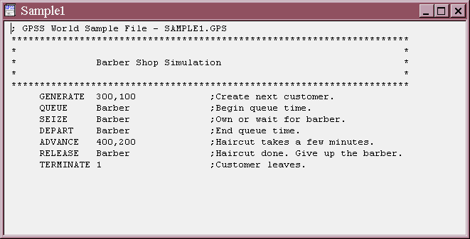
First gpss model implementation of M_{1Q}
gpssW runs on all Windows OS versions (NT or newer), but not on Unix/Linux-based systems.
= > YOU NEED a Windows OS based computer in first half of this course for using gpss
Below: first COMPLETE gpss simulation for a 1-barber barbershop satisfying ideal model assumptions
( In the source code above, a time unit (t.u.) is not documented with block Comment(s), nor a short model Functional description, but should be ) A ‘*’ or ‘;’ begins comment for the rest of a line
In this model, the t.u. is 1 second (1 minute is also a reasonble t.u., but minutes would involve
more fraction arithmetic for time values)
A model t.u. is problem-specific & user-defined & must appear in code preamble comments.
Each customer enters the simulation by an effect of a GENERATE block
GENERATE creates entities of one type, similar to a a Java constructor or the python class
instance creation
SAMPLE1.GPS does MORE THAN implement the 2 customer paths; it also gathers some stats
= > Characteristic of many special-purpose DES languages, default stats are output with no need for
the model developer to code the actual calculations or do I/O for such stats

Slide 10
SAMPLE1.GPS gpss blocks
Although the names are misleading, the QUEUE & DEPART blocks have a passive purpose;
as a pair, they automatically gather various stats for the blocks they bracket/surround.
= = > For generality, a particular QUEUE/DEPART pair will have the same A operand;
the operand identifies a region of code that the pair surrounds
Example in SAMPLE1.GPS:
QUEUE Barber and DEPART Barber
An entity passes through each QUEUE or DEPART block transparently, uses 0 t.u., and
has Refuse Mode “None”
None means that a QUEUE block or DEPART block can never pause execution of blocks by an active entity
( In the simple barberShop simulation, the QUEUE/DEPART code region consists only of the
SEIZE block; this means that stats gathered only involve waiting in the queue )
Note: The 7-line demo barberShop code is reduceable to 5 lines if the modeler does not want
service wait stats !!!
QUEUE/DEPART pairs can be non-nested or nested in a gpss model .
Cj residence stat w is an example involving the largest possible code region for one process
(get w by a QUEUE x right after GENERATE and DEPART x immediately before TERMINATE)
= = > A QUEUE/DEPART pair can specify a code region size as small as one block, or
arbitrarily many (consecutive) blocks.

Slide 11
First gpss model implementation of M_{1Q}
Example of automatically-generated report stats section for server behavior:
---------------------------------------------------------------------------------------------------
FACILITY ENTRIES UTIL. AVE. TIME AVAIL. <-- 2 lines in default report created during model run:
BARBER 1001 0.999 401.161 1 ρ and avg(service duration) for barber server
AVE.TIME means (average time elapsed during a customer service since these stats are for a facility)
----------------------------------------------------------------------------------------------------------------------------------------------------------------
It is not necessary to surround an ADVANCE block with a QUEUE/DEPART pair for gathering
service duration stats. Such stats are automatically gathered by the gpss runtime
Note – as old as gpss’s environment is, nonetheless,
it really is “OO”; if you translate a model and take a default report snapshot BEFORE
any customer encounters a SEIZE block, there is no report line involving FACILITY info
= = > each facility entity is dynamically created the FIRST TIME that some object
encounters a SEIZE block for that facility
barberShop results stats display AVE.TIME = 401.161 is close to the value of the first operand
of the ADVANCE block ; this is the report average over 1000 service durations
(The first ADVANCE block operand specifies the mean of a uniform distribution of a random variable (abbreviate as rv) – in this model, the rv values are the customer service durations)
GENERATE operands 300,100 specify operands of UNIFORM distribution of
cj interarrival times = the distribution of time difference between successive cj arrivals
= = > time between successive cj arrivals is equi-probable in [300-100, 300+100] = [200,400]
Fractional value precision is 6 digits to the right of the decimal; all values are equally likely.
Def – for i > 0, and arrival time ai of customer ci, and letting a0 = 0,
Ai = (ai – a i-1) is the ith interarrival time = arrival time difference between ai and a i-1
Note - Whether an arrival at t=0 is possible depends on the model and Ai distribution.
(in 148, our arrivals processes will usually not have arrival events aj at t = 0)

Slide 12
gpss blocks execution behavior, 1
A sequence of gpss “blocks” B starting with a GENERATE and continuing to a TERMINATE specifies the actions for each customer entity in the barber shop simulation.
gpss terminology: a sequence of blocks between a GENERATE and TERMINATE is a “transaction”.
An arriving customer (eventually) “enters” various blocks B, resides in B for some amount of
0 or > 0 simulation time units, and then leaves that B, and goes to some following block;
(More complex simulations involve branching/looping among blocks).
In our simple barbershop model, processing (in source code order) is all that is needed ;
that is, gpss processes each block in source-code order, per customer
gpss executes each block “B” as follows:
IF B has Refuse Mode “None”, then B execution is never paused /delayed, and the
actions for B are started immediately at current model time tc
(Example: QUEUE block)
ELSE when B’s Refuse Mode is NOT “None”, and model state at time tc is such that Refuse
Mode is satisfied, B execution is paused/suspended until that Refuse Mode condition
causing the pause becomes false.
Duration of the pause/suspend depends on current and near-future model state
After B’s entry pause/suspend completes, block B is entered and its actions are executed.
Example: SEIZE block suspends/pauses each arriving Cj when barber, is currently busy
Each paused Cj is automatically placed in the server’s (anonymous) FIFO wait queue.
When learning how to use each gpss block, study its documented Refuse Mode property.
Note that entry into GENERATE, QUEUE, DEPART, RELEASE, ADVANCE and TERMINATE blocks
is never refused (that is, each of these block types has Refuse Mode ‘None’)
However, a transaction that specifies a customer’s actions is refused entry into a SEIZE block whenever that customer arrives and the barber is busy

Slide 13
gpss blocks execution behavior, 2
Each transaction has no branching/looping in our simple barberShop model.
SEIZE block behavior implements executing path 1. or path 2, per customer C
in the barber shop customer flow, as follows:
1: Each arriving customer C will execute the QUEUE block (that starts automatic statistics
gathering; since its Refuse mode is None, QUEUE never pauses a transaction)
2: As C arrives at the SEIZE block, either the server (refer to as SVR) is idle or busy –
IF SVR is idle, C immediately starts service
ELSE SVR is busy servicing a previously arrived customer, so C is placed in Q, and C’s
transaction is automatically paused at the SEIZE block until it is C’s turn for service.
Completing the sequence: SEIZE, DEPART, ADVANCE and RELEASE models C’s service processing.
RELEASE represents (instantaneous) “freeing” the server from a completed service, and immediately makes the server able to start a next service.
Each seize x MUST HAVE a corresponding release x, otherwise execution has a fatal error
(model translation does NOT detect such a logic error)
Each customer arrives according to the distribution of Ai values in a service model.
GENERATE operands specify a specific distribution’s parameters –
Example: GENERATE 300,100 specifies uniform distribution (by default) of Ai values,
where (300-100 <= aj <= 300+100), j >= 0.
More generally, for ANY transaction type, the Ai values define the model time difference between successive creations of an object of that transaction’s type
A customer leaving barberShop (after a completed haircut) is modeled by entering a TERMINATE block; (Note - TERMINATE destroys that transaction instance)
“gpss simulation time” is model-specified and based on a t.u..
Physically, wall clock time has a “tick” of 1 second, and each tick must be done.
Compare with a DES engine, where model time will “jump” over many t.u.s for
each time interval having no events.

Slide 14
gpss blocks execution behavior, 3
An ADVANCE block represents the haircut process and specifies its duration distribution
The effect of entering an ADVANCE is several things:
1. Simulation of customer C’s service begins, say at current model time startCservice
2. C is being served when it is “in” an ADVANCE block;
gpss automatically schedules C to proceed past this ADVANCE block at future time
(startCservice + (C service duration) = tcf
(C remains “in” this ADVANCE block for the duration of C’s barber service)
gpss scheduler determines next action to perform at time t >= startCservice
Note: Entry into an ADVANCE does NOT automatically increment current model time !!!
Example a1 & s1 a2 f1
----------------------|-------------------------------|----------|------------------- model time t
0 250 524 625
ADVANCE illustrations: Use following notations for “simple” events; cj is the jth customer
aj = (arrival time of cj); sj = (cj service start time); fj = (cj service finish time)
With GENERATE and ADVANCE operands of our M1Q model, c1 can immediately start service at time a1= 250. GENERATE then automatically schedules a2’s value between 450 and 650.
C1 started service since it successfully entered the ADVANCE block; however, gpss calculates a future f1 = 625 value as part of the ADVANCE processing.
c1 is placed in the FEC at model time 250. c1’s state in the model in interval (250,f1] is that
C1 is being server by the server. These effects of an ADVANCE block give a gpss model the flexibility of scheduling OTHER EVENTS at/after t=250 and prior to f1, such as a2 = 524.
Assuming no other aj occur before f1, we have snapshot model states such as: n(600)=2, c2 is in the wait queue, and from ideal behaviors we are assuming for M1Q,
we also know s2= 625. However, f2 will be some future event occurring at some time >= (625+200) because 200 is the min(cj service duration).

Slide 15
gpss blocks execution behavior, 4
After each Cj leaves block ADVANCE 400,200 cj immediately enters and leaves the
RELEASE block. After RELEASE block processing, the server has finished with C
and the server is now immediately ready to serve the longest-waiting cj, if any.
(the gpss terminology is “ready” rather than “available” because available has a
technical meaning related to gpss server failure/recovery modeling – studied briefly later)
Cj will move on to the block following RELEASE, in our model, a TERMINATE.
Note - the RELEASE consumes 0 model time, thus, “finishing” a haircut takes 0 model time
(by ideal M_{1Q} model assumption 6 described earlier)
RECALL - THE FIRST READING ASSIGNMENT discussed event scheduling:
gpss implements a DES event scheduler using the following internal data structures:
At any model time t, gpss maintains the list CEC (Current Event Chain) of actions to happen at
current model time t.
During each customer C’s service, C is represented in the FEC (Future Event Chain)
from the time the haircut starts at startCservice until time tcf <- - see previous slide
gpss always maintains the FEC having an entry for each scheduled “future” event to occur
at a time > (current model time)
= = > a gpss model run is self-perpetuated by using internal random number generator calls to get sample values for Ai and service duration values “Just In Time”.
This means that Ai values are NOT PRE-CALCULATED during model run initialization;
Instead, each Ai value is calculated immediately before it is needed.

Slide 16
Starting and Stopping a model run
After successful Create Simulation Command, start execution with the START Command:
START tc { Default tc value is 1; Example: to model 250 haircuts, issue: START 250 }
where “tc” stands for model execution’s initial ” “termination count”
Each time a customer finishes model execution by entering and immediately leaving (with 0 model time elapsed) a TERMINATE 1 block. tc is decremented by operand value 1.
(The operand 1 is the decrement amount); tc is a global variable visible to all transactions.
In service models, the initial tc value determines the length of a model run.
TERMINATE also automatically destroys the transaction – no need to manage object removal.
If a TERMINATE block has no A (i.e., first) Operand, Cj is destroyed, but tc is unchanged
==============================================================
Assuming the block: TERMINATE 1, as customer number 250 enters the TERMINATE block,
tc has value 1, and when customer 250 passes TERMINATE 1, model execution terminates.
When customer 250 passed the TERMINATE block, gpss decremented tc from 1 to 0.
= > In gpss source code, preamble comment “tc < == 0” specifies an execution termination
condition.
= > A fatal execution error or arriving at a breakpoint are other run abort or pause causes.
Normal model execution completes when TERMINATE block entry (by ANY entity)
decrements tc to 0, regardless of the transaction type whose TERMINATE resulted in tc = 0
When execution either terminates or is paused,
a default x.rpt file (= a standard stats summary Report) is displayed in a new window.
And a x.sim file (= a model run events trace) is displayed in another new window
( During model execution, x.sim and x.rpt are continually, updated in the background.
Because x.rpt and x.sim are written incrementally as a simulation executes, both files
have correct/current content, even if a run aborts or is paused (useful for debugging) )
In class homepage subdirectory named labs, do all parts of file ‘lab1.docx’

Slide 17
The standard gpss Report format
The default x.rpt file is organized into several sections.
For the simple single-server barbershop model, the complete report file contents is as follows:
GPSS World Simulation Report - h0BaseModel_148_f20.27.1 < -- Header and Date
June 24, 2022 00:21:46
START TIME END TIME BLOCKS FACILITIES STORAGES < -- Model service & run summary
0.000 401931.114 7 1 0
NAME VALUE < -- Symbol table of model labels
BARBER 10001.000
CJ 1.000
W_BARBER 10000.000
LABEL LOC BLOCK TYPE ENTRY COUNT CURRENT COUNT RETRY < -- Model blocks layout
CJ 1 GENERATE 1347 0 0 ALWAYS examine ENTRY COUNT
2 QUEUE 1347 346 0 values – this determines if
3 SEIZE 1001 1 0 each block was entered the
4 DEPART 1000 0 0 correct number of times.
5 ADVANCE 1000 0 0 IF ENTRY COUNT is
6 RELEASE 1000 0 0 incorrect, source code
7 TERMINATE 1000 0 0 logic likely has errors.
FACILITY ENTRIES UTIL. AVE. TIME AVAIL. OWNER PEND INTER RETRY DELAY < --facility stats (if
BARBER 1001 0.999 401.161 1 1001 0 0 0 346 model has facilities)
QUEUE MAX CONT. ENTRY ENTRY(0) AVE.CONT. AVE.TIME AVE.(-0) RETRY < -- QUEUE/DEPART stats
W_BARBER 347 347 1347 1 174.888 52184.845 52224.615 0 (1 stats line per
QUE/DEP region)
CEC XN PRI M1 ASSEM CURRENT NEXT PARAMETER VALUE < -- CEC contents when model
1001 0 298909.662 1001 3 4 finished or suspended
FEC XN PRI BDT ASSEM CURRENT NEXT PARAMETER VALUE < -- FEC contents when model
1348 0 402257.310 1348 0 1 finished or suspended
Models different from M_{1Q} might have somewhat different report format: some above sections might not appear,
and other sections could occur for model types we have not covered.

Slide 18
State info of Concurrent objects; more on model stats
Suppose customer c1 (first customer) arrives a time t= 5, and immediately starts a haircut that takes 10 minutes. Customer c2 arrives at time 9. Assume that c3 and other future arrivals occur after time 15
Below, a model snapshot at current time 9 shows customer transaction (tr) occurrences c1 and c2.
Each customer tr eventually completes its service and leaves S
(gpss block names are abbreviated to 3 characters each):
c1 < -- Getting haircut at t=9 c2 < -- Immediately enters service wait at t=9
gen gen
que que
sei sei < -- tr c2’s current block pointer
dep dep c2 is paused waiting to enter SEI
adv < -- tr c1’s current block pointer adv (part of c2’s state information)
rel c1 paused in ADV for 5 <=t <= 15 rel
ter (part of c1’s state information) ter
Current model run stats include:
Model state at time t = 9 includes: n(9) = 2 (number of C in S is 2), and LQ(9) = 1 (number of C in Q is 1)
average stats over model time interval [0,9] includes
ρ = 4/9 (For 5 of the 9 minutes S was empty); w = avg(customer residence duration) = (4 + 0)/2 = 2 t.u.
Note – Statistically, the calculated ρ and w values are very inaccurate/approximate because the above demo
is very short duration and involves insufficient event history for accurate long-term stats.
As explained in the first reading assignment, the operation of the main loop in a DES simulator ensures:
at t=9, GENERATE will post the arrival time t > 9 of customer c3 as an arrival event on the FEC.
REVIEW - In trace displays and in the FEC section of the default report, successively generated transactions are denoted by XNn. Example: XN7 denotes transaction number 7.
Transaction naming
A gpss execution creates transaction names/ids: XN1, XN2, … but the successive XNj can be instances of different transaction types. (GENERATE statement labels are not related to the XNj names)

Slide 19
gpss terminology for simulation models
From the gpssWorld documentation -- How a gpss simulation executes:
Blocks and Transactions
“GPSS simulations consist of a network of "Blocks", which represent actions or delays to be encountered by a set of "Transactions", which "enter" one Block, then the next. The whole simulation is simply a sequence of one Transaction waiting or entering one or more Blocks,
then another Transaction, and so on. . . .”
Explanation of each underlined section of the above
“network of Blocks” – all gpss source code blocks of a gpss model
“actions or delays” – each gpss block that is executed (aka “entered” as gpss describes it)
during a model run can cause an action or event or model state change;
gpss term “delay” refers to a block for which a transaction x encountering that block is suspended/delayed by gpss; the delay simulates an activity by x or a model state change;
the delay of x is completed when the cause/reason for the delay s no longer true
“transaction” (tr), not related to database or computer peripheral bus, etc. transaction construct.
tr refers to a sequence of gpss blocks: GENERATE … other blocks … TERMINATE x
For example, SAMPLE1.GPS has one transaction type modeling the actions of a customer; on the other hand, the barber is very “passive” (actions simulated by SEIZE, ADVANCE, RELEASE)
Any gpss model M (a queuing model or other type) requires a GENERATE … TERMINATE sequence for each distinct transaction type.
Our simple barberShop model represents customer haircut processing. The model could be expanded with a linen & supplies transaction (visits the shop approx. every two weeks),
a county health & safety inspection (visits are rare, randomly occurring, and un-announced), etc..

Slide 20
Some tr blocking cases
1: gpss models can have several non-nested tr definitions, each of the form:
GENERATE Operands
some blocks <- - No TERMINATE or GENERATE blocks here
TERMINATE x
2: But, this code GENERATE Operands
is not allowed. some blocks (with no GENERATE/TERMINATE/branch past next GENERATE- - No TERMINATE or GENERATE or branching (2) Demo
GENERATE Operands <- - Illegal to “step into” a GENERATE block . . . within another transaction
TERMINATE x
On the other hand, a blocks structure like the following is legal. It is useful for >=2
tr that have different blocks in their start behavior and have common blocks at their end.
3: tr1 GENERATE Operands GENERATE Operands
.blocks <- - N some blocks <- - No TERMINATE or GENERATE o TERMIN. . .ENERATE or branching here
branch past next nested GENERATE to label LAB
tr2 GENERATE Operands
. . .
LAB < -- Blocks from here through TERMINATE x are common to tr1 & tr2
. . .
TERMINATE x GENERATE Operands (3)
Each GENERATE/TERMINATE and its blocks is associated with one distinct entity type.
In each gpss model, there can be any number of tr patterns of types 1 and 3 above.
Note: The label on each GENERATE in Case 3 is simply as a name/label for referencing
different transaction types. It is illegal to “branch/jump” to a GENERATE block’s label

Slide 21
Some interacting skeleton tr flows - Continued
(Case 3: above) multi_gen_common_terminate.gps Demo: transactions without service
* Demo Usage: Execute with START 2 Run terminates when tc <- -- 0
GEN1 generate 5 ; Arrival every 5 T.U. of 1st tr type “GEN1”
transfer ,fin_tr ; Unconditional Branch to common terminate block
GEN2 generate 8 ; Arrival every 8 t.u. of 2nd tr type “GEN2”
fin_tr terminate 1 ; EXIT The System
===========================================================
Summary of some of the Result default Report file for the above model (.rpt file)
START TIME END TIME BLOCKS FACILITIES STORAGES < -- - Top label line of the default report file
0.000 8.000 4 0 0 <- - 4 model blocks, 0 single-servers, thus, no SEIZE blocks
When the first GEN2 tr terminates, the model run terminates.
Program labels and virtual address values, sorted by Name:
NAME VALUE
FIN_TR 4.000
GEN1 1.000
GEN2 3.000
Block entry trace counts < -- Counter values at end of run
LABEL LOC BLOCK TYPE ENTRY COUNT CURRENT COUNT RETRY
GEN1 1 GENERATE 1 0 0
2 TRANSFER 1 0 0
GEN2 3 GENERATE 1 0 0
FIN_TR 4 TERMINATE 2 0 0
Future Scheduling chain contents (Display using: Widow - -> Simulation Snapshot - -> FEC Snapshot)
FEC XN PRI BDT ASSEM CURRENT NEXT PARAMETER VALUE
3 0 10.000 3 0 1 <-- After t=8, each transaction type has an arrival
4 0 16.000 4 0 3 scheduled at a future time on FEC

Slide 22
Model execution tracing (and display in .sim file) for multi_gen_common_terminate.gps
During model execution an events “trace” file named x.sim is automatically displayed in a separate window
There are 3 different tracing formats that x.sim can display.
First trace format - when the model starts/resumes from a suspended state, trace the model, one block entry at a time. For example, if an entire model run is executed, one block-at-a-time, successively using Command STEP 1, the trace looks like:
06/03/14 20:59:40 Model Translation Begun.
06/03/14 20:59:40 Ready.
06/03/14 21:00:00 STEP 1
06/03/14 21:00:00 Simulation in Progress.
06/03/14 21:00:00 Halt. XN: 1. Block 2 Next.
06/03/14 21:00:00 Clock:5.000000. Next: TRANSFER. Line 5.
06/03/14 21:00:00 transfer ,fin_tr
06/03/14 21:00:03 STEP 1
06/03/14 21:00:03 Simulation in Progress.
06/03/14 21:00:03 Halt. XN: 1. Block 4 Next.
06/03/14 21:00:03 Clock:5.000000. Next: TERMINATE. Line 7.
06/03/14 21:00:03 fin_tr terminate 1
06/03/14 21:00:04 STEP 1
06/03/14 21:00:04 Simulation in Progress.
06/03/14 21:00:04 Halt. XN: 2. Block 3 Next.
06/03/14 21:00:04 Clock:8.000000. Next: GENERATE. Line 6.
06/03/14 21:00:04 GEN2 generate 8
06/03/14 21:00:05 STEP 1
.
When the model run is suspended or has not started,
Single stepping is done with:
Command - - > STEP 1
Also, when the model run is suspended,
model execution can be resumed using
Command - - > CONTINUE

Slide 23
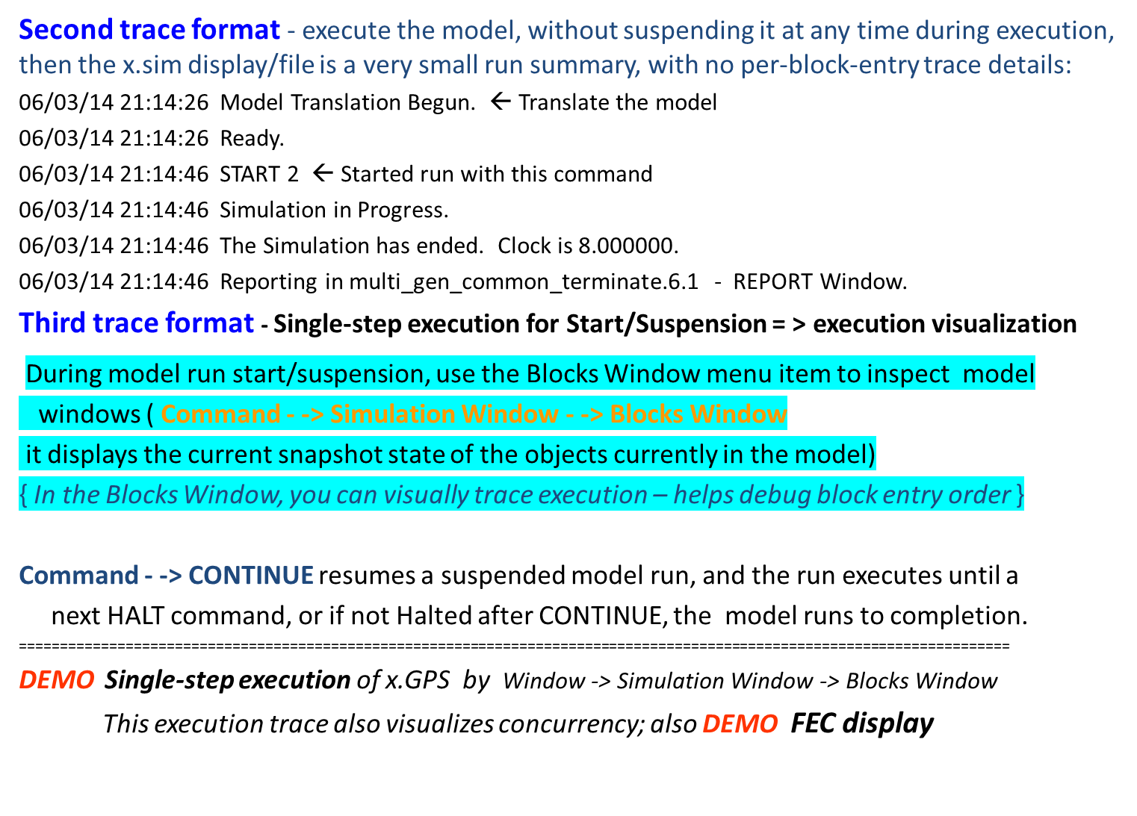
Model execution tracing (.sim file)

Slide 24
Model assumptions for M_{1Q} models
Implications of the earlier M1Q ideal model assumptions for gpss M1Q model runs
By 5a), a facility operates continuously until a model run termination condition is met
Assuming each service duration is > 0, simultaneous service finishes are not possible (because of
non-preemptive service on a single server and assumption 2 )
By 5b), an Cj never stays in S forever, nor disappears when in S; each arriving Cj eventually gets service &
leaves S). Each correct model must specify a (service duration) > 0 for each Cj.
Guaranteed (eventual) service is referred to as “conservation of customers” (the DES modeling analogue to
“conservation of energy” in physics)
Note – suppose an M_{1Q} run terminates for which START 1000 was specified; the report at run termination
might display that 3 Cj are STILL in S Why?
The Reason is that gpssW always “works ahead” and schedules future Ck arrivals at times that might
exceed model time t when execution terminated. And those Ck have not yet completed service.
No real system S is an ideal system, but modeling an ideal system provides a first version of
a system “myS” that you are building or observing.
(This will be the first level of understanding of myS)
As detail is added to myS for creating more complex/realistic models, some ideal assumptions are either
dropped or modified.
Example: server/barber - occasionally resting, rather than ready to do a service at any model time
Examples: works 8AM-6PM, except for lunch break; closed Sundays
Model objectives AND design decisions dictate:
which system behaviors to include vs which behaviors to omit
Behavior inclusion/omission decisions are the most difficult/challenging part of designing advanced simulations
Examples of more realistic/detailed behavior, not in our first barbershop model:
* If desired, the programmer could implement service startup using x t.u. > 0, to simulate such things as
a brief conversation about haircut style, the customer’s sick dog, or, anything else.
* joining/leaving the service wait queue could model a time duration > 0

Slide 25
Model stability
Def - Model stability means that long-term statistics such as avg(Cj residence time) and avg(queue length)
will approach limit values { analogous to the limit value (if it exists) of an infinite series }
In calculus, you saw that sum{ from 0 to ∞ } (x ^{n} ) = 1/(1-x) for |x| < 1 Get as close to 1/(1-x) as you want by summing enough terms. Similarly, run a stable model long enough, and statistics limits are approached.
Stability can be expressed mathematically for an M1Q model as:
(rate of customer service) > (rate of customer arrivals) (1)
The intuitive idea is that when customers arrive faster than haircuts can be done, then wait time for a haircut (=average service wait time) increases without bound; server falls behind and never “catches up”
GENERATE 300,100 and ADVANCE 400,200 in our simple barberShop specify:
Mean time between customer arrivals (aka interarrival time) = 300 seconds = 5 minutes AND
Mean time per haircut = 400 seconds = 6.67 minutes
Using minutes at the time unit in the following calculations:
Rate of customer arrivals = 1 / (mean time between customer arrivals ) = 1 / 5 = 0.2 arrivals/minute
Rate of haircut = 1 / (mean haircut duration) = 1 / 6.67 = approx. 0.15 haircuts/minute
Inequality (1) does not hold; thus, this system is unstable, caused by operands 300 and 400
= => if this model is run long enough, any pre-specified max(queue length) is exceeded
Mathematicians/Engineers have dealt w. stability for > 3 centuries: involves many variables & randomness
Physical mechanical systems – you buy 2 new tires for your vehicle front end … ? done spending $ ?
- -> Input modeling such as gpss GENERATE and ADVANCE operands is a significant part of design of any
service-oriented DES simulation. Analyzing run results is also a major topic for simulation systems.
In many simulation textbooks (30% !!! of the topics) involve modeling input/output data and parameters.

Slide 26
Default formatted Report output from a gpssW single-barber model run
gpss World Simulation Report - b1_jan06.1.1
Wednesday, January 6, 20XX 10:22:02
START TIME END TIME BLOCKS FACILITIES STORAGES ← Report header line
0.000 8040.997 5 1 0
NAME VALUE ← Symbol table (only 1 symbol in SAMPLE1.GPS)
BARBER 10000.000
LABEL LOC BLOCK TYPE ENTRY COUNT CURRENT COUNT RETRY ← Block activity – ENTRY COUNT is total number of tr
1 GENERATE 1000 0 0 (of any type) that entered the block during the run
2 SEIZE 1000 0 0
3 ADVANCE 1000 0 0
4 RELEASE 1000 0 0
5 TERMINATE 1000 0 0
FACILITY ENTRIES UTIL. AVE. TIME AVAIL. OWNER PEND INTER RETRY DELAY
BARBER 1000 0.742 5.970 1 0 0 0 0 0
This UTIL. value cannot possibly be from 1000 haircuts in the original SAMPLE1.GPS – Why ?
FEC XN PRI BDT ASSEM CURRENT NEXT PARAMETER VALUE < - - FEC contents at end of run
1001 0 8041.266 1001 0 1
--------------------------------------------------------------------------------------------------------------------------
Report Item Explanations
Report header line
START TIME – Model start time (usually 0; “warm up” techniques covered later) (0.000)
END TIME – Clock value when run finishes (8040.997)
BLOCKS – Number of gpss blocks in source program (5)
FACILITIES – Number of identified/labeled single-servers, aka facilities (1)
Blocks activity section
LABEL - Block label (if any)
LOC – Relative block number in source program
BLOCK TYPE – Type of gpss language block
ENTRY COUNT – Number of tr (of any type) that entered this block during the run
CURRENT COUNT – Number of tr in/occupying this block at current time
+ FACILITY – For each facility in a model, a stats summary; (more on next slide)
+ FEC XN – Future Event Chain tr number; a line for each event scheduled at time >= currentTime
To display FEC when the model is suspended: Window → Simulation Snapshot → FEC Snapshot

Slide 27
Default Report info for each facility and queue/depart
Each facility in a simulation model has 10 stats results. The stats for each model facility appear on an output line after the heading line of labels:
Facilities section
FACILITY – Name/Label of a facility in the model
ENTRIES – Total number of tr that have entered the SEIZE block for this facility during the run
UTIL. – Average utilization of this facility = (% of time this server was busy during the run): expressed as a fraction (0.0 <= UTIL.<=1.0) or as a % Example: UTIL. 0.742 or 74.2%
AVE. TIME – Average service duration over all transactions that used
this server (does NOT include service wait time)
AVAILABLE - When =1, facility is “up”, and when=0, is “down”;
when =0, server simulates a repairable failure state
{ We simulate service failures later in course }
OWNER - Transaction (number) of current owner/user of facility
If 0, no transaction currently is using the server
+ 4 others - Not covered in this course
QUEUE section
For each QUEUE/DEPART pair several summary stats are listed, including:
AVE.CONT – average(number of tr currently between a QUEUE and its DEPART)
AVE.TIME – average(time spent, per tr, between a QUEUE and its DEPART)
AND => there are other built-in functions for several other stats
------------------------------------------------------------------------
Special-purpose simulators such as gpss have built-in reporting that is adequate for many purposes (substantially reduces need for modelers to code report formatting)
Simple models do not need developers to code report logic, but, in models with complicated stats, user-written reporting code is needed.

Slide 28
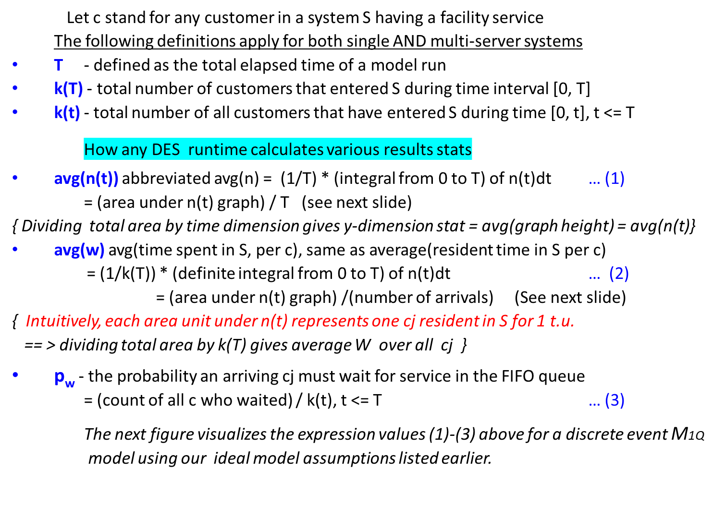
Computing Result Statistics for M_{1Q}

Slide 29
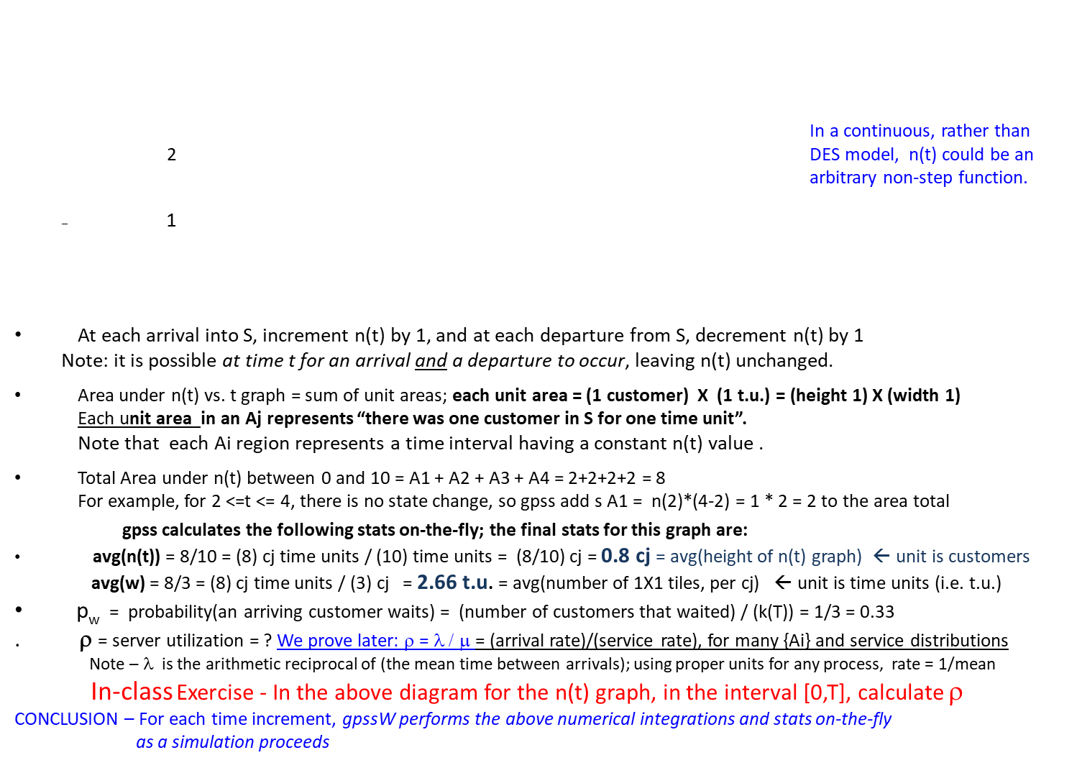
Computing Result statistics for M_{1Q ,} cont’d
Figure – n(t) vs. t graph – for simplicity, events occur at integer times
n(t)
A3
A1
A2
A4
0 2 4 5 7 8 10 t

Slide 30
_{More on gpss model state}
gpssW does not support parallel threading, that is, hardware-based concurrent instruction execution,
so on 1 execution core:
Events happening at the same model time are automatically sequenced by gpss internal algorithms;
For advanced models, events at the same model time (such as cj arrival and ck service finish) can be ordered (i.e., override internal algorithm) by additional source code
During an M_{1Q} simulation run, at time t, the state for a facility named “SVR” can be inspected by any tr:
> SVR is idle means n(t) is 0; gpss function call f$facilityName (here, f$SVR) returns numeric value 0
> SVR is busy when n(t) > 0, and f$SVR returns numeric value 1
= => Built-in function call f$facilityName returns a facility idle/busy state value of 0 or 1.
Components of any M_{S} – with illustration from a system S of type M_{1Q}
1. Clock – clock tick unit value is user-defined, per model; defined ONLY IN SOURCE CODE DOCUMENTATION
gpss does NOT need to increment each clock tick; time jumps over time intervals having no events
2. Objects – the things/entities that the model represents (customers, servers, etc.)
3. Events – below are 3 “simple” event types; they are assumed to happen instantly in models so far
e1 = customer c arrives in S, or some kind of object is created of some tr type
e2 = some c starts service
e3 = some c finishes service and immediately leaves S (first M_{1Q} implementation for finish service & leave S
with RELEASE and TERMINATE x, and these two blocks take 0 model time)
ce1 = “Complex” events, called processes/activities (depending on the DES) use non-zero elapsed time
Example: in gpss, simulating one cj service via ADVANCE
4. State variables to represent S state; M_{1Q} has a simple current state
n(t) = ( count(customers waiting) + count(customers being served) ) at time t
k(t) = count of c that have entered S between times 0 and t inclusive
f$facilityName value at time t

Slide 31
More on gpss model state
5. Delays, or waits
. the amount of model time take by a given event ej is model-specific
. Details of an ej actions are also specific to a tr type
Example – Vehicle repair shop: Assume car & truck are different tr types
Case 1 – 2016 Toyota Highlander in good condition comes in for an oil change vs.
Case 2 – 1987 Ford Bronco died in street & being pushed in (suspension control
arm broke)
= => Case 1 and Case 2 process prior to repair start differ widely: near 0 vs. 40 minutes
In advanced models Analysis & Design of a simulation become more difficult -
1) what each event type occurrence does and when
2) all distinct object types: in gpss, defining tr types
3) synchronizing (delaying/resuming/interrupting) events/actions
4) stats calculations & display

Slide 32
Different kinds of Ai and service distributions; more on model assumptions
Some Ai distribution choices -
Constant: Although simple, it can be useful. For example, in the barberShop model, if 1 t.u. = 1 minute,
we can add a once-per-quarter barbershop inspection process. Inspections are created using
GENERATE 90#24#60 ; An inspection every 90 days
The A operand was left non-symbolically to show the constant periodic inspection process starting every 90 days, expressed in minutes. (In gpss, you should code the value 129,600 symbolically, using an EQU statement)
Uniform: The Ai distribution is uniform and its mean is the value of the first operand.
The second operand is max(deviation from the mean), abbreviate as maxdev.
Uniformly distributed satisfies: (mean – maxdev) <= iaj <= (mean + maxdev), so in the basic barberShop,
each Aj value satisfies 200 <= Ai <= 400, and each Ai value, significant to 6 decimal places, is equally likely.
(That is, Aj values such as 307 or also 307.286634 are equally probable)
Exponential: Properties of a “Poisson arrival process”: each inter-arrival value Aj satisfies 0 < Aj < ∞, and the Aj are highly variable. Aj values are not affected by previous arrival times; event rate is constant per t.u.
An exponential distribution is the probability density function of a Poisson process
An example of removing an ideal model M_{1Q} assumption
In models so far, a transition such as: server SVR is busy to free uses no model time elapsed time.
Following each service completion, some additional random activities taking >=0 model time can be represented by ADVANCE block(s), as shown below:
SEIZE svr ; Acquire svr
ADVANCE operands ; Getting service at facility svr
RELEASE svr ; Free up svr
ADVANCE operands ; Do some other things after svr service
Ideal models simplify introduction to simulation modeling. By contrast, removing an ideal assumption
results in more realistic models, but, at the cost of more detailed simulation logic and coding.

Slide 33
_{Additional gpss modeling}
Facility state
For each SEIZE x block in a model, there must appear a corresponding RELEASE x block.
The RELEASE changes the state of facility x from busy to free.
Assuming a service for cj in M1Q eventually completes, an ADVANCE block is followed by a RELEASE block.
A RELEASE block removes tr x’s “ownership” of a server, thereby allowing another tr y to start service
The first barber shop example is simple, in that each cj encounters a SEiZE block one time (to get one haircut).
However, code such as:
SEIZE abc ; Acquire abc for a service
. . .
RELEASE abc ; Finished an abc service
. . .
SEIZE abc ; Acquire abc for another service
. . .
RELEASE abc
. . .
is not only legal, but needed for more complicated service schemes in which cj might get more than one service
from the same facility abc (systems terminology would be: “abc is revisited by cj”)
(Server revisit can also be implemented using loops)
Extending a simulation model by adding other tr types
Interarrival times & other Operands for GENERATE blocks are independent of those Operands for other tr types.
There must be n GENERATE blocks in the source code, one for each of the n transaction types in a model.
A gpss facility is a “passive” entity
You do not use a GENERATE or any other block type to “create” a model facility.
In fact, for the barber shop model, as example, after the source code is translated, and
before execution starts, the barber (= facility entity) DOES NOT EXIST in the model runtime state.
Interestingly, gpss automatically creates a barber entity when a SEIZE block is first encountered by any tr
occurrence during model execution.
In general, a model entity that gets service OR does actions that affect model state must be created with its own
distinct GENERATE block
--------------------------------------------------------------------------------
Test your understanding: in gpss, does each SEIZE block require an Operand? Why or why not?

Slide 34
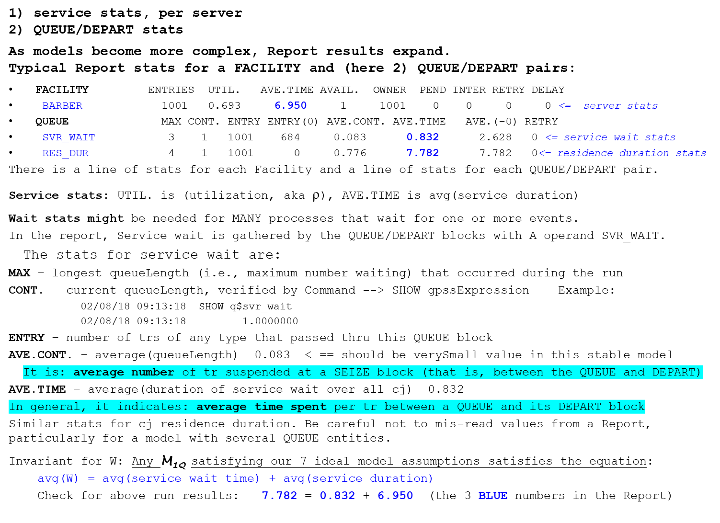
More on Report contents for M_{1Q} - most stats mean the same thing for single or multi servers

Slide 35
Classification of model types based on execution method
3 model types M_{S}
If S is not Type 1 or 2, then a simulation program(s) for MS must be developed.
CSC148 does not emphasize: GUI / graphics / animation (covered in other courses)
Note: computer games are simply one form of Type 3 simulation that emphasizes
human interfacing with sound, visualization, competition strategies, etc.
Next = = > Generating random values
Classification | Type 1 | Type 2 | Type 3
How it is executed | Carried out by hand; manual calculations | Has exact mathematical solution, or has a sufficiently-accurate approximate mathematical solution | Simulation using executable program(s) in gpss, C++, JavaSim, simpy… or even spreadsheets. { the program(s) is (are) the model implementation }
When to use & Characteristics | VERY simple model, small number (not millions) of event types and event occurrences | Most preferred model type But, most complex models {medical, financial, industrial} are almost never mathematically solvable | Model is not Type 2 and has a large amount of detail.

Slide 36
Calculating deterministic distribution values using table lookups
For a Type 1 system, below is a small example for obtaining 6 arrival & service distribution values
Given only a sequence of interarrival times Ai, successive arrival times can be derived by the iteration: For c3: (next arrival time) <- - (previous arrival time) + next Ai time ( 6 < - - 2 + 4 )
If deterministic, as in the left table, {Ai} is: 2,4,1,2,6, … , and this sequence is determined in
advance of model execution, and fed in during a run. Arrival times are thus, deterministic,
Table-driven arrival times. Cj service duration by table lookup
Deterministic service durations, 2,1,3,2,…, are obtained from the right table. Simply use the next deterministic Service time value for cj’s service duration. No calculation is needed.
Customer ck, k=1,2,… | Next Ai time | Arrival time
1 | - | 0
2 | 2 | 2
3 | 4 | 6
4 | 1 | 7
5 | 2 | 9
6 | 6 | 15
Customer | Service duration
1 | 2
2 | 1
3 | 3
4 | 2
5 | 1
6 | 4

Slide 37
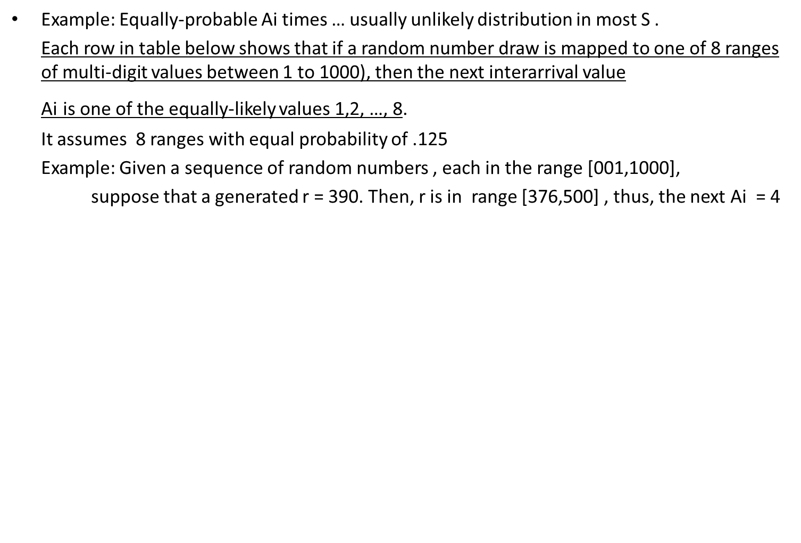
Random equally-probable distribution values
Next Ai value | Probability | Cumulative probability | Random digits sample value r
1 | 0.125 | .125 | 001-125
2 | 0.125 | .250 | 126-250
3 | 0.125 | .375 | 251-375
4 | 0.125 | .50 | 376-500
5 | 0.125 | .625 | 501-625
6 | 0.125 | .750 | 626-750
7 | 0.125 | .875 | 751-875
8 | 0.125 | 1.000 | 876-1000

Slide 38
Empirical distribution of service duaration values
Def - An empirical distribution follows a unique distribution for the particular application, and the distribution is NOT any well-known one seen in math/stats/simulation textbooks
(such as: exponential, constant, uniform, normal, Poisson, triangular, Pareto, etc.).
The values associated with an empirical distribution are based on unequally-distributed service duration values
Concerning the column “Random digits value r”, for 0 < random# r < 1, map r to its value in the range 1 to 100. The Random digits value r ranges/weights have proportional probabilities.
Example: If r is .617, then the corresponding Random digits range value is r * 100 = 61.7,
thus, the corresponding “Service duration” value is 4 minutes
A service distribution is often empirical:
many industries/processes have unique services with special-case processing
that cannot be accurately modeled by any well-known distribution.
Service duration (minutes) | Probability | Cum. probability | Random digits value r
1 | .10 | .10 | 01-10
2 | .20 | .30 | 11-30
3 | .30 | .60 | 31-60
4 | .25 | .85 | 61-85
5 | .10 | .95 | 86-95
6 | .05 | 1.0 | 96-00 (00 represents 100)

Slide 39
gpss random number generation
Every DES system needs random number generator (aka RNG) capability for implementing randomly-occurring actions. RNG capability is used in simulation for creating values of random variables.
For this discussion, assume that a model is using a RNG named rng.
Given a random variable named rn,
each value v of rn is obtained by
an rng generates a random number r
r is transformed into value v within the range of possible values of v
gpss example
; Demoing gpss RNG processing
generate 1
advance 1
terminate 1
Pausing execution after the GENERATE block, gpss RNGs can be illustrated:
05/31/25 14:47:33 Clock:1.000000. Next: ADVANCE. Line 4.
05/31/25 14:47:33 advance 1
05/31/25 14:49:39 SHOW RN1
05/31/25 14:49:39 638.0000000
05/31/25 14:50:04 SHOW RN2
05/31/25 14:50:04 252.0000000
gpss has 8 built-in RNGs having names RN1, RN2, …, RN8.
Each RNx is an implicit function call. The value returned from a call is a whole number between 1 and 999.
RNx by itself is a legal expression.
RNx can appear as a term any place in gpss where an expression can occur.

Slide 40
Main loop of a DES runtime
Processing components of any discrete-event simulation include:
> Configuring Start and Execution termination conditions
> Model run initializations
> Generation of future events
> Processing the next event at the current time
From an “event-processing” viewpoint, a DES executes an event-processing loop:
  > Initialize the runtime; do all events at time 0 (if any)
> Advance clock to min. future time “x” having > 0 events posted
> Process all of events for time x on CEC; post items on FEC, as needed, including GENERATEs
Gather and do stat. calculations for current time x, etc.
> IF (run Not Finished) { branch back }
{ Terminate run and do post-run processing and Reporting }
current time
Future event(s) scheduled at times y1, y2, …
Note 1: With gpss studied so far, only GENERATE and ADVANCE can schedule future events
Note 2: One of the most complicated aspects of a DESS run-time system design is
state and state change logic as events occur.
If no such time x exists, Halt simulation
0 CEC: ex1, … exn y1 y2 FEC t

Slide 41
Some Operating Rules for DES engines
Deterministic simulations use random values that are known before execution.
Stochastic simulations calculate random values during execution to produce values of the model’s random variables.
We cover only one common discrete model paradigm in this course,
namely, stochastic (means: randomly-determined) discrete event simulations.
Summary of Properties/Operating Rules of stochastic discrete event simulators
State variables take on only discrete values (but fractional as well as type int values)
Model time can increment over varying amounts (avoiding MANY clock ticks)
All state variable values remain unchanged during a clock increment by the runtime system
No model time elapses during a model’s state changes calculations –
regarding gpss, a tr “x” that enters block “B” changes x’s state, and thus the model state (Report ‘ENTRY COUNT’ records x’s entry into B). There is no model time consumed by
a tr entering B, except for some internal (invisible to the user) stats processing.

Slide 42
M_{S} classifications based on behavior of model variables
Def - In a continuous model, variables (temperature, etc.) change continuously over time
Def – In a discrete model, variable values change at discrete times < -- there is a min (time Δ)
Def – in closed loop M_{S} , results (called feedback) are used by M_{S} as it runs = >
feedback affects system operation and results
Example: space heater operation; sensor monitors temperature as heater runs until temperature v is reached; WHEN room temperature > v, THEN shut off heater fan motor
The feedback = (sampled room temperatures)
Def – in open loop, M_{S} runs a pre-determined amount of model time OR until some event
occurrence or pre-defined condition; runtime results are not fed back into the model;
Example: { For ICEs, (Internal combustion engines) some sensor feedback occurs during startup, such as
camshaft position sensor output voltage sent to Ignition control module as a signal to produce spark;
therefore, auto/truck ICE subsystems operate mostly in open loop @startup and then closed loop for the rest
of a drive cycle; in the driving phase, many sensors implement closed loop operation }
Def – in static M_{S} each event is unaffected by previous events
Example: (Assuming a “fair” coin) each coin toss is not affected by any previous toss(es)
Def – in dynamic M_{S} events affect other events/states
Example: cj can decide to enter S based on the current service queue length
All simulations in CSC148 are: 1) discrete event 2) open loop, and 3) dynamic models

