Slide 1
Azure Mini Project: HDinsight
Section 18.5

Slide 2
Overview
Due to having 0 quota for HDInsight vm cores, I was unable to configure head/worker nodes
I attempted to do so using both my free AND PayAsYouGo subscriptions, without success
Requested quota increases with tickets to Azure Global Capacity Support, requiring weeks of email* exchanges and significant delay.
*The PayAsYouGo support ticket emails are included as Quote_Request_HDInsight.pdf
By the time the issue neared resolution, my free account expired, thus voiding my credits and risking dangerous costs.
As a workaround, I instead installed and configured spark Jupyter Notebook kernel locally.
This alternative runtime facilitated completion of SparkDataframesProjectExercises.ipynb

Slide 3
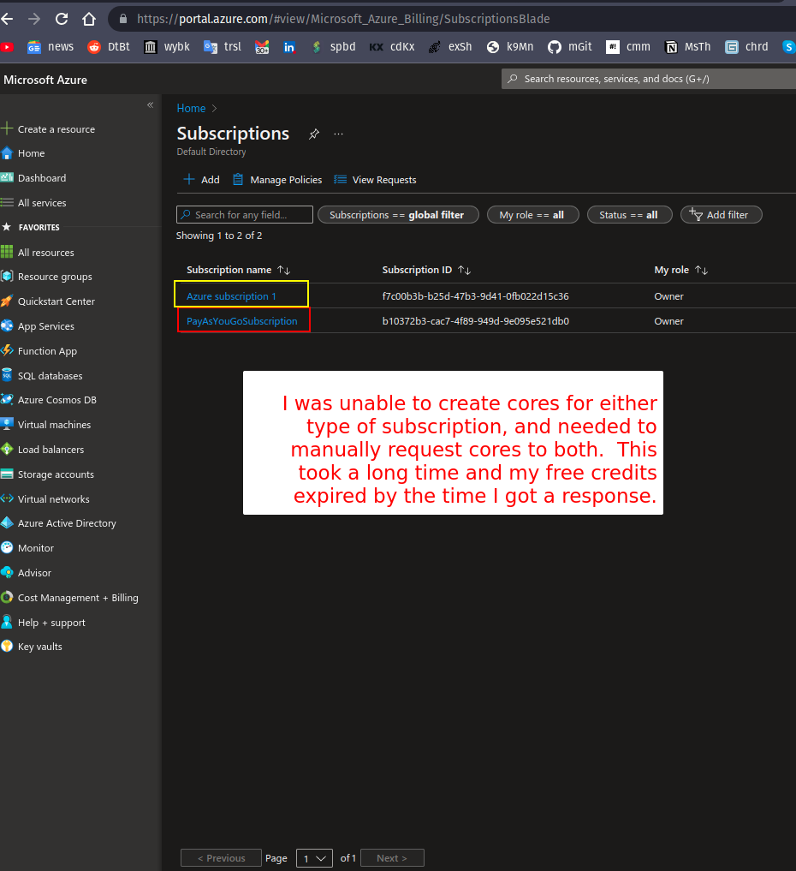
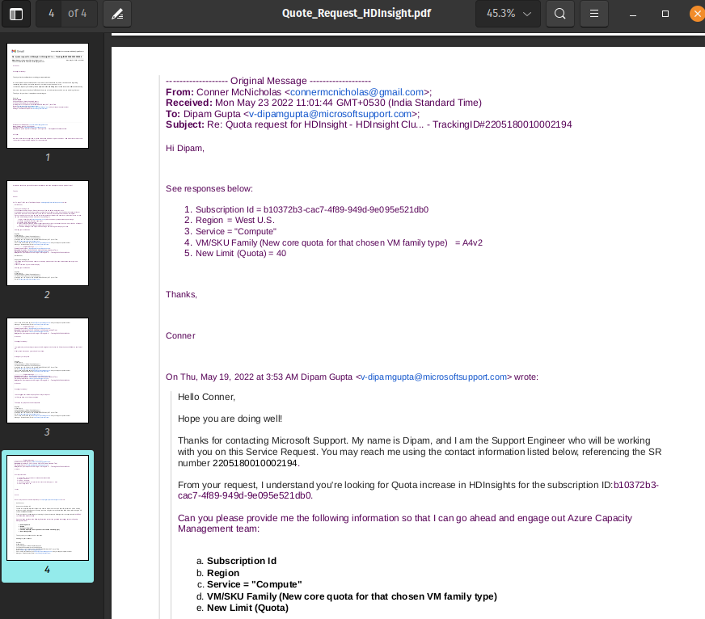
To prevent the creation unwanted manifest/log files/folders in the project directory, as well as enable max cpu threads, the Jupyter Notebook spark session was configured with the following parameters:
SparkConf().setMaster("local[*]").set('spark.driver.extraJavaOptions','-Dderby.system.home=/tmp/derby')

