Slide 1
Exploratory Data Analysis
Capstone Step 5

Slide 2
Choices Regarding Data Cleaning/Transformation
During prototyping I observed a few high level improvements possible via treating the raw data. Specific choices are annoted in screenshots on the subsequent slides.
1. Location file is entirely redundant and will be descoped.
2. A number of columns are redundant and will be removed after verifying the other locations offer equivalent data
3. A number of columns can be joined/consolidated
4. A number of columns can be converted from varchar to numerical type

Slide 3
Choices Regarding Pipeline Automation
The prototyping phase helped form the following approach to automation in order to achieve the optimal reliability:
1. To handle embedded commas within csv columns, use Linux csvkit’s csvcut tool from Python (cut and awk both have tremendous difficulty).
2 . Use sqlalchemy create_engine, pandas read_csv and dataframe.to_sql instead of looping through each row to execute mysql_connector_python insert statement. The latter fails in cases of NULL values.
3. Dot not declare any columns NOT NULL, and err on the side of caution with strings (TEXT instead of VARCHAR).
4. Delete files after processing to keep to manageable level.

Slide 4
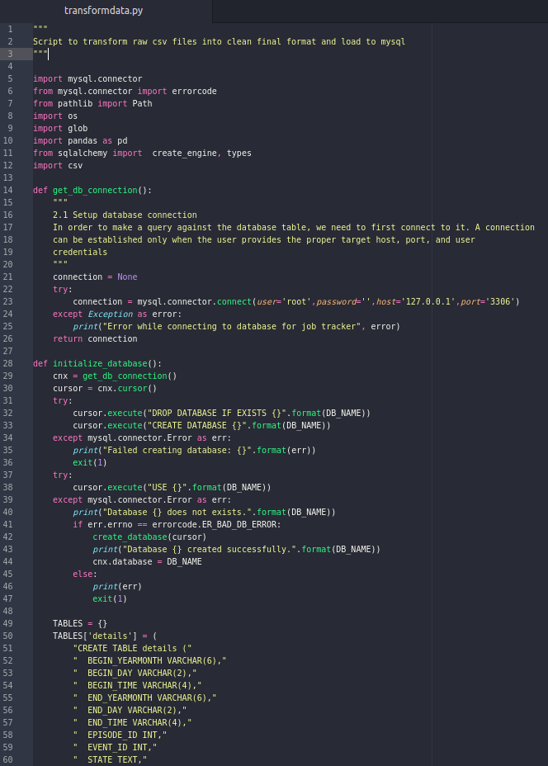
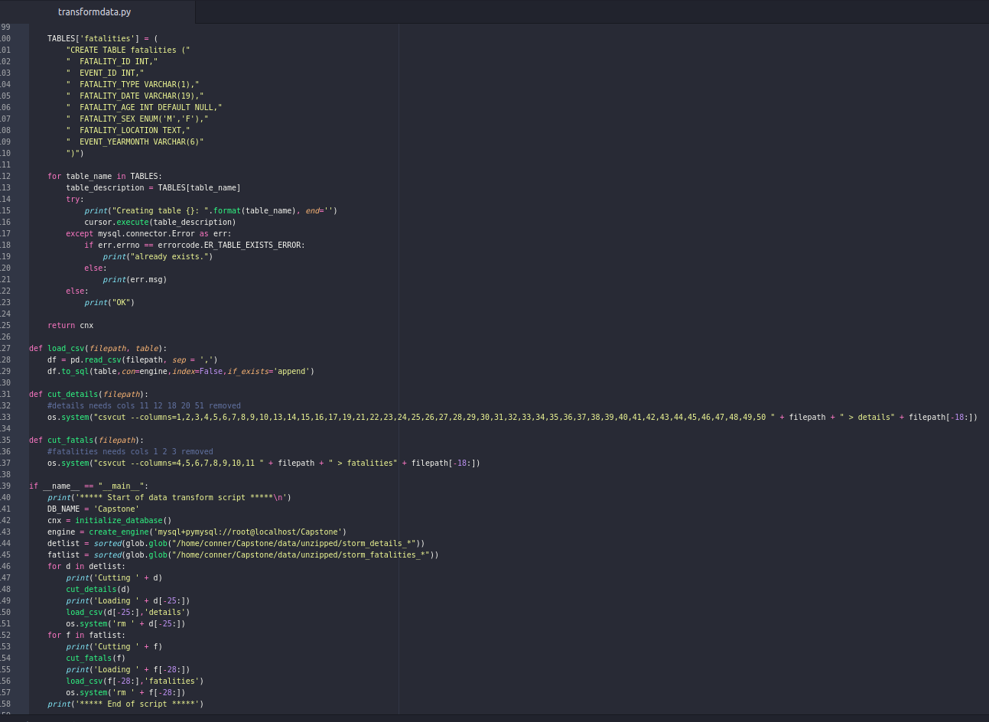
Pipeline Script: transformdata.py

Slide 5
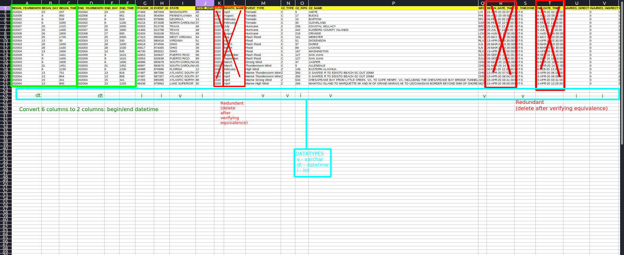
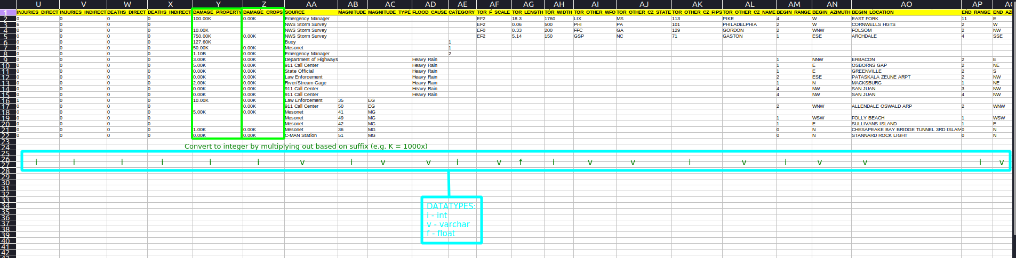
Details

Slide 6
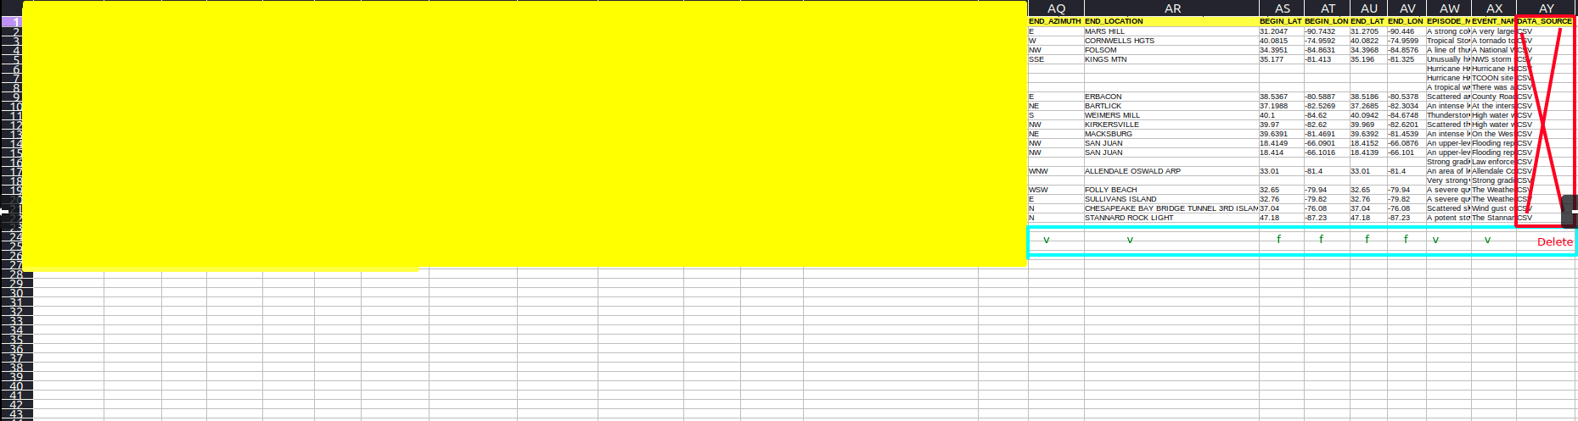
Details (cont)

Slide 7
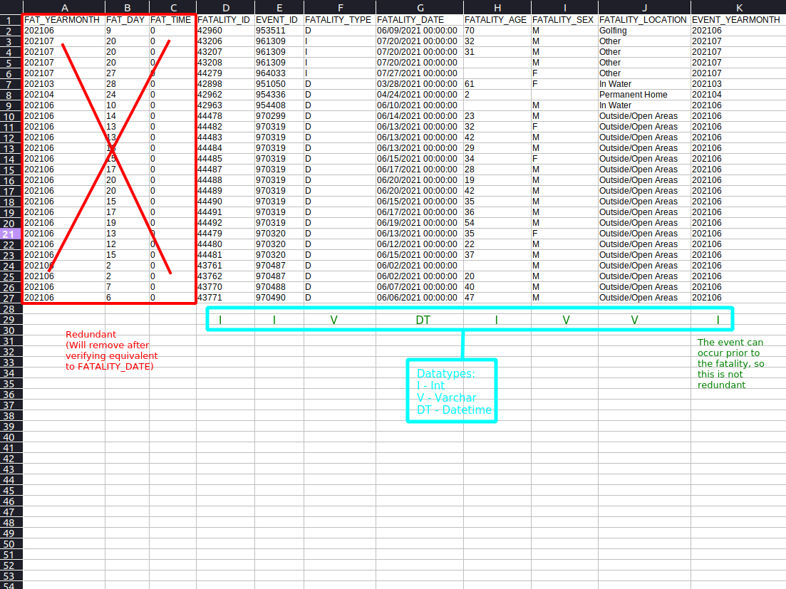
Fatalities

Slide 8
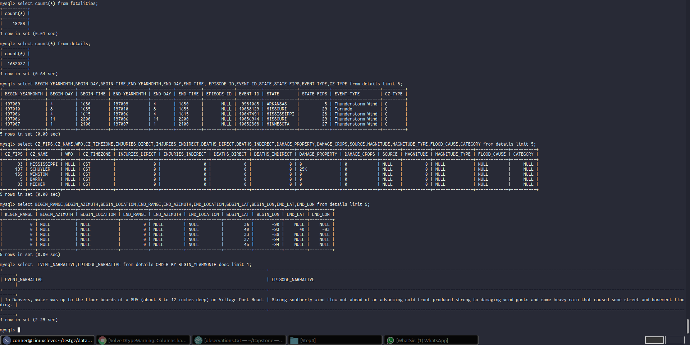
After running transform.py, both tables are fully populated in mysql:

Slide 9
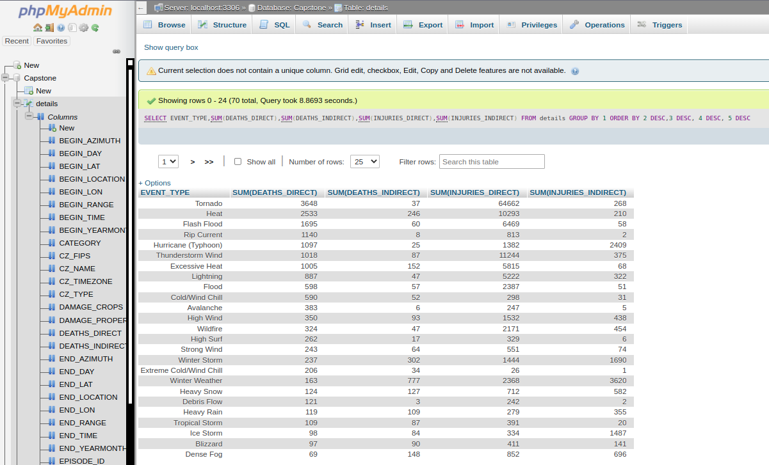
Data is returning meaningful queries for analysis:

