Slide 1
Deploy Code For Testing
Capstone Step 8

Slide 2
Process
There are 2 primary steps to this ETL:
1) Run python script to batch upload all files to Azure Data Lake containers:
python uploadtoblob.py 2000
2) Run pipelines in Azure Data Factory to copy data from blob input to MySQL table output
I wrote 4 test cases (2 tests x 2 tables - details + fatalities)
-1 test to verify that all available files from source have been uploaded to blob
-1 test to verify that every line from source files have been copied over to MySQL tables

Slide 3
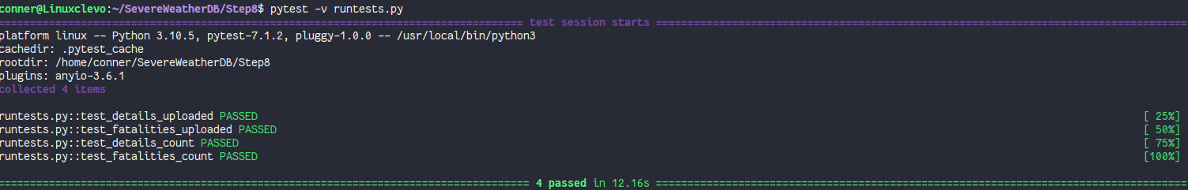
All Tests Pass

