Slide 1
Scaling The Prototype
Capstone Step 6

Slide 2
Process Updating ETL to Spark
This process was quite more involved than it had to be. The main steps of the approach included:
1. Attempting and ultimately failing to debug Azure Toolkit aztk.
This repository, prescribed by the project instructions, has become obsolete.
The technical details of the issues are documented in development_notes.txt
2. Opted to use Azure Databricks instead of aztk.
3. Created Azure Blob Storage Container
Uploaded data to blob container
Configured entitlements of new Databricks Cluster to read from blob container.
4. Created notebook pyspark_pipeline_nbook.ipynb in Databricks with Pyspark kernel to load data from Azure blob storage.
Translated code from Step 5 from Python to Pyspark.
Observed noticeable speed improvement from locally deployed python script.

Slide 3
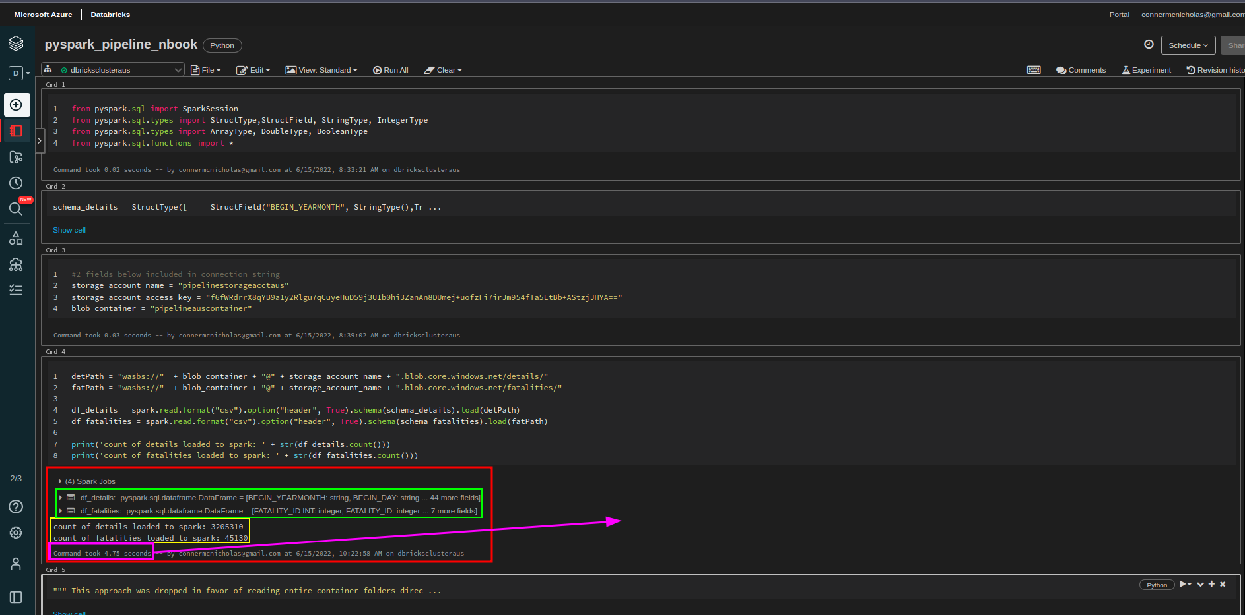
Databricks Spark Notebook
Nice performance gain!

