Slide 1
Create Deployment Architecture
Capstone Step 7

Slide 2
Decision Making Process
This process was fairly straightforward, as I now have experience using each of the tool required.
1. I did have to decide between using Apache Airflow vs Azure Data Factory for orchestration of ETL pipeline tasks
I chose Azure Data Factory because I knew it would ease any pain encountered when authenticating connections between services
2. I also was not sure if a standalone Azure Data Factory resource would be required, as Azure Synapse Analytics provides embedded pipeline resources
The work being done under the hood is still managed by Azure Data Factory, so it should be included in the diagram
3. I was unable to create a Microsoft Power BI resource without using an organization email account
Provisioning business intelligence software is overkill for my requirements, as the python library GeoViews supports geospatial visualization

Slide 3
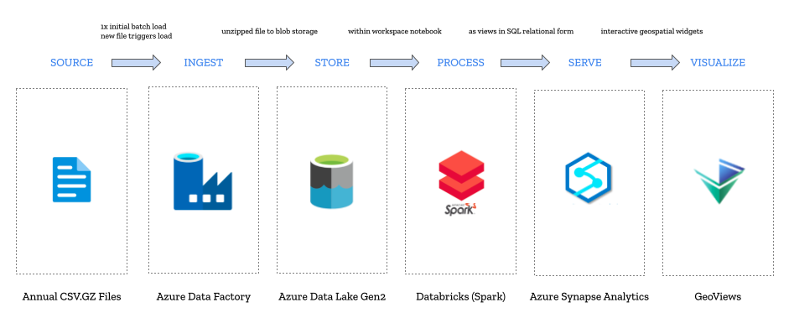
Final Architecture Diagram

Slide 4
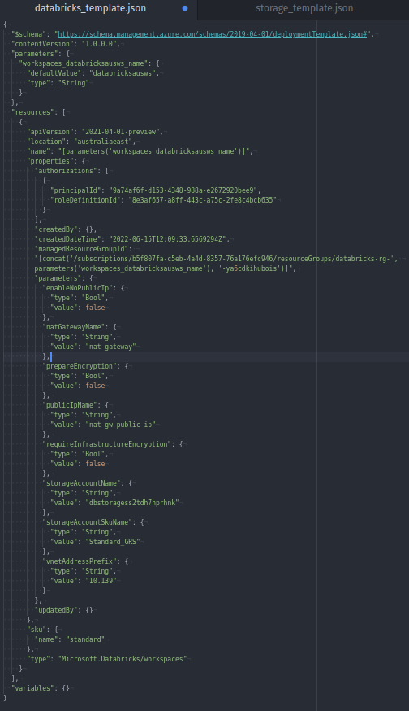
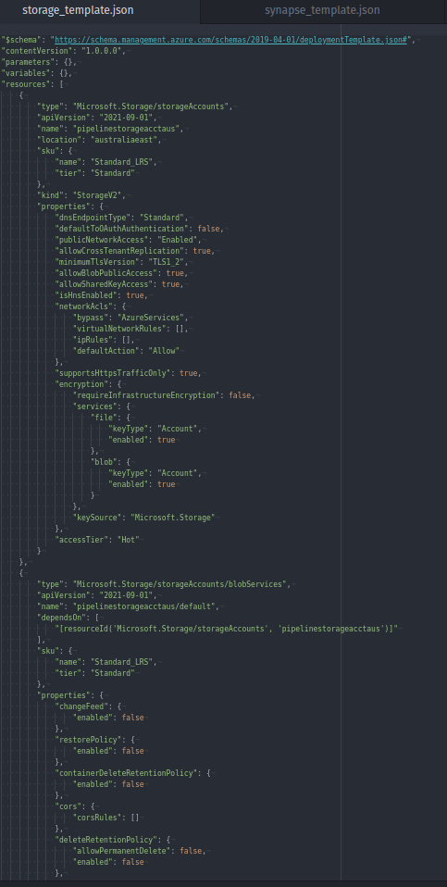
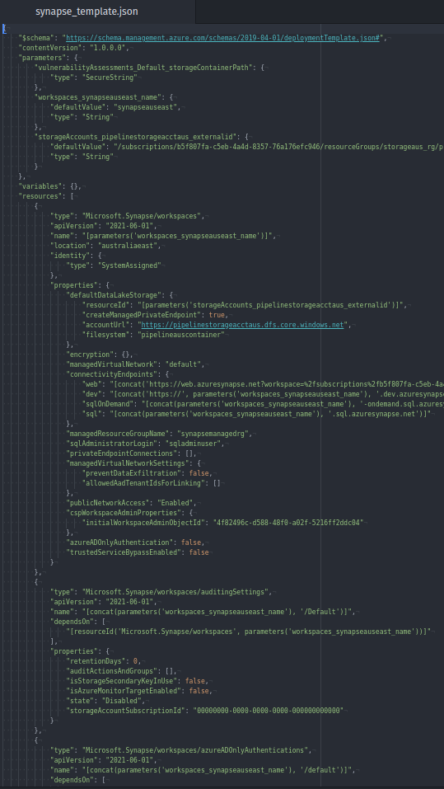
Resource Deployment Exports
The ability to deploy and export the resources was possible for all resources except Azure Data Factory, which lacks the feature.

