Slide 1
Deploy Code For Production
Capstone Step 9

Slide 2
Approach
Created Docker Container Packaging with Scripts to Deploy:
Azure Data Lake Gen2
Azure MySQL Database
Azure Databricks
Azure Data Factory (ADF)
Exported pipelines from ADF workspace as json configs

Slide 3
Decisions
First Attempted Coordinating Pipelines between Airflow and Azure Data Factory (ADF)
Connectors from Airflow to ADF were riddled with bugs
Then Attempted with ADF, using Batch jobs for processing data extract scripts:
Realized spinning up pools/jobs/tasks was overkill complexity for ETL
I actually did get this fully working before abandoning it entirely
Moved files to Step8/azurebatch_approach, as this could be considered failed testing
Finally settled on calling scripts using Databricks Python activity in ADF:
Possibly over-resourced, but future-proofs against later uncertainties

Slide 4
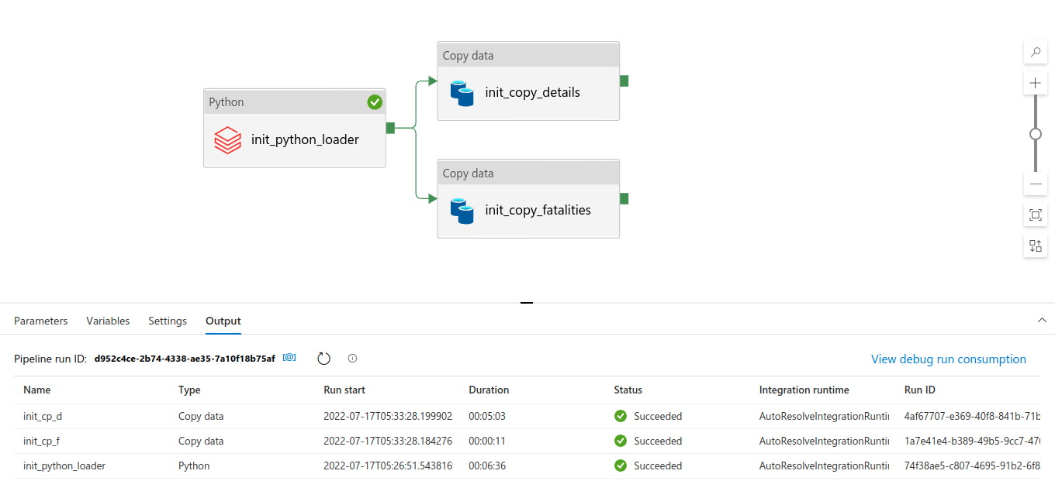
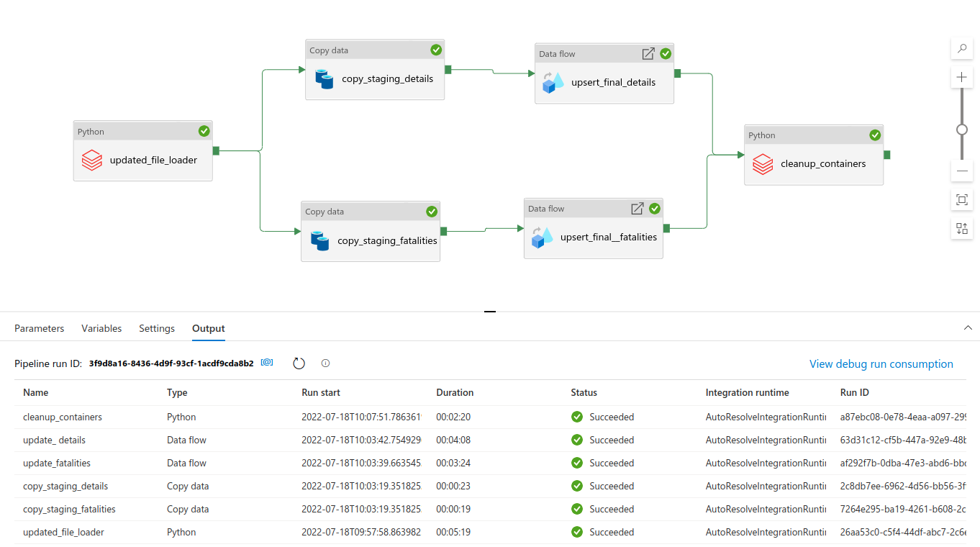
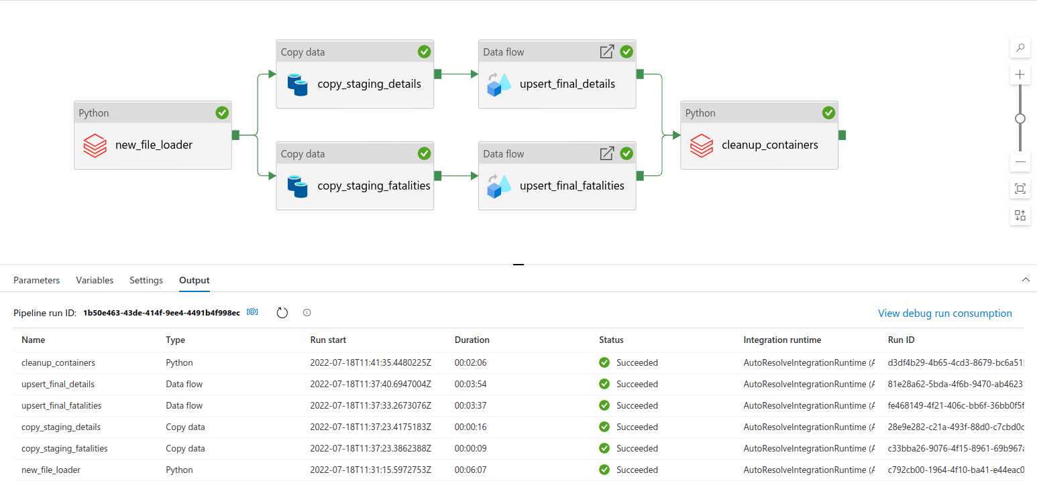
Azure Data Factory
Each pipeline tailored for different use case based on source data release cadence
Initial Load
Monthly Update
Yearly New

Slide 5


“Initial Load” Pipeline
Use Case: All details/fatalities csvgz files with post y2k data from ncei.noaa.gov severe weather data repo (source) require ETL to MySQL
(ignores files with year of record < 2000, and all “location” files as it is entirely redundant with “details” files)
Databricks Python Activity:
run: initial_files_to_blob.py
extract: all csvgz files on source url with date of record > 2000
from: source url
to: data lake “allfiles” container
Copy Data Activity
copy: new 2022 csvgz file
from: data lake “newfiles” container
to: mysql staging table
*parallel activities configured for details/fatalities schemas
Trigger
Now!

Slide 6

“Monthly Update” Pipeline
Use Case: 16th of each month, ncei.noaa.gov severe weather data repo (source) drops updated csvgz file for current year+month with recent data appended and requiring ETL.
Copy Data Activity
copy: all data from updated 2022 csvgz file
from: data lake “newfiles” container
to: mysql staging table
Data Flow Activity
insert: only new rows based on primary key
from: mysql staging table
to: mysql final table
Databricks Python Activity
run: clean_newfile_container.py
delete old 2022 files
from: “allfiles” container
copy updated 2022 files
from: “newfiles” container
to: “allfiles” container
delete updated 2022 files
from: “newfiles” container
Databricks Python Activity:
run: updated_file_to_blob.py
if: source url’s 2022 file shows modification since last ETL
then: extract updated 2022 csv.gz file
from: source url
to: data lake “newfiles” container
*parallel activity sequences configured for details/fatalities schemas
Trigger
schedule: @monthly on 17th

Slide 7
“Yearly New” Pipeline
Use Case: May 16th of each year, ncei.noaa.gov severe weather data repo (source) drops new csvgz file with fresh January data of that year requiring ETL.
(it takes 65 days for severe weather event data to be recorded, submitted, and published)
Databricks Python Activity:
run: new_file_to_blob.py
if: source url has dropped a new filename for new year
then: extract 2022 csv.gz file
from: source url
to: data lake “newfiles” container
Copy Data Activity
copy: all data from new year csvgz file
from: data lake “newfiles” container
to: mysql staging table
Data Flow Activity
insert: new rows based on primary key (equates to all)
from: mysql staging table
to: mysql final table
Databricks Python Activity
run: clean_newfile_container.py
delete old 2022 files
from: “allfiles” container
copy new 2022 files
from: “newfiles” container
to: “allfiles” container
delete new 2022 files
from: “newfiles” container
*parallel activity sequences configured for details/fatalities schemas
Trigger
schedule: @annually on May 17th

Slide 8
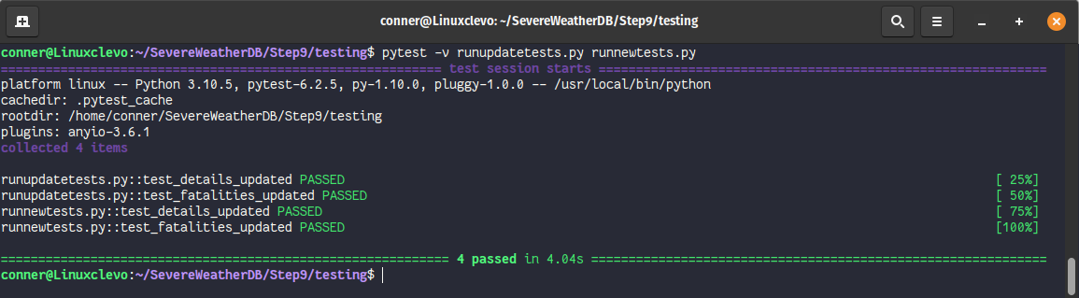
Testing Full Pipelines
I had already vetted the basic ingestion in Step 8 tests
This final deployment added tests for all edge cases and iterative updates

