Slide 1
Exploratory Data Analysis
Capstone Step 4

Slide 2
Document Purpose
This document serves as a high level overview of the process by which this Capstone project was carried out.
It tells the story of how I will arrive at the final state in a way that any engineer could follow.

Slide 3
Insights of Exploratory Data Analysis
The Storm Events Database contains the records used to create the official NOAA Storm Data publication, documenting:
The occurrence of storms and other significant weather phenomena having sufficient intensity to cause loss of life, injuries, significant property damage, and/or disruption to commerce;
Rare, unusual, weather phenomena that generate media attention, such as snow flurries in South Florida or the San Diego coastal area; and
Other significant meteorological events, such as record maximum or minimum temperatures or precipitation that occur in connection with another event.
The database currently contains data from January 1950 to November 2021, as entered by NOAA's National Weather Service (NWS). Due to changes in the data collection and processing procedures over time, there are unique periods of record available depending on the event type. NCEI has performed data reformatting and standardization of event types but has not changed any data values for locations, fatalities, injuries, damage, narratives and any other event specific information.
The source data exists as CSVs which have been created since 1950 until present:
storm_details_*.csv
storm_locations_*.csv
storm_fatalities_*.csv
Each has an EVENT_ID column available.
The details/locations data also have an EPISODE_ID
The fatalities data has FATALITY_ID

Slide 4
Insights of Exploratory Data Analysis
The Storm Events Database contains the records used to create the official NOAA Storm Data publication, documenting:
The occurrence of storms and other significant weather phenomena having sufficient intensity to cause loss of life, injuries, significant property damage, and/or disruption to commerce;
Rare, unusual, weather phenomena that generate media attention, such as snow flurries in South Florida or the San Diego coastal area; and
Other significant meteorological events, such as record maximum or minimum temperatures or precipitation that occur in connection with another event.
The database currently contains data from January 1950 to November 2021, as entered by NOAA's National Weather Service (NWS). Due to changes in the data collection and processing procedures over time, there are unique periods of record available depending on the event type. NCEI has performed data reformatting and standardization of event types but has not changed any data values for locations, fatalities, injuries, damage, narratives and any other event specific information.
The source data exists as CSVs which have been created since 1950 until present:
storm_details_*.csv
storm_locations_*.csv
storm_fatalities_*.csv
Each has an EVENT_ID column available.
The details/locations data also have an EPISODE_ID
The fatalities data has FATALITY_ID
event_id is unique for each row in details
every fatality has an event_id match in detail
those have repeated values, so the distinct subset is less
some fatalities have an event_id match in location
those have repeated values, so the distinct subset is less
every location has an event_id match in detail
those have repeated values, so the distinct subset is less
some locations have an event_id match in fatality
those have repeated values, so the distinct subset is less

Slide 5
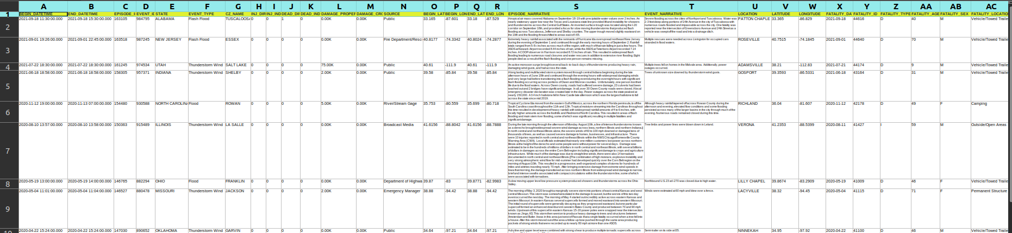
Visuals
Total row count of details: 1680127
Total row count of locations: 1387001
Total row count of fatalities: 19133
I created a csv of a random sample of 10 records from the result of joining all 3 sets together, selecting a subset of critical columns, concatening columns and casting from strings to more suitable datatypes, and filtering to only non-null rows: randfull.csv

Slide 6
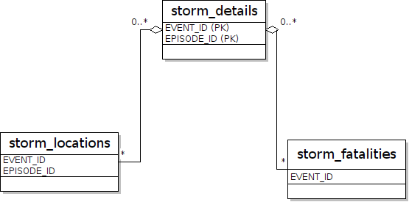
ERD Diagram

