Slide 1
Build Monitoring Dashboard
Capstone Step 10

Slide 2
Process
Followed guide from Microsoft and created 2 custom dashes:
MySQL Database Server Monitor
Data Lake Gen2 Blob Storage Container Monitor

Slide 3
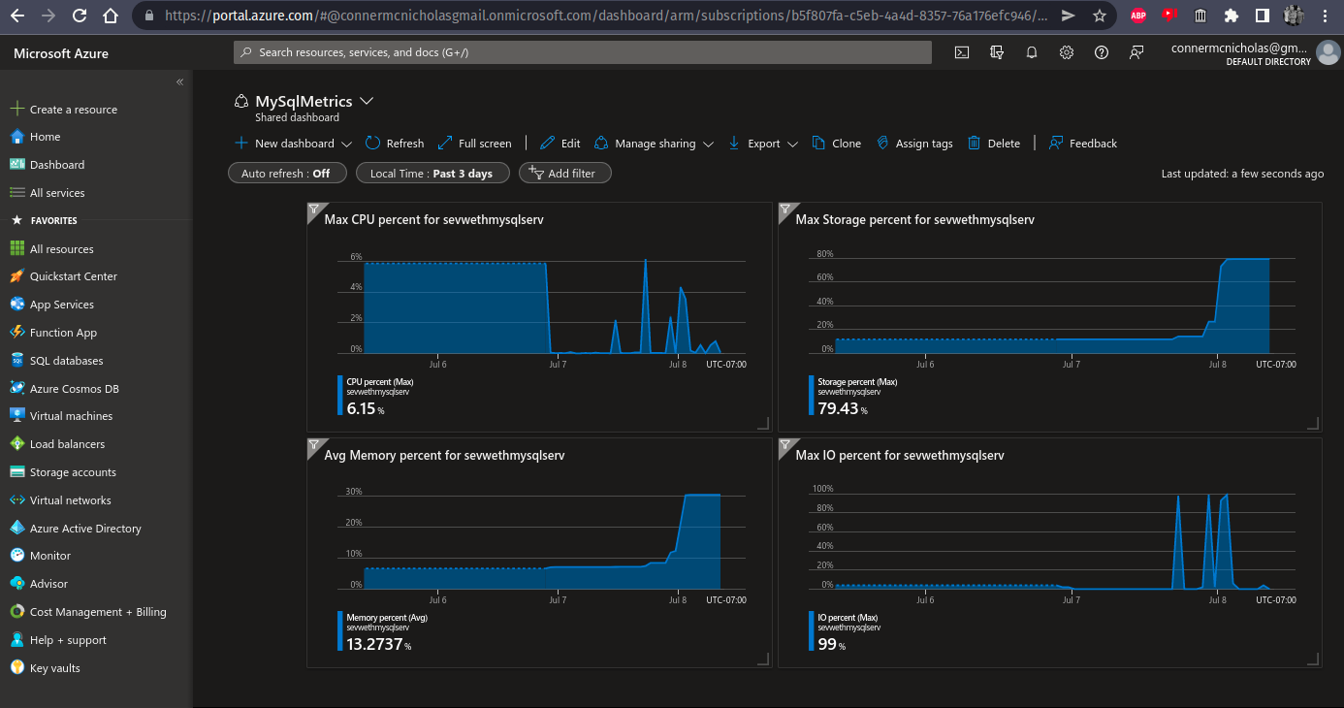

Slide 4
