Slide 1
CSCI480 Layered IDS/IPS
Multi-Model Intrusion Detection and Prevention System
Senior Capstone Project

Slide 2
Problem Statement & Motivation
Cybersecurity threats are increasingly sophisticated and automated
Traditional signature-based IDS cannot detect zero-day attacks
Network administrators need real-time threat detection and automated response
Organizations require layered defense with multiple detection models
Need for active prevention capabilities beyond passive monitoring
Growing volume of network traffic requires automated analysis

Slide 3
Key Features & Functionality
Live packet capture with real-time analysis
Layered ML detection using 7 different models
Active prevention and healing via firewall rules
Real attack simulation for testing
PCAP replay and upload for forensic analysis
Real-time dashboard with visualization
Adaptive decoy deployment for threat deception
Windows packaging for easy deployment

Slide 4
System Architecture
Left Column:
Backend (Flask API)
- Packet capture engine (Scapy)
- ML model inference pipeline
- Prevention/healing logic
- Attack simulator
- Decoy manager
Right Column:
Frontend (Dashboard UI)
- Real-time traffic visualization
- Alert management interface
- Defense controls
- PCAP analysis tools
- Results export

Slide 5
Technologies Used
Left Column:
Backend Frameworks
- Flask (Python web framework)
- Flask-CORS (cross-origin)
- Scapy (packet capture)
- psutil (system monitoring)
Right Column:
ML & Data Science
- PyTorch (deep learning)
- scikit-learn (ML models)
- NumPy & Pandas (data)
- 7 ML models: AE, IsoForest, KMeans, RF, GNN, PPO, GBDT

Slide 6
ML Models Overview
AutoEncoder (Unsupervised) - Anomaly detection via reconstruction error
IsolationForest (Unsupervised) - Isolates anomalies using random partitioning
KMeans (Unsupervised) - Clustering-based anomaly detection
RandomForest (Supervised) - Multi-class attack classification
GradientBoosting (Supervised) - Ensemble decision trees
Graph Neural Network (Deep Learning) - Flow pattern analysis
PPO (Reinforcement Learning) - Adaptive response policy

Slide 7
Key Challenges & Solutions
Left Column:
Challenge: Real-time packet capture
Solution: Batched capture with Scapy, async processing
Challenge: ML model integration
Solution: Unified prediction API with feature scaling
Challenge: Windows firewall integration
Right Column:
Solution: PowerShell-based firewall rule management
Challenge: False positive reduction
Solution: Ensemble voting with risk ranking
Challenge: Deployment complexity
Solution: PyInstaller packaging with Inno Setup installer

Slide 8
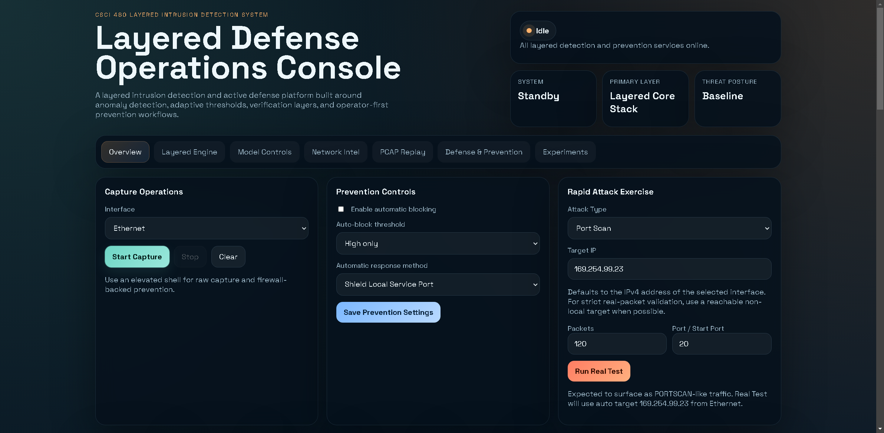

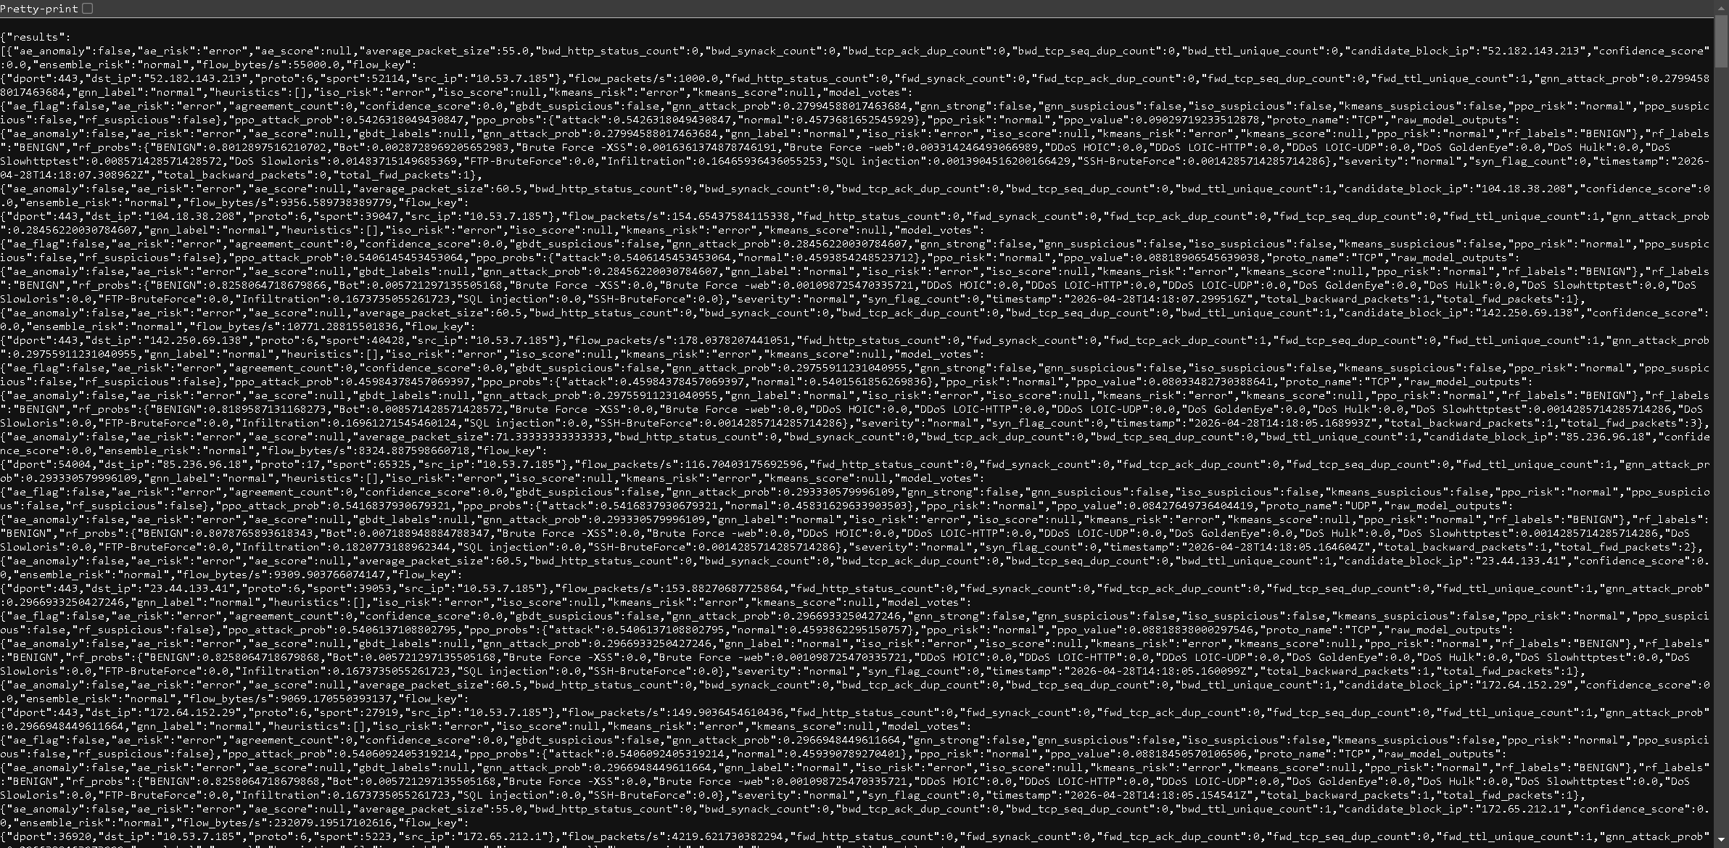
Application Screenshots
Dashboard Overview
Main UI
Live Results
Defense & Prevention
PCAP Replay
Model Settings

Slide 9
What Makes This Project Unique
Layered detection with 7 complementary ML models
Active prevention capabilities (firewall blocking, decoy deployment)
Real-time attack simulation for testing
PCAP replay for forensic analysis
Windows-native packaging for easy deployment
Adaptive response using reinforcement learning
Comprehensive dashboard with real-time visualization

Slide 10
Future Improvements
Add user authentication and role-based access control
Implement feedback loop for adaptive model learning
Expand ML model ensemble with additional architectures
Add mobile app for remote monitoring
Integrate with SIEM systems
Implement distributed deployment for enterprise networks
Add threat intelligence feed integration

Slide 11
Live Demo Overview
1. Launch the application and access dashboard at http://127.0.0.1:5000
2. Select network interface for packet capture
3. Start live capture and observe real-time analysis
4. View results table with model predictions and risk scores
5. Demonstrate attack simulation capabilities
6. Show prevention/healing actions (firewall blocking)
7. Upload and analyze PCAP files
8. Export results for further analysis

Slide 12
Thank You
Questions?
CSCI480 Layered IDS/IPS Team

