Slide 1
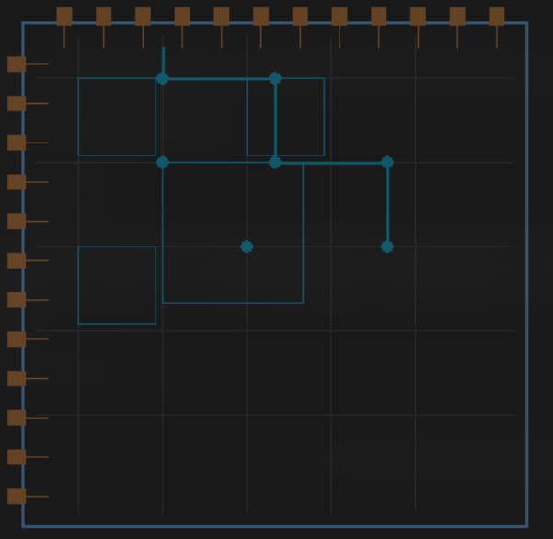
1 / 10
Scan-Based Procedural Fragment Shader ASIC
Scan-Based Procedural Fragment Shader ASIC
Image Processing with Tiny Tapeout
Conner Daehler · ECE 429 · Tiny Tapeout
Notes:
Welcome everyone. Today I'll be presenting my Tiny Tapeout project: a scan-based procedural fragment shader implemented as a real ASIC. This is a hardware-only image processing chip — no CPU involved. I'll walk through the motivation, architecture, results, and lessons learned. Let's get started.

Slide 2

2 / 10
Scan-Based Procedural Fragment Shader ASIC
Overview & Purpose
🎯 Goal
⚡ Platform
🔧 Approach
Design a procedural graphics ASIC that applies image processing to an input image, without a CPU (only hardware).
Built for Tiny Tapeout — a community chip-sharing platform that lets people tape out real silicon designs affordably.
Implemented in Verilog. A top-level module exposes 8-bit pixel input and 8-bit pixel output, with control pins for mode, freeze, and invert.
Notes:
The core goal was to design a procedural graphics chip that applies lighting and shading to an image entirely in hardware. We used Tiny Tapeout, which is a community chip-sharing platform that makes real silicon tape-outs affordable. The design is written in Verilog, with an 8-bit pixel input, 8-bit pixel output, and hardware pins for mode, freeze, and invert control. No software, no CPU.

Slide 3
3 / 10
Scan-Based Procedural Fragment Shader ASIC
System Flow
Test Image
Generator
cocotb
Testbench
Top Module
tt_um_connerdaehler
Procedural
Graphics Core
Output
Frames
256×256 synthetic
scene (Python)
Drives clk, rst_n,
mode, pixel in
Routes control pins
to graphics core
Per-pixel distance
field + lighting math
PNG saved per mode
(mode0–mode3)
Control pins: MODE[1:0] | FREEZE | INVERT → all driven via ui_in[3:0]
Clock: 10 MHz · Language: Verilog · Tile: 1×2
Notes:
This slide shows the full simulation pipeline. We start with a synthetic 256x256 test image generated in Python, then drive that through a cocotb testbench which controls the clock, reset, mode, and pixel inputs. The top-level Verilog module routes control signals to the procedural graphics core, which computes per-pixel distance fields and lighting math. The output is saved as PNG frames for each mode. The chip runs at 10 MHz and fits within a 1x2 Tiny Tapeout tile.

Slide 4
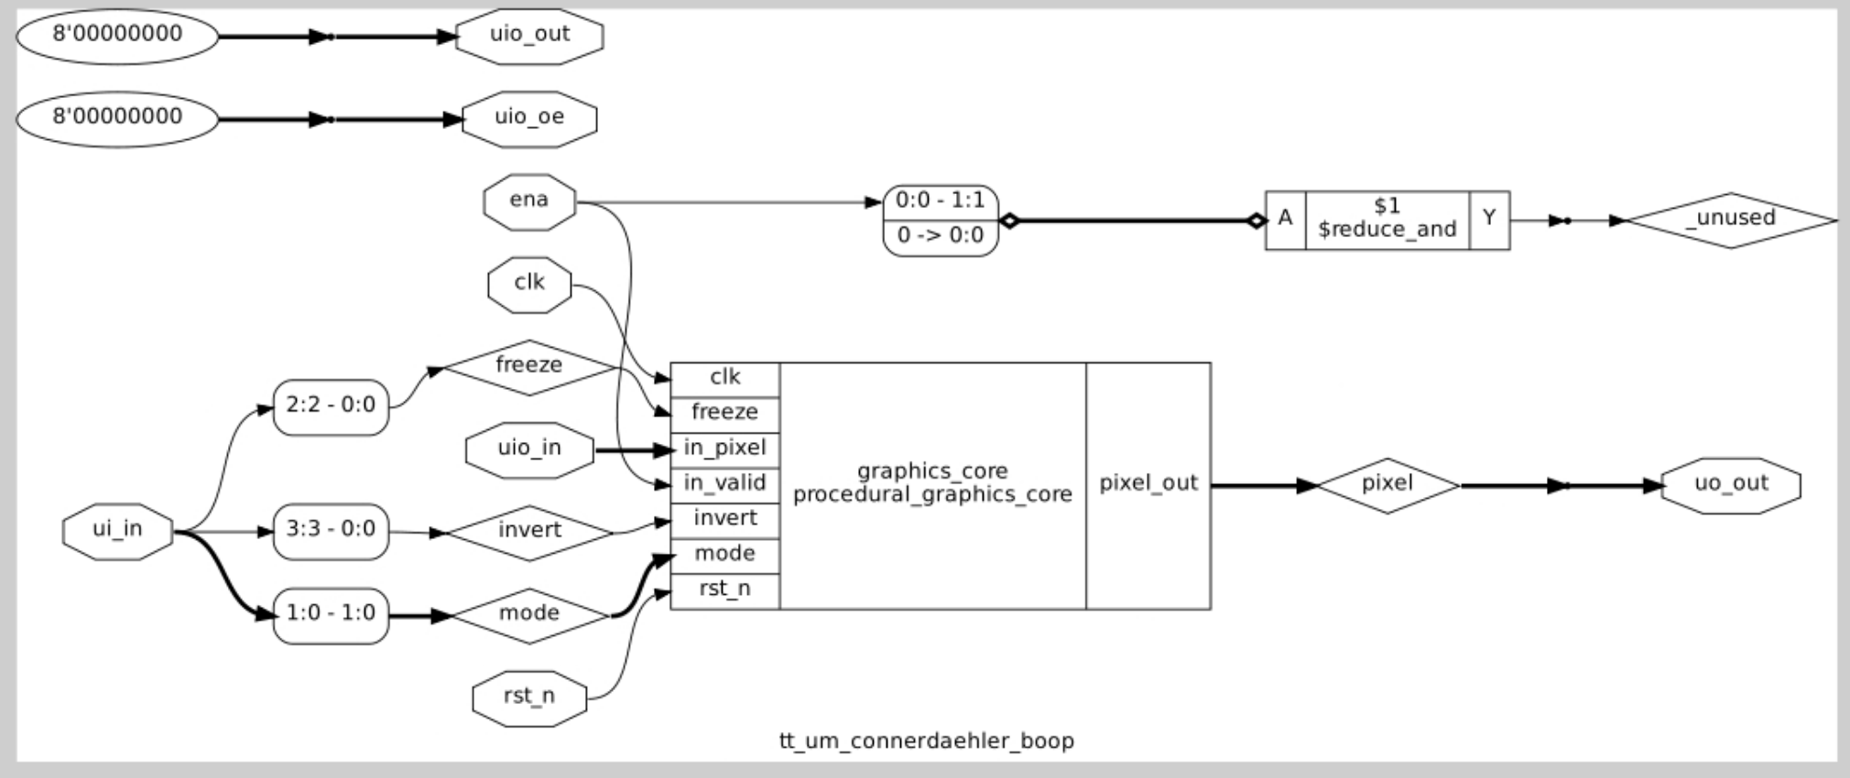
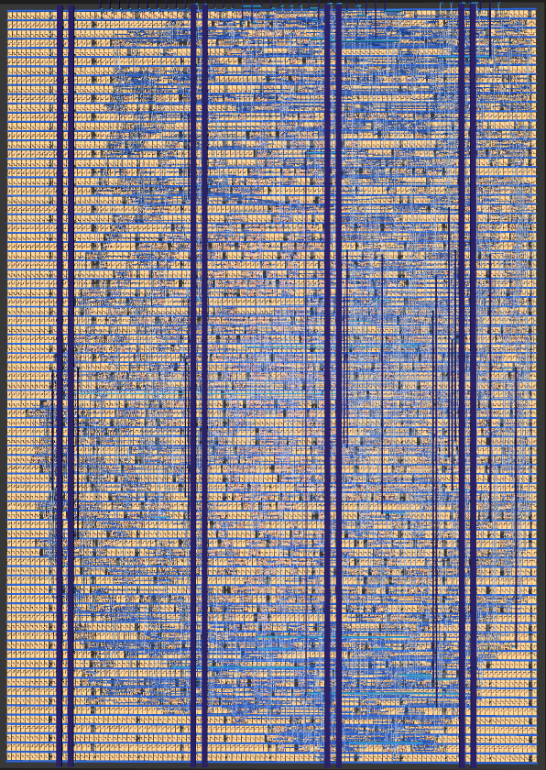
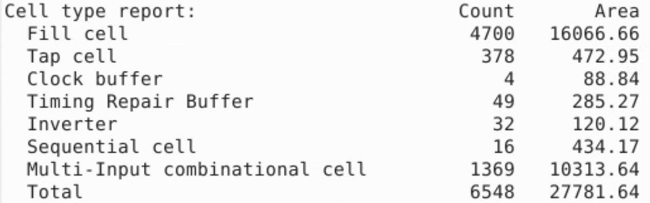
4 / 10
Scan-Based Procedural Fragment Shader ASIC
Sky130A Outputs
Notes:
Here you can see the actual synthesized Sky130A layout output from the design. These images represent the physical chip layout produced after running the Verilog through the OpenLane toolchain targeting the SkyWater 130nm process. This is what gets sent off for fabrication on a real silicon die.

Slide 5
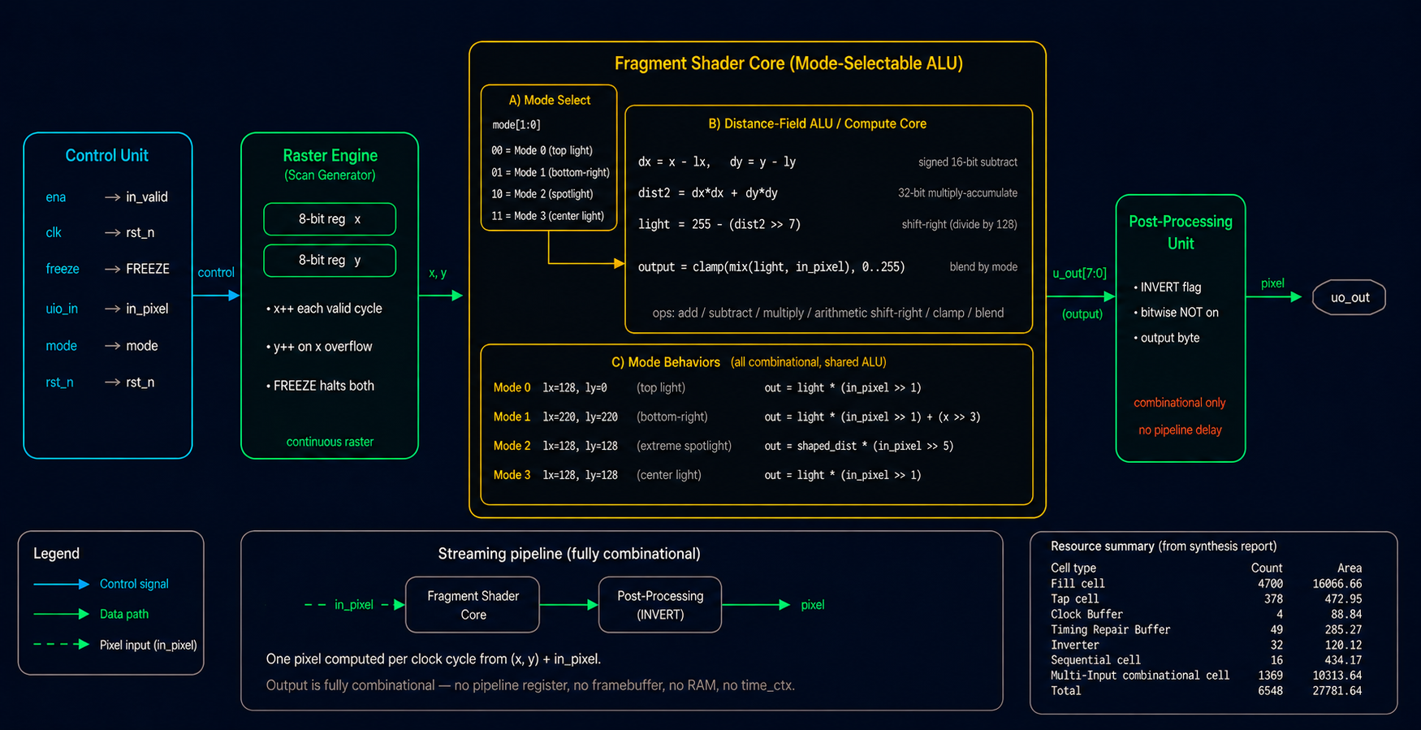
5 / 10
Scan-Based Procedural Fragment Shader ASIC
Architecture Block Diagram
Scan-based procedural fragment shader · largely combinational · no CPU · 10 MHz clock
clk
Notes:
This is the architecture of the graphics core. The design is largely combinational — meaning most computations happen in a single clock cycle without requiring registers or state machines. The per-pixel lighting math computes distance fields from the light source using only integer arithmetic, keeping the logic compact and fast. The 10 MHz clock is more than sufficient given the combinational nature of the pipeline.

Slide 6



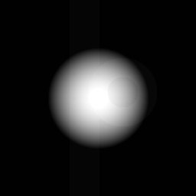

6 / 10
Scan-Based Procedural Fragment Shader ASIC
Results
Input
Mode 0 — Top Light
Mode 1 — Bottom-Right Light
Mode 2 — Extreme Spotlight
Mode 3 — Center
Notes:
Here are the four output modes running on the synthetic test image. Mode 0 applies a top-down lighting effect. Mode 1 shifts the light source to the bottom-right. Mode 2 applies an extreme spotlight effect with a very tight falloff. Mode 3 centers the light source in the middle of the image. Each mode is controlled purely through the hardware pins — no firmware required.

Slide 7



7 / 10
Scan-Based Procedural Fragment Shader ASIC
Photo Input
Input Image
Greyscale Input Image
Output Image from Mode 0
Notes:
To further validate the design, we also tested it on a real photo input rather than the synthetic scene. The left image shows the original color input, the center shows the greyscale conversion fed into the chip, and the right shows the Mode 0 output with the top-down lighting applied. The hardware processes real image data correctly, confirming the design works beyond just synthetic test cases.

Slide 8
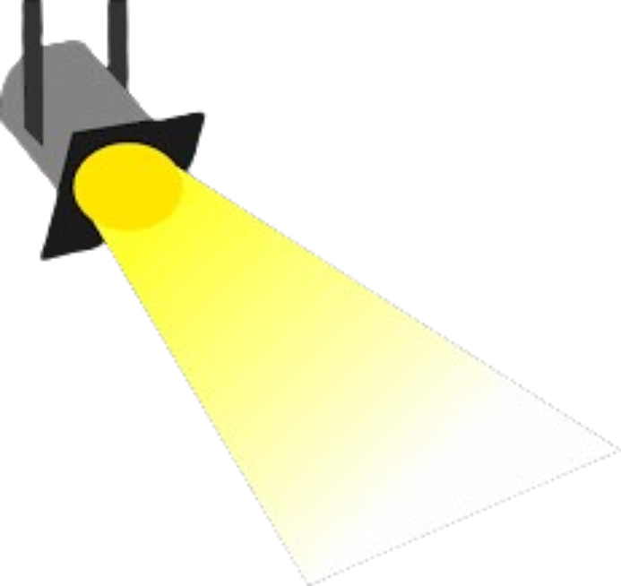
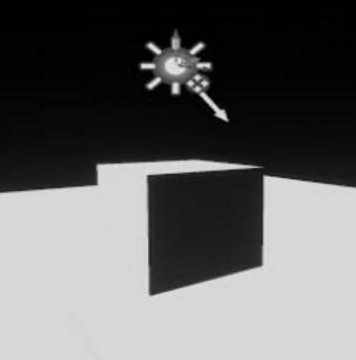
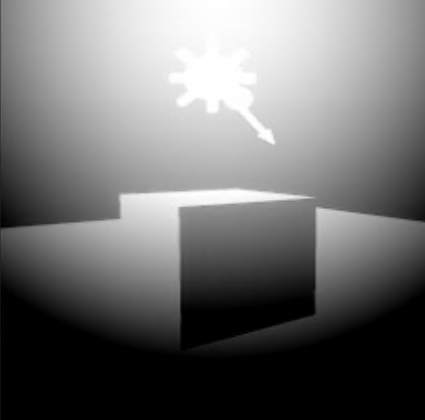

8 / 10
Scan-Based Procedural Fragment Shader ASIC
Shortcoming of Model
No Raytracing
No implementation of ray tracing for shading
No Shadows
Shading is a function of distance from the source, does not actually consider object itself
y
Only 2D
x
Design only utilizes X-Y coordinates, cannot handle isometrics.
Input Image
Greyscale Input Image
Notes:
Let's be honest about the limitations. First, the design only operates in 2D — it uses X and Y pixel coordinates and cannot handle isometric or 3D geometry. Second, there is no ray tracing; shadows are not simulated. Third, the shading is purely a function of distance from the light source and does not account for the shape or surface normal of objects. These are expected constraints of a compact ASIC targeting a single Tiny Tapeout tile.

Slide 9
9 / 10
Scan-Based Procedural Fragment Shader ASIC
Conclusions
✅
Successfully implemented a real-time procedural lighting engine in Verilog targeting actual silicon via Tiny Tapeout.
🎛️
Achieved multiple real-time lighting and shading modes controlled directly through hardware pins, enabling fully autonomous operation without CPU or software intervention.
📐
Demonstrated distance-field and lighting computations entirely with integer arithmetic, showing the feasibility of compact ASIC-based procedural graphics hardware.
🚀
Mimics selected GPU fragment-stage behaviors such as per-pixel lighting and procedural shading, while not implementing full geometric rasterization or a complete graphics pipeline
Notes:
To wrap up: we successfully implemented a real-time procedural lighting engine in Verilog that will tape out on real silicon. We achieved multiple hardware-controlled lighting modes with no CPU involvement. The design proves that integer arithmetic alone is sufficient for compact ASIC-based procedural graphics. And while it doesn't implement a full GPU pipeline, it successfully mimics key fragment-stage behaviors like per-pixel lighting and procedural shading.

Slide 10
10 / 10
Scan-Based Procedural Fragment Shader ASIC
Thank You!
Any Questions?
💻 github: https://connerdaehler-boop/
Notes:
That concludes the presentation. Thank you for your time. I'm happy to take any questions about the design, the Tiny Tapeout platform, or the implementation details. You can also find the full source code and documentation on my GitHub at connerdaehler-boop.

