Slide 1
Sarah’s Allston Investment: Maximizing ROI
All good in Allston
By Conner, Jacob, and Moi
Notes:
Thank you…
Names

Slide 2
Profile & Investigation Overview
Client Overview:
Sarah
Located in Buffalo, NY
Home in Allston, MA
Nursing Student
Looking to maximize ROI of investment property
Questions to Investigate:
Do short-term Airbnb rentals or long term lease agreements provide a better ROI?
With the better option in mind, what steps can we take to maximize the cost?
Notes:
Sarah, we appreciate your business
Compiled & analyzed a few different data sources to help build a thoughtful recommendation
Before we get into that - To recap your situation & goals:
Hypothesized AirBnB would be a better option

Slide 3
Sarah’s Goals - Summarized
ROI
Time Investment
Verbal Addition: Check in with subject and confirm

Slide 4
Legislation & Other Assumptions
Legislation:
Boston heavily regulates Airbnb
Registration Fees
Local Contact
Other Assumptions:
Property Management
Utilities
Airbnb Occupancy Rate
Notes:
Came across some legislative roadblocks to consider, as well as assumptions we had to make:
Legislation:
COB heavily regulates AirBnB market
Other:
Property mgmt - necessary due to distance from Buffalo & AirBnB regulations
Utilities - Sarah would cover the cost of utilities for AirBnB, not for a lease agreement
AirBnB Occupancy Rate

Slide 5
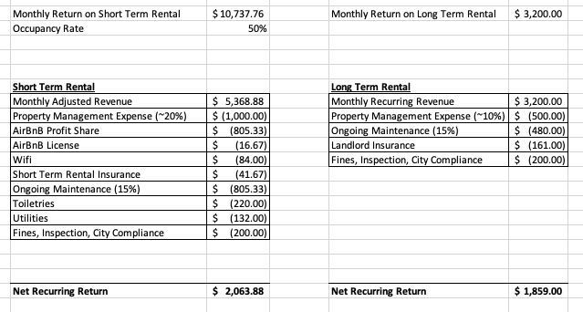
Short Term vs Long Term - the Math
Notes:
Profiled the data
Found what people with similar amenities were charging per night
Assumed a 50% occupancy rate
Added in the fees we researched

Slide 6
Cost & Benefits
Cost Difference of $204 for Short-Term
Let’s look at the benefits of Long-Term
Less vacancy risk
Less regulation from both city of Boston and Airbnb
Difference in how the home is treated
Time investment - less with leasing
Recommendation: Long Term Leasing
Notes:
Paint a story here - spending time and energy stressing over constant rentals vs working with a single tenant and having a property manager handle all issues

Slide 7
How Can We Maximize the Value of the Long Term Lease?

Slide 8
Maximizing Lease Price - How Can We Investigate?
Data for private homes in Allston
Filtered for listing allowing stays of > 365 days
Compare the correlation of specific amenities to the price

Slide 9
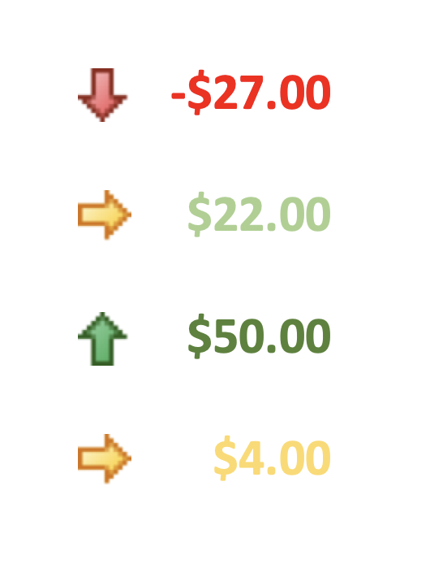
Amenities to Investigate:
A/C -
Parking -
Wifi -
Laundry -
*Verbally stated: these data demonstrate a correlation to higher rent prices with the inclusion of these amenities, not a direct dollar value increase/decrease*
* Associated change in nightly rental price for Allston listings allowing stays over 365 days *
Notes:
AC - associated with a $27 decrease in nightly cost
Job is not to explain correlation, but to share that there is insufficient evidence to support installing A/C in your home
Parking - associated with a modest $22 increase in nightly avg cost
Wifi - biggest increase, associated with a $50/night increase in nightly cost

Slide 10
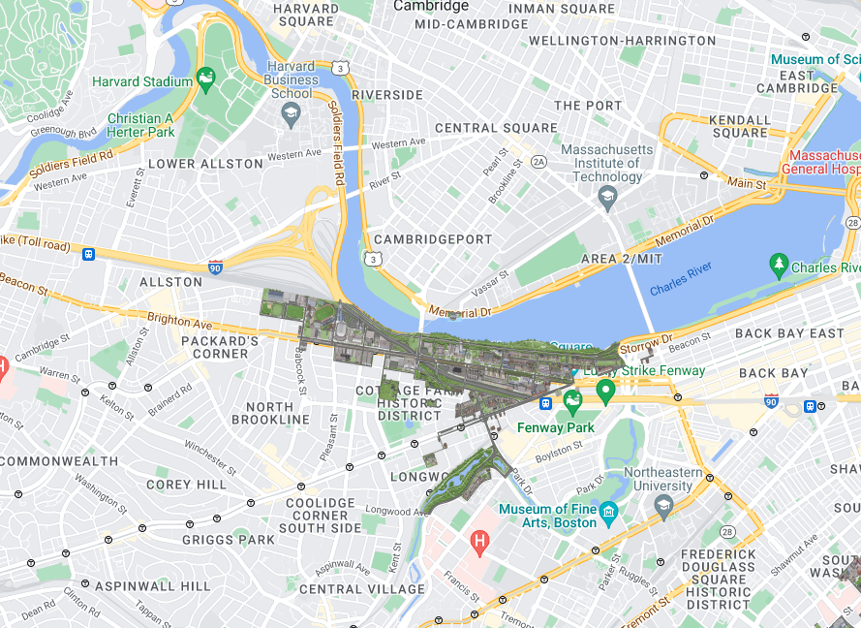
Additional Leasing Option - Boston University
Average 2 Bedroom Rent for Boston University Off-Campus Housing*:
$3,500
Monthly net Increase from non-student housing:
$300
Allston
BU Campus
*https://www.zumper.com/rent-research/near-boston-university-ma

Slide 11
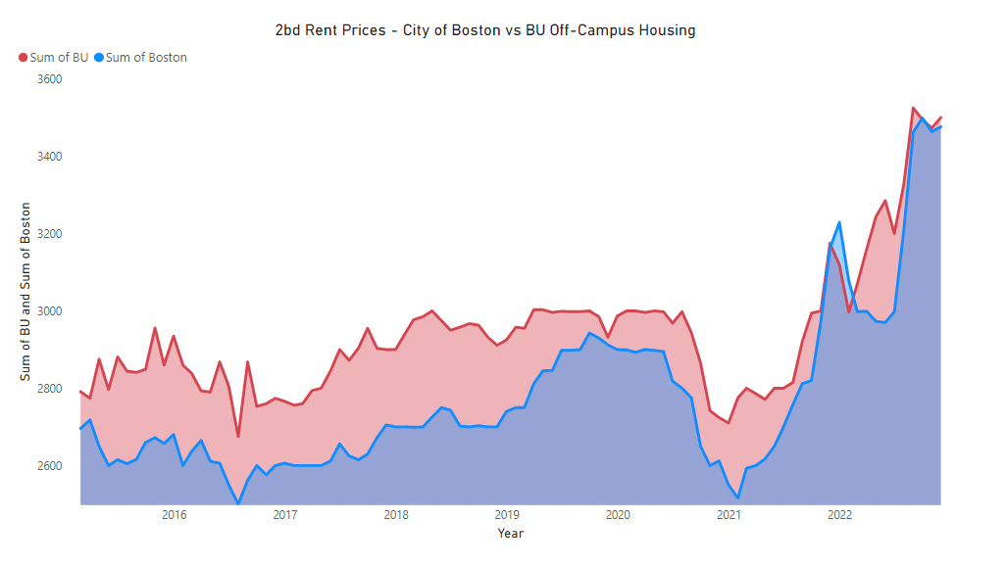
BU Off Campus Housing
Source: https://www.zumper.com/rent-research/boston-ma & https://www.zumper.com/rent-research/near-boston-university-ma
Notes:
Shows that historically, price of 2bd Lease for BU off-campus housing has outpaced the price of 2bd apartments in Boston

Slide 12
Final Recommendation
Airbnb vs Lease Agreement?
Lease agreement
Maximizing Lease Value?
Provide parking & wifi
Do not provide A/C or Laundry
Market your listing to BU students

Slide 13
Next Steps
Follow Up Material
Charts, Graphs, Tables, PDF of presentation, and source material to be sent over
Questions?
Reach out to our team:
______@xyz.com
(111) 123-4455

Slide 14
Citations:
Inside Airbnb Dataset:
http://insideairbnb.com/get-the-data/
Supplemental Lease Data:
https://www.zumper.com/rent-research/boston-ma
https://www.zumper.com/rent-research/near-boston-university-ma
https://www.zillow.com/rental-manager/market-trends/boston-ma/
https://www.boston.com/real-estate/renting/2022/09/09/an-in-depth-look-at-the-massachusetts-rental-market-september-edition/
Boston City Legislation
https://www.boston.gov/sites/default/files/document-file-08-2018/short-term_rental_ordinance.pdf
Expense Costs:
https://www.mass.gov/info-details/tenant-rights
https://www.airdna.co/vacation-rental-data/app/us/massachusetts/boston/overview
https://www.7hillspropertymanagement.com/pricing/
https://www.mysmartmove.com/SmartMove/blog/5-biggest-landlord-mistakes-kill-profit.page
https://www.cnbc.com/2019/07/03/is-running-an-airbnb-profitable-heres-what-you-need-to-know.html
Wifi - Conner’s Boston Xfinity Bill

