Slide 1
Evaluating Exit Potential: Venture Capital Investment Strategy
Conner Edwards
Notes:
My project is to help develop an investment strategy for a hypothetical Venture Capital firm
Data came from Crunchbase funding information (1980-2013)
Comprised of 11 tables
--geared towards VC investors, so may be some unfamiliar terms
, contained within 11 tables

Slide 2
Scenario
Helping a VC firm in 2013 direct high level investment strategy
Purely data-driven approach
Notes:
Goal of the project is to take a data driven approach and then blend it in with operational/investor knowledge to create the ideal investment strategy
It’s mean to serve as an additional layer in the investment plan focused on funding info, in addition to the knowledge and experience based investment theses used by VCs
Emphasize - - Not an investment plan in and of itself
Focusing on exit potential using funding data as the source

Slide 3
Questions to Answer
Industries
Geography
Funding
Fundraising Timeline
What industries should we invest in?
Where should we establish a geographical presence?
How much are successful startups raising?
Are there any trends in the pace at which successful startups raising money?
Successful Operators
Successful Investors
Who are the successful operators we can approach to work with?
Who has had the most success investing? How can we learn from them or work with them?
Notes:
Here are the questions my analysis seeks to answer in order to build an investment strategy layer:
What industries should we invest in?
Where are the most successful startups? Where should we establish a geographical presence?
How much are successful startups raising? Is it less or more than others?
How fast are successful startups raising money? Does it differ from others?
Who are the most successful operators?
Who has had the most success investing? What can we learn from them?

Slide 4
Defining Success
For the sake of this analysis, a ‘successful’ company is one that meets one of the following criteria:
Pursued an Initial Public Offering (IPO)
Was acquired by a larger organization
~5.5%
Percentage of companies in the dataset that meet the criteria of ‘successful’
Notes:
In order to evaluate what factors lead to startup success, had to:
Needed to find a way to define a successful company
For the sake of the analysis, created a definition with the two following criteria
~5.5% of companies met that criteria
A lot of the analyses will be focused on understanding the trend of a specific field for the 5.5% vs all companies in the dataset

Slide 5
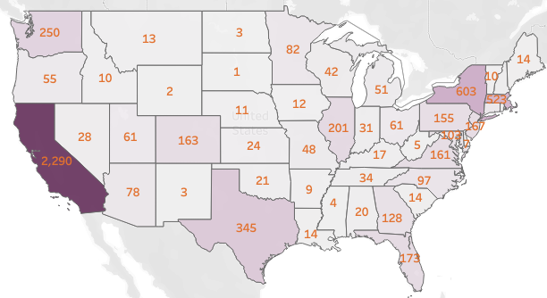
Location – where are the successful companies?
Notes:
Talk about location
Where are the successful companies located?
Unsurprisingly, CA, NY, MA, TX, WA
That tells us we need to establish
visibility in Silicon Valley, NYC, Boston, Austin

Slide 6
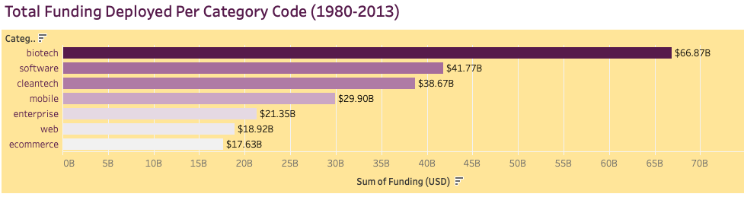
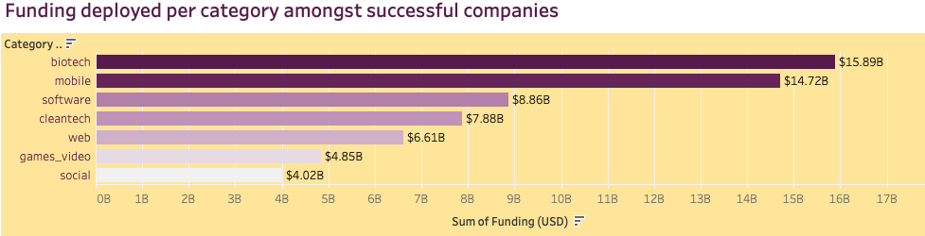
Industry – where is the funding going?
Notes:
Next factor to investigate – industry
First manner to evaluate industries is -
Where is the funding going?
This visualization shows what industries have received the funding for both successful companies and all companies
No major trends to be discerned
Require further research from SMEs

Slide 7
Top Industries by Count
All Companies
Successful Companies
Software
Web
Other
eCommerce
Video Games
Mobile
Advertising
Software
Web
Biotech
Mobile
Enterprise
Other
Video Games
Notes:
If we can’t see trends in funding by industry, wanted to check out qty by industry
What industries have seen the highest quantity of successful companies?
Biotech – an industry that has outsized success for it’s representation
Outsized percentage of biotech companies having successful exits
Software – most successful, albeit also the most common
While there are a few insights to be gleaned here…
This further exaggerates point that additional due diligence is necessary here

Slide 8
$35,297,838.37
Average Total Funding of Successful Startups
Notes:
Let’s talk about funding -
Avg successful startup raises ~$35M
This appears to be the sweet spot for funding, to get companies over the hump to self-sustaining profitability
Much more, and you’re not building streams of revenue or minimizing cost quick enough
Much less, and you won’t be able to scale at the pace of your competition
This is the dichotomy of funding data with startups – issue arise when companies raise too little or too much, not just one end of the spectrum
Makes the averages of unsuccessful startups tough to evaluate
But, we’ll want to focus on startups on track to raise this amount over 3, 4, 5 rounds

Slide 9
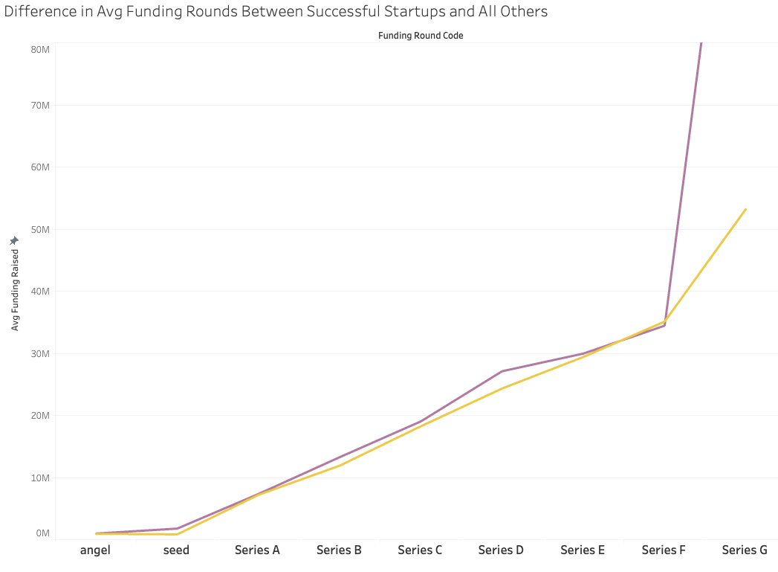
Funding – Size of Investments
Notes:
Going a step further…
Wanted to evaluate the avg size of funding rounds for successful vs all startups
Successful in purple
Oddly enough, there isn’t much trend to discern here, before series G
Likely an outlier as companies that have raised that many rounds are atypical – (2.04% of companies in dataset completed a series G)
More specialized circumstances

Slide 10
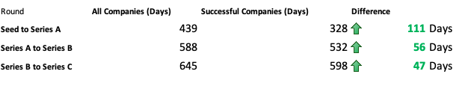
Timing of Fundraising
Notes:
While there is not a significant trend in terms of amount of funding raised, there is a significant difference in terms of how fast successful companies move
When you’re scaling quickly, you need that money faster
Can use this to our advantage when evaluating investments
By seeing how fast they’ve moved

Slide 11
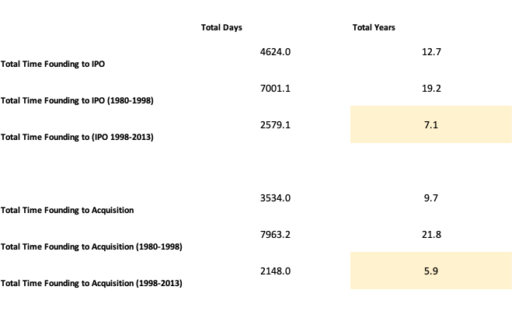
Time to success
Notes:
Also evaluated total Time from founding to success (whether that’s IPO or acquisition)
Further Divided the data to show trends in time (1980-1998) (1998-2013)
Shows that startups are reaching maturity quicker than ever
How’s that relevant?
Age of company is a factor that needs to be evaluated
Past 7 years, likelihood of IPO/Acquisition decreases

Slide 12
Ideal Investment Timing Checklist
Seed Round
Series B
Under 600 days from founding to seed round
Under 532 days from Series A
Seed
A
B
C
Series A
Series C
Under 328 days from Seed Round
Under 598 days from Series B
Notes:
With all that in mind
Created this checklist to help evaluate the speed at which a startup is moving – and answer the question: is it fast enough to warrant our investment to help them scale?

Slide 13

People – Who’s Involved with Successful Startups?
Notes:
Shifting focus to people the firm should be involved with– these are people we should try and work with
These are the top individuals involved in successful startups
They are organized by how many successful startups they have worked with, advised, or invested in
More startups they’ve worked with, larger/darker the font
Provides a baseline list of people to partner with, employ, invest alongside, learn from, etc

Slide 14
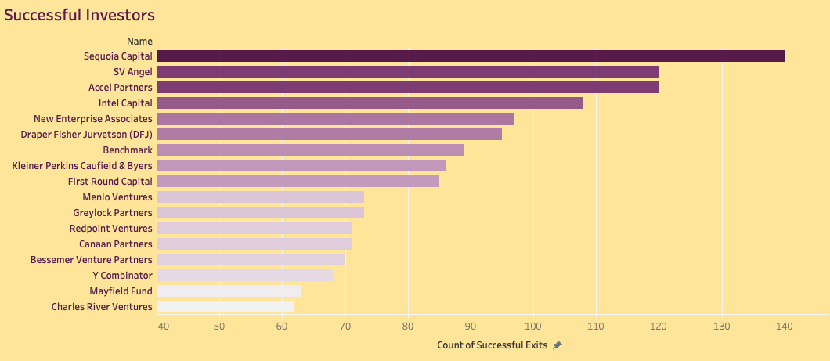
Investors
Notes:
Who has had the most success investing?
This list shows investors ordered by count of successful exits
Shows who we can learn from, who’s approach we can follow, try to co-invest with

Slide 15
Recap
Location
Industry
Funding
Funding Timing
Maturity
People
Notes:
Quick recap of the results of my analysis:
Location – Target SF/NYC/Boston/Austin based startups – means establishing presence there
Industry Specialization
This is going to need additional research, and is best left to the Subject matter experts
Fundraising - $35M sweet spot
If they’re raising more/less, their needs to be a clear path to profitability
Timing of funding rounds
Look for companies that have moved quickly in early rounds
To invest in later stage rounds
Strong predictor of success
Maturity –
Speed is king these days, companies are moving quicker than ever
In order to maximize exit potential, focus on companies on track to IPO/be Acquired within 7 years of operations
People – we now have a definitive, yet non-exhaustive list of individuals to approach to work with

Slide 16
Thanks!
Do you have any questions?
conneredwards@gmail.com
(415) 328-0838
yourcompany.com
Please keep this slide for attribution
Notes:
That’s all I have for you today
Hope to have provided some useful insights to aid in the development of an investment strategy
Happy to answer any questions

