Slide 1
Project Overview
Modular, single-cycle RV32I CPU core in Verilog
Reusable blocks, automated Makefile flow, testbenches
Goals: clarity for learning and easy extensibility

Slide 2
Objectives
Objective | Details
Implement RV32I subset | ALU, control, memory, branch & jump support
Deliver reusable modules | Decode, execute, memory access, write-back
Automate workflow | make targets for lint, sim, schematics, Vivado

Slide 3
Simulation & Validation
Program | Focus
add | ALU arithmetic
store / load | Memory interface
jump | PC control
branches | Branch comparator

Slide 4
Cross-checked with RARS/QEMU.

Slide 5
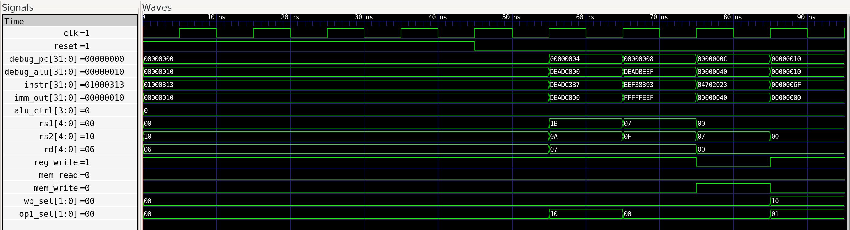
Waveforms
1) 0x01000313
ADDI x6, x0, 16
imm_out=0x10, rd=06, rs1=00, alu_ctrl=ADD
debug_alu=0x10 equals x0 + 16
reg_write=1 writes x6
2) 0xDEADC3B7
LUI x7, 0xDEADC
rd=07, imm_out=0xDEADC000
debug_alu=0xDEADC000
reg_write=1
3) 0xEEF38393
ADDI x7, x7, -273 (0xFFFFFEEF)
rs1=07, rd=07, imm_out=0xFFFFFEEF
debug_alu=0xDEADC000 + 0xFFFFFEEF → expected 0xDEADC0..
Matches spec
4) 0x04702023
SW x7, 72(x0)
mem_write=1, rs2=07, base x0, imm=0x48
Control signals correct
5) 0x0000006F
JAL x0, 0
PC updates, wb_sel=01, op1_sel set for jump
reg_write=0 since rd=x0
CPU program waveform

Slide 6
Instruction Coverage
Category | Instructions
Arithmetic & logic (reg) | add, sub, and, or, xor, sll, srl, sra, slt, sltu
Arithmetic & logic (imm) | addi, xori, ori, andi, slli, srli, srai, slti, sltiu
Memory access | lw, sw
Branches | beq, bne, blt, bltu, bge, bgeu
Jumps | jal, jalr
Upper immediates & PC-relative | lui, auipc

Slide 7
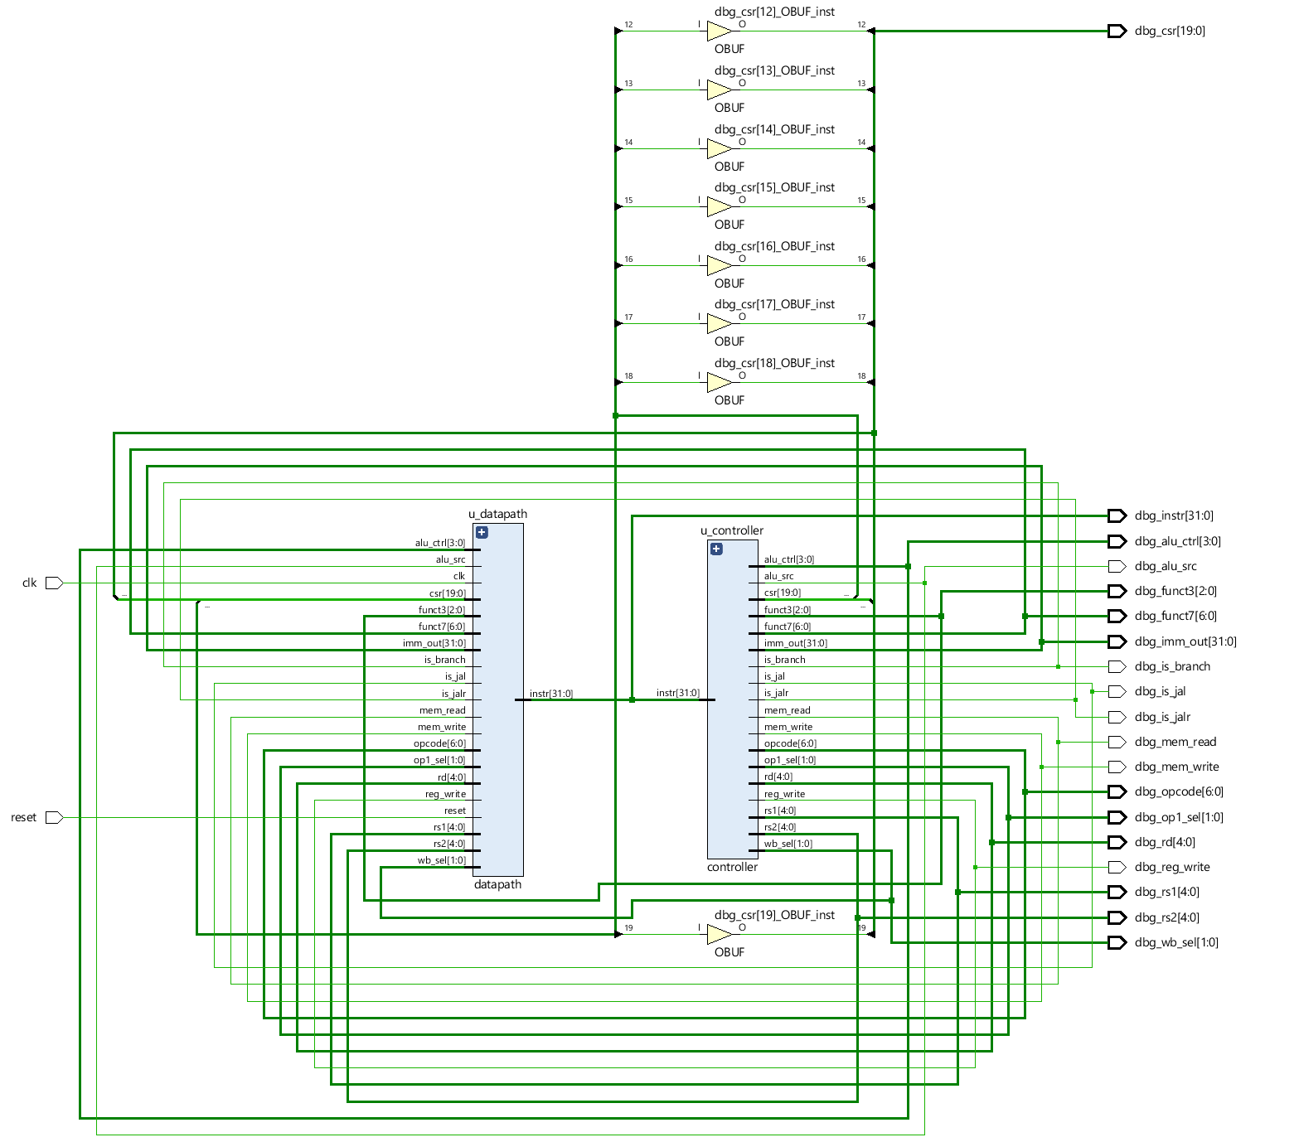
Architecture Snapshot
Controller decodes and generates signals
Datapath executes via regfile, ALU, memories
Branch comparator and PC logic drive control flow
CPU Block Diagram

Slide 8
Core Modules
Module | Responsibility
controller | Decode, generate control, ALU op selection
datapath | Regfile, ALU, memories, PC & branch logic
cpu | Top-level wrapper with debug probes

Slide 9
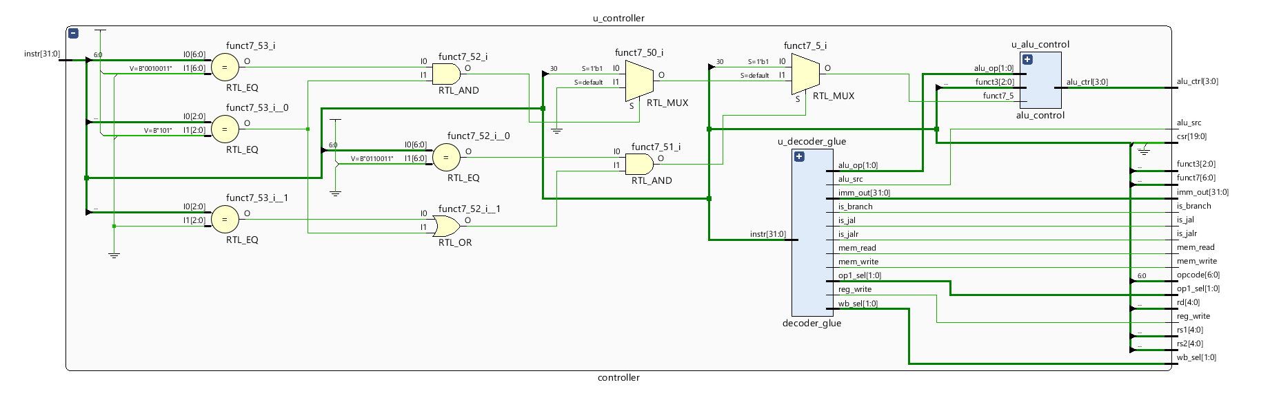
Controller
Slices fields from instruction (opcode, funct3, funct7, rs/rd)
Delegates to decoder_glue:
decoder: classify instruction, set reg_write
control: map to datapath signals (mem_*, alu_src, wb_sel)
imm_gen: sign-extend immediates (I/S/B/U/J)
Feeds alu_op, funct3, funct7[5] into alu_control
Emits all signals for datapath
Controller Diagram

Slide 10
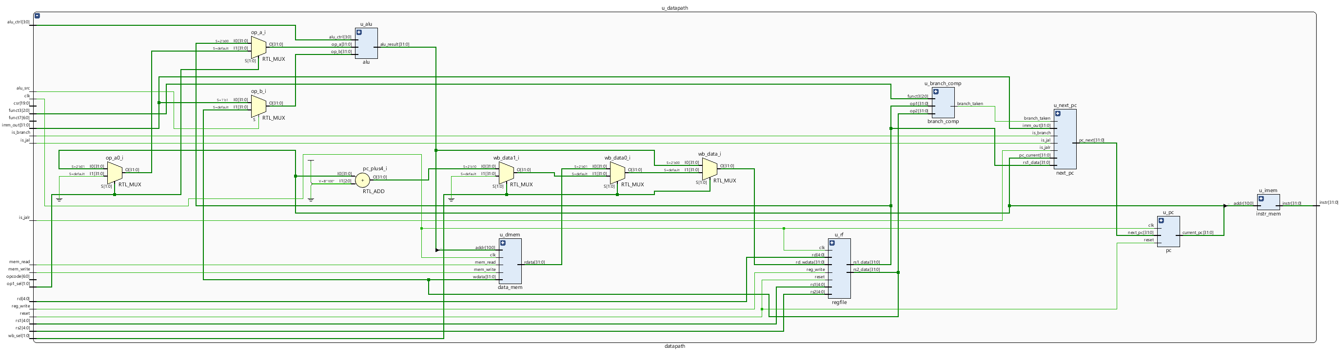
Datapath
Executes full instruction cycle
Control flow: branch_comp + next_pc + PC register
Regfile: 32×32, sync write, combinational read
Operand select: rs1/PC/zero and rs2/imm
ALU: arithmetic/logic ops, result → mem or write-back
Memory: word-addressed instruction/data memories, sync writes
Write-back: mux between ALU result, memory, pc+4
Datapath Diagram

Slide 11
Supporting Modules
Module | Purpose
alu, alu_control | Arithmetic & logic execution
branch_comp | Branch evaluation
regfile | 32×32 register file, x0 guard
instr_mem, data_mem | Program/data storage, $readmemh init
next_pc | PC update logic
imm_gen | Immediate extraction
mux2, mux4 | Multiplexers
pc | Program counter register
instr_slicer | Instruction field utility
wb_mux | Write-back mux

Slide 12
CPU Validation
Program | Tested Instructions | Pass
prog.mem | load, store, jal | yes
branches.mem | beq, bne, blt, bltu, bge, bgeu | yes
r_alu.mem | add, sub, and, or, xor, sll, srl, sra, slt, sltu | yes
i_alu.mem | addi, xori, ori, andi, slli, srli, srai, slti, sltiu | yes
mem_rw.mem | lui, sw, lw, add | yes
jumps.mem | auipc, jal, jalr | yes
x0_guard.mem | addi(x0), sub(x0), beq | yes

Slide 13
RTL Testing
Module | Scope | Tests
adder | Overflow, negatives | 4
alu_control | ALUOp decoding | 22
alu | ADD, SUB, logic, shifts, cmp | 11
branch_comp | BEQ/BNE/BLT/BGE/BLTU/BGEU | 13
controller | Flow checks | 65
control | R/I ops, mem, branch, jumps | 17
cpu | Small program | 2
data_mem | Init read | 1
datapath | ALU, mem, branch, jumps | 17
decoder_glue | Glue interface | N/A
decoder | R/I/S/B/U/J decode | 9
imm_gen | Immediate formats | 11
instr_mem | Program read | 3
instr_slicer | Field slices + random tests | 210
next_pc | PC updates | 7
pc | Reset, increment, jump | 4
regfile | Reset, writes, x0 check | 154
wb_mux | ALU/MEM/PC+4 paths | 8

Slide 14
Key Results
Metric | Value | Source
Slice LUTs | 2,439 | utilization.rpt
Slice Registers | 1,056 | utilization.rpt
Max clock frequency | N/A (no timing constraints) | timing_summary.rpt
On-chip power | 3.618 W (dyn 3.453, static 0.165) | power.rpt

Slide 15
Challenges & Mitigations
Challenge | Mitigation
Branch waveform misalign | Added delay/register
Limited RV32I subset | Plan incremental expansion
Higher LUT use | Accepted for teaching

Slide 16
Future Work
Extend ISA: RV32M, CSR, pipelining
Broaden automated test coverage
Add privileged ISA support
Benchmark against other cores

Slide 17
References
RISC-V ISA Specification, Volume I
Icarus Verilog and GTKWave documentation
Xilinx Vivado user guides
yosys and netlistsvg documentation
Patterson & Hennessy, Computer Organization and Design RISC-V Edition

Slide 18
Contact & Handover
Repository includes docs, schematics, waveforms
Contact maintainers for onboarding
End of handover

